Slide 1
ACL Training

Slide 2
Jason A. Snyder, MBA
Jason is a Senior Associate of CBIZ Risk & Advisory Services. Jason has more than 14 years of experience within the areas of internal audit and information technology. He has worked within the Internal Audit departments at a variety of organizations, including government, financial services, health care and distribution. His work has included developing, performing, leading and supervising various internal and IT audits.
Education: BS in Accounting, Indiana University of Pennsylvania
  MBA, Indiana University of Pennsylvania
IT Audit Experience: Performed and lead various IT audits for Banking, Finance, Government, and Healthcare organizations.

Slide 3
Dean Travis, CISA
Dean Travis is a Senior Associate with CBIZ. Dean has over 10 years of experience in Information Technology Audit. During that time he has worked within the Internal Audit departments for various companies spanning across Government (Pennsylvania Department of the Auditor General), Banking (Susquehanna Bank), Financial Services (PHEAA), and Manufacturing (TE Connectivity) industries. His work has included developing, performing, and leading audits of IT General Controls, Infrastructure, Network Security, and various applications. He has an expertise in Data Analytics and Database Management.
Education: BS in Accounting, Susquehanna University, Selinsgrove PA
Professional Certifications: Certified Information Systems Auditor (CISA)
IT Audit Experience: Performed 50+ IT audits for Banking, Finance, Government, and Manufacturing organizations.

Slide 4
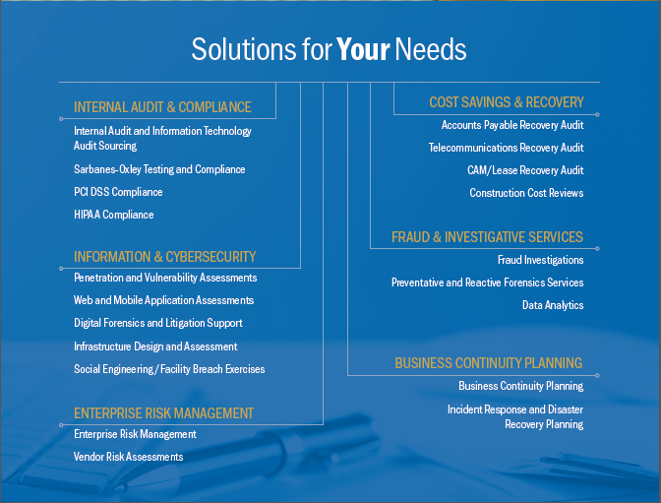

Slide 5
Course Contents
Data Mining
Statistical Analysis
Predictive Analysis
Continuous Audit
ACL Demo

Slide 6
Data Mining
The process of analyzing data from different perspectives and summarizing it into useful information
Data mining is the process of finding correlations or patterns among dozens of fields in large relational databases
Data mining software is one of a number of analytical tools for analyzing data.

Slide 7
Data Mining
Organizations are accumulating vast and growing amounts of data in different formats
Examples include:
  operational or transactional data such as, sales, cost, inventory, payroll, and accounting
  nonoperational data, such as industry sales, forecast data, and macro economic data

Slide 8
Data Mining
Data Warehouses
  Data warehousing is defined as a process of centralized data management and retrieval.
  Central Repository for an organizations data
  Represents a copy of the production data
When requesting data from the warehouse the user must determine the update requirements to ensure the data retrieved is the most current available

Slide 9
Data Mining
Common audits utilizing data mining
  Expense reimbursement
  Payroll
  Sales
  Allocation analysis

Slide 10
Data Mining
Five elements of data mining
  Extract, transform, and load transaction data onto the data warehouse system.
  Store and manage the data in a multidimensional database system.
  Provide data access to business analysts and information technology professionals.
  Analyze the data by application software.
  Present the data in a useful format, such as a graph or table.

Slide 11
Statistical Analysis
Statistics is the study of the collection, analysis, interpretation, presentation, and organization of data. In applying statistics to, e.g., a scientific, industrial, or social problem, it is conventional to begin with a statistical population or a statistical model process to be studied.
Statistical analysis is a component of data analytics. In the context of business intelligence (BI), statistical analysis involves collecting and scrutinizing every data sample in a set of items from which samples can be drawn.

Slide 12
Statistical Analysis
Statistics with ACL
  Provides the highest and lowest values in the data set
  Provides the average
  Number of lines that contain a zero value
  Absolute value
  Range

Slide 13
Predictive Analysis
advanced analytics which is used to make predictions about unknown future events
uses techniques such as data mining, statistics, modeling, machine learning, and artificial intelligence to analyze current data to make future predictions

Slide 14
Predictive Analysis
Common Predictive analysis uses
  Fraud
  Marketing
  Reducing risk
  Forecasting

Slide 15
Predictive Analysis
Fraud Detection
  Combining multiple analytics methods can improve pattern detection and prevent criminal behavior. As cybersecurity becomes a growing concern, high-performance behavioral analytics examines all actions on a network in real time to spot abnormalities that may indicate fraud, zero-day vulnerabilities and advanced persistent threats.

Slide 16
Predictive Analysis
Marketing
  Predictive analytics are used to determine customer responses or purchases, as well as promote cross-sell opportunities. Predictive models help businesses attract, retain and grow their most profitable customers.

Slide 17
Predictive Analysis
Reducing Risk
  Credit scores are used to assess a buyer’s likelihood of default for purchases and are a well-known example of predictive analytics. A credit score is a number generated by a predictive model that incorporates all data relevant to a person’s creditworthiness. Other risk-related uses include insurance claims and collections.

Slide 18
Predictive Analysis
Forecasting
  Many companies use predictive models to forecast inventory and manage resources. Airlines use predictive analytics to set ticket prices. Hotels try to predict the number of guests for any given night to maximize occupancy and increase revenue. Predictive analytics enables organizations to function more efficiently.

Slide 19
Continuous Audit
IIA’s Global Technology Audit Guide (GTAG) on continuous auditing defines it as “any method used by auditors to perform audit-related activities on a more continuous or continual basis.”

Slide 20
Continuous Auditing Benefits
Continuous Auditing allows Internal Audit to continually gather from processes data that supports auditing activities.
Achieve compliance with policies, procedures, and regulations in a more timely manner with less cost.
Reduce audit costs wile increasing effectiveness.
Complete more proactive reviews

Slide 21
Designing Continuous Audit
Identify the controls to test.
Understand the systems, data and processes in place and assess the available testing techniques.
Design and implement the continuous tests

Slide 22
Identifying the Controls to Test
What Risks reside in the organization?
  Utilize previously completed business or IT risk assessments.
Identify processes or controls in place within the organization.
  What is the probability of occurrence
  What is the impact of risk

Slide 23
Systems, Data, and Processes
What are the critical systems used in the processes where critical controls are identified?
Is the underlying data readily available?
Can it be tested through automated testing?

Slide 24
Design and Implement the Continuous Tests
What is the most effective way to test the designated control?
  Can the testing be automated?
  What tools will be used to test the control ?
For automated testing, what will constitute a Red Flag?
  How will red flags be handled?
How will the results be reported?
How often will the continuous program be reviewed?
  Further refining tests
  Adding controls

Slide 25
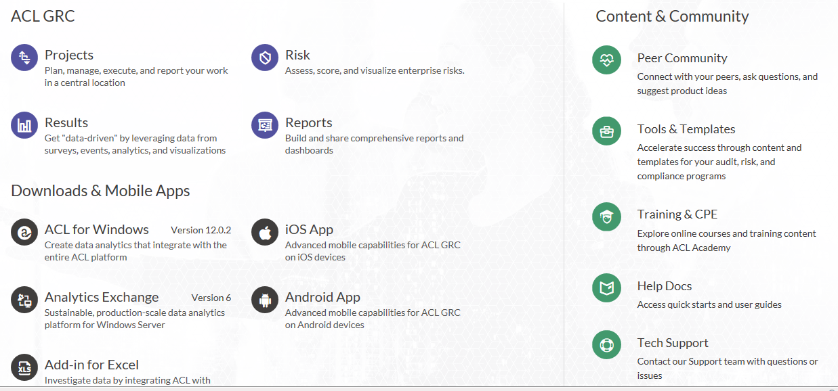
ACL

Slide 26
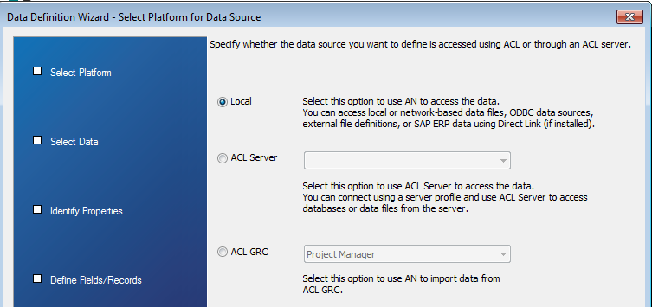
ACL – Data Imports
Data can be pulled from various ACL products

Slide 27
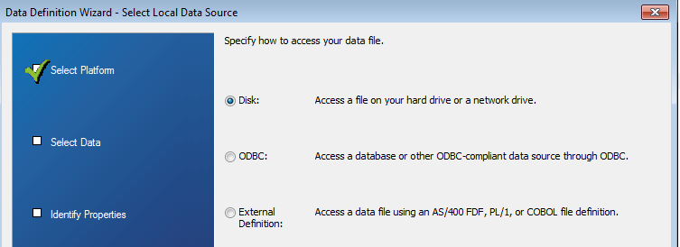
ACL – Data Imports
And sources

Slide 28
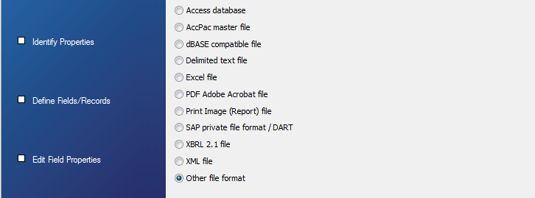
ACL – Data Imports
In Multiple Formats

Slide 29
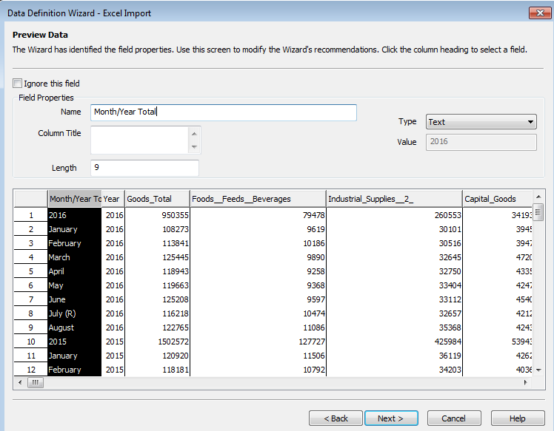
ACL – Data Imports
ACL Import Wizard will guide you through the process and try to predict the field types, lengths, and titles.

Slide 30
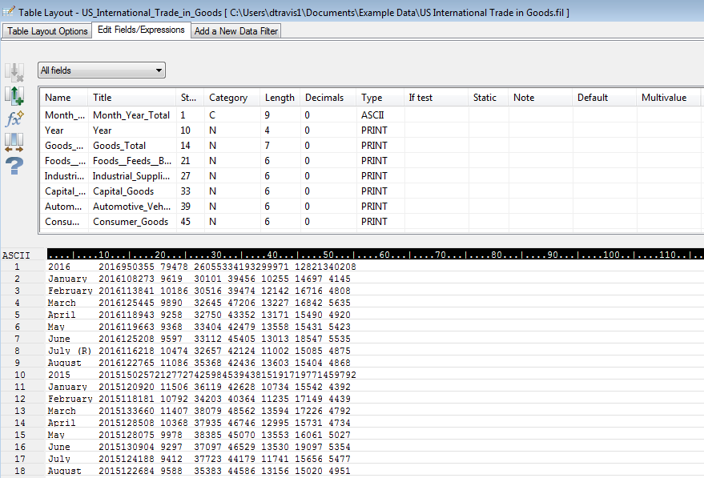
ACL – Data
After import you can go to Edit > Table Layout (CTRL + I)

Slide 31
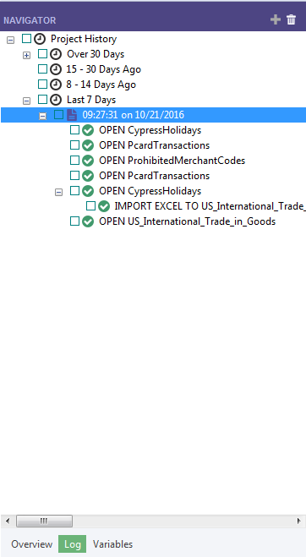
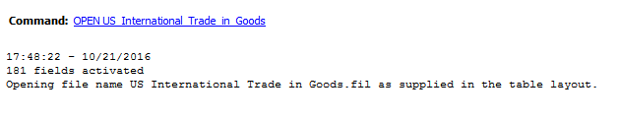
ACL - Logging
              All actions are logged within ACL to maintain file integrity

Slide 32
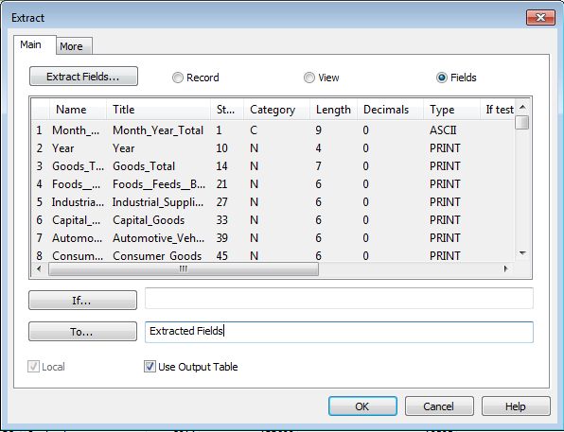
ACL - Focus on Analytics
Extract fields to narrow populations

Slide 33
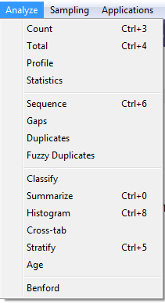
ACL - Analytics
Perform Analysis of data sets

Slide 34
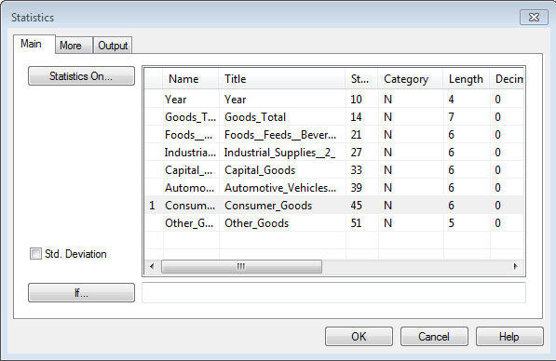
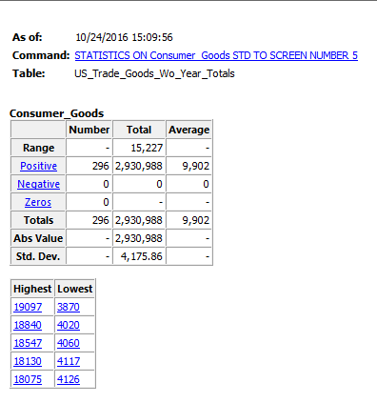
ACL Statistics Function

Slide 35
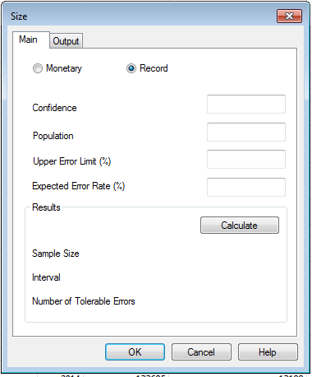
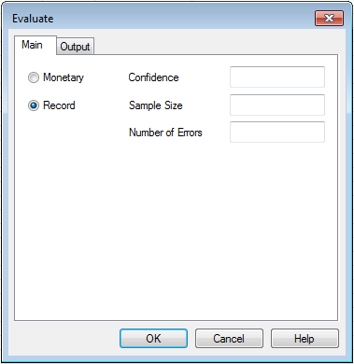
ACL – Calculating Sample Size

Slide 36
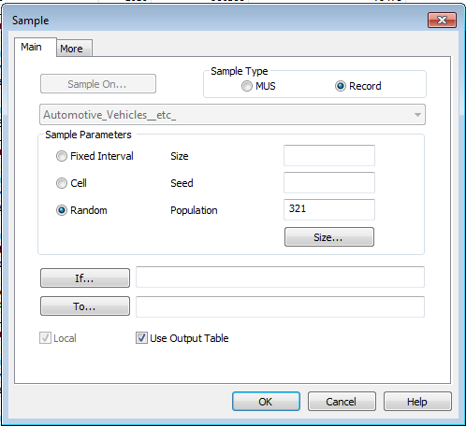
ACL - Sampling
ACL can be utilized to pull your sample.
Notes:
A

Slide 37
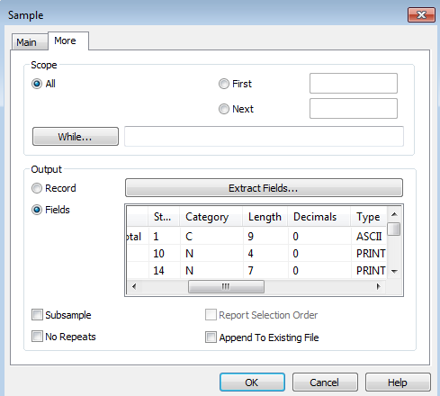
ACL – Sampling Selection Order

Slide 38
ACL Scripting
ACL is designed to automate repetitive tasks
For example a repetitive continuous audit test.
3 ways to write a script
  Script Recorder
  Log Selection
  Freeform

Slide 39
ACL Scripting – Script Recorder
Tools > Set Script Recorder On
Easiest way to write a script.
Automatically creates a new script if one has not been designated.
All actions will not run but instead be written to the new script.

Slide 40
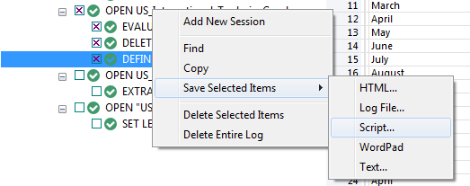
ACL Scripting – Log Selection
Select items from the log, right click, save selected items > script
This will save selected items to a log file that can be run.

Slide 41
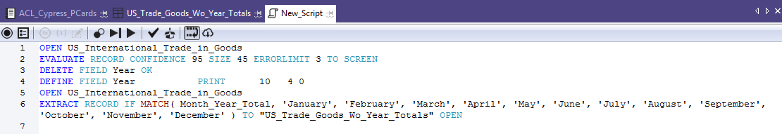
ACL Scripting - Freeform
File > New > Script
Allows user to write their own script from scratch.
Best used in combination with the previous two scripting techniques.

Slide 42
ACL - Functions
Functions can be nested.
Some commonly used functions:
BETWEEN( value , min , max ) – returns records between set limits.
FIND( string <,field_to_search_in> ) – Finds a defined value. Function can search entire data set or a specified field only.
MATCH( comparison_value , test1 , test2 <,test3...> ) – Finds multiple preset values.
SUBSTR( string , start , length ) – Pulls a defined portion of field.

