Slide 1

Audit Findings

Slide 2


Introductions
Tom Kenenitz, CPA
McKonly & Asbury
Audit Supervisor
TKenenitz@macpas.com
Jackie Winchell
McKonly & Asbury
Audit Senior Accountant
JWinchell@macpas.com

Slide 3
Disclaimer
The information contained in this presentation, both that contained in the slides and that expressed by the presenter, is not intended to be complete and comprehensive. To obtain a more detailed understanding of technical literature mentioned, please consult the full standards and interpretations.

Slide 4
Learning Objectives
Introduction to Internal Controls
Deficiencies in Internal Controls
Impact of Deficiencies on an Audit

Slide 5
What are Internal Controls?
Process used by management to help an entity achieve its objectives
Can help an entity
  Run its operations efficiently and effectively
  Report reliable information about its operations
  Comply with applicable laws and regulations

Slide 6
Internal Control Requirements
Operations
  Effectiveness and Efficiency of Operations
Financial Reporting
  Reliability of reporting for internal and external use
Compliance
  Demonstrate compliance with laws, federal statutes, regulations, and the terms and conditions of federal awards

Slide 7
Internal Controls for Compliance Requirements
Transactions that are properly recorded and accounted for:
  Permit the preparation of financial statements
  Maintain accountability over assets
  Demonstrate compliance with federal statutes, regulations, and the terms and conditions of federal awards

Slide 8
Limitations of Internal Controls
Provides reasonable, not absolute assurance, that an entity’s objectives are being achieved
Specific Limitations
  Unrealistic objectives
  Faulty human judgment
    Errors and mistakes
  Controls may fail due to breakdowns
    Employee misunderstanding, carelessness, or fatigue
  Management override of internal controls
  Controls circumvented by collusion
  External events beyond an entity’s control

Slide 9
What are Deficiencies in Internal Control over Financial Reporting?
Introduction to:
  Deficiency
  Significant Deficiency
  Material Weakness
  Examples

Slide 10
What are Deficiencies in Internal Control over Financial Reporting?
Deficiency
  Design, implementation, or operation of a control does not allow management or personnel, in the normal course of performing their assigned functions, to achieve control objectives and address related risks (Source: Independent Auditor’s Report on Internal Control Over Financial Reporting)

Slide 11
What are Deficiencies in Internal Control over Financial Reporting?
Examples of deficiencies
  Inadequate design of internal control over a significant account or process
  Inadequate segregation of duties within a significant account or process
  Employees or management who lack the qualifications for their assigned function
  Absence of an internal process to report deficiencies in internal control to management on a timely basis

Slide 12
What are Deficiencies in Internal Control over Financial Reporting?
Significant Deficiency
  A deficiency, or combination of deficiencies, in internal control that is less severe than a material weakness, yet important enough to merit the attention by those charged with governance (Source: Independent Auditor’s Report on Internal Control Over Financial Reporting)

Slide 13
What are Deficiencies in Internal Control over Financial Reporting?
Examples of significant deficiencies
  Controls over nonroutine and nonsystematic transactions
  Controls over the period-end financial reporting process
  Controls over the selection and application of accounting principles

Slide 14
What are Deficiencies in Internal Control over Financial Reporting?
Material Weakness
  A deficiency, or combination of deficiencies, in internal control such that there is a reasonable possibility that a material misstatement of the entity’s financial statements will not be prevented, or detected and corrected, in a timely basis (Source: Independent Auditor’s Report on Internal Control Over Financial Reporting)

Slide 15
What are Deficiencies in Internal Control over Financial Reporting?
Examples of material weaknesses
  Ineffective oversight of the entity’s financial report and internal control
  Restatement of previously issued financial statements to reflect the correction of a material misstatement
  Ineffective regulatory compliance function
  Identification of fraud on the part of senior management
  An ineffective control environment

Slide 16
What are Deficiencies in Internal Control over Financial Reporting?
Other audit observations
  Audit recommendations to management
    Do not rise to level of significant deficiency or material weakness
    Do not affect audit report on financial statements
    Communicated to management either verbally or in writing
    Examples
      Initial reconciliations to verify a review is taking place
      Adapt to published organization polices (i.e. accrued vacation)
      Document retention
      Insufficient descriptions for general ledger detail

Slide 17
Where are Significant Deficiencies and Material Weaknesses Reported?
Financial Statements
  Independent Auditor’s Report on Internal Control over Financial Reporting and on Compliance and Other Matters Based on an Audit of Financial Statements Performed in Accordance with Government Auditing Standards
  Schedule of Findings and Questioned Costs
AU-C 265 Letter
Communications with Management

Slide 18
Independent Auditor’s Report on Internal Control over Financial Reporting
Report content:
  Auditor’s consider internal control over financial reporting
  Provides definition of deficiency, significant deficiency, and material weakness
  If applicable, states that findings exist
  Auditor performed tests of compliance to obtain reasonable assurance that the financial statements are free from material misstatement
  Does not provide an opinion on the effectiveness of the Organization's internal controls

Slide 19
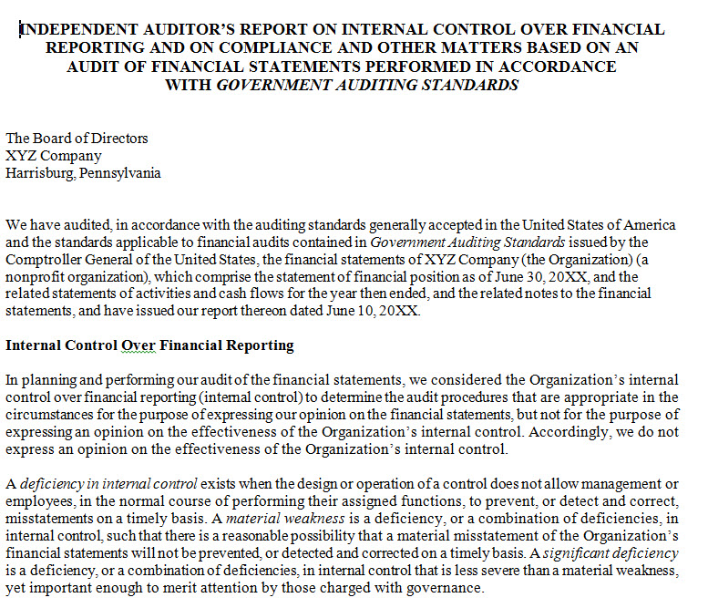
Independent Auditor’s Report on Internal Control over Financial Reporting

Slide 20
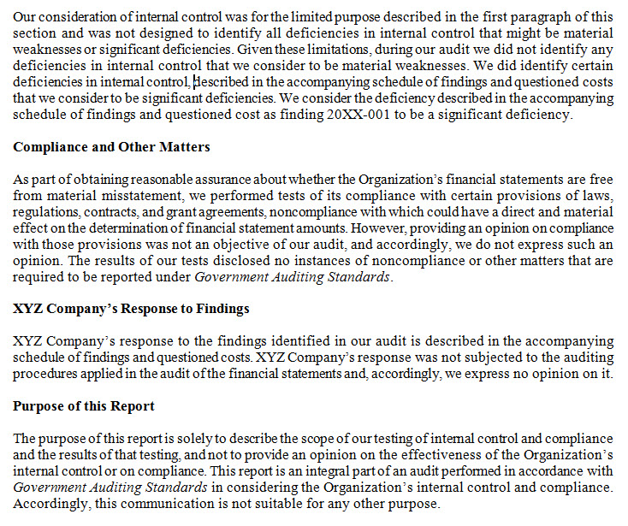
Independent Auditor’s Report on Internal Control over Financial Reporting

Slide 21
Schedule of Findings and Questioned Costs
Report content:
  Condition
    Observed audit finding
  Criteria
    What should be happening?
    Why is the condition happening?
  Effects of Condition
  Recommendation
  Management Response

Slide 22
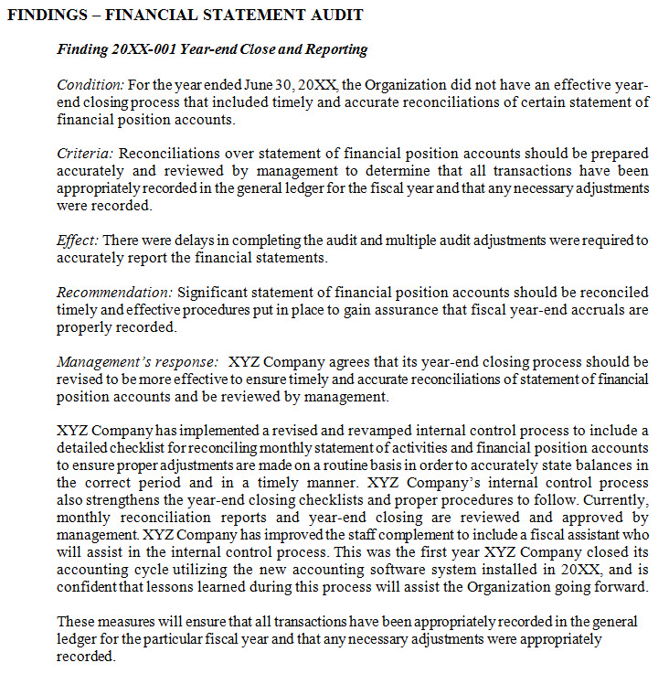
Schedule of Findings and Questioned Costs

Slide 23
Corrective Action Plan (CAP)
Required for significant deficiencies and material weaknesses
Components of a CAP:
  Description of deficiency (What went wrong?)
  Steps to correct the deficiency (What was done to correct it?) and prevent it from recurring (What should be done to prevent it?)
  Responsible party for ensuring correction of deficiency
  Action plan that details the steps to correct/prevent from recurring

Slide 24
AU-C 265 Letter
Communication between auditor and those charged with governance
Defines deficiencies, significant deficiencies, and material weaknesses
States if findings exist and provides detailed description of finding, if applicable

Slide 25
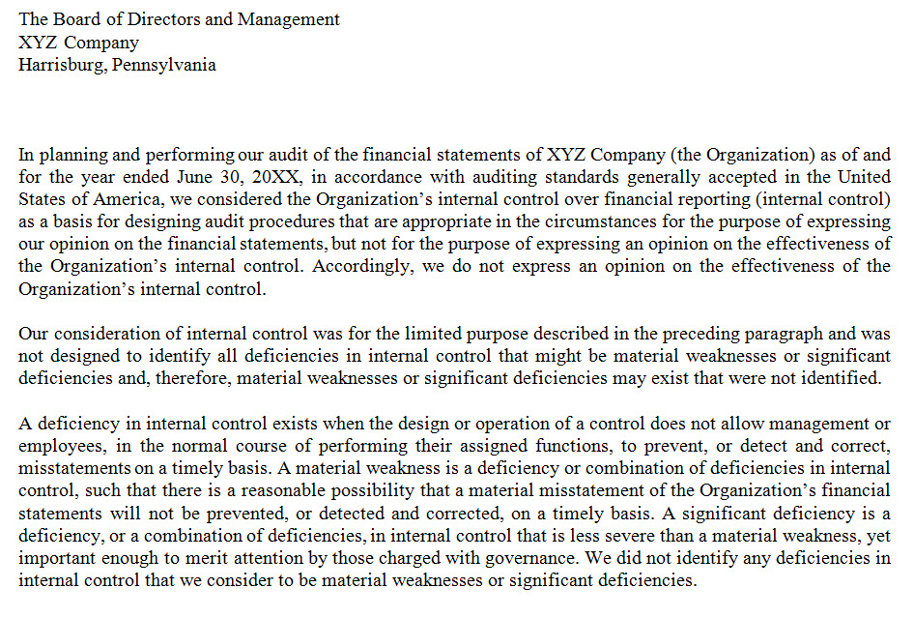
AU-C 265 Letter Examples

Slide 26
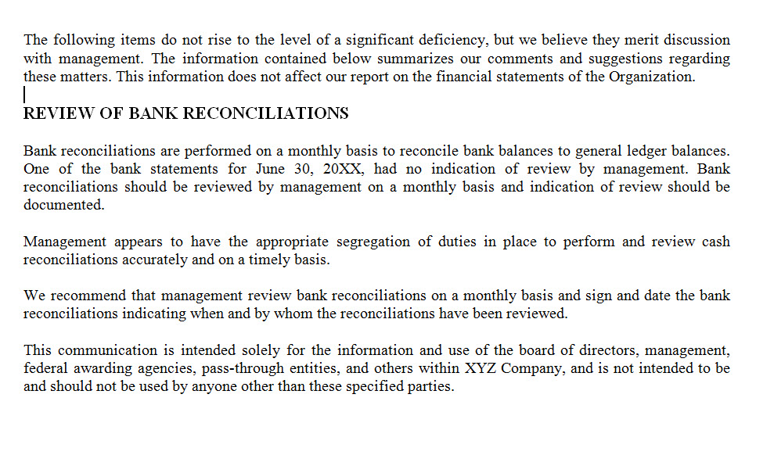
AU-C 265 Letter Examples

Slide 27
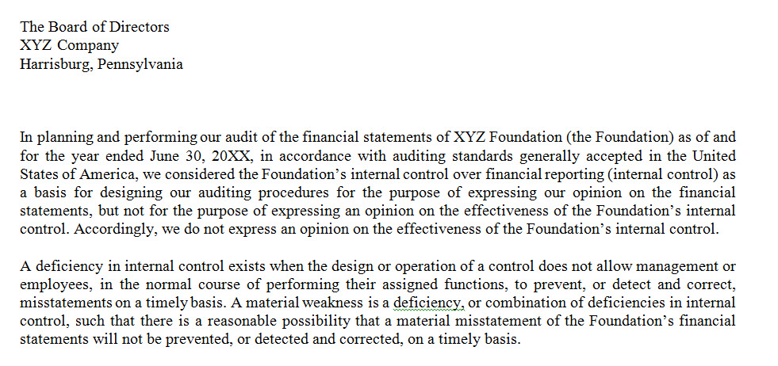
AU-C 265 Letter Examples

Slide 28
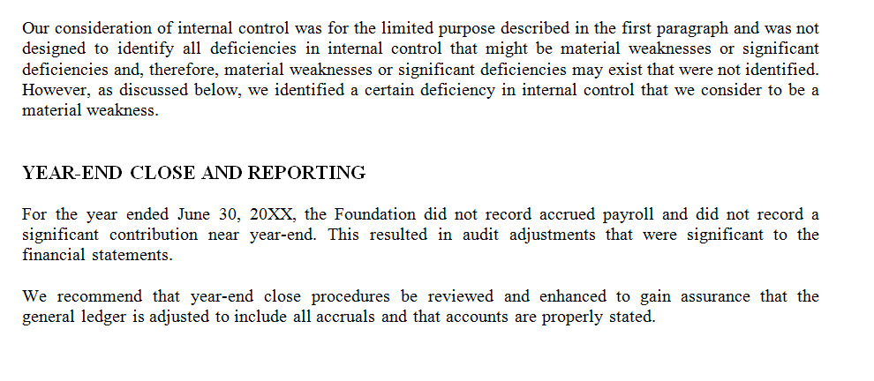
AU-C 265 Letter Examples

Slide 29
Impact on a Single Audit
What is a single audit?
  Required for all organizations expending $750,000 in federal awards
    Office of Management and Budget (OMB) Uniform Administrative Requirements, Cost Principles, and Audit Requirements for Federal Awards (2 CFR part 200)
  Audit of compliance and internal controls over federal programs
  Audit of financial statements

Slide 30
Impact on a Single Audit
High Risk Auditee
  If a material weakness existed in the prior two years, the auditee is high risk
  Other Factors
    Personnel Changes
    Multiple Internal Control Structures
    Oversight by Federal Agencies and Pass-Through Entities
    Use of Subrecipients
    Program Maturity at the Auditee and at Federal Agency
    Size of Program
    Complexity
Difference between high risk and low risk auditee
  Low-risk = 20% of federal funding audited
  High-risk = 40% of federal funding audited

Slide 31
Single Audit Reports
Schedule of Expenditures of Federal Awards (SEFA)
Notes to SEFA
Report on Internal Control over Financial Reporting
Report on Internal Control over Federal Programs
Schedule of Findings and Questioned Costs
Summary Schedule of PY Audit Findings

Slide 32
Single Audit Reports
Schedule of Expenditures of Federal Awards (SEFA)
Notes to SEFA
Report on Internal Control over Financial Reporting
Report on Internal Control over Federal Programs
Schedule of Findings and Questioned Costs
Summary Schedule of PY Audit Findings

Slide 33
Impact of Findings on Future Audits
Auditors will revisit prior year findings to determine if they have been resolved
If significant deficiency existed in the prior year
  And same deficiency exists in the current year, consider if it rises to the level of a material weakness
Single Audit
  Auditee at potential risk of decrease in funding or losing funding

Slide 34
Questions?
Tom Kenenitz, CPA
McKonly & Asbury
Audit Supervisor
TKenenitz@macpas.com
Jackie Winchell
McKonly & Asbury
Audit Senior Accountant
JWinchell@macpas.com

