Slide 1




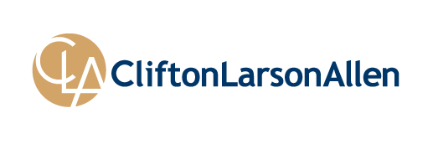






©2013 CliftonLarsonAllen LLP
P
L L
n
e
l
l
A
n
o
s
r
a
L
n
o
t
f
i
l C
3
1
0
2
©
Introduction to Information Technology (IT) Auditing
Jim Kreiser, Principal, CISA, CRMA, CFSA
AGA Central PA
October 25, 2016
cliftonlarsonallen.com

Slide 2
Objectives/Agenda
Value of IT General Controls (ITGC)
  Operational Benefits
  Audit Enhancements
ITGC Components & Key Areas
  Logical Security
  Change Control
  Operations
Leading Controls and Audit Procedures
  Related Risks

Slide 3
Why Evaluate IT?
International Auditing Standards & Requirements
  ISA sections 315 and 330
AICPA SAS Standards & Requirements
  Risk Assessment Standards 104-111
  “Eliminates the "default to maximum" for control risk, which should encourage testing of controls.”
  SAS 94
Regulatory & Compliance Influences
  For example, HIPAA, OMB A-133, U.S. Sarbanes-Oxley Act and PCAOB
Control based audit approach
Contractual considerations or evaluation
Better assessment of risk (control risk and IT risks) and entity-level controls

Slide 4
Why Evaluate IT?
Can we truly understand the financial reporting risks without evaluating the risks and impacts of IT controls and processes?
  Report Integrity?
  Misstatement risks?
  Misappropriation of assets?
  Fraud risks?
Can we assess operational and organizational (ERM) risks without understanding the IT risk/Control risk?

Slide 5

IT Risk Universe
What do we include?
5

Slide 6
Integrating IT Risk
Where do we even begin to get a sense of what an IT risk universe (or the scope/extent of IT risks) would be?
  So many resources that exist… where to look?
    NIST (800-53)?
    ISO 27001/02?
    CSF - including cybersecurity assessment
    Information Technology Infrastructure Library (ITIL)
    AICPA Trust Service Principles
      Security
      Availability
      Confidentiality
      Process Integrity
      Privacy
    Many others - Need to be careful on how focused on security specific risks these may be
6

Slide 7
IT Risk Universe
CLA utilizes an outline to guide the discussion around IT risks, and to provide “parameters” to the IT audit/risk universe:
  Organization and Administration
  Vendor Management (critical area as mentioned above)
  Infrastructure
  IT Security
  Data Administration (Data Classification and Ownership included)
  Application Admin
  User and Account Management
  Physical Controls
  IT Operations (Scheduling, Change Controls, Backups, Logs, etc.)
  Incident Response
  Disaster Recovery and Business Continuity
There can certainly be more – but this generally provides us a good outline to start discussions to highlight key risks in each “domain”
7

Slide 8
Goals of Risk Management & Risk Assessment
Finance
Internal Control, Disclosure, Credit, Liquidity, Commodity, Risk Analytics & Modeling
General Counsel
Legal and Intellectual Property
Compliance and Ethics
Ethics and Business Conduct, and Regulatory Compliance Risks
Internal Audit
Risk informed audits, risks to internal control, key exposures and vulnerabilities, and assurance
Information Management
IT Security, Data Integrity, Information Adequacy, Business Process/Continuity Risks
Business Development
Market and Strategy Risks
Security
Risks to property and people
Operations
Quality of care, Customer Relations, Market and Pricing, Competitive, People/Process/Asset Performance, Environmental and Safety Risks
Insurance
Property, Casualty, Liability, and Hazards
Challenge is how to align and integrate all these various groups; and how to address the
alignment and “overlap” with each area

Slide 9
Identifying and Integrating IT Audit Activities
How Do You Do It?
9

Slide 10
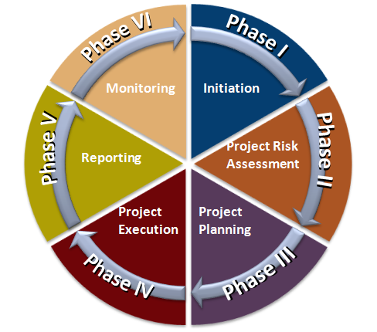

10

Slide 11
Types of IT Controls
General Controls
  Foundation Controls
Application Controls
  Operational/Transactional Controls
IT Dependent Controls
  Reports
11

Slide 12
Significant Accounts/Processes
Balance
Sheet
Income
Statement
G/L
Inventory
Other
Classes of Transactions / Business Processes
Process A
Process B
Process C
Financial Applications
Application A
Application B
Application C
Application controls (examples)
Seg of Duties
Data integrity
Completeness
Timeliness
General Computing Controls
Security
Retention
Operations
Configuration
12

Slide 13
ITGC Control Focus Areas
IT Governance Controls
IT Security Controls
IT Operations Controls
Development Controls (as applicable)
Change Management Controls
  NOTE – These apply equally to “internal” processes vs. vendor or outsourced services and controls (e.g. SOC discussion or SLAs)
13

Slide 14
IT General Controls
IT general controls are IT processes and related controls that are generally applied to support the computer application level. IT general controls are designed to:
  Allow for changes to systems, databases, and applications to be properly authorized, tested, and approved before they are implemented
  Allow for only authorized persons and applications to have access to data and perform specifically defined functions (e.g., inquire, execute, update).
14

Slide 15
Why Test or Assess IT General Controls
IT General Controls (ITGCs) provide:
  The base of support for reliance on application and IT dependent manual controls (e.g., reports) related to the financially significant applications
  Basis for management assertions relative to monitoring, risk assessment and other audit & operational considerations
ITGCs Include:
  Logical Security, Change Control, and certain Operations controls (e.g., backup and recovery, job scheduling, physical/facility controls)
Effective ITGCs May Allow Us To:
  Perform a “test of one” for application and IT-dependent manual controls (e.g., reports)
  More accurately assess control risk, provide better ERM reporting, and support entity level control environments
15

Slide 16
IT General Controls - Considerations
Logical Security Controls
Authorization of user access (internal and external)
Appropriateness of user rights
Segregation of duties
Security parameters in operating system
Password parameters
Security software settings
Security violation logging
Program Change Controls
Authorization and Approval of program changes
Testing/Quality Assurance
User involvement and sign-off
System Development Life Cycle (SDLC)
Source Code Control software – access restrictions & version control
Emergency Changes approvals
Segregation of duties, including programmer access
16

Slide 17
ITGC Operations
Backup and Recovery of Data and Programs
  Mechanism to track successful completion of backups
  Population of backups
  Periodic testing to establish the validity of backups
Incident Management
  Monitoring
  Tracking and response
Job Scheduling
  May be governed by change control, but may also fall into operations
Physical/Environmental
17

Slide 18
Application Controls
Application controls are automated processes that effect business transactions. There are two types of application controls:
    Inherent to the application
    Configured within the application
Inherent controls include the Software logic defined by the software vendor (“Out of the Box Functionality”)
Configured controls rely upon management to determine the parameters or possible values (e.g. tolerance levels in the Accounts Payable approval authority)
18

Slide 19
Link of General Controls and Application Controls
In order to rely on, and utilize/assess, application controls, effective IT General Controls need to be present. Given that General Controls support Application controls, tests of both and effective conclusions of both are necessary for reliance.
19

Slide 20
Application Controls
Typical Application Examples
  ERP Systems
  Payroll Systems
  Fixed Asset Systems
  Spreadsheets
Applications Are NOT
  Operating Systems
  Network Operating Systems
  Utility Programs (Copy, Cut, Format, etc.)
20

Slide 21
Logical Access – Leading Controls
Logical Security/Access
  Policies & Procedures
    Minimum Security Baseline Standards
    Acceptable Use Policy
    Privacy/Confidentiality – e.g. Data Classification
  Processes
    Restriction of Administrator (Root) functions
    Single Sign-On or Pass Through Authentication(s)
    Logging & Monitoring (Syslog)
  Organization
    Segregate IT Security function
    DBA review and separation from development/promotion
    CIO Reporting – Aligned for entity overall?
21

Slide 22
Logical Access Procedures & Risk
Audit Procedures
  Validate appropriateness and approvals of user access
  Verify administrator access controls
  Review network and application account/password and audit policies (e.g. password syntax, intruder lockout, change intervals, etc.)
  Observe the performance of periodic access reviews
Risks
  Evidence of network/application settings at a point in time. How to validate configurations over an extended period?
  Documentation. Are processes and review activities documented?
22

Slide 23
Change Control
Leading Controls
  Well defined and segregated development environments and promotion cycles
    Test, QC, Model Office, Production
  Change Management “Committee”
    Including version software or tools to notify/document migrations
    Documented prioritization, review, and approval process
  System Development Life Cycle (SDLC)
    Utilized for both in-house/custom applications and also for purchased software/systems
  Segregation of developers from operational IT team
  Implementation of automated approval tracking for changes
    i.e. Endevor, Librarian; or other ticket systems such as Remedy
23

Slide 24
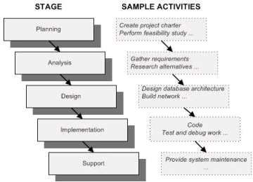
SDLC Example Methodologies
Waterfall - A sequential design process in which process is seen as flowing steadily downward through the phases.
Strengths:
Easy to understand
Highly structured
Defined Milestones
Quality > Cost/Schedule
Drawbacks:
Inhibits flexibility
False impression of progress
24

Slide 25
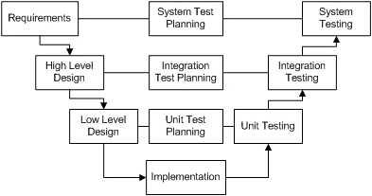
SDLC Example Methodologies
V-Shaped – An extension of the Waterfall method which demonstrates the relations between each phase of development and testing
Strengths:
Easy to understand
Emphasis on verification and validation
Defined milestones
Drawbacks:
Does not contain risk analysis activities
Does not handle concurrent events
Inhibits flexibility
25

Slide 26
SDLC Phases
Planning
Requirements Definition
System Design
Implementation
Verification and Validation
Acceptance and Deployment
Maintenance
The project and change management function(s) may determine that all or only parts of the SDLC are applicable to the project. Guidelines should be included in the SDLC on how this decision should be made.
26

Slide 27
Change Control Procedures and Risks
Audit Procedures
  Validate appropriateness of developer access
  Assess policy documentation of SDLC, change review and approval process, etc.
  Observe change migration and evidence
  Review configurations of version control and/or change approval tracking systems
  Test sample of changes for reasonableness
Risks
  Identification of change populations. Often times there is manual tracking of changes, but limited evidence of system generated population of changes (i.e. may be limited to last executable change, etc.)
  How to assess or use judgment for approval process (i.e. emails, changes after-the-fact, etc.)?
27

Slide 28
Operational Leading Controls
Backup and Recovery of Data and Programs
  Redundant operations, parallel processing and mirroring (virtual archiving/backup)
  Archiving capabilities
  Formalized data retention policies and procedures
  Automated backup management system/logging
Incident Management
  Formal implementation of problem management/ticket system (including escalation, priority levels, etc.)
Job Scheduling
  Integrated scheduling system (e.g. Tivoli, OpenView, CA-Unicenter)
  Shift turnover and job tracking mechanisms
Physical/Environmental
  Various, including facility redundancies, video surveillance, anti-passback, UPS, HVAC, etc.
28

Slide 29
Operational Controls
Risks
  Capabilities to assess facility controls such as:
    Electrical redundancies
    Sufficiency of UPS “modulation” of electric ebs/spikes
    Sufficiency of HVAC implementations
    Review of fire suppression coverage
  Ability to review/evidence over a period of time. Usually a point-in-time observation
  Validation of data disposal/retention – test strategies can be difficult.
29

Slide 30
Other Considerations
30

Slide 31
Other Implications
Audit Leverage
  Enhances the ability for auditors to leverage entity level control considerations to lower risk assessments and use control testing within the audit approach
  Provides better internal reporting and evidence for external or internal audits to lower risk assessments relative to auditable units
  Supplies better evidence, documentation, and analysis to support compliance reporting requirements.
31

Slide 32
Other Considerations
Various systems, platforms, utilities, interfaces, and applications greatly impact the shape and context of the ITGC environment.
  Several systems and applications have limitations relative to logical access security features
  Applications, operating systems, and databases may or may not integrate well and/or perform optimally from an ITGC capability perspective
  Platforms used will greatly impact decisions and determinations relative to ITGCs
  As with most other internal control aspects, there is a “balancing act” relative to managing the cost of implementing tools/applications to enhance ITGC vs. managing the level of risk tolerance that the organization will accept
  The use of spreadsheets, ODBCs, and other similar data file types makes the implementation of ITGCs more complex and difficult. “Operationalizing” data and reporting where possible generally enhances the control environment
32

Slide 33
Conclusions & Reporting
33

Slide 34
Documentation of Procedures
Are documentation/evidence standards for IT procedures different than financial assessments?
    NO.
  Document and conclude on working papers.
  Tickmark and evidence specific parameters, listings, etc. reviewed.
  Tests should be able to be re-performed by an objective individual.
  IT evidence should specifically focus on the source of the document (manual report, system generated listing – and what system or individual/position provided).
  Conclusions and exceptions should be clearly noted
34

Slide 35
Conclusions/Reporting
Reporting can be difficult – not a quantitative measure:
  IT conclusions and findings can be quantitative in the context of specific compliance provisions; however, they are often qualitative.
  Must evaluate and assess criteria related to the IT area, the nature and extent of exceptions, etc. in order to conclude on findings, sufficiency, etc.
  As much work as possible should be done during planning to establish the criteria for evaluation of exceptions, findings, etc. (particularly with performance audits).
  Establishing a risk/exception ranking criteria can be very helpful with conclusions/reporting and exit conferences and discussions.
35

Slide 36

Questions?
36

Slide 37
Thank you!
Jim Kreiser, CRMA, CISA, CFSA
Principal
Business Risk and Specialty Advisory Services
James.Kreiser@CLAConnect.com
717-558-0860
37

