Slide 1

Understanding and Disclosing Tax Abatement: Enhancing Tax Abatement Transparency
Presented to Central Pennsylvania Chapter, AGA
Tuesday, October 25th: Harrisburg, Pennsylvania
Dr. JANE BECKETT-CAMARATA
Penn state- harrisburg

Slide 2
Statement 77, Tax Abatement Disclosures
Governmental Accounting Standards Board (GASB) Statement No. 77, Tax Abatement Disclosures, will require governments that forgo revenue in connection with tax abatements to provide certain information regarding that fact in the notes to the financial statements.
We will:
(1) review the definition, key principles (the what) and requirements of GASB Statement No. 77,
(2) offer illustrative examples of how to meet the practical challenges of gathering the required information (the how) , and
(3) review GFOA suggestions on how to adjust the letter of transmittal to complement the new tax disclosures (the how).

Slide 3
GASB Statement 77:
Tax Abatement Disclosures
Effective 12/15/2015:
State and local governments use many different programs and policies that reduce taxes that an individual or entity would owe.
Intent is to encourage individuals or businesses to engage in certain behaviors
GASB 77 provides “essential information about the nature and magnitude of the reduction in tax revenues through tax abatement programs.”

Slide 4
GASB Statement 77
Tax Abatement Disclosures
Tax Abatement defined for financial reporting:
  A reduction in tax revenues that results from an agreement between one or more governments and an individual or entity in which
    (a) one or more governments promise to forgo tax revenues to which they are otherwise entitled and
    (b) the individual or entity promises to take a specific action after the agreement has been entered into that contributes to economic development or otherwise benefits the governments or the citizens of those governments

Slide 5
Statement 77 – Definition
Key parts of the GASB definition of a tax abatement:
Existence of an identifiable agreement between a government and a specific individual or entity.
  Elements:
    Promise by a government to reduce individual’s/entity’s taxes
    Promise by individual/entity to subsequently perform certain beneficial
  action.
    Agreement may be in writing or may be implicitly understood
    Program label not important—the key is if it meets the GASB definition of tax abatement

Slide 6
Tax Expenditure Programs
Governments use various programs to lower taxes – referred to as “tax expenditures”
Tax Expenditure programs include three forms:
  Tax exemptions
  Tax deductions
  Tax Abatements*
  * Statement 77 focuses on Tax Abatements

Slide 7
GASB Statement 77
Tax Abatement Disclosures
Disclosures Principles Distinguish between:
    Agreements that are entered into by the reporting government
    Agreements that are entered into by other governments and that reduce the reporting government’s tax revenues

Slide 8
GASB Statement 77
Tax Abatement Disclosures
Disclosure Principles:
  Tax abatements may be disclosed individually and/or aggregated:
    By major tax abatement program (own agreements)
    By government (agreements of others)
    Disclosures should be made from the date of agreement until its expiration

Slide 9
GASB Statement 77
Tax Abatement Disclosures
Disclosure Requirements:
    Only disclose individual details for agreements that exceed a quantitative threshold set by the government
    Brief description of the abatement (name of program, purpose, type of taxes abated, authority for program, criteria for eligibility, methods of abatement, terms for recapture if conditions unmet, commitments made by recipient)

Slide 10
GASB Statement 77:
Tax Abatement Disclosures
Disclosure requirements:
(1) Name of tax abatement recipient
(2) Gross amount that tax revenues were reduced by the abatement (on an accrual basis)
(3) Any amounts received/receivable from another government (name, authority, amount)
(4) Commitments made by the government
The quantitative threshold used for individual disclosures

Slide 11
GASB Statement 77:
Tax Abatement Disclosures
Disclosure requirements:
If legally prohibited from disclosing details of certain agreements, a general description of what is omitted and why.

Slide 12
GASB Statement 77:
Tax Abatement Disclosures
Disclosure requirements for discretely presented Component Units
If agreement is “essential to fair presentation” then treat as government’s own program
Otherwise, treat as a program of another government

Slide 13
GASB Statement 77:
Sample Illustrative Note Disclosures
NOTE (X): Tax Abatements
The Village enters into property tax abatement agreements with local businesses under the State Economic Development Opportunity Act of 20X1. Under the Act, localities may grant property tax abatements of up to 50 percent of a business’ property tax bill for the purpose of attracting or retaining businesses within their jurisdictions. The abatements may be granted to any business located within or promising to relocate to the Village.

Slide 14
GASB Statement 77:
Illustrative Disclosure
Note (X): Tax Abatement
For the fiscal year ended June 30, 20X7, the Village abated property taxes totaling $146,480 under this program, including the following tax abatement agreements that each exceeded 10 percent of the total amount abated:
A 40 percent property tax abatement to a grocery store chain for purchasing and opening a store in an empty storefront in the business district. The abatement amounted to $97,500.
A 50 percent property tax reduction for a local restaurant increasing the size of its restaurant and catering facility and increasing employment. The abatement amounted to $21,750.

Slide 15
GASB Statement 77:
Illustrative Disclosure
(Information relative to disclosure of these agreements)
Sample Small Village negotiates property tax abatement agreements on an individual basis.
The Village has tax abatement agreements with five entities as of June 30, 20X7.
  Amount of
                Percent of Taxes Taxes Abated
                Abated during the during the
                Purpose Fiscal Year Fiscal Year
  Grocery store chain purchases empty
  building and opens store 40% $97,500
  Relocate hardware store 50 13,225
  Retain health and fitness facility 30 5,100
  Increase size and employment of
  Restaurant/catering business 50 21,750
  Open gas station and convenience store 40 8,905

Slide 16
GFOA Best Practice:
Implementation of GASB Statement 77
GFOA Best Practice
Letter of Transmittal- Benefits Derived from business incentives
Letter of Transmittal focus on:
  1. types of incentives offered,
  2. process the business must adhere to in obtaining the business incentives, applicable laws pertaining to the abatement(s),
  3. entity valuation responsibility,
  4. monitoring requirements and any annual review process.
This gives the reader a better understanding that the process is transparent in line with state and municipal disclosure laws.

Slide 17
GFOA Best Practice:
Implementation of GASB Statement 77
Define what types of business tax incentives utilized effecting tax dollars abated or afforded. Identify costs to your entity associated with business incentives.
What is the entity’s application process to offer an abatement?
What are the entity’s requirements (application, cost/benefit analysis, minimum return on investment) to offer these business incentives-benefits to be obtained? Property dollars invested or value added investments, number of jobs created, rehabilitation of neighborhoods, for example.
Define and identify any tax sharing agreements with other entities. For example, payments to school districts for loss of tax dollars.

Slide 18
GFOA Best Practice:
Implementation of GASB Statement 77
How to obtain information?
Community Reinvestment Area Tax Incentives
  Identify Businesses – Start with applications, Legislation, or Contracts with the entities and the Businesses involved (Exhibit A).
  Create Schedule of Abatements-
    Obtain related real estate property tax information from county auditor, or fiscal officer, state agencies or relevant entity to obtain real estate tax records. (Exhibit B)

Slide 19
GFOA Best Practice:
Implementation of GASB Statement 77
Exhibit A
      Proposed Agreement for Community Reinvestment Area Tax Incentives between the
      (local legislative authority) located in the County of _______________and property owner
      1. A. Name of property owner, home of main office address, contact person, and telephone
      Number (attach additional paper if multiple enterprise participants)
      Enterprise Name Contact Person
      Address Contact Information
      1. B. Project site
      Contact Person
      Address Contact Information
      2. A. Name of commercial/industrial activity (manufacturing, warehousing, wholesale or retail stores or other) to be conducted at the site

Slide 20
GFOA Best Practice:
Implementation of GASB Statement 77
What’s next after obtaining information:
  Create a schedule of abated properties (Exhibit B) and include the following:
  Include total taxable valuation of each property, reduced assessed valuation (business incentive valuation) real estate taxes paid on each property, and equivalent real estate taxes abated. (personal property taxes may also be required)
  Identify your entities costs of providing business incentives (Real estate taxes abated) and also identify your entities Real estate taxes paid (benefits of incentives)

Slide 21
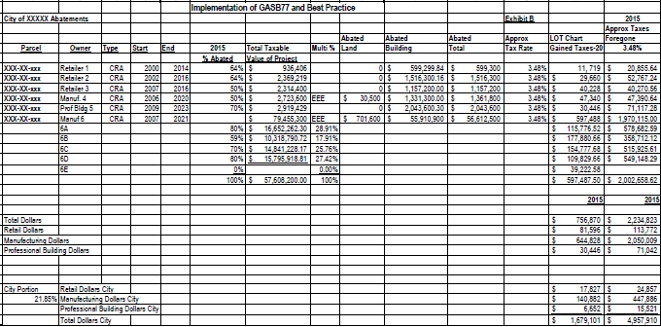

Slide 22
GFOA Best Practice:
Implementation of GASB Statement 77
GFOA Best Practice
Present tax abatement information in a format that depicts the benefits derived in the best suited manner for the entity. Can be achieved by including 5 year charts; however, graphs can be beneficial also.
Entity can create spreadsheets over many years which can be used for rating agencies to show current economic strengths or weaknesses of the entity by showing actual and projected benefits derived from businesses with incentives in the form of increased real estate taxes (Exhibit C), increases in the number of jobs, increase in payroll associated with new jobs, and increases in municipal income tax collections. All amounts reported by aggregate type.
Entity maintains records and updates annually the actual data and forecasts payroll wages and employment in line with commitments agreed upon by the businesses.

Slide 23
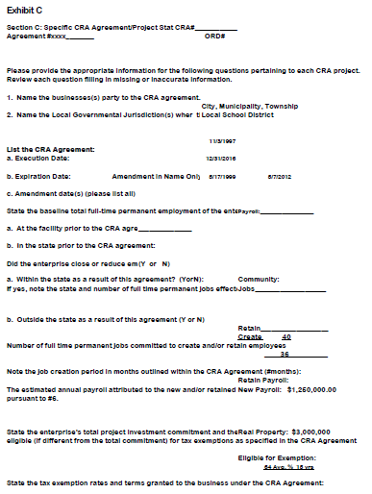

Slide 24
GFOA Best Practice:
Implementation of GASB Statement 77
GFOA Best Practice
Therefore the benefits derived far outweigh the costs of the business incentives and correlate to the cost/benefit analysis performed on all business incentive agreements.
The entity may pull any agreements that are not compliant with the business contractual obligations.

Slide 25
GFOA Best Practice:
Implementation of GASB Statement 77
Note Disclosure:
Organize by major tax abatement program:
  Such as Community Reinvestment Area Incentives (CRA’s) Enterprise Zone Agreements (EZA’s), Economic Development Job Creation Income Tax Abatement programs related to jobs retention or jobs growth

Slide 26
GFOA Best Practice:
Implementation of GASB Statement 77
Note Disclosure:
Aggregate by type under programs:
  Utilize aggregate categories of (for example):
    Manufacturing
    Retail
    Professional Buildings
    Retail-Auto
    These can best fit types of business incentives without divulging specific business data not allowed by State and City laws.

Slide 27
GFOA Best Practice:
Implementation of GASB Statement 77
Note Disclosure:
Post figures to footnotes associated only with the entity
Can use the county breakdown of real estate effective millage by entity to obtain the City’s % share of abatement.
Use accrual accounting for values, receivables may apply and should be noted.
Disclosures commence in the period in which the tax abatement agreement is entered into and continue until the tax abatement agreement expires or is terminated.

Slide 28
Conclusion
We have:
(1) review the definition, key principles (the what) and requirements of GASB Statement No. 77,
(2) offered illustrative examples of how to meet the practical challenges of gathering the required information (the how) , and
(3) reviewed GFOA suggestions on how to adjust the letter of transmittal to complement the new tax disclosures (the how).
We will now hear from Representatives from York County on their use of Tax Abatements.

