Slide 1

Tax Abatement Disclosures
Statement No. 77 of the
Governmental Accounting
Standards Board

Slide 2
Tax Abatement
Reduction in tax revenues from an agreement between one or more governments and an individual in which:
One or more governments agrees to reduce the individual or entity’s taxes
The individual or entity promises to take a specific action that contributes to economic development or otherwise benefits the government or its citizens

Slide 3
York County’s Potential Tax Abatement Disclosures Requirements
Local Economic Revitalization Tax Act (LERTA)
Residential Tax Abatement Program (ReTAP)
Tax Incremental Financing (TIF)
Clean & Green Program

Slide 4
Local Economic Revitalization
Tax Act (LERTA)
Act authorizes local taxing authorities to exempt new construction from real estate taxes in deteriorated areas of economically depressed communities and improvements to certain deteriorated industrial, commercial and other business property.

Slide 5
LERTA
In a public hearing the governing body fixes the boundaries of a “deteriorated area” in accordance with Urban Redevelopment Law
Taxing authority grants an exemption on the assessment attributable to the actual cost of new construction or improvements or up to any maximum cost established by the municipal governing body.

Slide 6
LERTA
Taxes exempted are subject to the following limitations:
The schedule of taxes exempted shall not exceed ten years.
The exemption is limited to the additional assessed value attributable to the costs of new construction or improvements to deteriorated property

Slide 7
LERTA
The tax abatement on the additional assessed value is generally 100% the first year and decreases by 10% each year thereafter. In the eleventh year, the property is 100% taxable.
Each LERTA Property will require disclosure for 10 years in accordance with GASB Statement #77

Slide 8
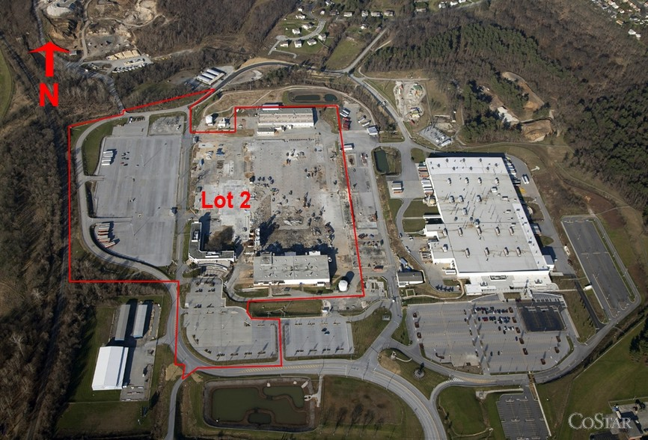
Harley Davidson Site, Route 30, York

Slide 9
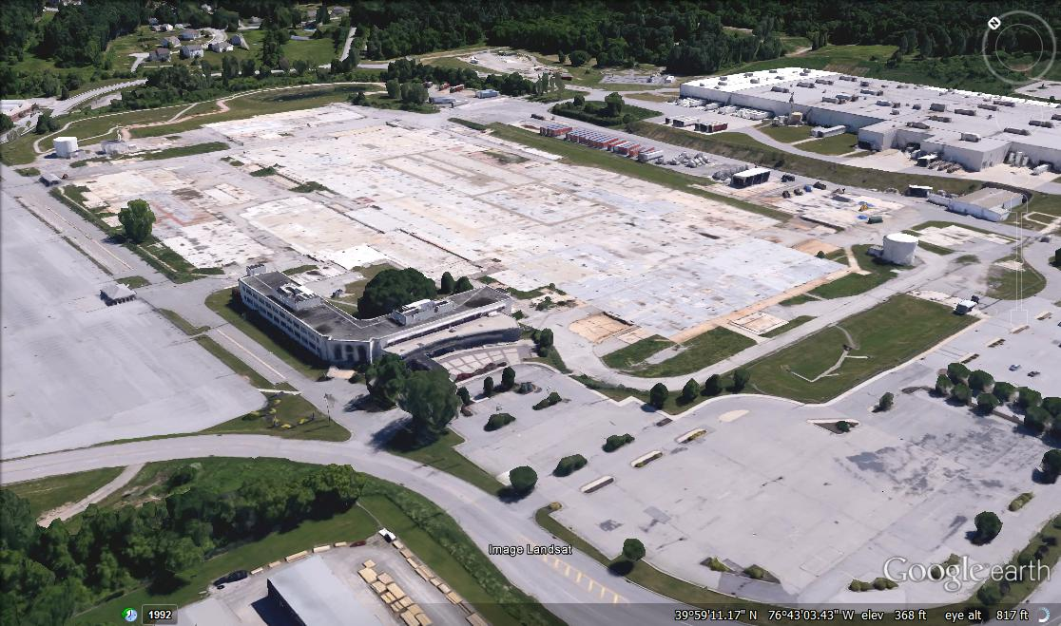
Predevelopment Conditions

Slide 10
Harley Davidson Site - Environmental
  Environmentally impacted by US. Dept. of Defense and Harley Davidson operations
  Investigations and remediation ongoing since 1986
  Remedial activities related to ground water contamination ongoing today, likely for next 15 years
  While remedial activities remain the responsibility of USDOD and Harley, there are additional environmental costs that will be incurred as a result of any future development – estimate $1.355 million

Slide 11
Current Redevelopment
  NorthPoint is constructing a 755,000 square foot industrial facility (spec building)
  Construction began in early 2016
  Operational in 2017
  Property will likely be leased by a single tenant, but will be built to accommodate multiple tenants
  Investment - $40 - $50 million
  Job Creation – approximately 650

Slide 12
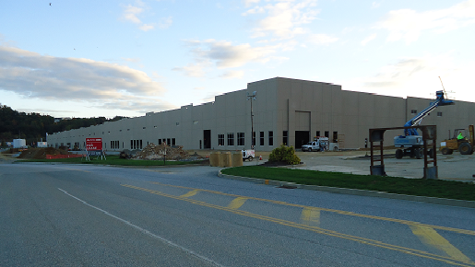
New Construction

Slide 13
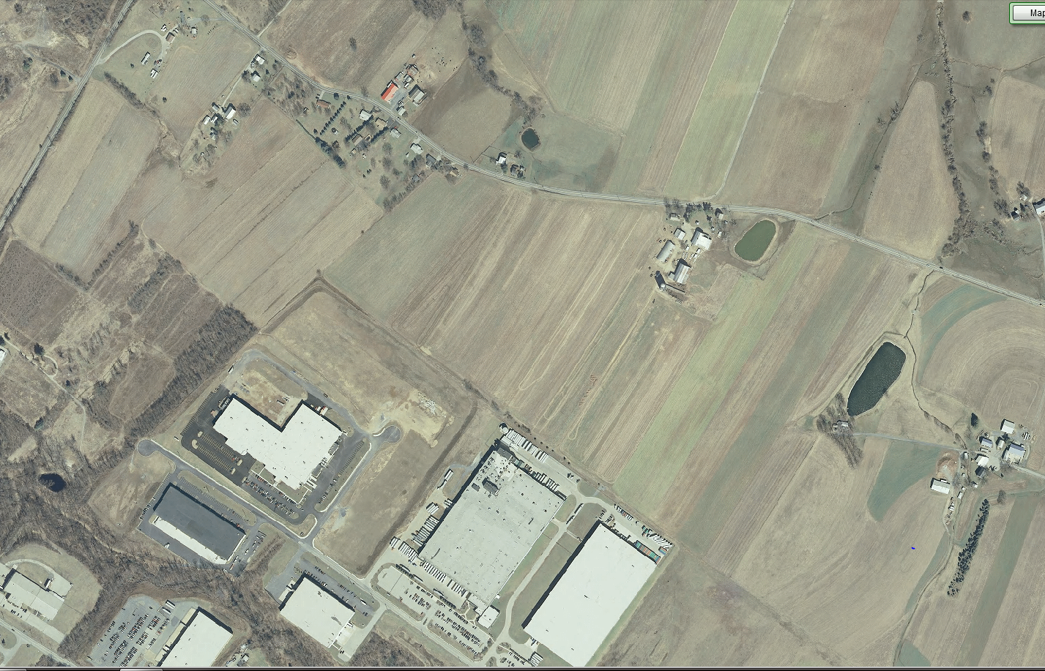
1605 Bartlet Drive, Manchester, PA

Slide 14
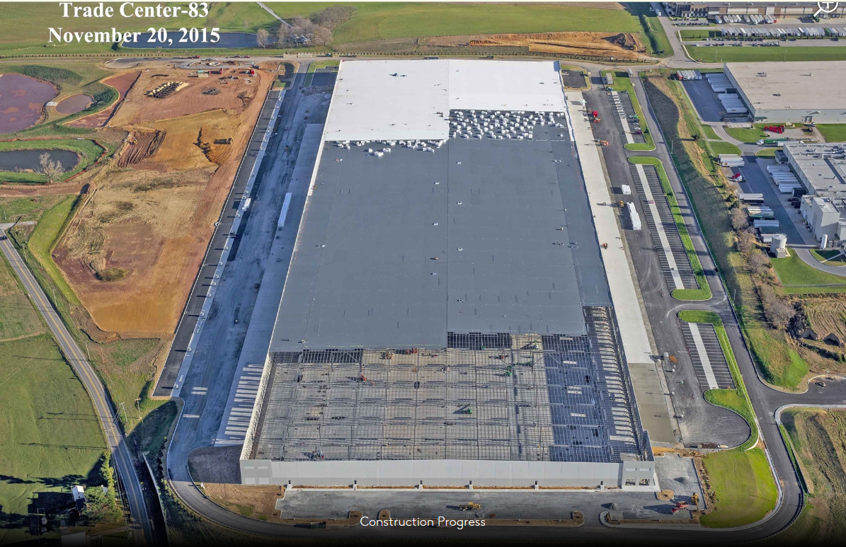
1605 Bartet Drive, Manchester, PA

Slide 15
What’s wrong with this picture ???
96 Acre Farm removed from Ag Security Area
Farm rezoned from Farm & Open Space to Industrial
Farm sold for $12 million to Texas Developer
Farm surrounded by other farms identified as “blighted”
A 1.2 Million Sq. Ft. warehouse was constructed as a “spec” building
After Construction was completed, Starbucks requested LERTA exemption as lessee of facility

Slide 16
Tax Abatement Calculation
Improved Assessed Value |  |  |  |  |  |  |  |  |  | $33,100,000
Original Assessed Value |  |  |  |  |  |  |  |  |  | $1,564,530
Value qualified for tax abatement |  |  |  |  |  |  |  |  |  | $31,535,470
Year |  | Abatement |  | County Tax |  | County Tax Credit |  | Township Tax |  | Township Tax Credit |  | School Tax |  | School Tax Credit |  | Total Tax |  | Total Tax Credit
Millage |  |  |  |  |  | 5.16 |  |  |  | 1.04 |  |  |  | 26.09
1 |  | 100% |  | $0 |  | $162,723 |  | $0 |  | $32,797 |  | $0 |  | $822,760 |  | $0 |  | $1,018,280
2 |  | 90% |  | $16,272 |  | $146,451 |  | $3,280 |  | $29,517 |  | $82,276 |  | $740,484 |  | $101,828 |  | $916,452
3 |  | 80% |  | $32,545 |  | $130,178 |  | $6,559 |  | $26,238 |  | $164,552 |  | $658,208 |  | $203,656 |  | $814,624
4 |  | 70% |  | $48,817 |  | $113,906 |  | $9,839 |  | $22,958 |  | $246,828 |  | $575,932 |  | $305,484 |  | $712,796
5 |  | 60% |  | $65,089 |  | $97,634 |  | $13,119 |  | $19,678 |  | $329,104 |  | $493,656 |  | $407,312 |  | $610,968
6 |  | 50% |  | $81,362 |  | $81,362 |  | $16,398 |  | $16,398 |  | $411,380 |  | $411,380 |  | $509,140 |  | $509,140
7 |  | 40% |  | $97,634 |  | $65,089 |  | $19,678 |  | $13,119 |  | $493,656 |  | $329,104 |  | $610,968 |  | $407,312
8 |  | 30% |  | $113,906 |  | $48,817 |  | $22,958 |  | $9,839 |  | $575,932 |  | $246,828 |  | $712,796 |  | $305,484
9 |  | 20% |  | $130,178 |  | $32,545 |  | $26,238 |  | $6,559 |  | $658,208 |  | $164,552 |  | $814,624 |  | $203,656
10 |  | 10% |  | $146,451 |  | $16,272 |  | $29,517 |  | $3,280 |  | $740,484 |  | $82,276 |  | $916,452 |  | $101,828
Total Taxes/Abatement |  |  |  | $732,254 |  | $894,977 |  | $147,586 |  | $180,383 |  | $3,702,422 |  | $4,525,182 |  | $4,582,261 |  | $5,600,542

Slide 17
Residential Tax Abatement Program (RETAP)
The York City & County ReTAP Program provides for a 100%, ten year tax exemption on the value of new residential construction or residential rehabilitation. This incentive runs with the land for 10 years. The property returns to full valuation in year eleven.
The companion York School District ReTAP provides ten year phased out exemptions: 100% in year one, 90% in year two, 80% in year three and so forth until a 10% abatement is granted in year ten for the value of new construction & rehabilitation of houses & condominiums.

Slide 18
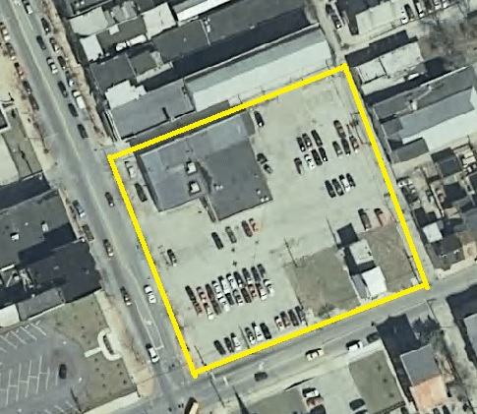
George Street Commons

Slide 19
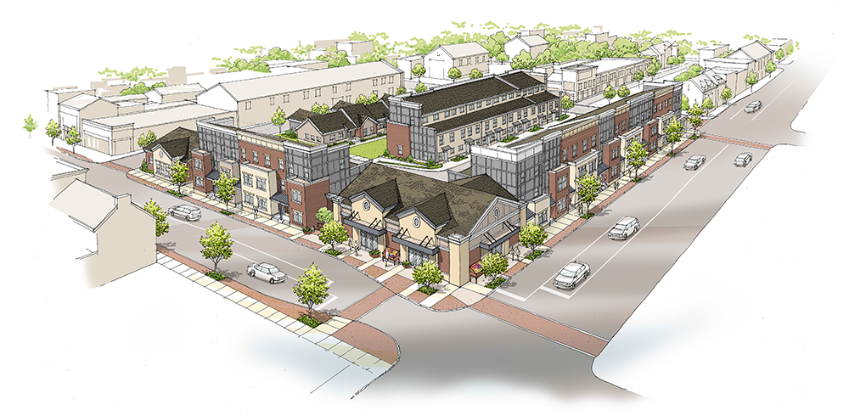
George Street Commons

Slide 20
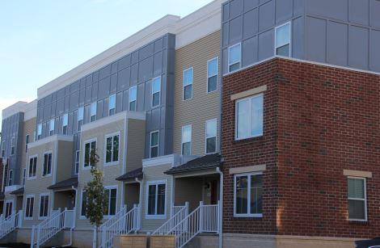
George Street Commons

Slide 21
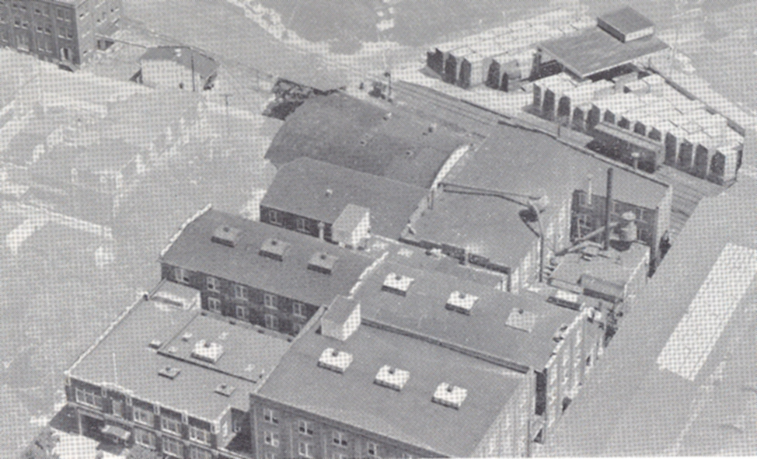
Linden Lofts

Slide 22

Linden Lofts

Slide 23
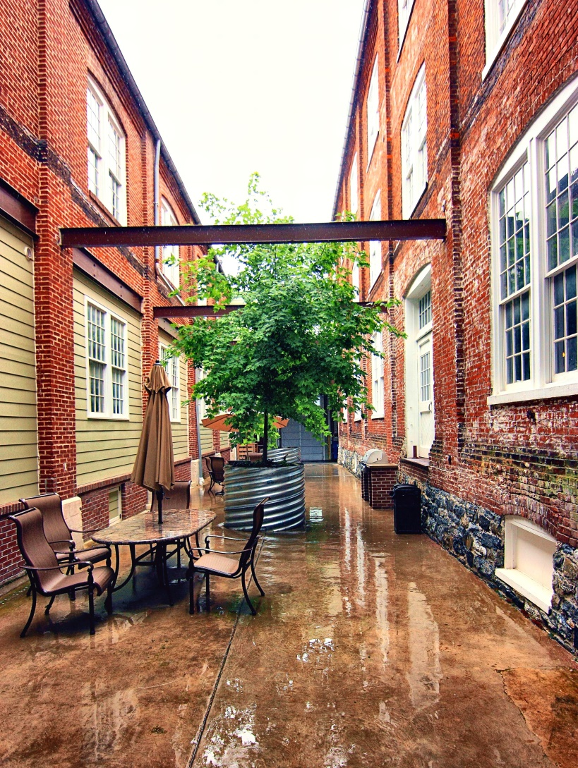
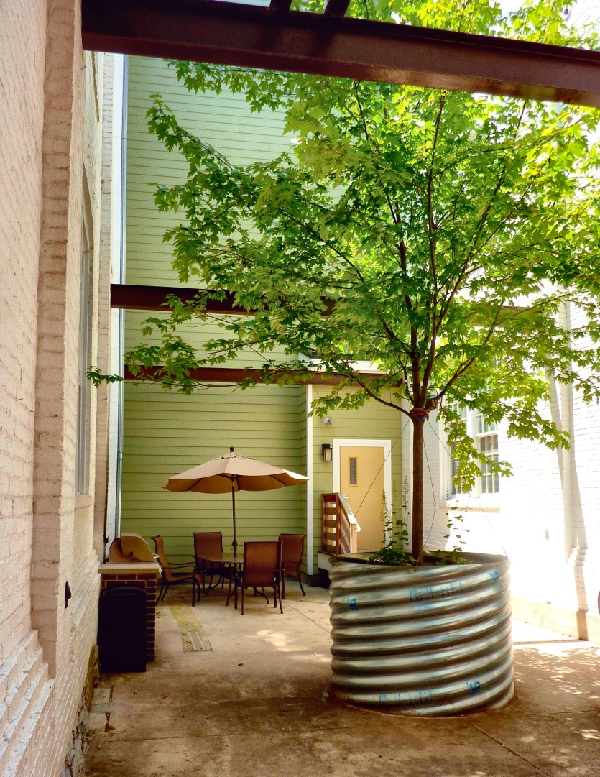
Linden Lofts

Slide 24
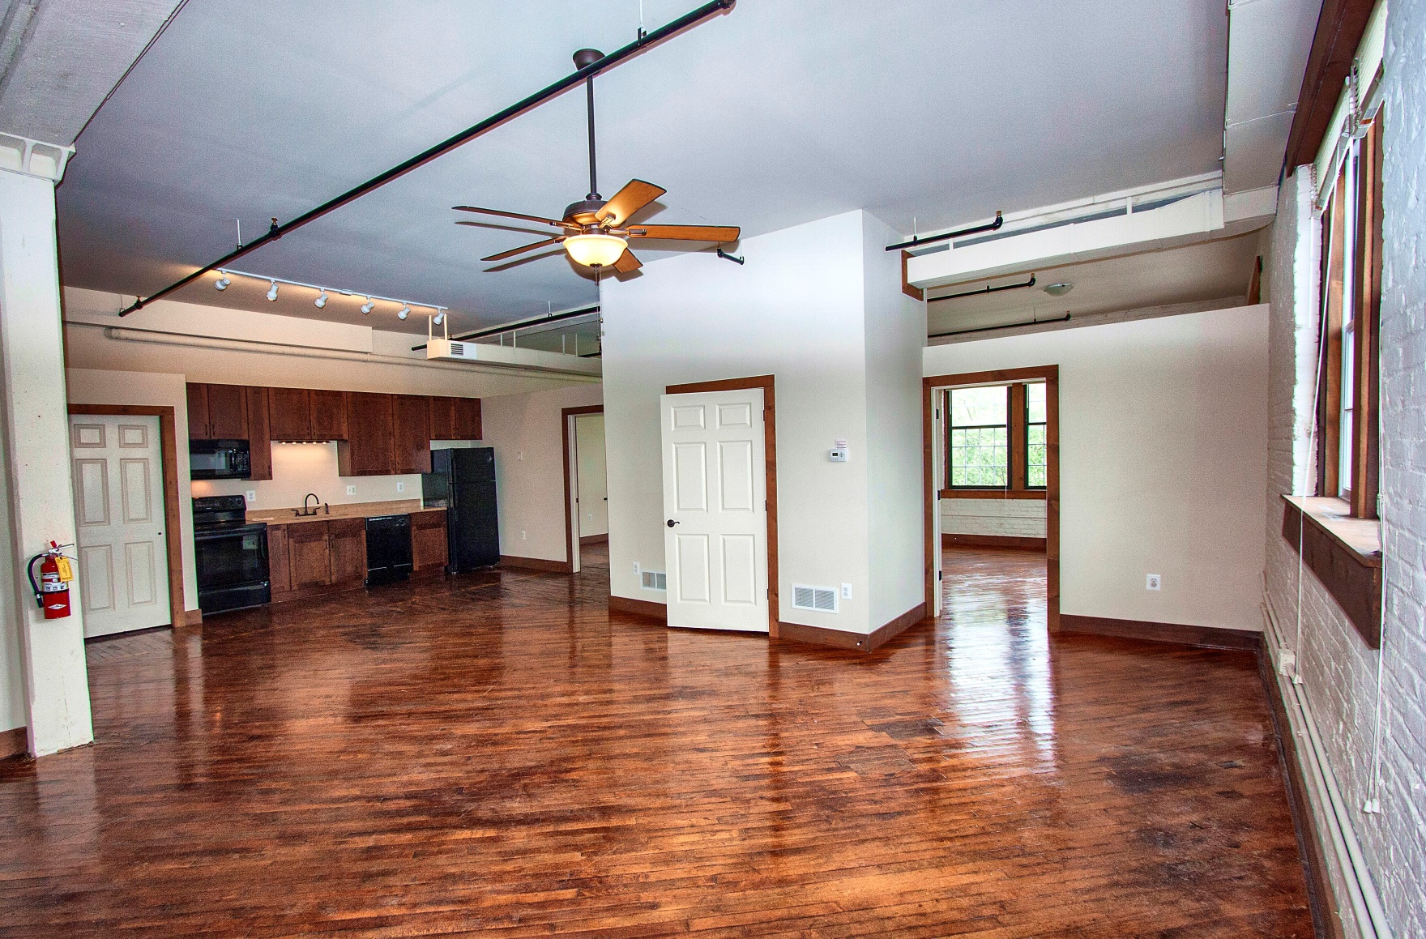
Linden Lofts

Slide 25
Tax Increment Financing (TIF)
Tax increment financing (TIF) is a tool that allows municipalities to promote economic development by earmarking property tax revenue from increases in assessed values within a designated TIF district.
The designation usually requires a finding that an area is “blighted” or “underdeveloped” and that development would not take place “but for” the public expenditure or subsidy. It is only a bit of an overstatement to characterize the “blight” and “but for” findings as merely pro forma exercises, since specialized consultants can produce the needed evidence in almost all cases.

Slide 26
Tax Increment Financing (TIF)
A TIF earmarks real estate tax revenue for the developer. Taxes are collected but then paid back to a trust established to pay all or a portion of the developer’s debt on the redevelopment project.
Does this qualify as tax abatement? Is it required to be disclosed?

Slide 27
Tax Increment Financing (TIF)
York County has approved two TIFs to date
West Manchester Mall – reconstruction project
A portion of Hopewell Township in southern York County which will be the new home of Johnston Controls.

Slide 28
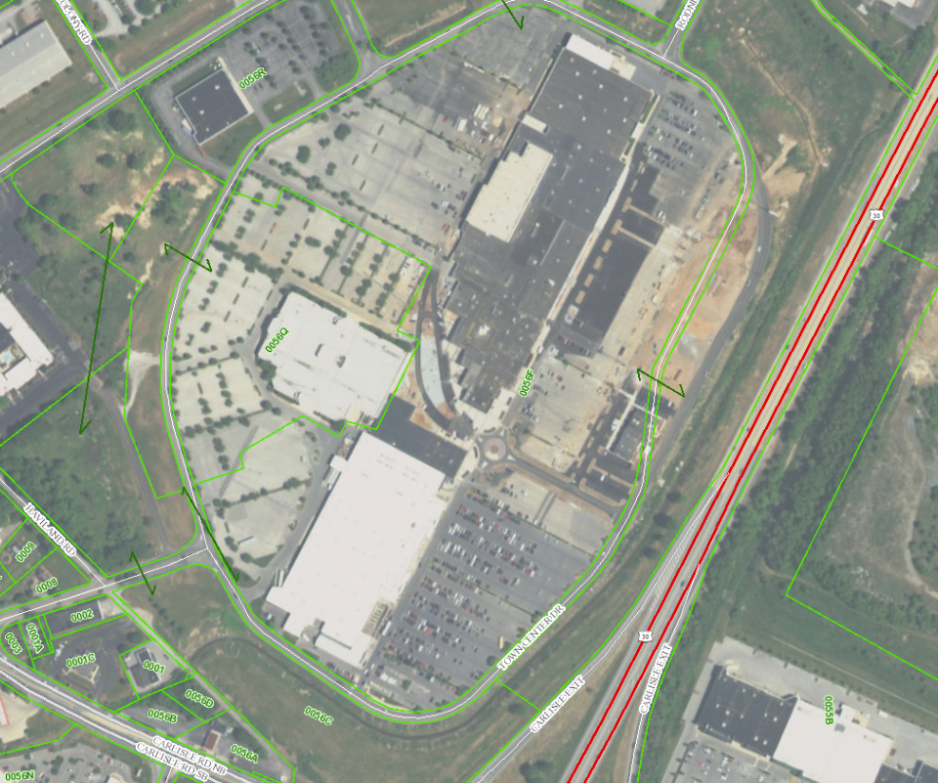
West Manchester Mall Reconstruction (TIF)

Slide 29
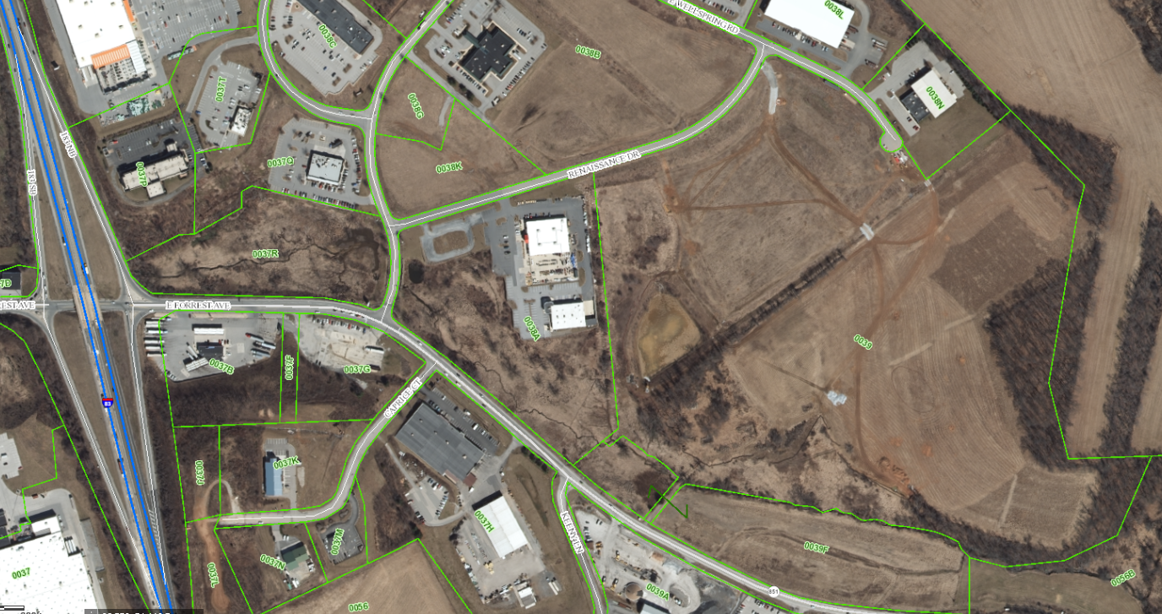
New Home of Johnson Controls (TIF)

Slide 30
Clean & Green Program
Clean and Green is a land conservation program that lowers the property tax rate for the landowner that is enrolled in the program.
Landowners are obligated to devote their land to agricultural use, agricultural reserve use or forest reserve use.
If you “exit” the program you may be obigated to payback 7 years’ worth of “roll-back” taxes plus interest.

Slide 31
Clean & Green
Agricultural Use
10 Contiguous acres minimum; or
Anticipated yearly gross income of at least $2,000 from ag
Have been in ag production or a soil conservation program for 3 years.
Includes Farmstead or Woodlot
Agricultural Reserve Use
10 acre minimum
Open to public without charge
Includes Farmstead or Woodlot

Slide 32
Clean & Green
Forest Reserve Use
10 Contiguous acres minimum
The land is presently stocked with trees
Includes land rented for the purpose of producing timber or wood products
Includes any Farmstead Land
The PA Department of Agriculture establishes land use values for each category.
You must submit an application to apply for the program.
Over 6.5million acres enrolled across the state as of 2000

Slide 33
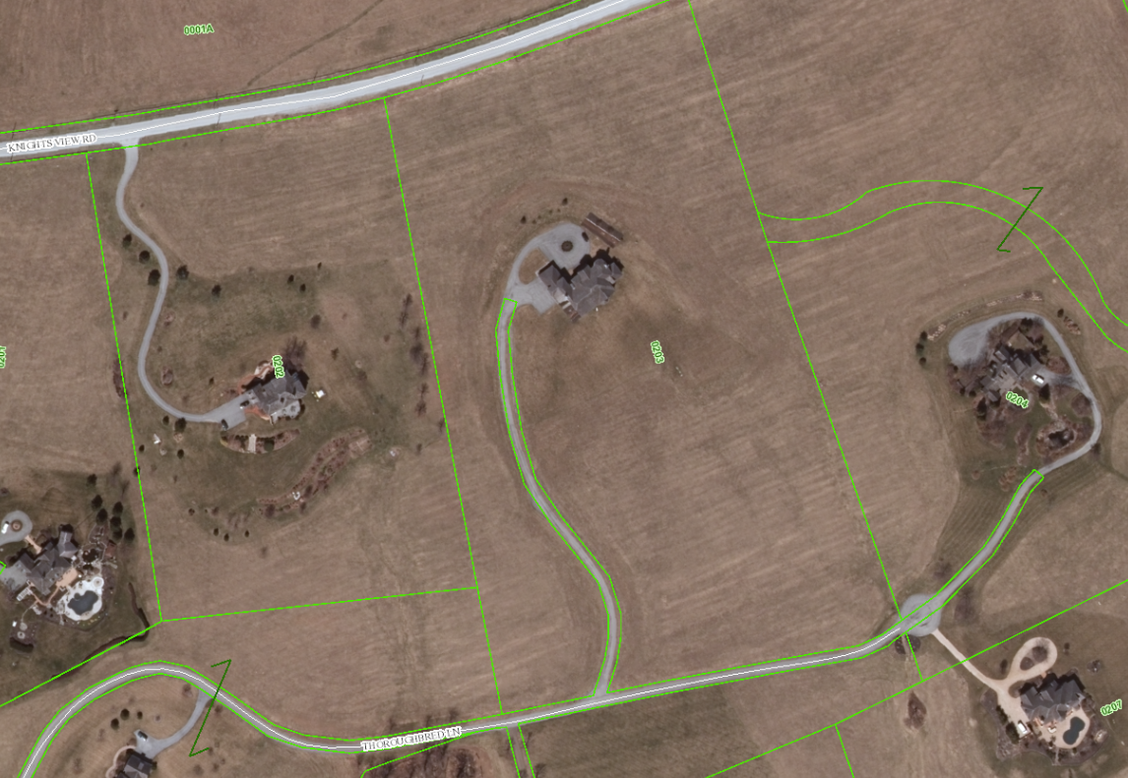
Clean & Green

Slide 34
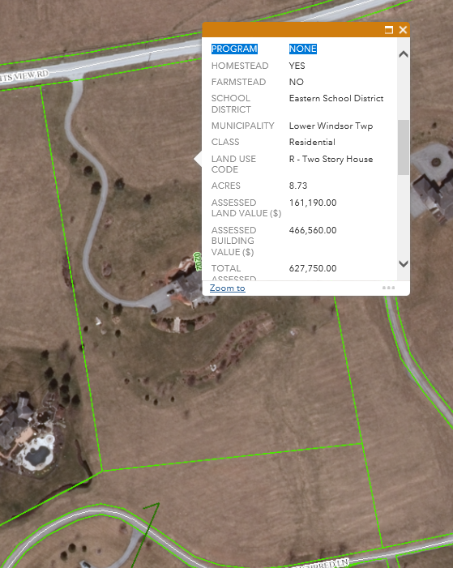
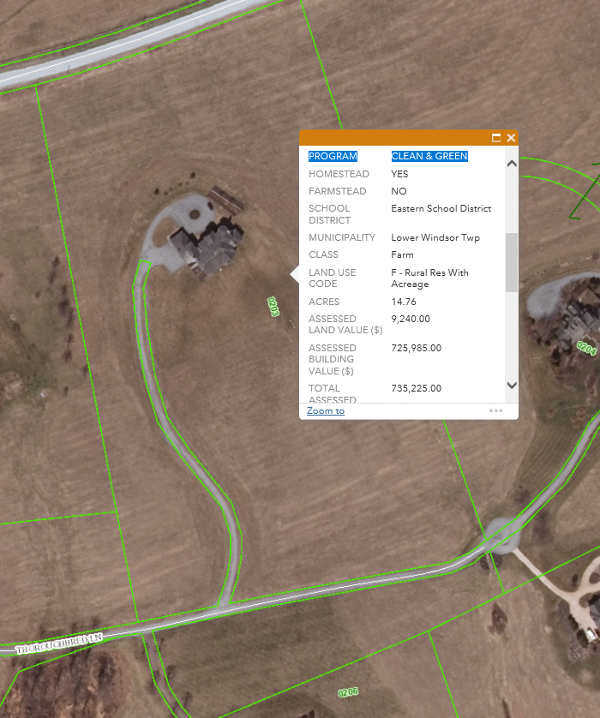
Clean & Green

Slide 35
Definition of a Tax Abatement
As a result of an agreement, either in writing or implicitly understood, that:
One or more governments promise to forgo tax revenues to which they are otherwise entitled.
The individual or entity promises to take a specific action that contributes to economic development or otherwise benefits the governments or citizens of those governments.
  Increase tax base
  Address cost disadvantages
  Revitalize distressed local economies
  Retain or attract jobs or companies in particular industries
  Increase employment

Slide 36
Disclose in Financial Statements?
LERTA?
ReTAP?
TIFs?
Clean & Green?
Homestead & Farmstead Exclusion?

Slide 37
Existence of an Agreement
Implicit in the notion that tax abatements are based on an agreement is the expectation that the agreement precedes the reduction of taxes and the fulﬁllment by the individual or entity of the promise to act. Certain tax expenditure programs that exhibit the features of a tax abatement—they reduce taxes, encourage beneﬁcial actions by individuals or entities, and may be based on an agreement—are, nevertheless, excluded from the scope of this Statement because the government does not commit to abate taxes until after the individual or entity has already performed the activity for which the government is providing the tax abatement.
The Board concluded that the timing provision offers the necessary demarcation between transactions included in the scope of this Statement and a much broader class of tax expenditures, which is beyond the scope of this Statement.

Slide 38
Thank
You

