Slide 1

If You Want Leaders,
Stop Teaching Students to be Managers
Darin Gerdes, Ph.D.
dgerdes@csuniv.edu
(843)863-7814

Slide 2
What is Management?
Managerial Chart:
  (The 4 Functions)
Management
Planning
Leading
Organizing
Controlling
-Creating a plan
-Defining goals
-Establishing strategy
-Problem solving
-Top to bottom
-Management plans/
Workers work
-Directing and coordinating work
-Motivating workers
to carry out the plan
-Harnessing followers
-Positional (office)
and by example
-Determining what is
to be done and who
is to do it
-Organizational charts
-Mechanistic model
-Job descriptions
-Chain of Command
-Evaluating
-Monitoring activities
-Ensuring compliance
-Enforcing rules
-Supervising
-Rewarding & punishing

Slide 3
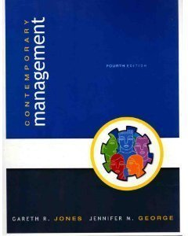
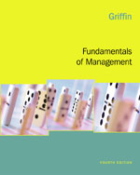
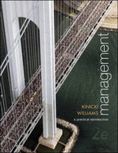
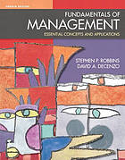
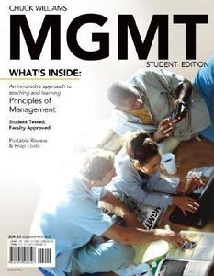
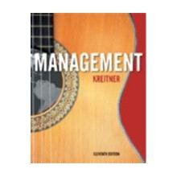
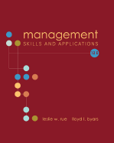

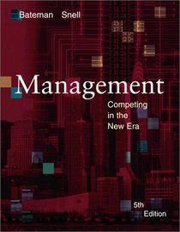
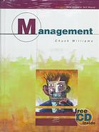
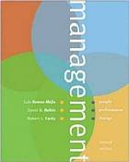
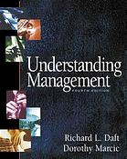

Slide 4
Definitions of Leading
from the Textbooks

Slide 5
Leading
Articulating a clear vision and energizing and enabling organizational members so that they understand the part they play in achieving organizational goals; one of the four principal functions of management. (Jones & George, 2006, p. 12)

Slide 6
Leading
The set of processes used to get members of the organization to work together to further the interests of the organization (Griffin, 2006, p. 10).

Slide 7
Leading
Leading is defined as motivating, directing, and otherwise influencing people to work hard to achieve the organization's goals. (Kinicki & Williams, 2003, p. 13)

Slide 8
Leading
Includes motivating employees, directing the activities of others, selecting the most effective communications channel, and resolving conflicts. (Robbins & DeCenzo, 2005, p. 9)

Slide 9
Leading
Involves understanding people and being able to work well with them. (Rue, L. & Byars, L., 2006, p. 6)

Slide 10
Leading
Motivating, directing, and otherwise influencing people to work hard to achieve the organization's goals (Williams, 2006, p. 13).

Slide 11
No Definition of Leading:
Hitt, M. A., Black, S., & Porter, L. W. (2005). Management. 1st Ed. Upper Saddle River, NJ: Pearson Prentice Hall.
Kreitner, R. (2009). Management. 11th Ed. Boston: Houghton Mifflin Co.
Gómez-Mejía, L. R., Balkin, D. B., & Cardy, R. L. (2005). Management: People, performance, change. Boston: McGraw-Hill/Irwin.
Daft, R. L., & Marcic, D. (2004). Understanding management. Mason, Ohio: Thomson/South-Western.
Bateman, T. S., & Snell, S. (2002). Management: Competing in the new era. 5th Ed. Boston: Irwin.

Slide 12
Definitions of Leadership
from the Textbooks

Slide 13
Leadership
The process by which an individual exerts influence over other people and inspires, motivates, and directs their activities to help achieve group or organizational goals. (Jones & George, 2006, p. 495)

Slide 14
Leadership
As a process, the use of noncoercive influence to shape the group's or organization's goals, motivate behavior toward the achievement of those goals, and help define group or organization culture; as a property, the set of characteristics attributed to individuals who are perceived to be leaders (Griffin, 2006, p. 360).

Slide 15
Leadership
Leadership is the process of directing the behaviors of others toward the accomplishment of some objective (Certo & Certo, 2009).

Slide 16
Leadership
Leadership: is the ability to influence employees to voluntarily pursue organizational goals. (Kinicki & William, 2003, p. 448).

Slide 17
Leadership
Ability to influence people to willingly follow one's guidance or adhere to one's decisions. (Rue, L. & Byars, L., 2006, p. 289).

Slide 18
Leadership
The ability to influence employees to voluntarily pursue organization goals (Williams, 2006, p. 444).

Slide 19
Leadership
Social influence process involving inspiring and guiding others in a common effort (Kreitner, 2005, p. 363).

Slide 20
Leadership
The ability to influence people toward the attainment of organizational goals (Daft & Marcic, 2004, p. 412).

Slide 21
No Definition for Leadership
Hitt, M. A., Black, S., & Porter, L. W. (2005). Management. 1st Ed.Upper Saddle River, NJ: Pearson Prentice Hall.
Robbins, S. P., & DeCenzo, D. A. (2004). Fundamentals of management: Essential concepts and applications. 4th Ed. Upper Saddle River, N.J: Pearson Prentice Hall.
Bateman, T. S., & Snell, S. (2002). Management: Competing in the new era. 5th Ed. Boston: Irwin.
Gómez-Mejía, L. R., Balkin, D. B., & Cardy, R. L. (2005). Management: People, performance, change. Boston: McGraw-Hill/Irwin.

Slide 22
Conclusion:
Leadership is motivating, influencing, and directing.

Slide 23
Conclusion:
Leadership is motivating, influencing, and directing.
reduced to

Slide 24
What is Management?
Managerial Chart:
  (The 4 Functions)
Management
Planning
Leading
Organizing
Controlling
-Creating a plan
-Defining goals
-Establishing strategy
-Problem Solving
-Top to bottom
-Management plans/
Workers work
-Directing and coordinating work
-Motivating workers
to carry out the plan
-Harnessing followers
-Positional (office)
and by example
-Determining what is
to be done and who
is to do it
-Organizational charts
-Mechanistic model
-Job descriptions
-Chain of Command
-Evaluating
-Monitoring activities
-Ensuring compliance
-Enforcing rules
-Supervising
-Rewarding & punishing

Slide 25
What is Management?
Managerial Chart:
  (The 4 Functions)
Management
Planning
Leading
Organizing
Controlling
-Creating a plan
-Defining goals
-Establishing strategy
-Problem Solving
-Top to bottom
-Management plans/
Workers work
-Directing and coordinating work
-Motivating workers
to carry out the plan
-Harnessing followers
-Positional (office)
and by example
-Determining what is
to be done and who
is to do it
-Organizational charts
-Mechanistic model
-Job descriptions
-Chain of Command
-Evaluating
-Monitoring activities
-Ensuring compliance
-Enforcing rules
-Supervising
-Rewarding & punishing
Top
managers
plan
Motivate
workers to
carry out their plan
Organize
for
efficiency
Control to be
sure their plan
was completed

Slide 26
It Doesn’t Work Very Well
Problems with the model:
Inefficiency
Miscommunication
Demoralization
Distrust
Lack of ownership
Lower productivity
Absenteeism
Higher turnover
Workplace deviance

Slide 27
?

Slide 28
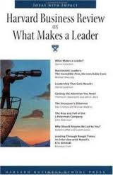
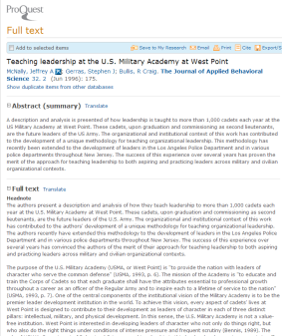
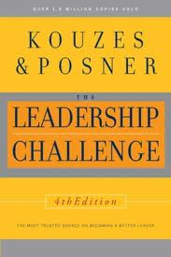
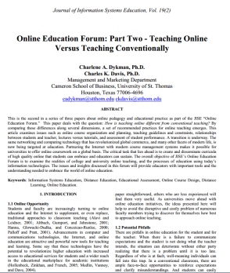
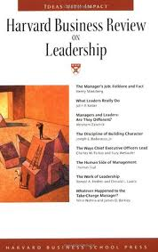
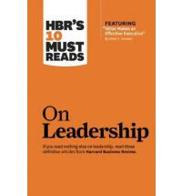
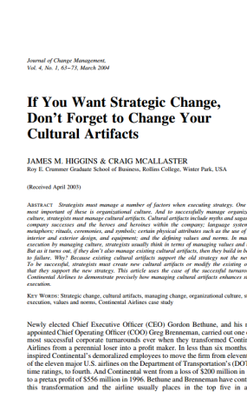
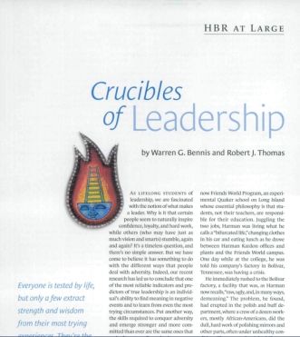
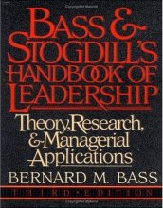
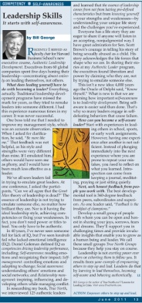
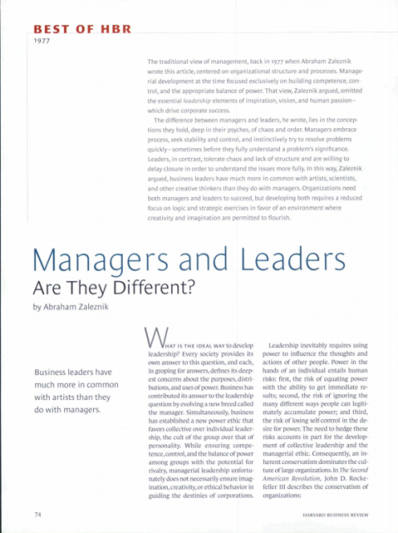

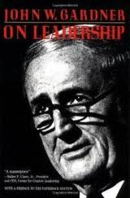
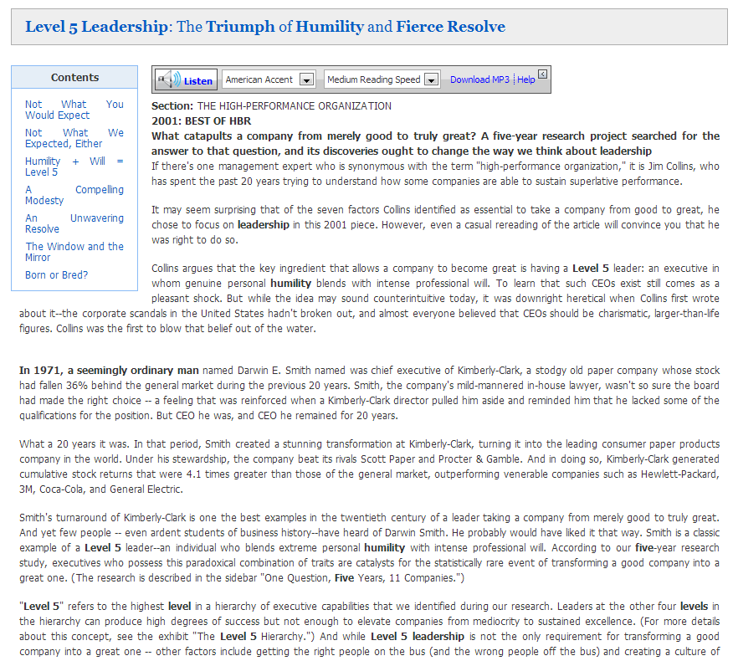
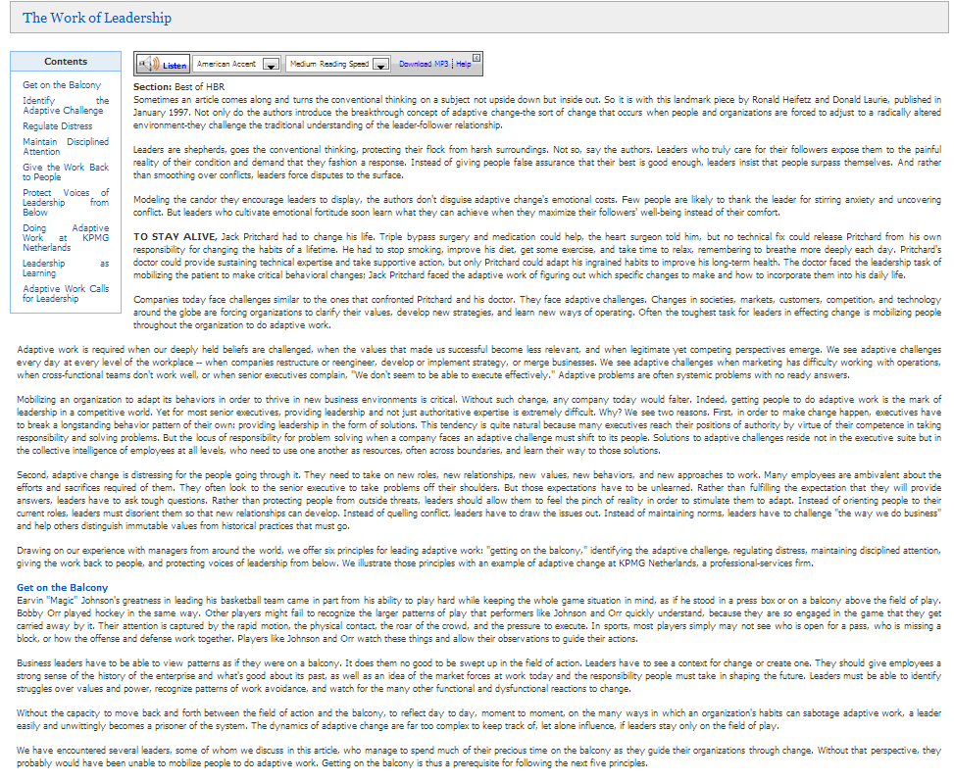

Slide 29
What is Leadership According to the Literature?

Slide 30
What is Leadership
(from the Academic Literature)?
Common Elements include
  Motivation
  Influence
  Vision
  Relationship
  Change
  Emotional connection
  Leading by example
  …and much more

Slide 31
Motivation

Slide 32
Motivation
Motivation is core to leadership (Goleman, 2004).
Leadership is more about motivating and inspiring than controlling (Kotter, 1990, p. 104). (George, Sims, McLean, & Mayer, 2007).

Slide 33
Influence

Slide 34
Influence
Leadership as “the influence increment over and above mechanical compliance with routine directives of the organization” (Katz and Kahn (1950/1978, pp. 302-303).
Leadership is: “the true measure of leadership is influence—nothing more, nothing less” (Maxwell, 1998, p. 11).
Influence may utilize power to alter the direction of the organization (Zaleznik, 1978).
Leadership is not about force; it is about persuasion (Mintzberg, 1990, Greenleaf, 1996; Denning, 2005).

Slide 35
Vision

Slide 36
Vision
Leaders develop and project a shared vision (Kouzes and Posner,2002).
Vision involves sensemaking (Ancona, Malone, Orlikowski, and Senge, 2007).
Vision means setting direction (Heifetz & Laurie, 2001; Kotter, 1990; Matthew 28: 18-20).
Creating a clear purpose (Farkas & Wetlaufer, 1996)
Translating visions through planning (Drucker, 2004).
Helping others see a compelling future (Ancona, Malone, Orlikowski, and Senge, 2007)
Or a combination of these things (Goffee & Jones, 2000).

Slide 37
Relationship

Slide 38
Relationship
Instead of a leader imposing his will upon a follower, leadership is better defined as a process or relationship (Hernez-Broome & Hughes, 2004).
Relationship is a core ingredient of leadership (Ancona, Malone, Orlikowski, & Senge, 2007; George, Sims, McLean, & Mayer, 2007; Hay & Hodgkinson,
2006; Kouzes and Posner, 2002).

Slide 39
Emotional Connection

Slide 40
Emotional Connection
Relationship and emotional connection are tied together.
Leadership is an emotional activity. (Goleman, Boyatzis, & McKee, 2002)
Where management is rational, leadership is emotional (Boyatzis, & McKee, 2005).
Mentors, for example, make emotional connections with their protégés (Zaleznik, 1978).

Slide 41
Change

Slide 42

Change
The purpose of leadership is change. At its most fundamental, leadership is about moving from one place to another.
“Management is about coping with complexity. Leadership is about coping with change” (Kotter, 1990, p. 104; Kotter, 1996).

Slide 43
Leading by Example

Slide 44
Leading by Example
“Leadership is the process of persuasion or example by which an individual (or leadership team) induces a group to pursue objectives held by the leaders or shared by the leader and his or her followers” Gardner, 1990, p. 1).
The first step in the leadership process, is modeling the way for followers (Kouzes and Posner, 2002).
Those that set the performance high for themselves earn credibility that does not rely on coercion (Goleman , 2004, p. 89).
“Leadership is not exerting power over others or exhorting them to follow you. It results from your example of empowering others to step up and lead” (George, 2011, p. 13).
Servant leadership, for example, begins with the idea that the leader is servant-first. He models the behavior he wishes to inculcate as Christ did by washing his disciples feet (Greenleaf, 1996; Matthew 20:25-28; John 13: 2-17).

Slide 45
Other Factors Related to Leadership
Other Factors Include:
  Alignment (Kotter, 1990)
  Credibility (Kouses and Posner, 2011)
  Duplication (Teal, 1996)
  Distributed leadership (Ancona, Malone, Orlikowski, & Senge, 2007, p. 94).
  Empowerment (Kotter, 1990)
  Developing character vs. technical proficiency (Teal, 1996, p. 36)
  Emotional Intelliegence (Goleman, D, 2004; Goleman, Boyatzis, & McKee, 2002),
  helping followers with Adaptive change (Heifetz & Laurie, 2001),
  Self-knowledge and authenticity (Goffee & Jones, 2000, pp. 67-68; George, 2011, p. 13; Rooke & Torbert 2005, p. 67).

Slide 46
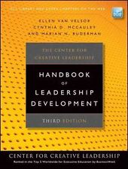
Leadership
Direction
Alignment
Commitment
Center for Creative Leadership, & VanVelsor, E. (2010). The Center for Creative Leadership handbook of leadership development.
San Francisco, Calif: Jossey-Bass.

Slide 47
What is Management?
Managerial Chart:
  (The 4 Functions)
Management
Planning
Leading
Organizing
Controlling

Slide 48
What is Management?
Managerial Chart:
  (The 4 Functions)
Management
Planning
Leading
Organizing
Controlling
-Creating a plan
-Defining goals
-Establishing strategy
-Problem Solving
-Top to bottom
-Management plans/
Workers work

Slide 49
What is Management?
Managerial Chart:
  (The 4 Functions)
Management
Planning
Leading
Organizing
Controlling
-Creating a plan
-Defining goals
-Establishing strategy
-Problem Solving
-Top to bottom
-Management plans/
Workers work
-Directing and coordinating work
-Motivating workers
to carry out the plan
-Harnessing followers
-Positional (office)
and by example

Slide 50
What is Management?
Managerial Chart:
  (The 4 Functions)
Management
Planning
Leading
Organizing
Controlling
-Creating a plan
-Defining goals
-Establishing strategy
-Problem Solving
-Top to bottom
-Management plans/
Workers work
-Directing and coordinating work
-Motivating workers
to carry out the plan
-Harnessing followers
-Positional (office)
and by example
-Determining what is
to be done and who
is to do it
-Organizational charts
-Mechanistic model
-Job descriptions
-Chain of Command

Slide 51
What is Management?
Managerial Chart:
  (The 4 Functions)
Management
Planning
Leading
Organizing
Controlling
-Creating a plan
-Defining goals
-Establishing strategy
-Problem Solving
-Top to bottom
-Management plans/
Workers work
-Directing and coordinating work
-Motivating workers
to carry out the plan
-Harnessing followers
-Positional (office)
and by example
-Determining what is
to be done and who
is to do it
-Organizational charts
-Mechanistic model
-Job descriptions
-Chain of Command
-Evaluating
-Monitoring activities
-Ensuring compliance
-Enforcing rules
-Supervising
-Rewarding & punishing

Slide 52
Further Questions:
Is there more to leadership than motivating, influencing, and directing?

Slide 53
Management
Planning
Leading
Organizing
Controlling
-Creating a plan
-Defining goals
-Establishing strategy
-Top to bottom
-Management plans/
Workers work
-Problem Solving
-Directing and coordinating work
-Motivating workers
to carry out the plan
-Harnessing followers
-Positional (office)
and example
Influence; Persuasion, not force; Motivation;
Vision; Sense making; Setting direction; Clear purpose; Planning;
Compelling future;
Relationship; Process;
Emotional; Connection;
Relational; Mentors;
Change; Coping with change; Modeling the way; Empowering others; Servant leadership; Alignment; Credibility; Duplication; Distributed leadership; Empowerment;
Developing character;
Emotional intelligence;
Self-knowledge; Authenticity
-Determining what is
to be done and who
is to do it
-Organizational charts
-Mechanistic model
-Job descriptions
-Chain of Command
-Evaluation
-Monitoring activities
-Ensure compliance
-Enforce rules
-Supervision
-Rewarding & Punishing

Slide 54
Further Questions:
How would a robust view of leadership change the way we lead?

Slide 55
Further Questions:
What if we applied leadership to all managerial processes?

Slide 56
Further Questions:
Influence; Persuasion, not force; Motivation;
Vision; Sense making; Setting direction; Clear purpose; Planning; Compelling future;
Relationship; Process;
Emotional; Connection;
Relational; Mentors; Change; Coping with change; Modeling the way; Empowering others; Servant leadership; Alignment; Credibility; Duplication; Distributed leadership; Empowerment;
Developing character;
Emotional intelligence;
Self-knowledge; Authenticity
Management
Planning
Leading
Organizing
Controlling
Leadership

Slide 57
Management
Planning
Leading
Organizing
Controlling
Leadership
-Creating a plan
-Defining goals
-Establishing strategy
-Problem solving
-Top to bottom
-Management plans/
Workers work

Slide 58
Management
Planning
Leading
Organizing
Controlling
Leadership
-Creating a plan
-Defining goals
-Establishing strategy
-Problem solving
-Top to bottom
-Management plans/
Workers work

Slide 59
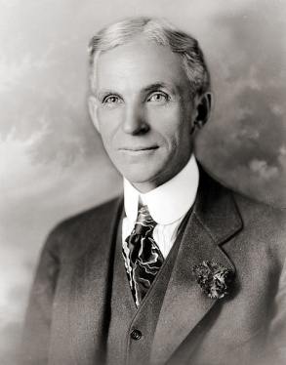
“Why is it that I always get the whole person, when what I really want is a pair of hands?”
–Henry Ford
Source: Pollard, C. W. (1996). The soul of the firm. New York: HarperBusiness.
Photo source: http://commons.wikimedia.org/wiki/File:Henry_ford_1919.jpg

Slide 60
Management
Planning
Leading
Organizing
Controlling
Leadership
-Creating a plan
-Defining goals
-Establishing strategy
-Problem solving
-Top to bottom
-Management plans/
Workers work

Slide 61
Management
Planning
Leading
Organizing
Controlling
Leadership
-Emphasizing vision
-Establishing purpose
-A compelling future
-Sense making
-Setting direction
-Empowering others
-Duplicating leaders
-Creating a plan
-Defining goals
-Establishing strategy
-Problem solving
-Top to bottom
-Management plans/
Workers work

Slide 62
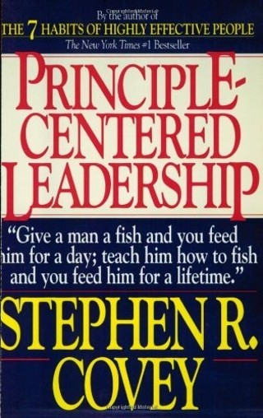

Slide 63
Management
Planning
Leading
Organizing
Controlling
Leadership
-Emphasizing vision
-Establishing purpose
-A compelling future
-Sense making
-Setting direction
-Empowering others
-Duplicating leaders
-Implications:
-Empowering process
-Involving others from
the start (front line)
-Consulting with team
-Using their ideas
-Creating a plan
-Defining goals
-Establishing strategy
-Problem solving
-Top to bottom
-Management plans/
Workers work

Slide 64

"Never tell people how to do things. Tell them what to do and they will surprise you with their ingenuity.”
–General George S. Patton
Source: http://www.generalpatton.com/quotes/index3.html

Slide 65
Management
Planning
Leading
Organizing
Controlling
Leadership
-Emphasizing vision
-Establishing purpose
-A compelling future
-Sense making
-Setting direction
-Empowering others
-Duplicating leaders
-Implications:
-Empowering process
-Involving others from
the start (front line)
-Consulting with team
-Using their ideas
-Listening & spending
time with your people.
-Teambuilding
-Planning as an opportunity
to develop future leaders
-Creating a plan
-Defining goals
-Establishing strategy
-Problem solving
-Top to bottom
-Management plans/
Workers work

Slide 66
Management
Planning
Leading
Organizing
Controlling
Leadership
-Emphasizing vision
-Establishing purpose
-A compelling future
-Sense making
-Setting direction
-Empowering others
-Duplicating leaders
-Directing and coordinating work
-Motivating workers
to carry out the plan
-Harnessing followers
-Positional (office)
and by example
-Implications:
-Empowering process
-Involving others from
the start (front line)
-Consulting with team
-Using their ideas
-Listening & spending
time with your people.
-Teambuilding
-Planning as an opportunity
to develop future leaders
-Creating a plan
-Defining goals
-Establishing strategy
-Problem solving
-Top to bottom
-Management plans/
Workers work

Slide 67
Management
Planning
Leading
Organizing
Controlling
Leadership
-Emphasizing vision
-Establishing purpose
-A compelling future
-Sense making
-Setting direction
-Empowering others
-Duplicating leaders
-Directing and coordinating work
-Motivating workers
to carry out the plan
-Harnessing followers
-Positional (office)
and by example
-Implications:
-Empowering process
-Involving others from
the start (front line)
-Consulting with team
-Using their ideas
-Listening & spending
time with your people.
-Teambuilding
-Planning as an opportunity
to develop future leaders
-Creating a plan
-Defining goals
-Establishing strategy
-Problem solving
-Top to bottom
-Management plans/
Workers work

Slide 68
Management
Planning
Leading
Organizing
Controlling
Leadership
-Emphasizing vision
-Establishing purpose
-A compelling future
-Sense making
-Setting direction
-Empowering others
-Duplicating leaders
-Directing and coordinating work
-Motivating workers
to carry out the plan
-Harnessing followers
-Positional (office)
and by example
-Implications:
-Empowering process
-Involving others from
the start (front line)
-Consulting with team
-Using their ideas
-Listening & spending
time with your people.
-Teambuilding
-Planning as an opportunity
to develop future leaders
-Creating a plan
-Defining goals
-Establishing strategy
-Problem solving
-Top to bottom
-Management plans/
Workers work

Slide 69
Management
Planning
Leading
Organizing
Controlling
Leadership
-Emphasizing vision
-Establishing purpose
-A compelling future
-Sense making
-Setting direction
-Empowering others
-Duplicating leaders
-Influencing
-Persuading (not coercing)
-Motivating
-Implications:
-Empowering process
-Involving others from
the start (front line)
-Consulting with team
-Using their ideas
-Listening & spending
time with your people.
-Teambuilding
-Planning as an opportunity
to develop future leaders
-Creating a plan
-Defining goals
-Establishing strategy
-Problem solving
-Top to bottom
-Management plans/
Workers work

Slide 70
Management
Planning
Leading
Organizing
Controlling
Leadership
-Emphasizing vision
-Establishing purpose
-A compelling future
-Sense making
-Setting direction
-Empowering others
-Duplicating leaders
-Influencing
-Persuading (not coercing)
-Motivating
-Personal relationship
-Emotional connection
-Mentoring & modeling
-Servant leadership
-Authenticity & credibility
-Implications:
-Empowering process
-Involving others from
the start (front line)
-Consulting with team
-Using their ideas
-Listening & spending
time with your people.
-Teambuilding
-Planning as an opportunity
to develop future leaders
-Creating a plan
-Defining goals
-Establishing strategy
-Problem solving
-Top to bottom
-Management plans/
Workers work

Slide 71
Management
Planning
Leading
Organizing
Controlling
Leadership
-Emphasizing vision
-Establishing purpose
-A compelling future
-Sense making
-Setting direction
-Empowering others
-Duplicating leaders
-Influencing
-Persuading (not coercing)
-Motivating
-Personal relationship
-Emotional connection
-Mentoring & modeling
-Servant leadership
-Authenticity & credibility
-Implications:
-Empowering process
-Involving others from
the start (front line)
-Consulting with team
-Using their ideas
-Listening & spending
time with your people.
-Teambuilding
-Planning as an opportunity
to develop future leaders
-Implications:
-Beyond motivation
-Knowing yourself and
your people
-Emphasizing trust
-Restraining yourself
-Team Building
-Growing leaders
-Creating a plan
-Defining goals
-Establishing strategy
-Problem solving
-Top to bottom
-Management plans/
Workers work

Slide 72
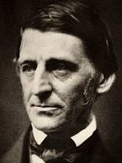
“An institution is the lengthened shadow of one man.”
-Ralph Waldo Emerson
Essay on Self Reliance, (p. 4). Retrieved from http://www.emersoncentral.com/selfreliance.htm

Slide 73
Management
Planning
Leading
Organizing
Controlling
Leadership
-Emphasizing vision
-Establishing purpose
-A compelling future
-Sense making
-Setting direction
-Empowering others
-Duplicating leaders
-Influencing
-Persuading (not coercing)
-Motivating
-Determining what is
to be done and who
is to do it
-Organizational charts
-Mechanistic model
-Job descriptions
-Chain of command
-Personal relationship
-Emotional connection
-Mentoring & modeling
-Servant leadership
-Authenticity & credibility
-Implications:
-Empowering process
-Involving others from
the start (front line)
-Consulting with team
-Using their ideas
-Listening & spending
time with your people.
-Teambuilding
-Planning as an opportunity
to develop future leaders
-Implications:
-Beyond motivation
-Knowing yourself and
your people
-Emphasizing trust
-Restraining yourself
-Team Building
-Growing leaders
-Creating a plan
-Defining goals
-Establishing strategy
-Problem solving
-Top to bottom
-Management plans/
Workers work

Slide 74
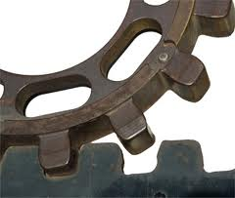

Slide 75
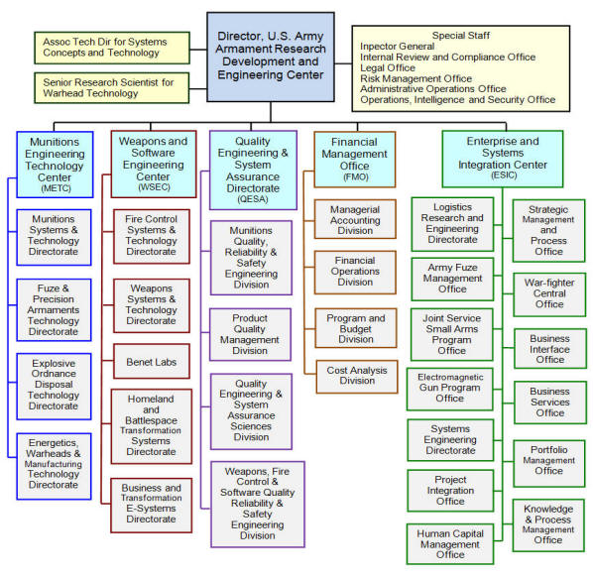

Slide 76
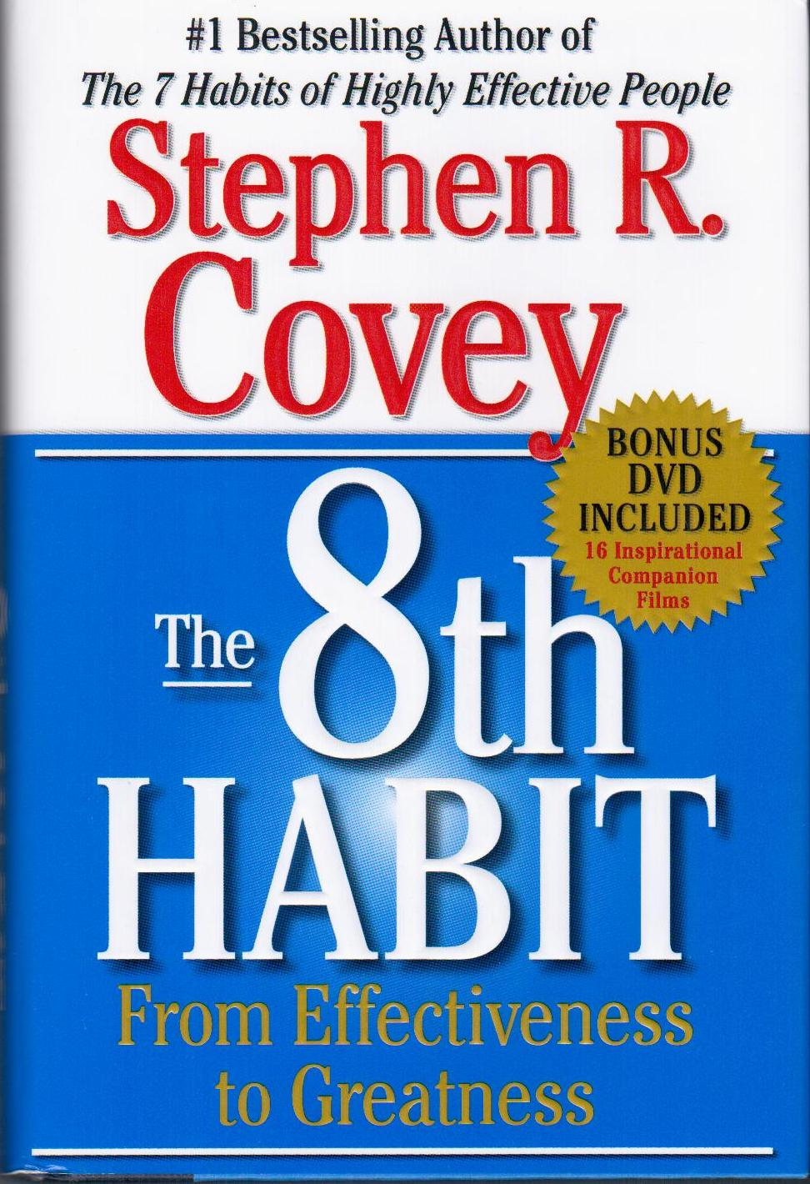

Slide 77
Management
Planning
Leading
Organizing
Controlling
Leadership
-Emphasizing vision
-Establishing purpose
-A compelling future
-Sense making
-Setting direction
-Empowering others
-Duplicating leaders
-Influencing
-Persuading (not coercing)
-Motivating
-Determining what is
to be done and who
is to do it
-Organizational charts
-Mechanistic model
-Job descriptions
-Chain of command
-Personal relationship
-Emotional connection
-Mentoring & modeling
-Servant leadership
-Authenticity & credibility
-Implications:
-Empowering process
-Involving others from
the start (front line)
-Consulting with team
-Using their ideas
-Listening & spending
time with your people.
-Teambuilding
-Planning as an opportunity
to develop future leaders
-Implications:
-Beyond motivation
-Knowing yourself and
your people
-Emphasizing trust
-Restraining yourself
-Team Building
-Growing leaders
-Creating a plan
-Defining goals
-Establishing strategy
-Problem solving
-Top to bottom
-Management plans/
Workers work

Slide 78
Management
Planning
Leading
Organizing
Controlling
Leadership
-Emphasizing vision
-Establishing purpose
-A compelling future
-Sense making
-Setting direction
-Empowering others
-Duplicating leaders
-Influencing
-Persuading (not coercing)
-Motivating
-Alignment instead of
relying on the
Organizational chart
-Distributed leadership
-Duplicating leaders
-Utilizing Emotional
Intelligence
-Expecting change
-Personal relationship
-Emotional connection
-Mentoring & modeling
-Servant leadership
-Authenticity & credibility
-Implications:
-Empowering process
-Involving others from
the start (front line)
-Consulting with team
-Using their ideas
-Listening & spending
time with your people.
-Teambuilding
-Planning as an opportunity
to develop future leaders
-Implications:
-Beyond motivation
-Knowing yourself and
your people
-Emphasizing trust
-Restraining yourself
-Team Building
-Growing leaders
-Creating a plan
-Defining goals
-Establishing strategy
-Problem solving
-Top to bottom
-Management plans/
Workers work

Slide 79
Management
Planning
Leading
Organizing
Controlling
Leadership
-Emphasizing vision
-Establishing purpose
-A compelling future
-Sense making
-Setting direction
-Empowering others
-Duplicating leaders
-Influencing
-Persuading (not coercing)
-Motivating
-Alignment instead of
relying on the
Organizational chart
-Distributed leadership
-Duplicating leaders
-Utilizing Emotional
Intelligence
-Expecting change
-Personal relationship
-Emotional connection
-Mentoring & modeling
-Servant leadership
-Authenticity & credibility
-Implications:
-Empowering process
-Involving others from
the start (front line)
-Consulting with team
-Using their ideas
-Listening & spending
time with your people.
-Teambuilding
-Planning as an opportunity
to develop future leaders
-Implications:
-Beyond motivation
-Knowing yourself and
your people
-Emphasizing trust
-Restraining yourself
-Team Building
-Growing leaders
-Creating a plan
-Defining goals
-Establishing strategy
-Problem solving
-Top to bottom
-Management plans/
Workers work

Slide 80
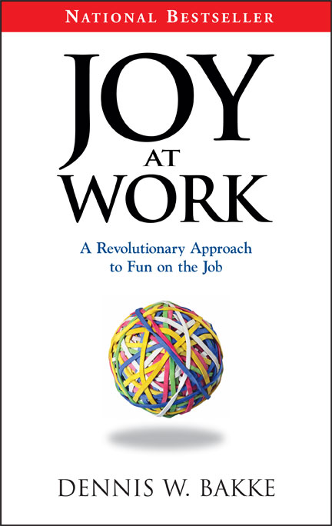

Slide 81
Management
Planning
Leading
Organizing
Controlling
Leadership
-Emphasizing vision
-Establishing purpose
-A compelling future
-Sense making
-Setting direction
-Empowering others
-Duplicating leaders
-Influencing
-Persuading (not coercing)
-Motivating
-Alignment instead of
relying on the
Organizational chart
-Distributed leadership
-Duplicating leaders
-Utilizing Emotional
Intelligence
-Expecting change
-Personal relationship
-Emotional connection
-Mentoring & modeling
-Servant leadership
-Authenticity & credibility
-Implications:
-Empowering process
-Involving others from
the start (front line)
-Consulting with team
-Using their ideas
-Listening & spending
time with your people.
-Teambuilding
-Planning as an opportunity
to develop future leaders
-Implications:
-Beyond motivation
-Knowing yourself and
your people
-Emphasizing trust
-Restraining yourself
-Team Building
-Growing leaders
-Implications:
-Beyond efficiency
-Removing obstacles
-Maximizing strengths
-Investing in people
-Treating each of your
people differently
-An organic process
-Organizing to grow leaders
-Creating a plan
-Defining goals
-Establishing strategy
-Problem solving
-Top to bottom
-Management plans/
Workers work

Slide 82


Slide 83

Source: http://commons.wikimedia.org/wiki/File:Wal-Mart_logo.svg

Slide 84
Management
Planning
Leading
Organizing
Controlling
Leadership
-Emphasizing vision
-Establishing purpose
-A compelling future
-Sense making
-Setting direction
-Empowering others
-Duplicating leaders
-Influencing
-Persuading (not coercing)
-Motivating
-Alignment instead of
relying on the
Organizational chart
-Distributed leadership
-Duplicating leaders
-Utilizing Emotional
Intelligence
-Expecting change
-Evaluating
-Monitoring activities
-Ensuring compliance
-Enforcing rules
-Supervising
-Rewarding & punishing
-Personal relationship
-Emotional connection
-Mentoring & modeling
-Servant leadership
-Authenticity & credibility
-Implications:
-Empowering process
-Involving others from
the start (front line)
-Consulting with team
-Using their ideas
-Listening & spending
time with your people.
-Teambuilding
-Planning as an opportunity
to develop future leaders
-Implications:
-Beyond motivation
-Knowing yourself and
your people
-Emphasizing trust
-Restraining yourself
-Team Building
-Growing leaders
-Implications:
-Beyond efficiency
-Removing obstacles
-Maximizing strengths
-Investing in people
-Treating each of your
people differently
-An organic process
-Organizing to grow leaders
-Creating a plan
-Defining goals
-Establishing strategy
-Problem solving
-Top to bottom
-Management plans/
Workers work

Slide 85
Management
Planning
Leading
Organizing
Controlling
Leadership
-Emphasizing vision
-Establishing purpose
-A compelling future
-Sense making
-Setting direction
-Empowering others
-Duplicating leaders
-Influencing
-Persuading (not coercing)
-Motivating
-Alignment instead of
relying on the
Organizational chart
-Distributed leadership
-Duplicating leaders
-Utilizing Emotional
Intelligence
-Expecting change
-Evaluating
-Monitoring activities
-Ensuring compliance
-Enforcing rules
-Supervising
-Rewarding & punishing
-Personal relationship
-Emotional connection
-Mentoring & modeling
-Servant leadership
-Authenticity & credibility
-Implications:
-Empowering process
-Involving others from
the start (front line)
-Consulting with team
-Using their ideas
-Listening & spending
time with your people.
-Teambuilding
-Planning as an opportunity
to develop future leaders
-Implications:
-Beyond motivation
-Knowing yourself and
your people
-Emphasizing trust
-Restraining yourself
-Team Building
-Growing leaders
-Implications:
-Beyond efficiency
-Removing obstacles
-Maximizing strengths
-Investing in people
-Treating each of your
people differently
-An organic process
-Organizing to grow leaders
-Creating a plan
-Defining goals
-Establishing strategy
-Problem solving
-Top to bottom
-Management plans/
Workers work

Slide 87


Slide 88
`
Management
Planning
Leading
Organizing
Controlling
Leadership
-Emphasizing vision
-Establishing purpose
-A compelling future
-Sense making
-Setting direction
-Empowering others
-Duplicating leaders
-Influencing
-Persuading (not coercing)
-Motivating
-Alignment instead of
relying on the
Organizational chart
-Distributed leadership
-Duplicating leaders
-Utilizing Emotional
Intelligence
-Expecting change
-Vision
-Relationship
-Motivation
-Credibility
-Mentoring & modeling
-Leading by example
-Personal relationship
-Emotional connection
-Mentoring & modeling
-Servant leadership
-Authenticity & credibility
-Implications:
-Empowering process
-Involving others from
the start (front line)
-Consulting with team
-Using their ideas
-Listening & spending
time with your people.
-Teambuilding
-Planning as an opportunity
to develop future leaders
-Implications:
-Beyond motivation
-Knowing yourself and
your people
-Emphasizing trust
-Restraining yourself
-Team Building
-Growing leaders
-Implications:
-Beyond efficiency
-Removing obstacles
-Maximizing strengths
-Investing in people
-Treating each of your
people differently
-An organic process
-Organizing to grow leaders
-Creating a plan
-Defining goals
-Establishing strategy
-Problem solving
-Top to bottom
-Management plans/
Workers work
-Evaluating
-Monitoring activities
-Ensuring compliance
-Enforcing rules
-Supervising
-Rewarding & punishing

Slide 89
Management
Planning
Leading
Organizing
Controlling
Leadership
-Emphasizing vision
-Establishing purpose
-A compelling future
-Sense making
-Setting direction
-Empowering others
-Duplicating leaders
-Influencing
-Persuading (not coercing)
-Motivating
-Alignment instead of
relying on the
Organizational chart
-Distributed leadership
-Duplicating leaders
-Utilizing Emotional
Intelligence
-Expecting change
-Vision
-Relationship
-Motivation
-Credibility
-Mentoring & modeling
-Leading by example
-Personal relationship
-Emotional connection
-Mentoring & modeling
-Servant leadership
-Authenticity & credibility
-Implications:
-Empowering process
-Involving others from
the start (front line)
-Consulting with team
-Using their ideas
-Listening & spending
time with your people.
-Teambuilding
-Planning as an opportunity
to develop future leaders
-Implications:
-Beyond motivation
-Knowing yourself and
your people
-Emphasizing trust
-Restraining yourself
-Team Building
-Growing leaders
-Implications:
-Beyond efficiency
-Removing obstacles
-Maximizing strengths
-Investing in people
-Treating each of your
people differently
-An organic process
-Organizing to grow leaders
-Implications:
-Trust
-Relationship
-Vision
-Ownership
-Preventative
control
-Being in command,
but not in control
-Creating a plan
-Defining goals
-Establishing strategy
-Problem solving
-Top to bottom
-Management plans/
Workers work
-Evaluating
-Monitoring activities
-Ensuring compliance
-Enforcing rules
-Supervising
-Rewarding & punishing

Slide 90
You Have a Choice:
Old Managerial Chart:
Management
Planning
Leading
Organizing
Controlling
-Creating a plan
-Defining goals
-Establishing strategy
-Problem Solving
-Top to bottom
-Management plans/
Workers work
-Directing and coordinating work
-Motivating workers
to carry out the plan
-Harnessing followers
-Positional (office)
and by example
-Determining what is
to be done and who
is to do it
-Organizational charts
-Mechanistic model
-Job descriptions
-Chain of Command
-Evaluating
-Monitoring activities
-Ensuring compliance
-Enforcing rules
-Supervising
-Rewarding & punishing
Top
managers
plan
Motivate
workers to
carry out their plan
Organize
for
efficiency
Control to be
sure their plan
was completed

Slide 91
Management
Planning
Leading
Organizing
Controlling
Leadership
-Emphasize vision
-Involves others from the start (front line)
-Beyond Motivation
-Emphasize trust
-Lead your people/
Manage your stuff
-Move beyond
efficiency
-Organize to
maximize people’s
strengths
-Trust
-Relationship
-Vision
-Ownership
Vision and
involvement
in planning
(ownership )
Motivated
workers
who
trust you to help
them carry out
their plan
In a healthy
organization
aligned for
effectiveness
Where members
are
controlled by their
commitment
to their organization

Slide 92
Management Vs. Leadership
Defining Goals
Limited Input from Team
Top Managers Create Strategy
Limited Input from Team
Establishing Strategy
Limited Input from Team
Checking up on workers
Planning
Manager Determines Goals
Checking up on workers
Managers as Brains
Manager Plans/
Workers Work
Back Room
Creating a plan
May Be Cause of Unethical Behavior
Managers Plan – Workers Carry it out
Limited Input from others
Problem solving
Hierarchy
Management Solves Worker’s Problems
Checking up on workers
Assumes people are like Animals
Positional
Harnessing Followers
Leading
Carrot and Stick
Positional Power is Primary
Example
Need to be directed
Example Rarely used
  Directing and Coordinating Work
No Self-management
  Motivating Workers to Carry Out the Plan
Management coaxes workers
Bad Management Crowds Out Good Leadership
Determining What is to Be Done and Who is to Do It
Organizing
Pleasing Manager, not customer
Organizational Charts
Org. Chart as Master, not Servant
Not Organic
Carrot and Stick
Mechanistic
Top Down
Self-management prevented
Tyranny of the Job Description
Evaluating
Supervising
Job Descriptions
Please the Boss
Not Organic
Controlling
Leads to sycophancy
Chain of Command is Great for Control
Chain of Command is Terrible for Speed
Chain of Command
Why the need to monitor?
Chain of Command is Worse for Flexibility
Monitoring Activities
Have to Ensure Compliance
No Leadership Substitutes
A Trust Tax
A Management Tax
Enforcing Rules
Ensuring Compliance
Behavioral or Bureaucratic
Time and Resources Spent on Compliance
Rewarding and Punishing
Punishment is force
Rewards are Force with a Smile

Slide 93
Management Vs. Leadership
Limited Input from Team
Purpose
Vision
Defining Goals
Empowerment
Setting Direction
Planning
Top Managers Create Strategy
Limited Input from Team
Involving others from the start
Establishing Strategy
Limited Input from Team
Checking up on workers
Team Building
Their ideas, not just your ideas
Planning
Manager Determines Goals
Checking up on workers
(Direction)
Sense-Making
Managers as Brains
Manager Plans/
Workers Work
Compelling Future
Consulting With the Team
Know Yourself and Know Your People
Creating a plan
Listening
Directing
Authenticity
Back Room
May Be Cause of Unethical Behavior
Duplicating leadership
Personal Relationship
Managers Plan – Workers Carry it out
Limited Input from others
Use Planning as an Opportunity to Develop Others
Leading
Problem solving
Hierarchy
Empowering Others
Management Solves Worker’s Problems
Checking up on workers
Growing Leaders
Moves Beyond Motivation
Assumes people are like Animals
Expecting Change
Servant Leadership
Positional
Harnessing Followers
Emphasizes Trust
Leading
Carrot and Stick
Organizing
Removing Obstacles
Influencing
Credibility
Positional Power is Primary
Example
(Alignment)
Organic Process
Emotional Connection
Need to be directed
Example Rarely used
  Directing and Coordinating Work
Team Building
No Self-management
Alignment vs. Org. Chart
Mentoring and Modeling
  Motivating Workers to Carry Out the Plan
Restraining yourself
Management coaxes workers
Bad Management Crowds Out Good Leadership
Move Beyond Efficiency
Maximizing Strengths
Influencing
Determining What is to Be Done and Who is to Do It
Distributed Leadership
Organizing
Treating Each of Your People Differently
Pleasing Manager, not customer
Utilizing Emotional Intelligence
Organizational Charts
Investing in People
Duplicating Leadership
Organizing to Grow People
Org. Chart as Master, not Servant
Not Organic
Carrot and Stick
Mechanistic
Top Down
Self-management prevented
Tyranny of the Job Description
Evaluating
Supervising
Preventative Controls
Job Descriptions
Please the Boss
Not Organic
Controlling
Being in Command, But Not in Control
Leads to sycophancy
Commitment vs. Control
Chain of Command is Great for Control
Controlling
Trust
Chain of Command is Terrible for Speed
Relationship
Chain of Command
Why the need to monitor?
Chain of Command is Worse for Flexibility
Monitoring Activities
Vision
(Commitment)
Motivation
Have to Ensure Compliance
No Leadership Substitutes
A Trust Tax
A Management Tax
Enforcing Rules
Relationship
Ownership
Ensuring Compliance
Behavioral or Bureaucratic
Time and Resources Spent on Compliance
Mentoring and Modeling
Leading by Example
Rewarding and Punishing
Punishment is force
Rewards are Force with a Smile

Slide 94
Questions?

Slide 95
If You Want Leaders,
Stop Teaching Students to be Managers
Darin Gerdes, Ph.D.
dgerdes@csuniv.edu
(843)863-7814
Charleston Southern University

