Slide 1
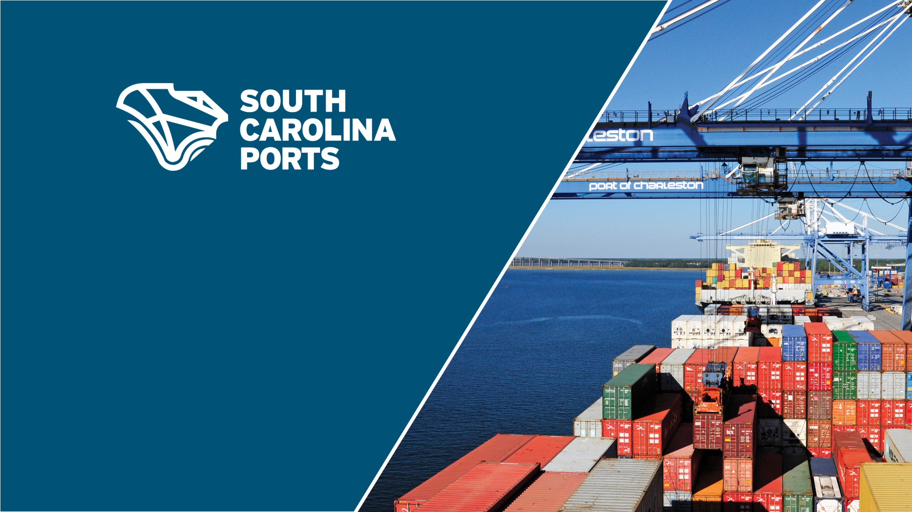
Keeping Freight Moving
Stan Van Ostran
JD, CPA, CIA, CFSA, CFE, CGMA, CRMA, IAP, AAE
Senior Vice President and CFO
Notes:
I have been with the Ports Authority since May 2016
Previously was the CFO for the Metro Nashville Airport Authority for past nine (9) years.
At Nashville, I oversaw more than $800 million in capital including terminal renovations and restructuring of our concession program, a new consolidated rental car facility, and major reconstruction of our airfield.
Nashville currently has a $1.2 Billion expansion program called the BNA Vision that is currently getting underway.

Slide 2
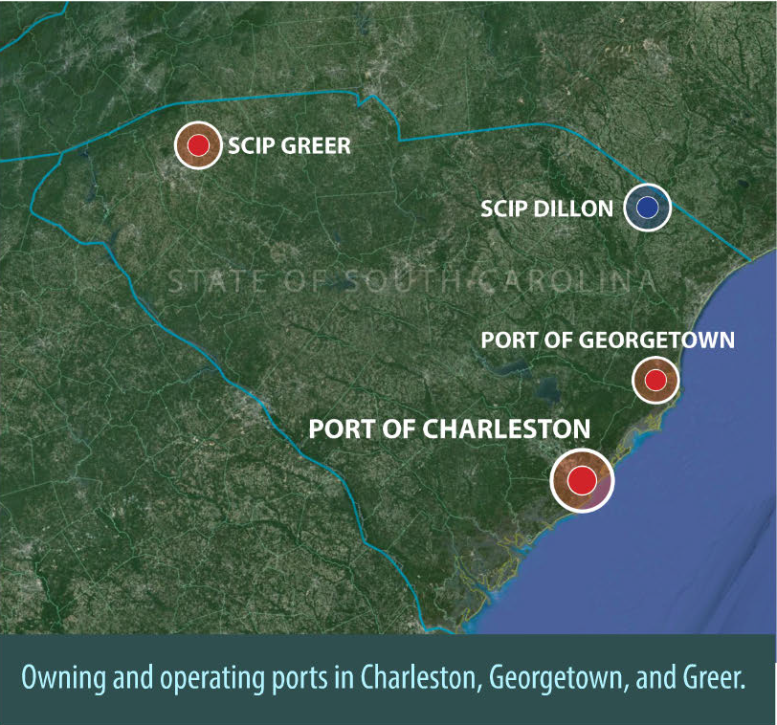
SC Ports Overview
9th Largest U.S. Container Port
Self-Sustaining & Operating Port
Fastest Growing Port Since 2011 (% Increase)
$53 Billion Annual Economic Impact
1 in 11 jobs in South Carolina attributed to SCPA
Focus on Manufacturing Logistics Economic
Development Catalyst for the State
Most Productive and Low Cost Port in United States
Deepest Permitted Harbor in Southeast
Dual Class 1 Rail Service (Norfolk Southern and CSX)
Focus on Rail growth: Inland Ports – Greer & Dillon
Skilled & Specialized Workforce
Significant Capital Investment to Remain a Top 10 Port
Notes:
9th Largest U.S. Container Port
We have close to the no. 7 & 8 (Houston & Oakland) ports by volume
Since 2011, the Fastest Growing Port by Percentage Growth
Manufacturing oriented vs. Retail Distribution
Auto –
BMW
Volvo
Michelin/Continental/Bridgestone/Tire Kingdom
Widely Acknowledged as Most Productive and Low Cost Port
Avg 35 – 40 Crane moves/Hr - compared to other ports at 20-25 moves
Deepest Harbor in South East and with Harbor Deepening will be deepest on the East Coast
Focus on rail enhancement:
Inland Ports – Greer & Dillon
Others Inland Ports are possible in future
Greer facility took over 120,000 Truck Trips off the road
Specialized Work Force
Takes years to develop a crane operator
Working with Trident Tech for training
Provided them crane simulators
$2 Billion Capital Program to ensure we remain a Top 10 Port

Slide 3
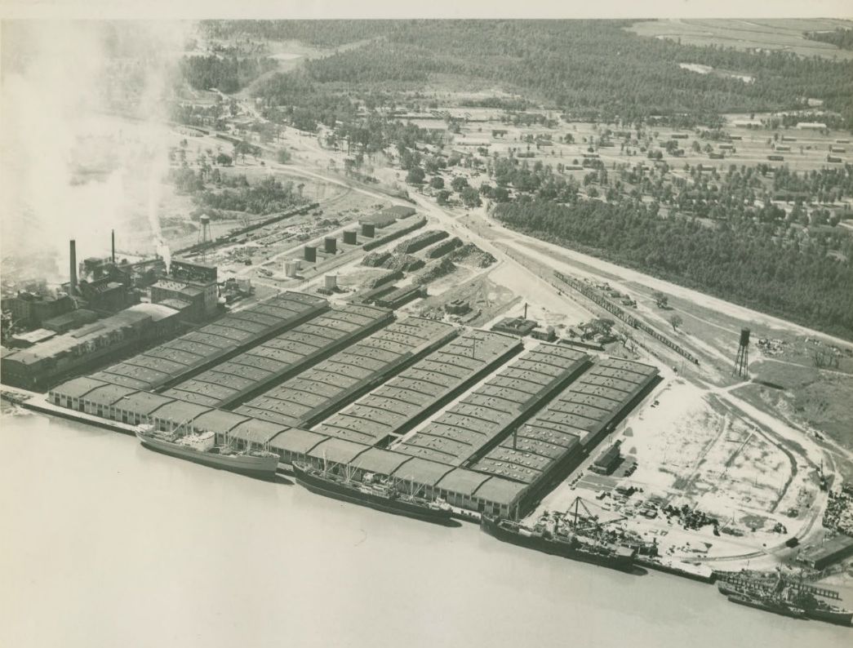
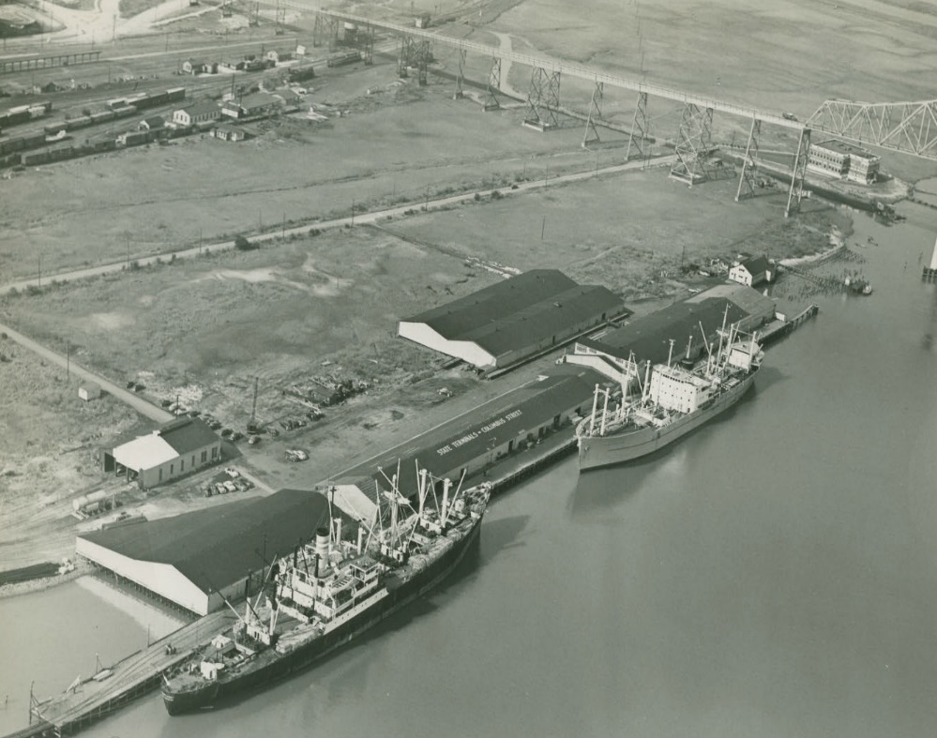
Where we were….
Columbus Street Terminal, 1944
North Charleston Terminal, 1945
Notes:
Some history…
The Port Authority started in 1942 during WWII
Operated mostly from Downtown Charleston
At Union Pier and Columbus Street Terminals
After WWII, the Port Authority acquired the former Army terminal
now known as our North Charleston terminal
Until the 1990’s most shipping activity in Charleston occurred at these two terminals

Slide 4
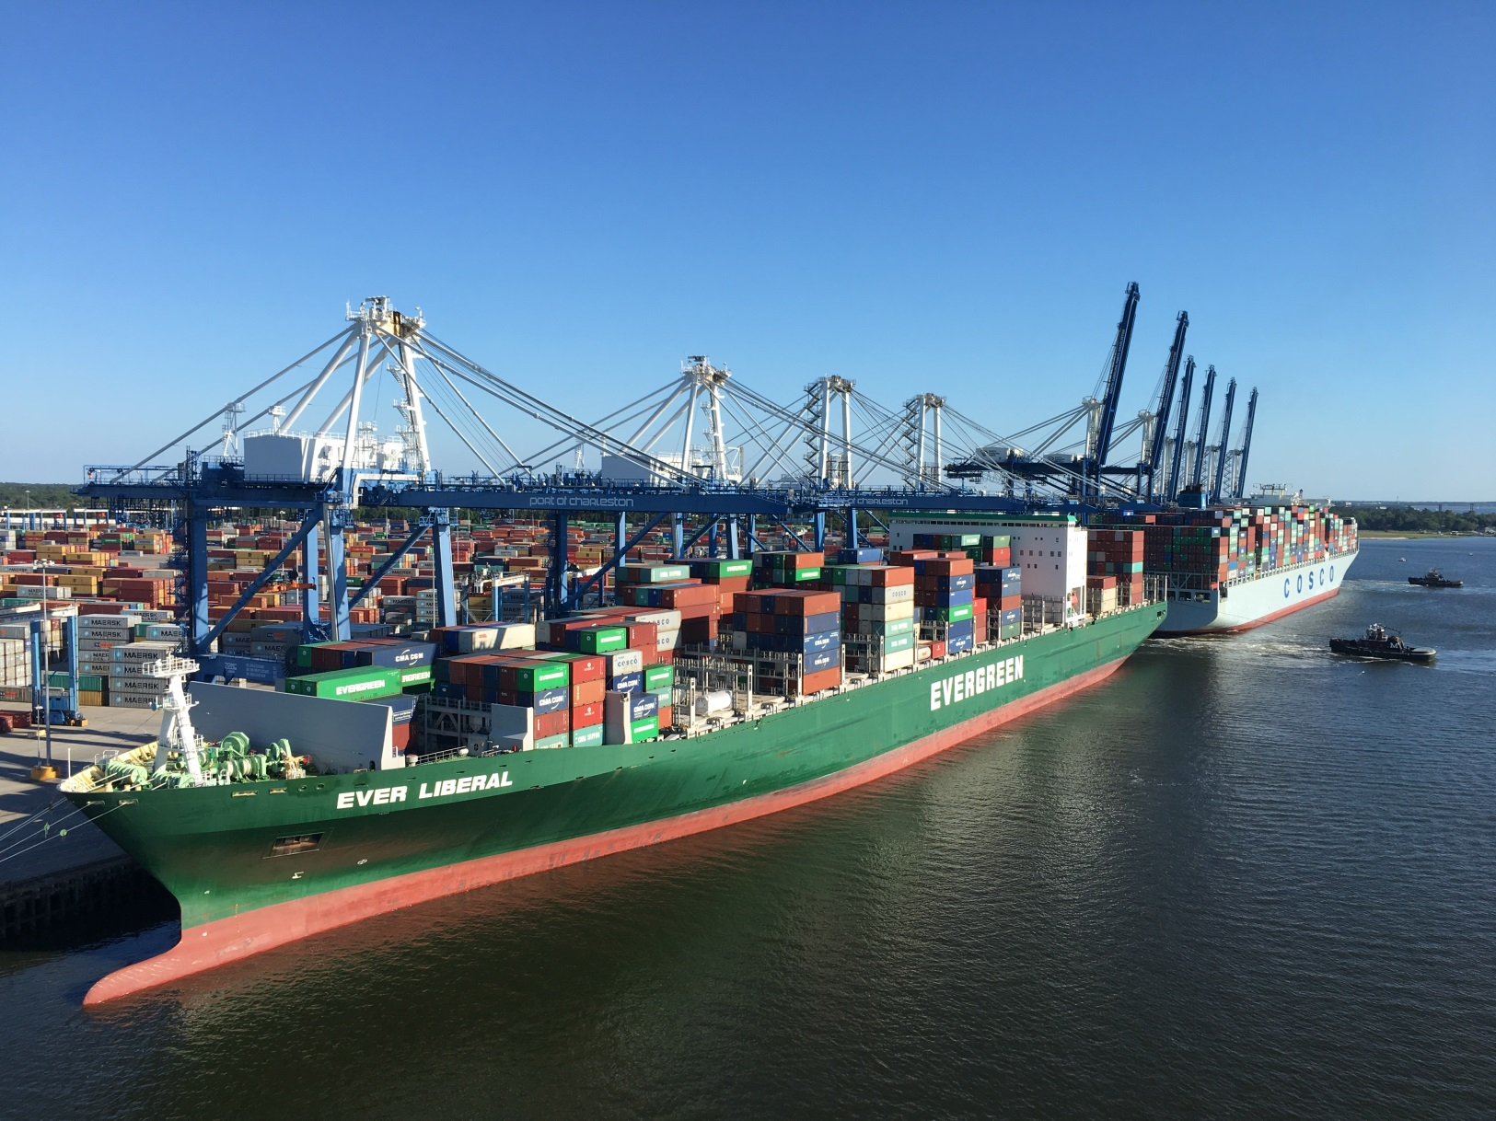
We’ve come a long way….
BIG SHIPS ARE HERE NOW.
Notes:
The Wando Welch terminal, built in the 1990s, is currently our largest container terminal
It now has weekly scheduled service of 13 - 14,000 TEU ships
These ships are the largest currently sailing the east coast.
If you are new to the industry – like me- TEU stands for 20 ft equivalent unit and is a standard metric for the industry.
Most containers you see on roadways are 40 foot units or 2 TEUs.
We recently simulated arrival of an 18,000 TEU ship with no issues

Slide 5
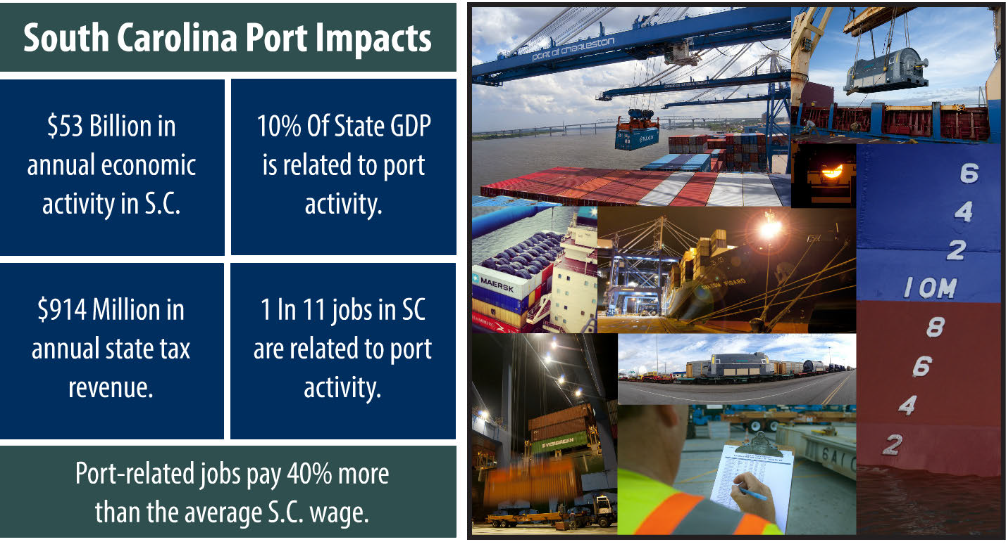
Our Impact
Notes:
We had an Economic Impact Study performed and completed in 2015
This slides shows some of the highlights from that study
In addition to a $53 Billion impact statewide, we have a $6.3 Billion Impact in the Charleston region
We are responsible for more than 200,000 jobs, or 1 in 11 jobs throughout the state
Port activities statewide accounts for 10% of South Carolina’s Gross Domestic Product

Slide 6
Largest Economic Engine for Our State
Notes:
These are some of the companies that have located in South Carolina in recent years.
Note the clustering around the Port and Charleston and the Inland Port –Greer.
Supply Chain is a critical factor for most, if not all, of these companies.

Slide 7
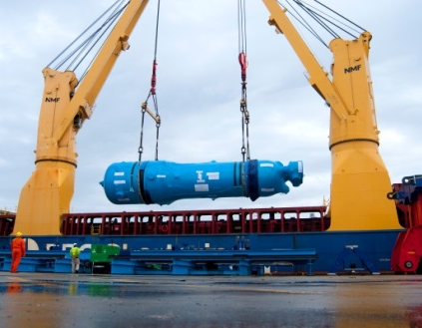
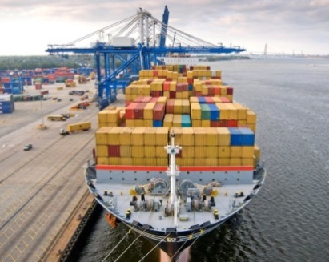

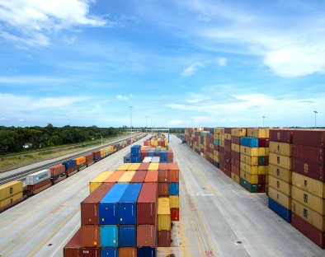
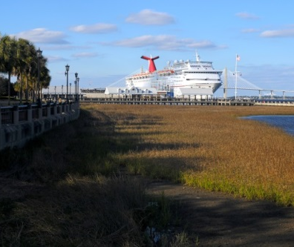
Business Segments
FY2017 – Percent of Revenue
Containers
Breakbulk/
Rolling Stock
SC Inland Port
Cruise
79%
10%
5%
5%
Notes:
Container operations are about 80% of our business.
I am frequently surprised what can be shipped in containers.
grain, plastic pellets, timber products, and other raw materials.
refrigerated goods, chemicals …. even vehicles
Breakbulk is our remaining freight business. It also includes Roll On-Roll Off or RORO operations.
RORO ships mostly handle automobiles,
but can include other rolling stock, such as construction equipment
BMW ships over 400,000 cars annually
We bring in almost 800 cars by rail every day.
The remainder are shipped in containers
We expect to see similar traffic when Volvo begins operations.
Breakbulk also includes any other freight shipments not placed in containers
Mostly Bulk materials, such as fuels, coal, scrap metal and oversize cargo
Inland Ports
Our first Inland Port at Greer (near Greenville)has been very successful, growing its operations every year.
Initial anchor customer was BMW
This past year we moved 121,000 containers by rail, taking a like number of trucks off of Interstate 26
We will open our second inland port in Dillon this next spring in the Northern part of the State.
Anchor customer is Harbor Freight Tools
Cruises are a small segment, but is our most profitable operation.

Slide 8
Keeping Freight Moving =
Big Investment in the Future
SCPA “Inside of the Fence”
Harbor Deepening
HLT Access Road
Rail Infrastructure
Notes:
Inside vs. Outside the Fence Projects
Harbor Deepening –
over $500m Million with the State contributing more than $300 Million.
HLT Access Road - $320 Million with the Port contributing $112 Million
Rail Infrastructure - $250 Million for ICTF (Inter Container Transfer Facility)
SCIP Dillon - $50 Million - $40 Million for SCPA and $10 Million from CSX

Slide 9
“Inside of the Fence”
Capital Priorities
Hugh Leatherman Terminal Phase 1
  2020 Projected Opening
Wando Welch Terminal Improvements
  Wharf Improvements
  Traffic Flow Improvements
  Equipment Modifications & Purchase
  Densification
Inland Port – Dillon (2Q CY18)
Corporate Office Building (4Q CY18)
All Other Improvements
  New Terminal Operating System
  Paving
  Capital Repairs
  Equipment
All Other
$168 Million
Wando Welch Improvements
$212 Million
Corporate Office
$40 Million
HLT Phase 1
$840 Million
Inland Port Dillon
$40 Million
Notes:
This slide shows our Capital Program over the next four (4) years.
We have projects totaling $1.3 billion currently underway or to be started in near term.
These are our various segments of our capital spend
Outside the fence, we have over $500 Million to be spent for Harbor Deepening, with the State and Port Authority paying over $300 million for this project.

Slide 10
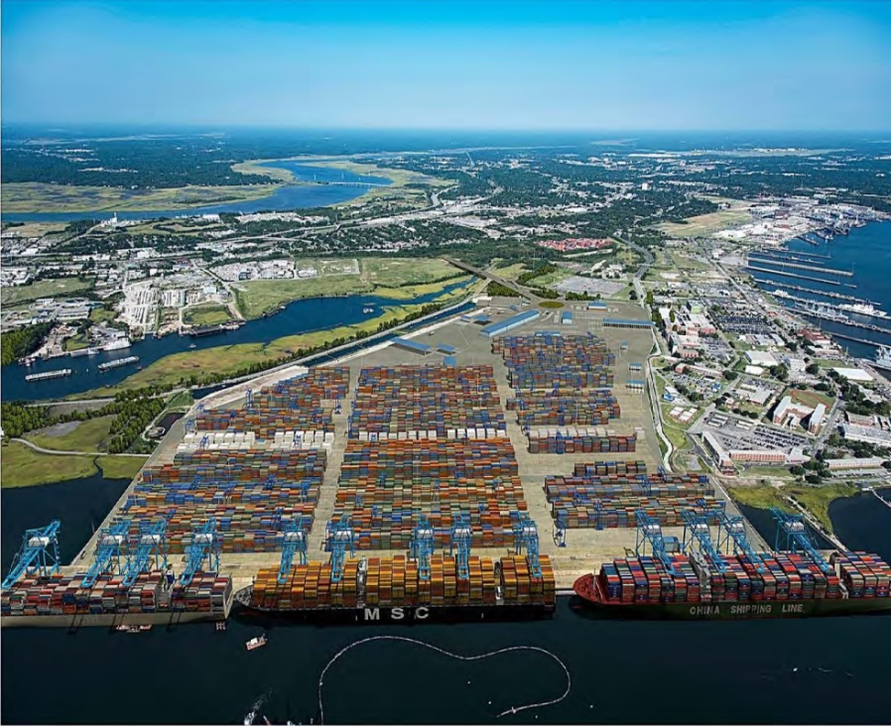
Hugh K. Leatherman, Sr. Terminal
New, fully-permitted container terminal constructed on previous Navy Base in North Charleston. Will have dual-served rail access to Palmetto Railway’s future ICTF.
Site Development: 66-Acre Reclamation
Rendering at Full Build-Out
Notes:
To date, we have completed or under construction the
Containment wall
In process of reclaiming 66 acres of tidal waters
4 million cubic yards of sand fill & crushed surcharge
6,000 miles of wick drains have been installed to aid in soil consolidation and compaction

Slide 11
Hugh K. Leatherman, Sr. Terminal
Total Project Cost = $1.4 Billion
  Phase 1 + Access Road Shortfall = $840 Million
Three-Phased Project with Phase 1 projected to open during 2020.
  Phase 1 over 50% of total project cost are site development costs.
Over $300 Million in design & site development spent to date.
  Site development nearly complete.
  66-acres of tidal areas reclaimed.
Superstructure & equipment will be next steps.
  Ship-to-shore cranes recently ordered.
Three Phases of HLT
Notes:
Plan of Finance
Construction to Date (Site Development):
$300 Million was mostly financed by Bonds and some Pay Go
Future Construction – Currently developing our plan of Finance
Includes Super Structure, Equipment and Access Road Shortfall
Looking at TIFIA , Revenue Bonds, Pay Go and Sale of Assets

Slide 12
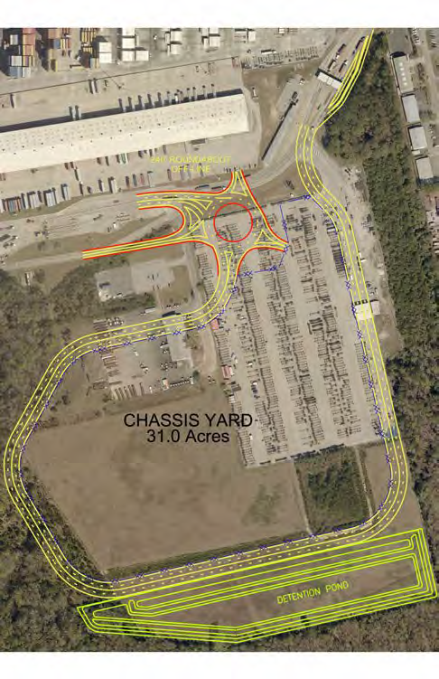
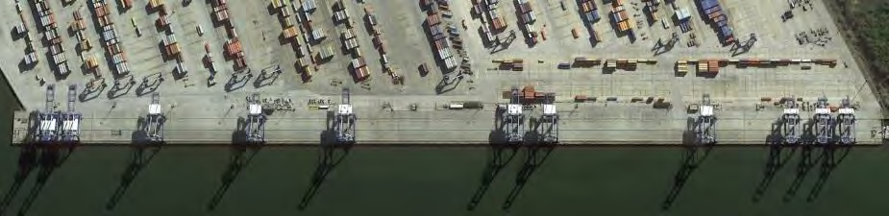
Wando Welch Upgrades
Getting Big Ship Ready
  Wharf Enhancements & Modernization – $49.5 Million
    Berths 1 & 2 built in early 1980s; Berth 3 in 1990s.
    Repairs and enhancements required for larger cranes & larger ships.
  Crane Modifications & Purchase – $56 Million
    Raising 4 cranes from 115’ to 155’
    Purchasing 3 additional cranes @ 155’
  Traffic Flow Improvements
    Three-Phased Project : Additional outbound truck lane, expanded outbound security gate, new POV in/out gates, additional inbound truck lanes, roundabout, & chassis yard
Notes:
The Wando Welch Terminal is our main container terminal
Most of our capital projects at this terminal are about handling larger ships t
When this terminal was completed in the 1990s – the largest vessel in the world was the Regina Maersk with a capacity of 6,600 TEUs
Today, we are routinely handling 13 - 14,000 TEU vessels
We have simulated and expect to handle ships as large as an 18,000 TEU in the next year
22,000 TEU ship orders are being ordered and built – mostly for Asia to Europe service

Slide 13
Dillon Inland Port
Notes:
We have a strategic initiative to improve rail service structure and remove trucks from our roads.
SCIP-Greer was a $50 million investment
It took more than 121,000 trucks off of I-26 this past year (FY2017).
That is 331 trucks a day on the 3 hour drive between Charleston and Greenville in FY2017.
SCIP Dillon will be another $50 million investment.
Since 2012, container rail cargo to and from Charleston has tripled and now represents 23% of our total container volume.

Slide 14

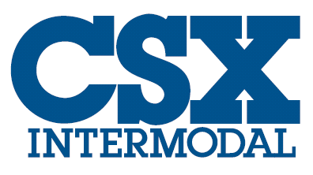
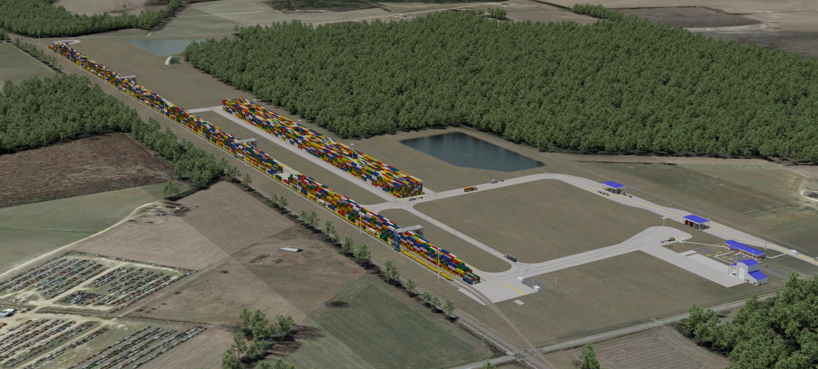
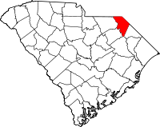
Dillon Inland Port
Greenfield project to build a $40 million inland rail terminal in Dillon, South Carolina served by CSX.
  Estimated Cost: $50+ Million (SCPA - $40 Million, CSX $10 Million)
  Estimated Completion: Spring 2018
Notes:
We expect to see similar results at our new Inland Port in Dillon, SC.
Harbor Freight is one of our anchor customers in Dillon.

Slide 15
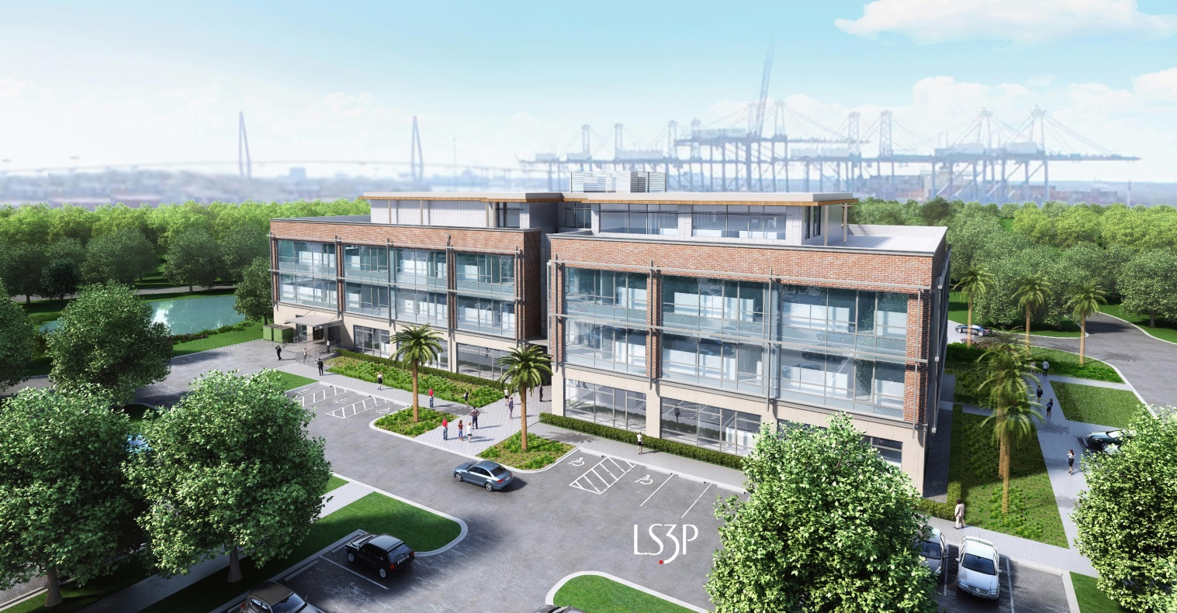
Corporate Office
Relocation of Corporate Headquarters from downtown Charleston to the SCPA’s Wando Welch Terminal.
  Design/Build contract
  Design: LS3P
  Construction: Choate
  Estimated Final Cost: $40 Million
  Funding: SCPA
  Estimated Completion: December 2018
Notes:
Old offices will be new site for a downtown hotel development
New office is 82,000 sq. ft.
Just under 200 employees will be brought under one roof.
Currently exist in 5 disparate locations throughout the Charleston area.
Scheduling meetings is often a challenge and we experience a loss of productivity due to travel times
This will be a modern campus with open & collaborative work areas, an exercise facility, walking trails, and a cafeteria.

Slide 16
Harbor Deepening
Notes:
So we will be the deepest port on the East Coast.
To be fair… Norfolk has plans to dredge to 55’ and may ultimately become the deepest port on the East Coast.
But at least for now, our dredging plan is permitted and contracts executed to begin dredging in early 2018.
The real point of this slide is that ports with drafts of 47’ or less will have ever increasing issues handling these newest, large ships.
And ocean depth and tidal restrictions are not the only issues….
Some ports already have air draft issues with bridges, with ships arriving not fully loaded, with the top deck possibly stripped off, and exacting requirements for tide conditions.
Whether it is dredging, larger cranes or increasing container capacity…large ships are mandating extensive capital investments at many ports.

Slide 17
Harbor Deepening
Construction phase is underway…
Notes:
Fastest federal deepening project from inception in 2011 to project construction.
Named one of President Obama’s “We Can’t Wait” initiatives.
$533 Million project
$300 Million set aside by SC General Assembly in 2012.
Federal appropriations of $17.5 million to date
We are working on securing additional federal funding.
First two contracts, totaling $273 million, were signed earlier this fall.

Slide 18
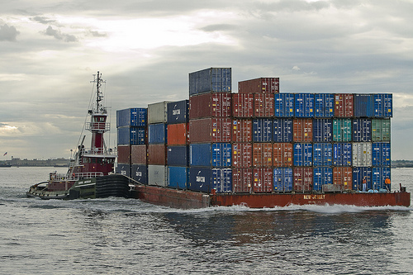
Into the Future
Potential barge to run between container terminals.
Will assist in getting local drays (trucks) off of the road between container & rail yards.
  Applied for a Marine Highway Designation
  Feasibility study will soon begin.
  Funding has not been determined.
Notes:
Barge Operations – Maritime Highway Designation
We currently truck all containers from the Wando Terminal
Including all shipments to or from Norfolk Southern or CSX rail yards.
This has the potential to remove over 150,000+ trucks annually that contribute to the congested Charleston traffic
Mostly on I-526
Alternatives
Night Dray Program

Slide 19
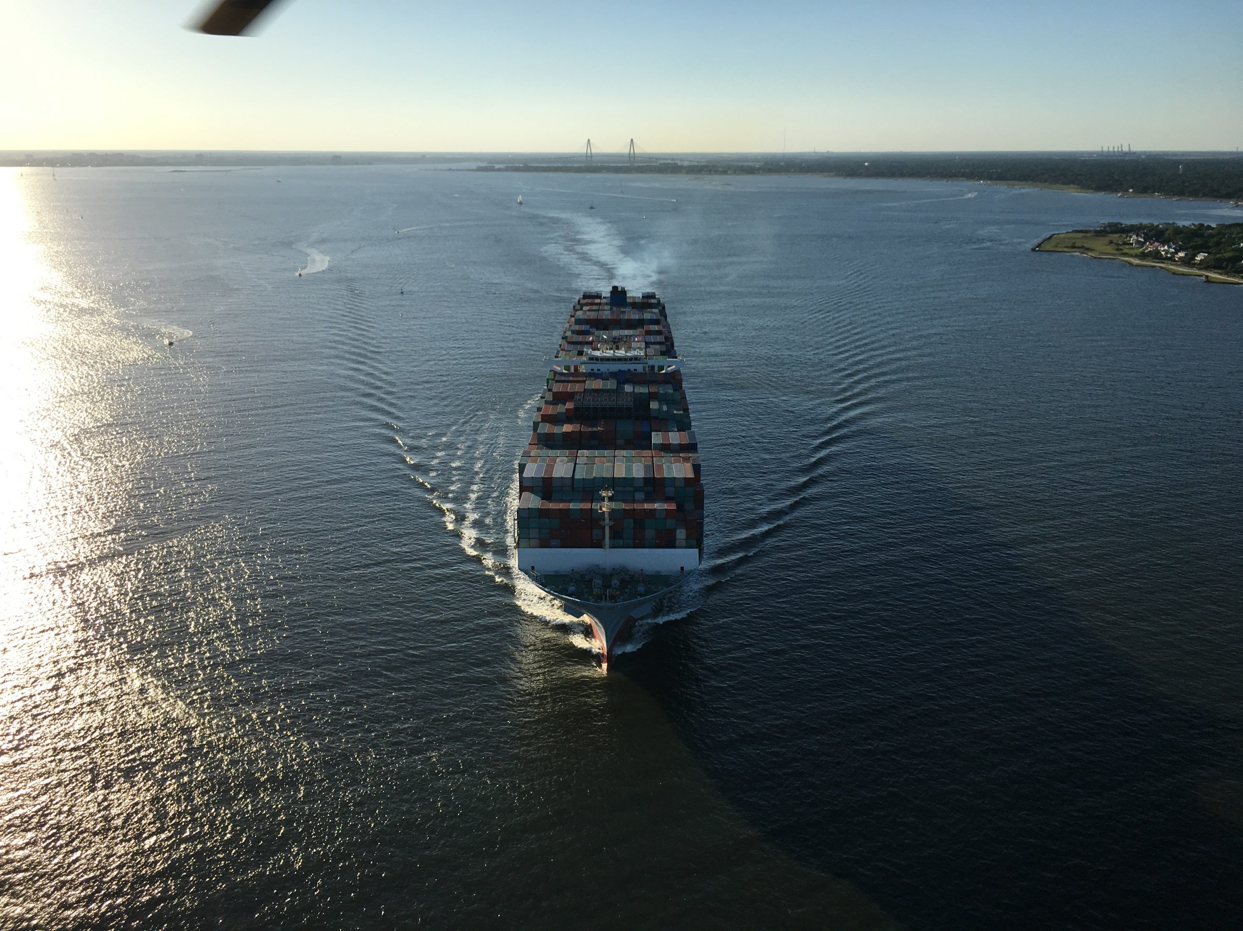
Keeping Freight Moving = Big Investment in the future
Keeping Freight Moving.

