Slide 1
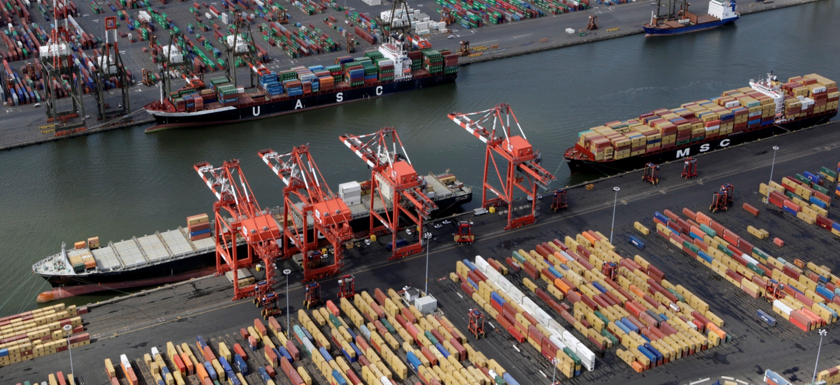

Revenue Division – CBP’s Frontline for Revenue Protection While Navigating the New Normal

Slide 2
Quiz*
(*Note: A minimum score of 20 points in required to obtain your CPE credit)
When was the United States established? (20 points)
When was the US Customs Service established? (20 points)
Why was the US Customs Service established? Hint: there are three major missions. (10 points each)
When and why did the US Customs Service become US Customs and Border Protection? (10 points each)
What is your name? (20 points)
Notes:
July 4, 1776
July 31, 1789
Collecting tariff revenue
Protecting the US economy from smuggling and illegal goods
Processing people and goods at the ports of entry
March 2003 Homeland Security Reorganization --- establish a single unified border agency for the US.
TBD

Slide 3
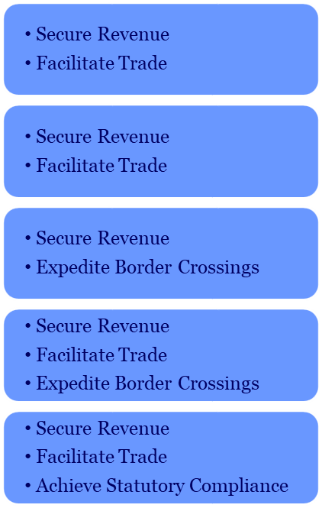
Revenue Mission Areas
The Revenue Division supports CBP’s overarching mission by securing revenue that funds Federal programs, facilitating timely trade and travel across U.S. borders, providing operational support to CBP’s ports, and leading special programs stemming from Government initiatives. The Revenue Division responds to and facilitates the resolution of over 200,000 inquiries each year
Mission Area Annual Volume Impact
Collections and
Reporting
$85.7 Billion in Duties, Taxes, & Fees
55 Million Transactions
Special
Programs
855 CDSOA Disbursements
Trade
Community
Traveling
Public
CBP Ports
of Entry
Reconciliation/Reporting to Treasury
400,000 Active Importers
12,000 Brokers
120 Sureties
10 Trusted Traveler Programs
330 Ports of Entry
International Carriers and Shippers
40 Border Crossing Fees
12,000,000 Credit Card Transactions
225 Deposit Sites
10,000 Deposit Differences
11,000 GSP Replacement Refunds
600 FOIA Requests

Slide 4





Revenue Stakeholders
The Revenue Division interfaces with various stakeholders/groups including those within CBP, other Departments and Agencies, regulatory bodies, and the trade community.
Internal Stakeholders
Regulatory Bodies
Office of Field Operations
Office of International Trade
Office of Info. & Technology
Assistant Chief Counsel
Congress
Department of Treasury
DHS
OMB
External Stakeholders
Revenue
Division
Government Agencies
Importers
Brokers
Sureties
Carriers and Vessels
Traveling Public
Shipping Companies
Foreign Individuals
Commercial Banks
Ultimate Consignees
Asset Locators
Affected Domestic Producers
Department of Treasury
Internal Revenue Service
US Dept. of Agriculture
Corps of Engineers
Department of Defense
Immigration and Customs Enforcement
US Coast Guard
Department of Commerce
Bureau of Public Debt
US Post Office
Payers of Revenue

Slide 5
Current Key Initiatives
Automated Commercial Environment (ACE)
CBP has completed ACE Collections Release 1, Release 2, Release 3, Release 4 and Release 5. Two more Releases to go!!!
Initiatives
Support completion of ACE Collections
Identify opportunities to modernize and reduce manual work
Benefit
Enable revenue processing in an updated/modern system; reduce manual work
Opportunities Currently Out of Scope
Electronic collection of remaining entry-types at the Ports of Entry
Electronic payment option for bills
ACH Credit through Pay.gov for user fees collected in Indianapolis

Slide 6
Current Key Initiatives
Check Writing Reduction Effort
Shift revenue refunds to electronic disbursement methods. 80 percent of 744,000 refunds in FY 2020 were issued via hard-copy check
Initiatives
Gain agreement with Treasury to leverage current Pay.gov collection functionality for electronic refunds
Coordinate internally with Office of Trade, OFO, and Office of Assistant Chief Counsel to update CBP regulations and implement technology and business process changes.
Benefit
Comply with Federal statute with a modernized process that is efficient for the Trade and CBP

Slide 7
So What!!!
WHY IS HE TELLING ME ALL OF THIS STUFF?

Slide 8

So why is he telling me all of this stuff?

Slide 9
So What is the New Normal?
How did it start?
What changed?
What changed again?
Where do we go from here, like as of today?
Notes:
Connect the dots time
Talk about pre-pandemic
Talk about pandemic
Talk about reintegration
Talk about all of the pending issues

