Slide 1


The Future of Federal Financial Management
Spring 2022

Slide 2
The Future of Federal Financial Management
Financial Management Service Delivery Transformation Accelerates The Realization of Goals
1
1
1
Key Drivers for Transformation:
People
Technology
Service Delivery
Process
IT Modernization
Federal Financial
Management
Transformation
Data Accountability and Transparency
People – Workforce of the 21st Century
2

Slide 3
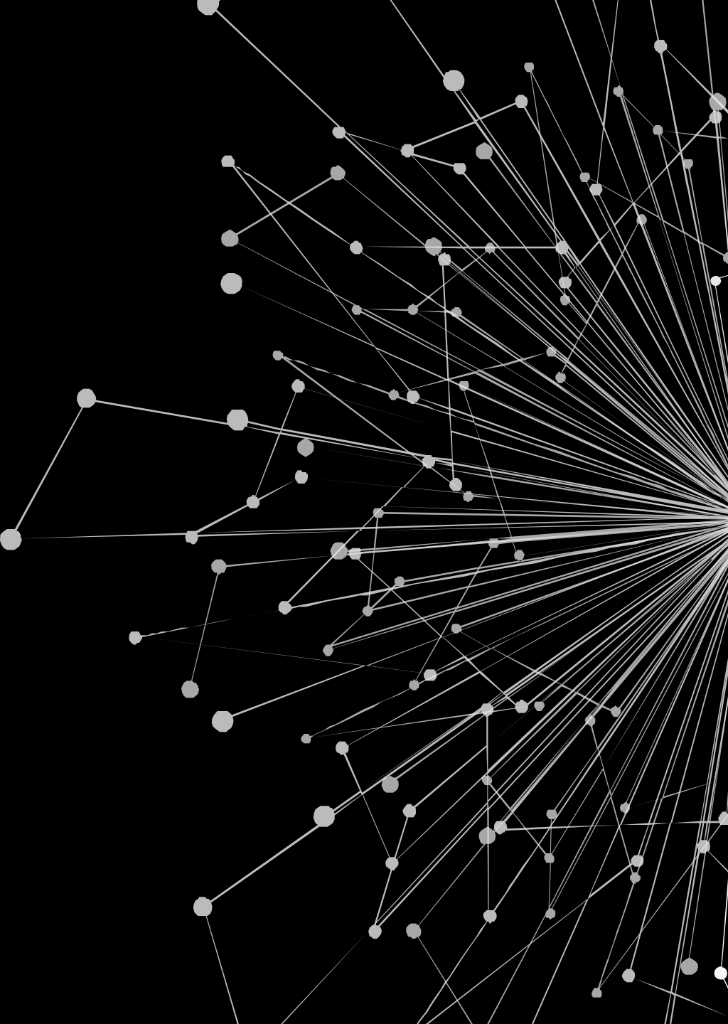
“The future is already here — it's just not very evenly distributed.”
William Gibson
Poll Question 1 –
When I hear “future of work” the first thing I think of is…
3

Slide 4
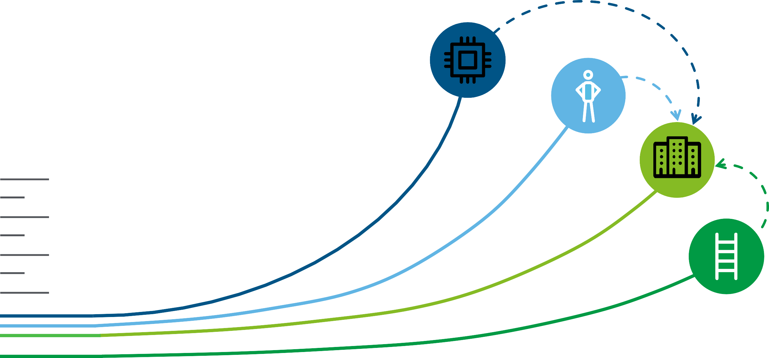
Today, external forces are pressuring organizations to change
Technology
Individuals
Businesses
Public Policy
1970s
1980s
1990s
2000s
2010s
Today
4

Slide 5


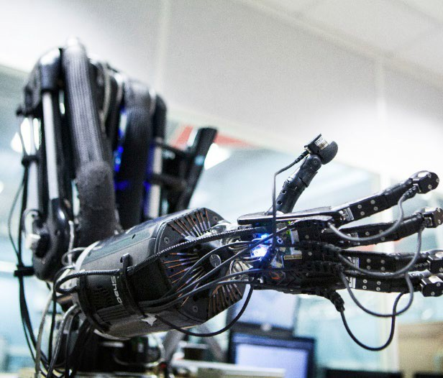




We’re seeing unprecedented disruption…
T ECHN O LO G Y I S E V E R Y W HER E
T S U NA M I OF D ATA
AI, COGNITIVE
COMPUTING & ROBOTICS
J O B S V U L N E R A B L E T O A U T OM A T I O N
DIVERSITY /
GENERATIONAL CHANGE
C A RE E RS – 100 YE A R L I F E
E X P LOS I O N I N
C ONT I N G E N T WOR K
5

Slide 6

… that impacts Government employees
T E C H NOL OG Y I S E V E R Y W HER E
77% of GPS respondents see the hyper-connected workplace as important, yet only 8% feel very ready to
introduce new communication tools in the workplace¹
T S U NA M I OF D A T A
17% of GPS organizations surveyed believe they have “excellent” processes to safeguard data, and only 6% use analytics as an integral part of business
and talent decisions¹
AI, COGNITIVE
COMPUTING & ROBOTICS
63% of GPS respondents say AI and cognitive technologies will have an impact on their workforce by 2020, however, only 31% use these technologies today¹
J O B S V U L N E R A B L E T O A U T OM A T I O N
GPS leaders are placing a higher premium on essential human skills¹: 50% social skills
60% problem solving
46% cognitive abilities
DIVERSITY /
GENERATIONAL CHANGE
Millennials make up 18% of the federal workforce (compared to 32% for the whole US), yet only 27% of
agencies have a plan to attract talent outside government¹
C A RE E RS – 100 YE A R L I F E
1/3 of the federal workforce is eligible to retire², yet 90% of CSRS-covered employees are continuing to work, as are 12% of FERS-covered employees³
E X P LOS I O N I N
C ONT I N G E N T WOR K
79% of public sector organizations say they consider new career models as important, yet only 7% say they are ready for the challenge¹
¹ Deloitte 2018 Human Capital Trends Report: A Government Perspective
² US Government Accountability Office (GAO)
³ Office of Personnel Management (OPM)
6

Slide 7




…unlocking opportunities for us to do what we do best
Listening, responding, and expressing ideas effectively in different contexts, influencing others
Service orientation
Cultural fluency
Emotional judgment
Exercising judgment and leadership to decide the way forward in complex environments
Decision making
Professional ethics
End-to-end/Big Picture thinking
Communication
Strategic Thinking
Finding creative solutions to difficult or complex issues
Design thinking
Agile thinking
Innovative thinking/creativity
Continuously evolving and upskilling oneself
Intellectual curiosity
Self-management
Problem Solving
Self Development
Processing complex information and drawing accurate conclusions
Critical thinking
Data fluency
Digital fluency
Technical fluency
Effectively work with others, team with others, and lead others
Teamwork
Leading Teams
Analytical Thinking
Collaboration & Leadership
8

Slide 8
The Future of Work is NOT just about technology…
it’s a whole set of opportunities to change how we work
Poll Question 2 –
I leverage data at work to…
9

Slide 9
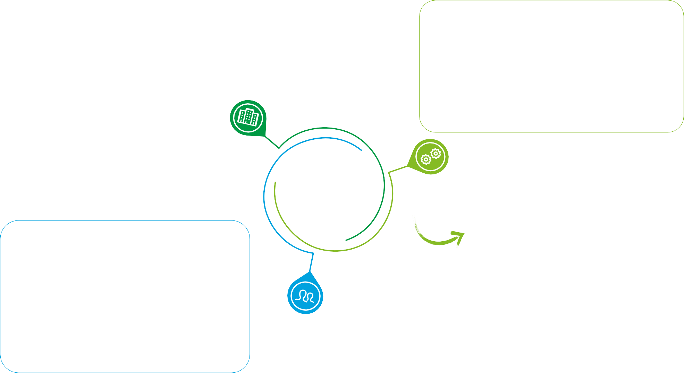
What could be affected by the Future of Work?
Workplace
The structure and practices to enable people to create value in the Future.
How can the way we work adapt to create the best environment for my workers to drive impact?
Work
The type of work people will do in the Future.
How can I drive the most impact for my agency?
Workforce
The composition and organizational structure to enable the organization to get work done in the Future.
What skills do my workers need to optimally drive impact?
Future of Work is an opportunity to reimagine the workplace, workforce, and type of work people will do based on radical shifts in technology and demographic changes
10

Slide 10














We’re seeing the effects already: 15 jobs that didn’t exist 15 years ago
Social Media Manager
AI-related jobs
Content Curator
Online Brand Ambassador
Data Scientist
Virtual Assistant
Podcast Producer
Cloud Architect
Telemedicine Physician
Mobile Web Developer
SEO Analyst
Automated Driving Jobs
Experience Designers
Developer Evangelist
Content Marketer
11

Slide 11






We are seeing a shortage of certain skills, as existing jobs are redefined and new jobs created
Job Shortages Job Growth
10,000
or fewer AI specialists exist worldwide
50 million
new technology jobs globally by 2030
250,000
The shortage data scientists
in the US economy by 2024
5 million
Net new care provider jobs in the US by 2030
1.8M
The workforce gap that cybersecurity will experience by 2022
50%
growth expected in creative roles in China and India by 2030
12

Slide 12



The implications will be felt at an individual, organizational and public policy level
Implications for individuals
Engage in lifelong learning
Shape your own career path
Pursue your passions
Redesign work for technology and learning
Source and integrate talent across networks
Implement new models of organizational structure, leadership, culture, and rewards
Implications for organizations
Reimagine lifelong education
Transition support for income and health care
Reassess legal and regulatory policies
Implications for public policy
13

Slide 13
“Management is about coping with complexity…. Leadership, by contrast, is about coping with change.”
John Kotter
Poll Question 3 –
I have the skills, knowledge and technology to keep pace with changing needs…
14

