Slide 1
Ethics Update
Spring 2022
Ethics in the Zoombie Apocalypse
Joby D. Jerrells
Attorney-Advisor
US Army Financial Management Command
Version Number
As of DD MMM YYYY
Version Number 1.0
As of 08-FEB-2022

Slide 2
Disclaimers
This presentation represents the personal views of the presenter and does not represent the views of the Department of the Army, Department of Defense, or the federal government.
This training was developed for annual training for government employees.
Use at your own risk, you assume all liability for your own actions.
Not responsible for windshield damage. Stay Back 200 Feet (you wouldn’t be able to read this warning at that distance anyway).
Peanut butter warning label: Warning! May contain peanuts!
No animals were harmed during the presentation or preparation of these materials.

Slide 3
Learning Objectives
Attendees will gain a better understanding of Behavioral and Regulatory Ethics
Attendees will have a better understanding about the limits and issues of working with 3rd parties, or contractors
Attendees will look closer at the ethics of telework or remote work
Attendees will review applied ethics principles from real-life cases

Slide 4


Ethics vs. Morals
What is the difference?
Morality is typically normative or personal
  Innate, intuitive
Ethics is the standards of good and bad as established by a communal standard
  Learned behavior
Can following an ethical code be immoral?
Uses innate superpowers to do good
Uses toolkit to do good
Has no superpowers
Superman and Batman do good, in different ways!

Slide 5

Behavioral Ethics
Ethical Decision-Making
Ethical Practice in Business
Personal Ethics
Diversity, Equity and Inclusion including unconscious bias training and Awareness
Maximus Decimus: “What we do in life, echoes in eternity”

Slide 6
What is Regulatory Ethics
This field of study deals with the necessary ethical background knowledge required to adhere to rules and regulations of state licensing bodies, other governmental entities, membership associations and other professional organizations or bodies.
Creating an ethical framework is absolutely necessary to be able to sort through professional dilemmas.
Includes professional licensure in public practice, industry and government.
  National Association of State Boards of Accountancy (NASBA), State Boards
  ABA, State Bar Associations
  Office of Government Ethics

Slide 7
Why is Regulatory Ethics important?
To ensure competence
  AICPA Standard 1.300.010 (Competence): A member (or member’s staff) possesses the necessary technical qualifications to perform professional services.
To ensure conflict-free services
  AICPA Standard 1.110.010 (Conflicts of interest): Would a 3rd party conclude there is a conflict?
    What types of conflicts might exist?
  GOV Employee Ethics Standards:
    5 CFR 2635.403 (Prohibited financial interests)
    18 U.S.C. § 208 (Acts affecting a personal financial interest)

Slide 8
First polling question
Should realtors be allowed to represent both the buyer and seller in the same transaction?
What ethical principle does dual agency address?

Slide 9
Why is Regulatory Ethics important?
To protect Confidentiality
  AICPA Standard 1.700.001 (Confidentiality): Prohibition on disclosing confidential client information without specific consent of the client.
  Safe harbor provisions.
  Must be able to explain how client information is protected.
To ensure the reasonability of fees
  AICPA Standard 1.510.001 (Contingent Fees Rule): Contingency fees prohibited. Why?
  GOV Practice:
    5 CFR 2635.203 (Gifts given because of EE’s position are prohibited)
    18 U.S.C. § 201 (Bribery)

Slide 10
Examples of Regulatory Ethics
Business Transactions with Clients
Competence
Confidential Client Information
Conflict of Interest
Contingent Fees, Commissions and Other Considerations
Discreditable Acts
General and Professional Standards
Independence
Integrity and Objectivity
Licenses and Renewals
Malpractice
Professional Conduct
Public Interest and Responsibilities
Regulatory Oversight
Retention of Client Records
State Rules and Regulations

Slide 11
Working with Contractors or 3rd Parties
From GOV perspective:
  Contractors cannot perform inherently governmental functions, such as: Criminal investigations, adjudicatory functions, direction of federal employees, hiring, discretionary functions
Contractors have their own system of ethics as required by FAR 3.10
Gifts: Exclusions, 20/50 Rule
Parties/unofficial outings
Time Management
  GOV may not: Authorize comp time, authorize activities outside the contract (including team building events, retirement ceremonies, “Org Day” events), grant early release
Awards

Slide 12
Working with Contractors or 3rd Parties
Use of government resources (use of recreational facilities is typically an exception)
Transportation
  GOV may accept contractor-transportation for official business as a gift to the government (exceptions apply, prior approval needed)
Training: Contractors must provide “ready to work” labor. “All-hands” training not typically for contractors
Switching teams, moonlighting
Non-disclosure
Fundraising
Confusion of identity: FAR 37.114(c)

Slide 13
Tales from the Ethical Darkside
The Director of the Centers for Disease Control and Prevention resigned after numerous financial conflicts of interest were brought to light. The Director of the Centers for Disease Control and Prevention, bought shares of stock in tobacco, drug and food companies one month into the job. These companies were the very ones she was regulating. When this was discovered, and she was unable to disqualify herself because of the breadth of purchases, the Director had no choice but to resign since she would not divest her financial interests.
Cannot ethically regulate an industry in which you hold a financial interest.
Section 208-type violation
Source: DoD Encyclopedia of Ethical Failures (2019)

Slide 14
Tweet and Re-tweet were sitting on a fence…
The U.S. Department of Transportation (DOT) violated an anti-lobbying provision in the Financial Services and General Government Appropriations Act, 2017, when it “retweeted” and “liked” a tweet urging followers to “tell congress to pass” pending legislation. Although DOT was not the author of the tweet, DOT, by retweeting and liking it, not only endorsed the message, but also created agency content. Because DOT obligated and expended appropriated funds in violation of a statutory prohibition, DOT also violated the Anti-Deficiency Act.
Violation of anti-lobbying laws and the Anti-Deficiency Act
Source: DoD Encyclopedia of Ethical Failures (2019)

Slide 15
Official Time
“It’s 5:00 somewhere” – A government employee attached to a Service base in the United States ended up taking a permanent vacation after a pattern of working an abbreviated work week. The investigation showed the employee worked an average of three hours a day, before leaving around nine or ten each morning to spend the rest of the day drinking at a local bar. The employee put in for retirement in lieu of disciplinary action.
Homer Simpson Defense – A Government employee was reported by his co-workers for sleeping on the job. When confronted, he admitted that he may have dozed off a time or two, but never actually slept at work. His three day suspension was reduced to one day after he revealed that drowsiness was a potential side-effect of his prescribed medication.
Source: DoD Encyclopedia of Ethical Failures (2019)

Slide 16
Interns
A group of interns used a Government rental vehicle to attend a 5-day Defense Acquisition University (DAU) class in Alabama. However, after the class was over they decided to drive to Nashville for a little weekend vacation, ultimately dropping the car off with an empty tank of gas. They charged the Government an extra two days for the weekend car rental and the $5/gallon gas refill. They were also improperly paid for an extra day of per diem during their boondoggle to Music City. The original vouchers claimed days that were not part of the interns’ official TDY, but were subsequently corrected. The intern group was counseled, received training on filing travel vouchers, and was made to contact DFAS regarding reimbursement to the Government for the improper expenditures.
Source: DoD Encyclopedia of Ethical Failures (2019)

Slide 17
Frolic and Detour
An employee was reprimanded after it was discovered that he drove his official Government vehicle every morning to the base eatery for coffee and breakfast. The employee readily admitted his actions, but indicated that he believed them to be proper because they were “official visits” to an activity under his command. He noted that he had formerly used his personal vehicle for all such visits, but with rising gas prices, that practice had become too expensive. He further hypothesized that the person who had tipped off investigators was simply jealous as they probably did not have a Government vehicle and were forced to drive their personal vehicle to get food.
31 U.S.C. § 1349 – Misuse of a government vehicle has a minimum statutory suspension penalty of “at least” one month, but could result in removal.
Source: DoD Encyclopedia of Ethical Failures (2019)

Slide 18
Second polling question
Have you ever used the government vehicle or company car for personal business?

Slide 19
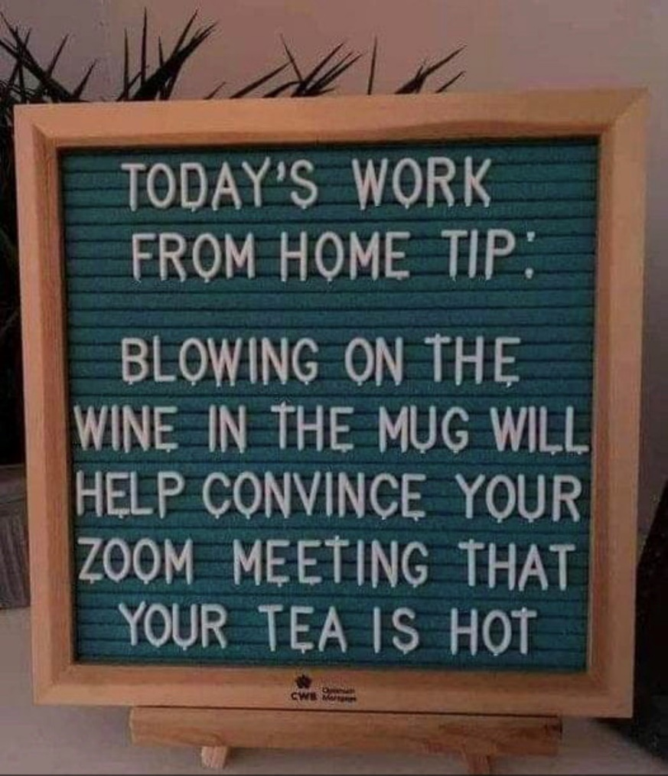
“Tworking” Ethics
Challenges: When does the workday start or end? Can I let the dog out? Can I switch out my laundry?
Teleworking employees are considered to be at work.
If you are teleworking, the workplace ethics rules still apply.
Check in with other employees.
Stick with an approved work schedule so the lines are less blurry.

Slide 20

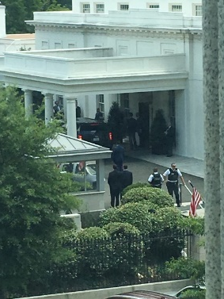
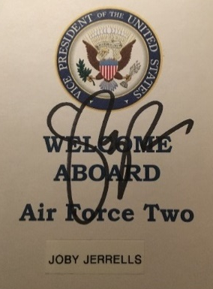
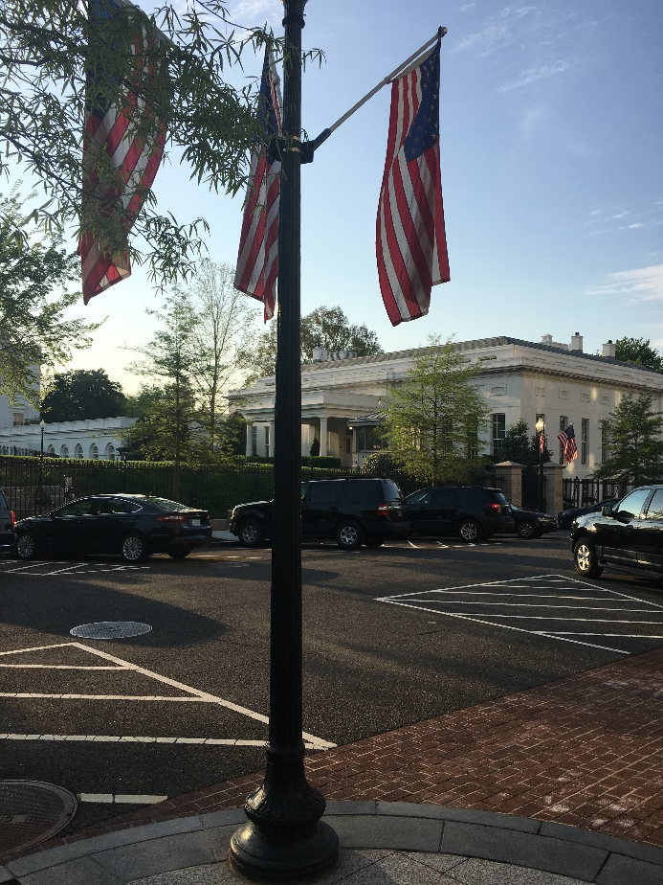
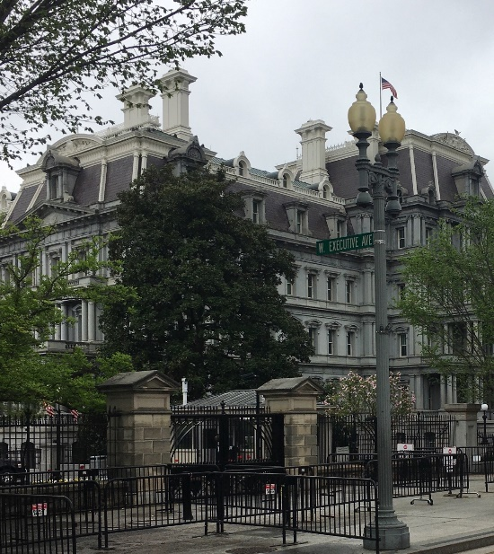
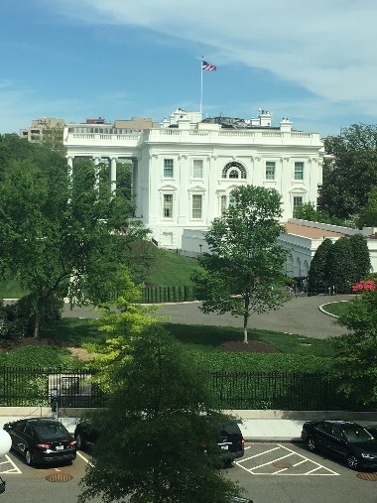
Ethics in Practice
Detailed to the White House as Ethics Counsel to the Office of the Vice President of the United States

Slide 21
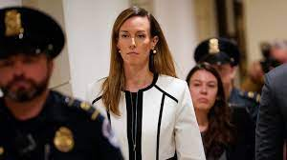
Ethics in Practice
Gifts
Conference attendance
Annual ethics reporting
Working with contractors
Ethics orientation: You never know when you may have a first chance to make a lasting impression on a new employee…

Slide 22
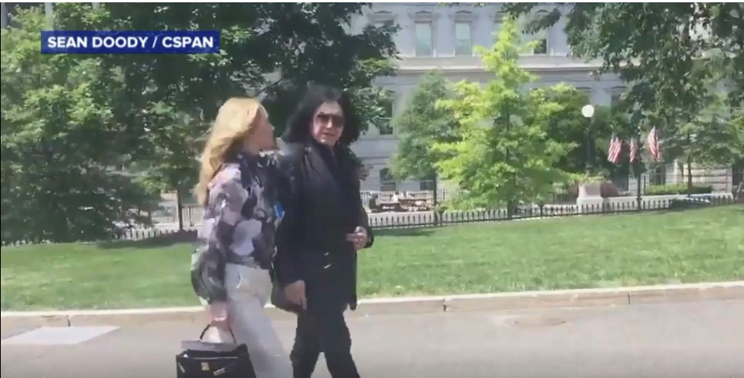
Ethics in Practice
Wacky gifts to POTUS and VPOTUS
White House Records

Slide 23
Attorney Ethics Example
Indiana Professional Conduct Rule 3.8 (Special Responsibilities of a Prosecutor), requires, inter alia:
  “[A prosecutor shall ] refrain from making extrajudicial comments that have a substantial likelihood of heightening public condemnation of the accused…”
  Comment: “A prosecutor has the responsibility of a minister of justice and not simply that of an advocate.”
  King v. State, 877 N.E.2d 518 (Ind. Ct. App. 2007)
    “Here, we reach an age old conclusion – a worthy end does not necessarily justify the means.”

Slide 24
Summation
Discussed Ethics vs. Morality
Defined Behavioral Ethics
Defined Regulatory Ethics
Discussed Working with Contractors
Discussed examples of Regulatory Ethics
Discussed special considerations for Teleworking
Ethics in Practice

Slide 25
“It takes a lifetime to build a good reputation,
but you can lose it in a minute.”
Will Rogers
Slide Subtitle Here

