Slide 1
Army Financial Statement Audit
Operating in a virtual world
April 2022

Slide 2
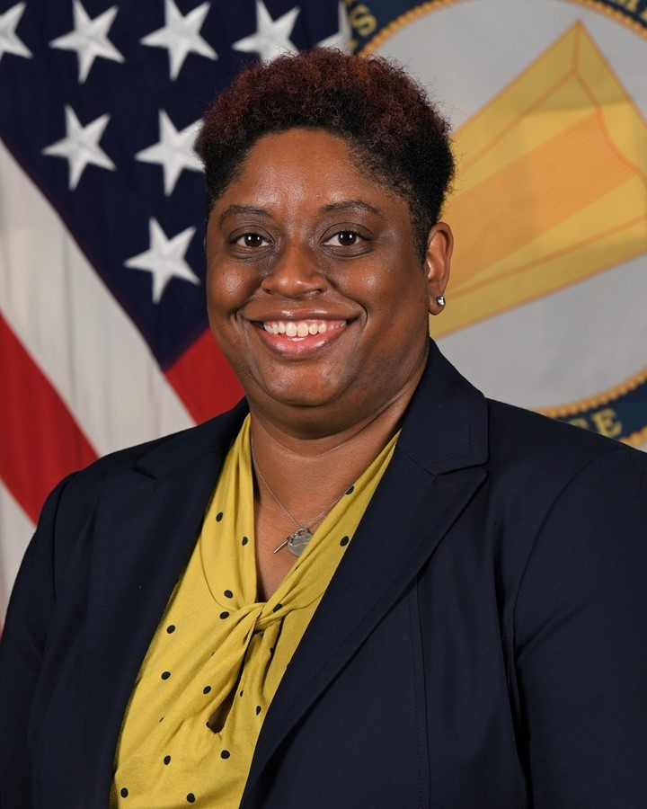
Introduction
Learning Objectives
Key Takeaways
Despite the challenges of COVID-19, the Army General Fund (GF) and Working Capital Fund (WCF) financial statement audits continued in FY20 and FY21 as the Army began operating in a remote work environment.
Despite these mandated operating adjustments, the Army conducted virtual audit walkthroughs and realized efficiencies, reduced travel costs, and accelerated audit progress.
1
Understand the current status of the Army financial statement audit
2
Learn about how the Army shifted to operating within a virtual environment
Natasha Anderson
Director
Financial Operations and Accounting
3
Identify ways to contribute to and learn about the Army audit
Notes:
In March 2020, Headquarters, Department of the Army (HQDA) implemented maximum telework at the onset of the COVID-19 pandemic. This forced the Army to adapt and conduct its first-ever, fully-virtual financial statement audit. The Army utilized technology and adapted to changing circumstances to continue the audit without delays.
Over the next few minutes together, I hope you come away with a better understanding of the Army’s financial statement audit, the ways in which we’ve adapted to a more virtual world, and how everyone can play a role in supporting the Army audit!

Slide 3
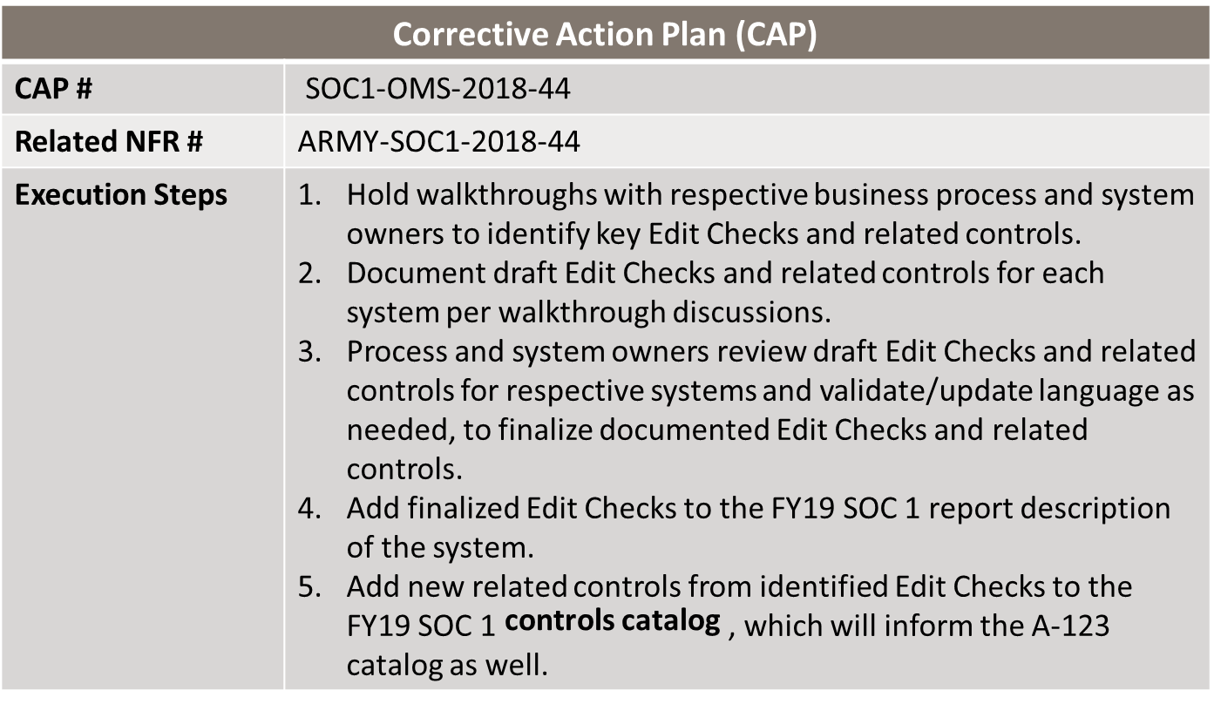
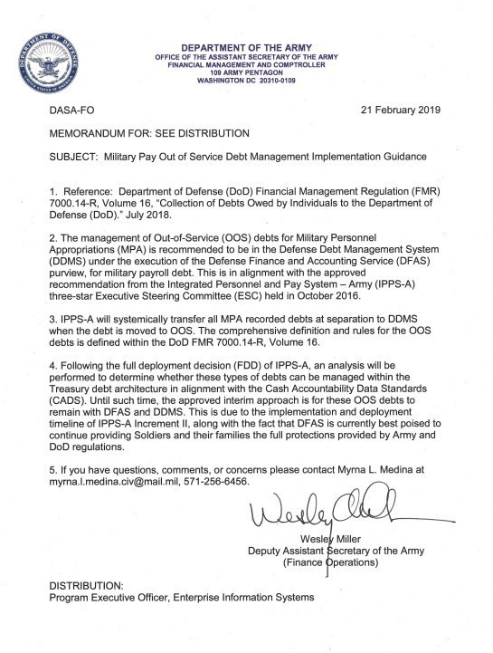
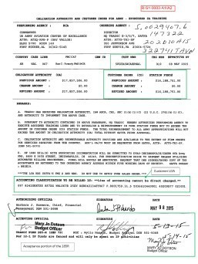
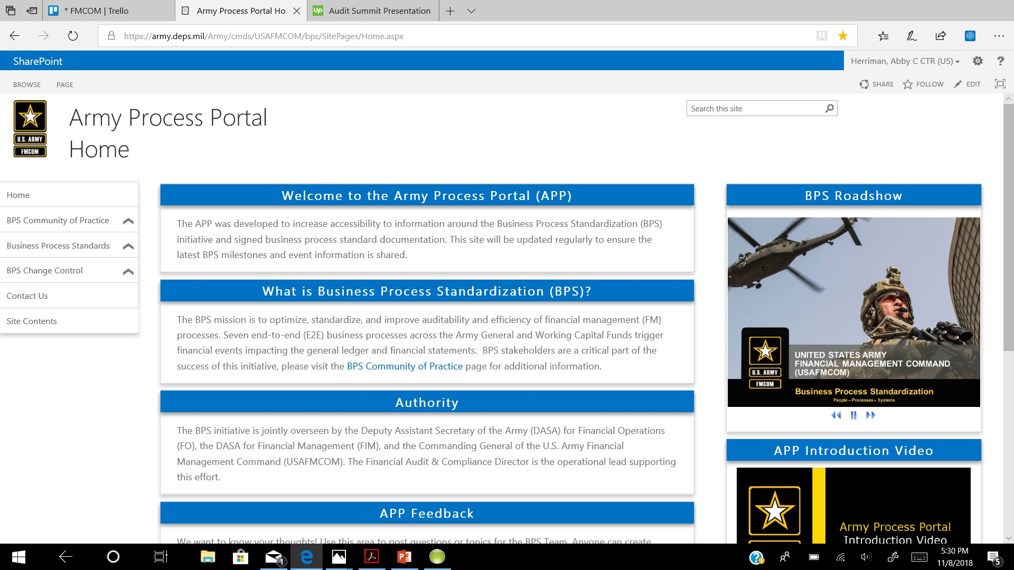
How does the Army benefit from the financial statement audit?
Audit success provides leaders with a better understanding of the data available for decision-making and the allocation of resources.
Audit Trail Package
Effective internal controls
Army created standardized test plans for key business processes across Reporting Organizations
Clear business processes
Stakeholders across Army came together during a virtual workshop to develop a shared vision of issues and solutions
for the government-furnished
property (GFP) business process
Complete Documentation
Army developed a virtual training to provide IMCOM Garrisons with the support they need to accurately input GFEBS entries and documentation
Notes:
We recognize that for many of our people, audit responsibilities are an additional duty atop your everyday responsibilities. However, audit readiness offers distinct benefits that lead to operational and mission readiness.
One example that I’d like to highlight here is a virtual effort still underway to examine and propose solutions for the GFP business process. In the virtual environment, we’re facilitating Design Thinking Workshops, convening stakeholders on Microsoft Teams to work together towards a plan and solution for longstanding audit issues.

Slide 4



FY21 Army Audit Overview
The Army GF and WCF financial statement audits continue to progress towards an audit opinion as the audit expands with more extensive testing each year.
469 NFRs
Fourth Full Financial Statement Audit
  498 (+276)
  Site visits conducted
FY 21
  315 Repeat (+10)
  19 Repeat Partial (-19)
  135 New (-38)
  127 WCF (+13)
  229 GF (+6)
  77 Multi-Audit (+18)
  27 SOC-1 (Munitions) (-11)
  9 SOC-1 (GFEBS) ) (+1)
7,611 (+389)
PBCs submitted to auditor
478 NFRs
Third Full Financial Statement Audit
FY 20
  303 Repeat
  38 Repeat Partial
  175 New
  114 WCF
  223 GF
  95 Multi-audit
  38 SOC-1, Munitions
  8 SOC-1, GFEBS
20,131 (+3,177)
Samples submitted to auditor
Notes:
The Army’s GF and WCF, collectively, account for an estimated $332B in assets. Even in the best of circumstances, an endeavor like the Army’s goal of a clean audit opinion is a tall task.
Year-over-year, the Army audit also has been growing, as the Army demonstrates to its auditor improved financial management practices.
I provide you with these level-sets to orient everyone to the seismic shift which occurred when the pandemic set-in and the Army moved to remote-work.
FY22 stats thus-far
Total NFRs (as of 22 MAR): 6 (all repeat GF)
PBCs submitted to auditor in FY22: 3,103
Samples submitted to auditor in FY22: 220

Slide 5
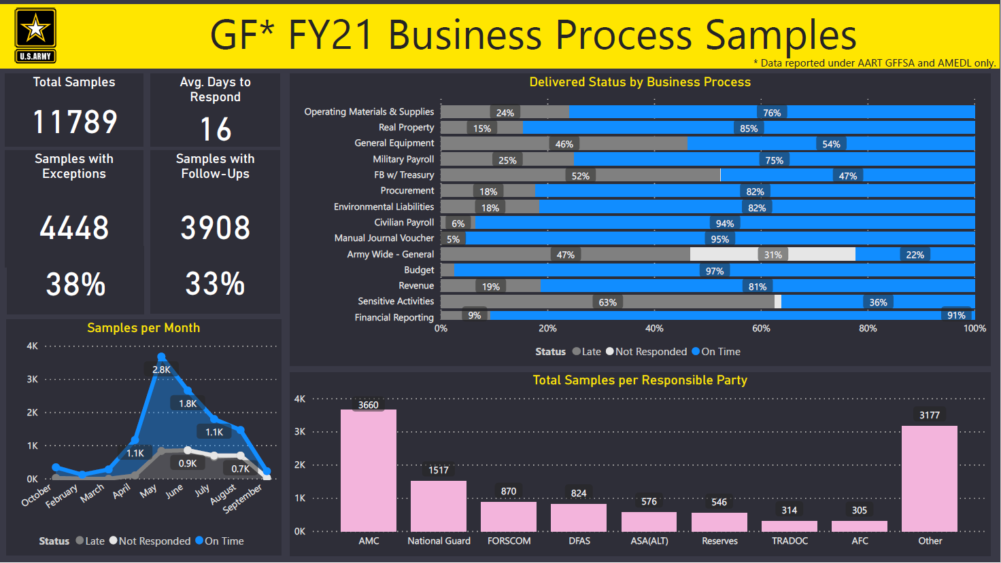
Notes:
During the pandemic, and to this day, our teams are investing in new ways to visualize the Army’s financial data. This dashboard you see here is powered by Microsoft Power BI.
Without the benefits of being in-person regularly, where it’s often easier to collaborate, we needed to identify better ways to efficiently provide our leaders with the information they needed.
These dashboards empower our leaders to make decisions, often without significant follow-up or explanation.
Some of the details here:
Improving timeliness of responses from 16 to 5 days will be paramount for the audit. Auditors typically want responses within 5 days.
On a positive note, there were very few samples with no responses, that speaks to the high level of commitment to the audit.
However, with 38 % of the samples having exceptions, more needs to be done to ensure accurate responses. I would note that this is considerable improvement from prior years audit.
This is a good starting point to start a conversation. See how your peers are doing, and if you see an opportunity to collaborate.

Slide 6
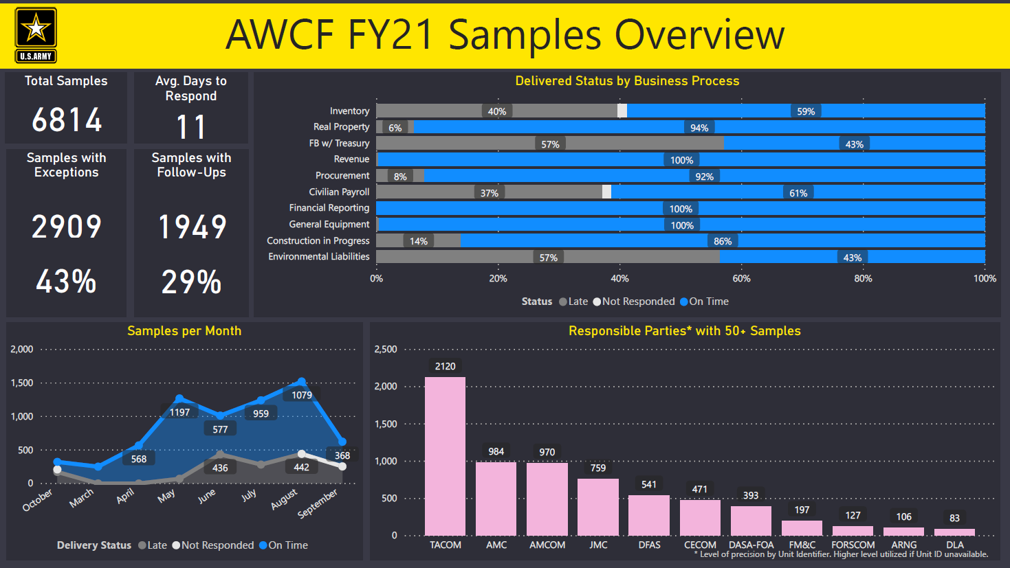
Notes:
For the Working Capital Fund, a similar view:
Improving timeliness of responses from 11 days to 5 days will be paramount for audit.
Timeliness of responses could be improved by reducing the number of follow-up questions asked by the auditor.
Ensuring we use the necessary resources with the appropriate knowledge and availability to ensure expedited fulfillment of samples during April-July is pivotal to improve performance.
43% of all samples have exceptions; understanding the root causes and targeting them based on common areas of improvement could help resolve them in a more agile manner.

Slide 7





How the army adapted to a more virtual world
Army leaders were encouraged to think outside the box when it came to developing internal controls, supporting transaction execution, and completing audit requests in a virtual environment.
Army used new methods to perform remote audit test work with the auditor, including but not limited to:
Stakeholders continued to share best practices, challenges, and alternative solutions remotely:
Screen Captures
Video
Conference Calls
Collaboration Spaces
Army Audit Response Tool
Army Process Portal
Command Calls
*See the final page of this presentation for links and additional resources to collaborate and learn about the Army audit
Notes:
To continue the FY20 Audit without delays after the onset of remote working, the Army adjusted and took full advantage of virtual teaming systems to successfully host mock audit training online and prepare for a virtual walkthroughs with the auditor. As this audit was taking place under a unique set of conditions, it was vital for all parties involved to gain a familiarity with the platforms and methods that would be utilized.
Ensuring every Army resource is fully prepared before an audit activity begins is vital to its success. Throughout the virtual mock audit, the system owner screenshares and walks through anticipated asks from the auditor, while the audit support team provides guidance over the phone. This includes how to maintain decorum while the auditor is present, helping system owners determine specific systems to be tested, and preparing to answer questions an Army resource may receive.
These training sessions enabled stakeholders to learn more about the new methods for conducting remote audit test work (e.g., screen captures, using video for inventory test work). The Army utilized collaboration spaces (e.g., AART, APP, etc.) and Command Calls to learn best practices from other organizations, discuss challenges, or develop alternative solutions in the virtual environment.

Slide 8
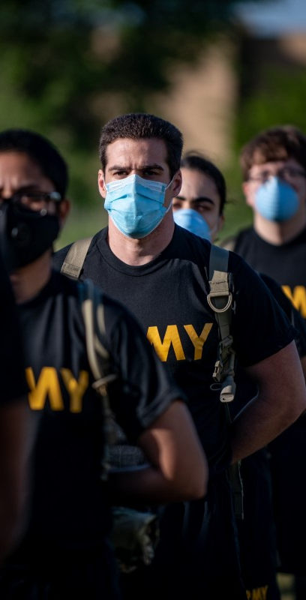


Virtual audit in action
Pandemic Response
The Army helped reduce the spread of COVID-19 by continuing to conduct virtual site visits, walkthroughs, trainings, etc.
Virtual Response Fast Facts
Engaged 500+ individuals, completely virtually, at the December 2021
Army Annual Audit Summit (AAS), leveraging Microsoft Teams Live
In FY21, 347 (68%) of all site visits & walkthroughs were held virtually (GF; WCF)
Key Successes
Virtual walkthroughs proved to be successful with wider stakeholder involvement, reducing the need for travel and its associated costs
Virtual trainings, workshops, and summits engaged more attendees than ever before to increase audit knowledge across the Army
Increased preparation and collaboration improved both virtual and in-person site visits and auditor feedback
Notes:
Virtual summits allowed the Army to expand its reach and train more individuals than ever before: by hosting our 2021 Army Annual Audit Summit on MS Teams Live, attendees from across the enterprise (and country) heard from Army Senior Leaders, signed up to take part in six individualized breakout sessions, and built new relationships.
In FY20, the Army needed to shift its efforts to conduct the audit remotely. Army conducted 38 virtual walkthroughs and site visits during FY20, and used the knowledge gained and lessons learned to be better prepared in FY21, with 347 virtual site visits and walkthroughs.
Those supporting the Army Audit were able to implement remote working practices and work as a cohesive team by utilizing tools such as Teams, Cisco WebEx, and Defense Collaboration Services (DCS).

Slide 9
Polling Question
Which platform does the Army use to conduct aspects of the audit virtually?
Defense Collaboration Services (DCS)
Microsoft Teams
Conference Calls
All of the above
Notes:
Answer: D

Slide 10
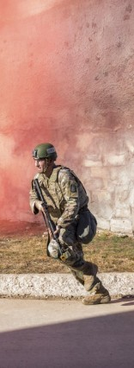
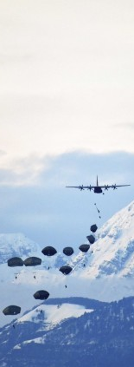



Recent accomplishments
People
Reduced spread of COVID-19 by continuing to improve virtual site visits, walkthroughs, trainings, etc.,
Engaged more people than ever before 2021 Army Annual Audit Summit – more than 500 attendees.
Initiated the “My FM&C Story” campaign on LinkedIn to connect and highlight our audit professionals virtually
Increased collaboration with virtual Design Thinking workshops to drive faster change for longstanding audit issues
Process
Utilized Microsoft Teams to conduct the first ever, fully-remote SOC-1 walkthrough with Army personnel at Camp Arifjan (Kuwait)
Leveraged automation to extract and consolidate key supporting documentation (KSDs) from a financial system for submission to the auditor, improving response rates and efficiency
Improved accountability of property, plant, and equipment, including the location, condition, quantity, and associated acquisition cost.
Audit Readiness
Per SECARMY and ASA(FM&C) guidance, implemented new platforms to improve ownership and innovation, e.g., the upcoming Audit Committee
Continued use of sprint methodology to drive solutions in weeks and months, not years
Improved controls, documentation accuracy and completeness, and ability to respond to IPA requests.
Increased preparation and collaboration to improve both virtual and in-person site visits
Notes:
People: The “My FM&C Story” campaign on LinkedIn enables my team to connect and recognize individuals despite the virtual environment. We’ve received great engagement with each post, with hundreds of reactions from the LinkedIn community.
Process: The Army leveraged Microsoft Teams to conduct its first ever fully remote SOC-1 walkthrough with Army personnel at Camp Arifjan (Kuwait) which will continue to be conducted remotely – this will save resource time and associated travel costs.
Audit Readiness: SECARMY and ASA(FM&C) authored and issued audit-focused memos directing action from across the enterprise, to include establishing an Audit Committee in April 2022. HON Caral Spangler invests her time in participating in many audit-focused events, most recently at an all-virtual audit summit for the FORSCOM-OCAR-USARC community last month. This tone at the top is especially important in a virtual working world.

Slide 11

Army audit roadmap: material weakness focus areas
FY23 | FY24 | FY25 | FY26 | FY27
General Fund (x13)
 | Entity-Level Controls Fund Balance with Treasury | Environmental & Disposal Liabilities | Accounts Payable and Receivable Beginning Year Balances Completeness Evidential Matter Financial Reporting General Ledger Adjustments Operating Materials & Supplies Property, Plant, & Equipment | Intra-government Transactions and Intra-entity Eliminations IT General Controls
Working Capital Fund (x14)
Environmental & Disposal Liabilities Fund Balance with Treasury General Ledger Adjustments | Accruals Beginning Year Balances Entity-Level Controls Financial Reporting IT General Controls Property, Plant, & Equipment | Completeness Evidential Matter Intra-government Transactions and Intra-entity Eliminations Inventory Revenue
Audit Opinion
Audit Opinion

Slide 12
Polling Question
When does the Army aim to achieve an audit opinion for the General Fund?
FY22
FY26
FY27
FY29
Notes:
Answer: C

Slide 13
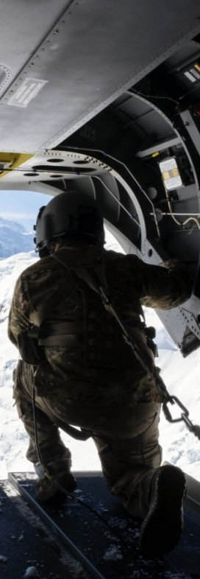





EVERYONE PLAYS A ROLE IN AUDIT READINESS
Ensure your process is documented correctly on APP to drive new controls documented in the control catalog
Compliance, Compliance, Compliance!
Review Army-wide CAPs and implement new controls to address identified deficiencies
Be aware of new policies issued
Review NFRs issued to determine if similar deficiencies exist at your organization – Develop CAPs when applicable
Forums to discuss the audit
Business Mission Area Champions (BMAC) monthly meetings
Command Accountability and Execution Review (CAER) Program
Audit Committee meetings, to be held quarterly (Beginning in April 2022)
Join the FM&C Audit Distro List
Join Command calls hosted by OASA FM&C
Email the Task Box to join:
usarmy.pentagon.hqda-asa-fm.mbx.audit-tasks@mail.mil
usarmy.pentagon.hqda-asa-fm.list.gf-fin-stmt-audit-procurement@mail.mil
Visit the Army Process Portal
https://army.deps.mil/Army/cmds/USAFMCOM/bps/SitePages/Home.aspx
Visit the Army Audit KM Portal on AART
Join us on social media
https://aart.army.mil/AAKM/SitePages/Home.aspx
Follow ASA (FM&C) on LinkedIn / YouTube / Twitter / Facebook
Notes:
Many of the elements here take advantage of our virtual world and enable remote participation (e.g., Command Calls; social media).
If you are interested and able, please look at these resources and engage with us!

Slide 14
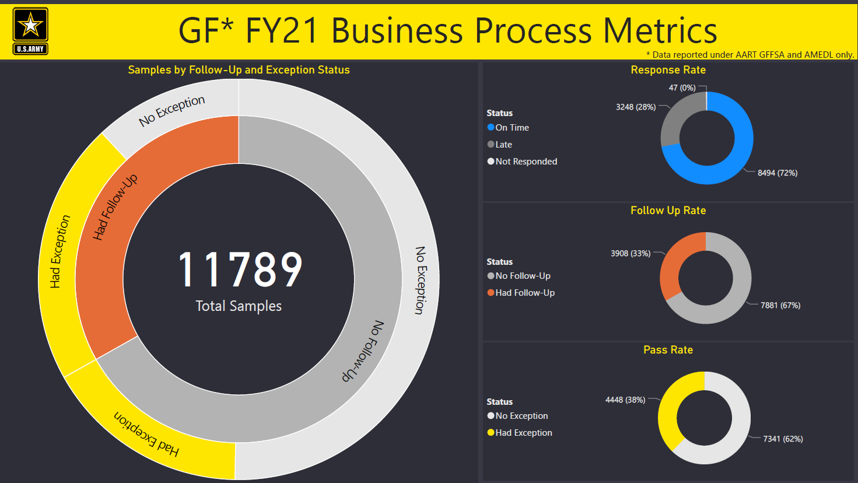
Notes:
The breakdown of this data allows us to drive remediation activities moving forward. For example, if there is a large month-over-month change, we can follow up with a specific business process to develop better walkthroughs and model audit packages.
In addition to what we are doing with the BMAC, Army will use command dashboards to track progress against exceptions.
Follow-up questions certainly indicate the potential for exceptions. Focusing more on what those issues are would be a good start to increase pass rates.
What are the drivers for the samples that are directly getting issued exceptions with no follow-up questions?
What can we do to address samples appropriately to ensure we reduce the rate of follow-ups?

Slide 15
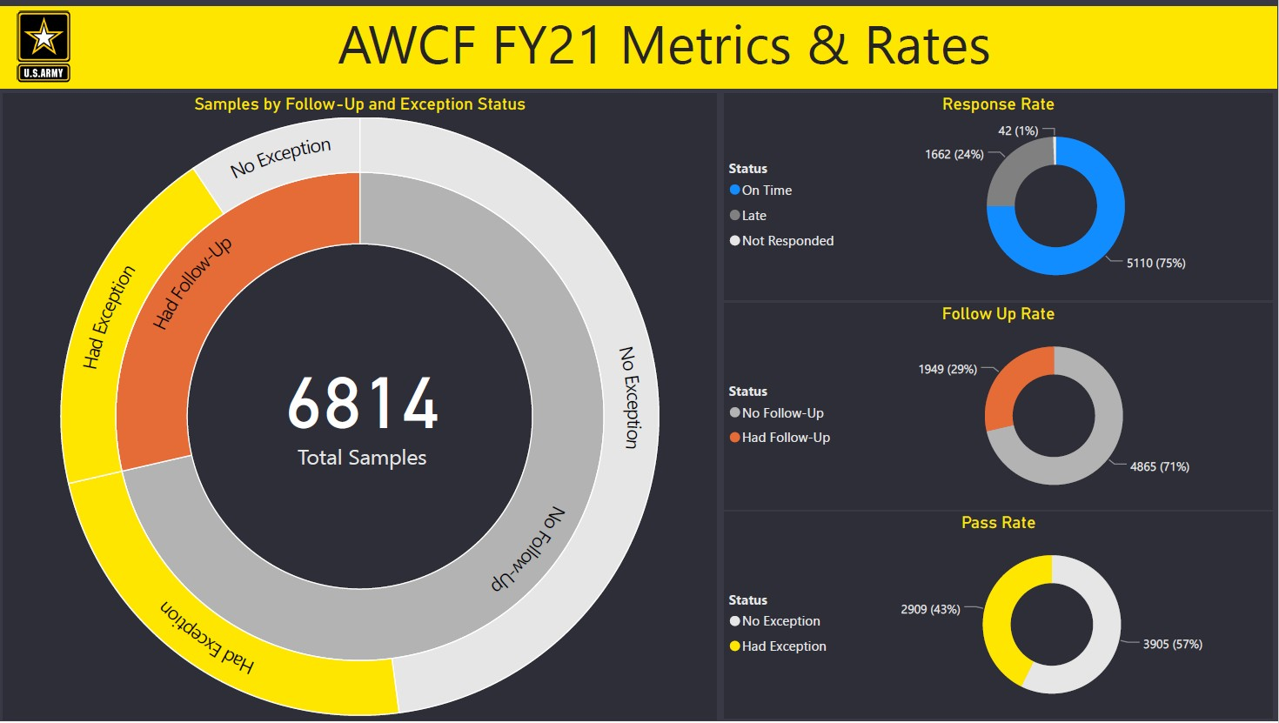
Notes:
Follow-up questions certainly indicate the potential for exceptions. Focusing more on what those issues are, would be a good start to increase pass rates.
What are the drivers for the samples that are directly getting issued exceptions with no follow-up questions?
What can we do to address samples appropriately to ensure we reduce the rate of follow-ups?

