Slide 1

AGA/ASMC 2023 Holiday Party

Slide 2
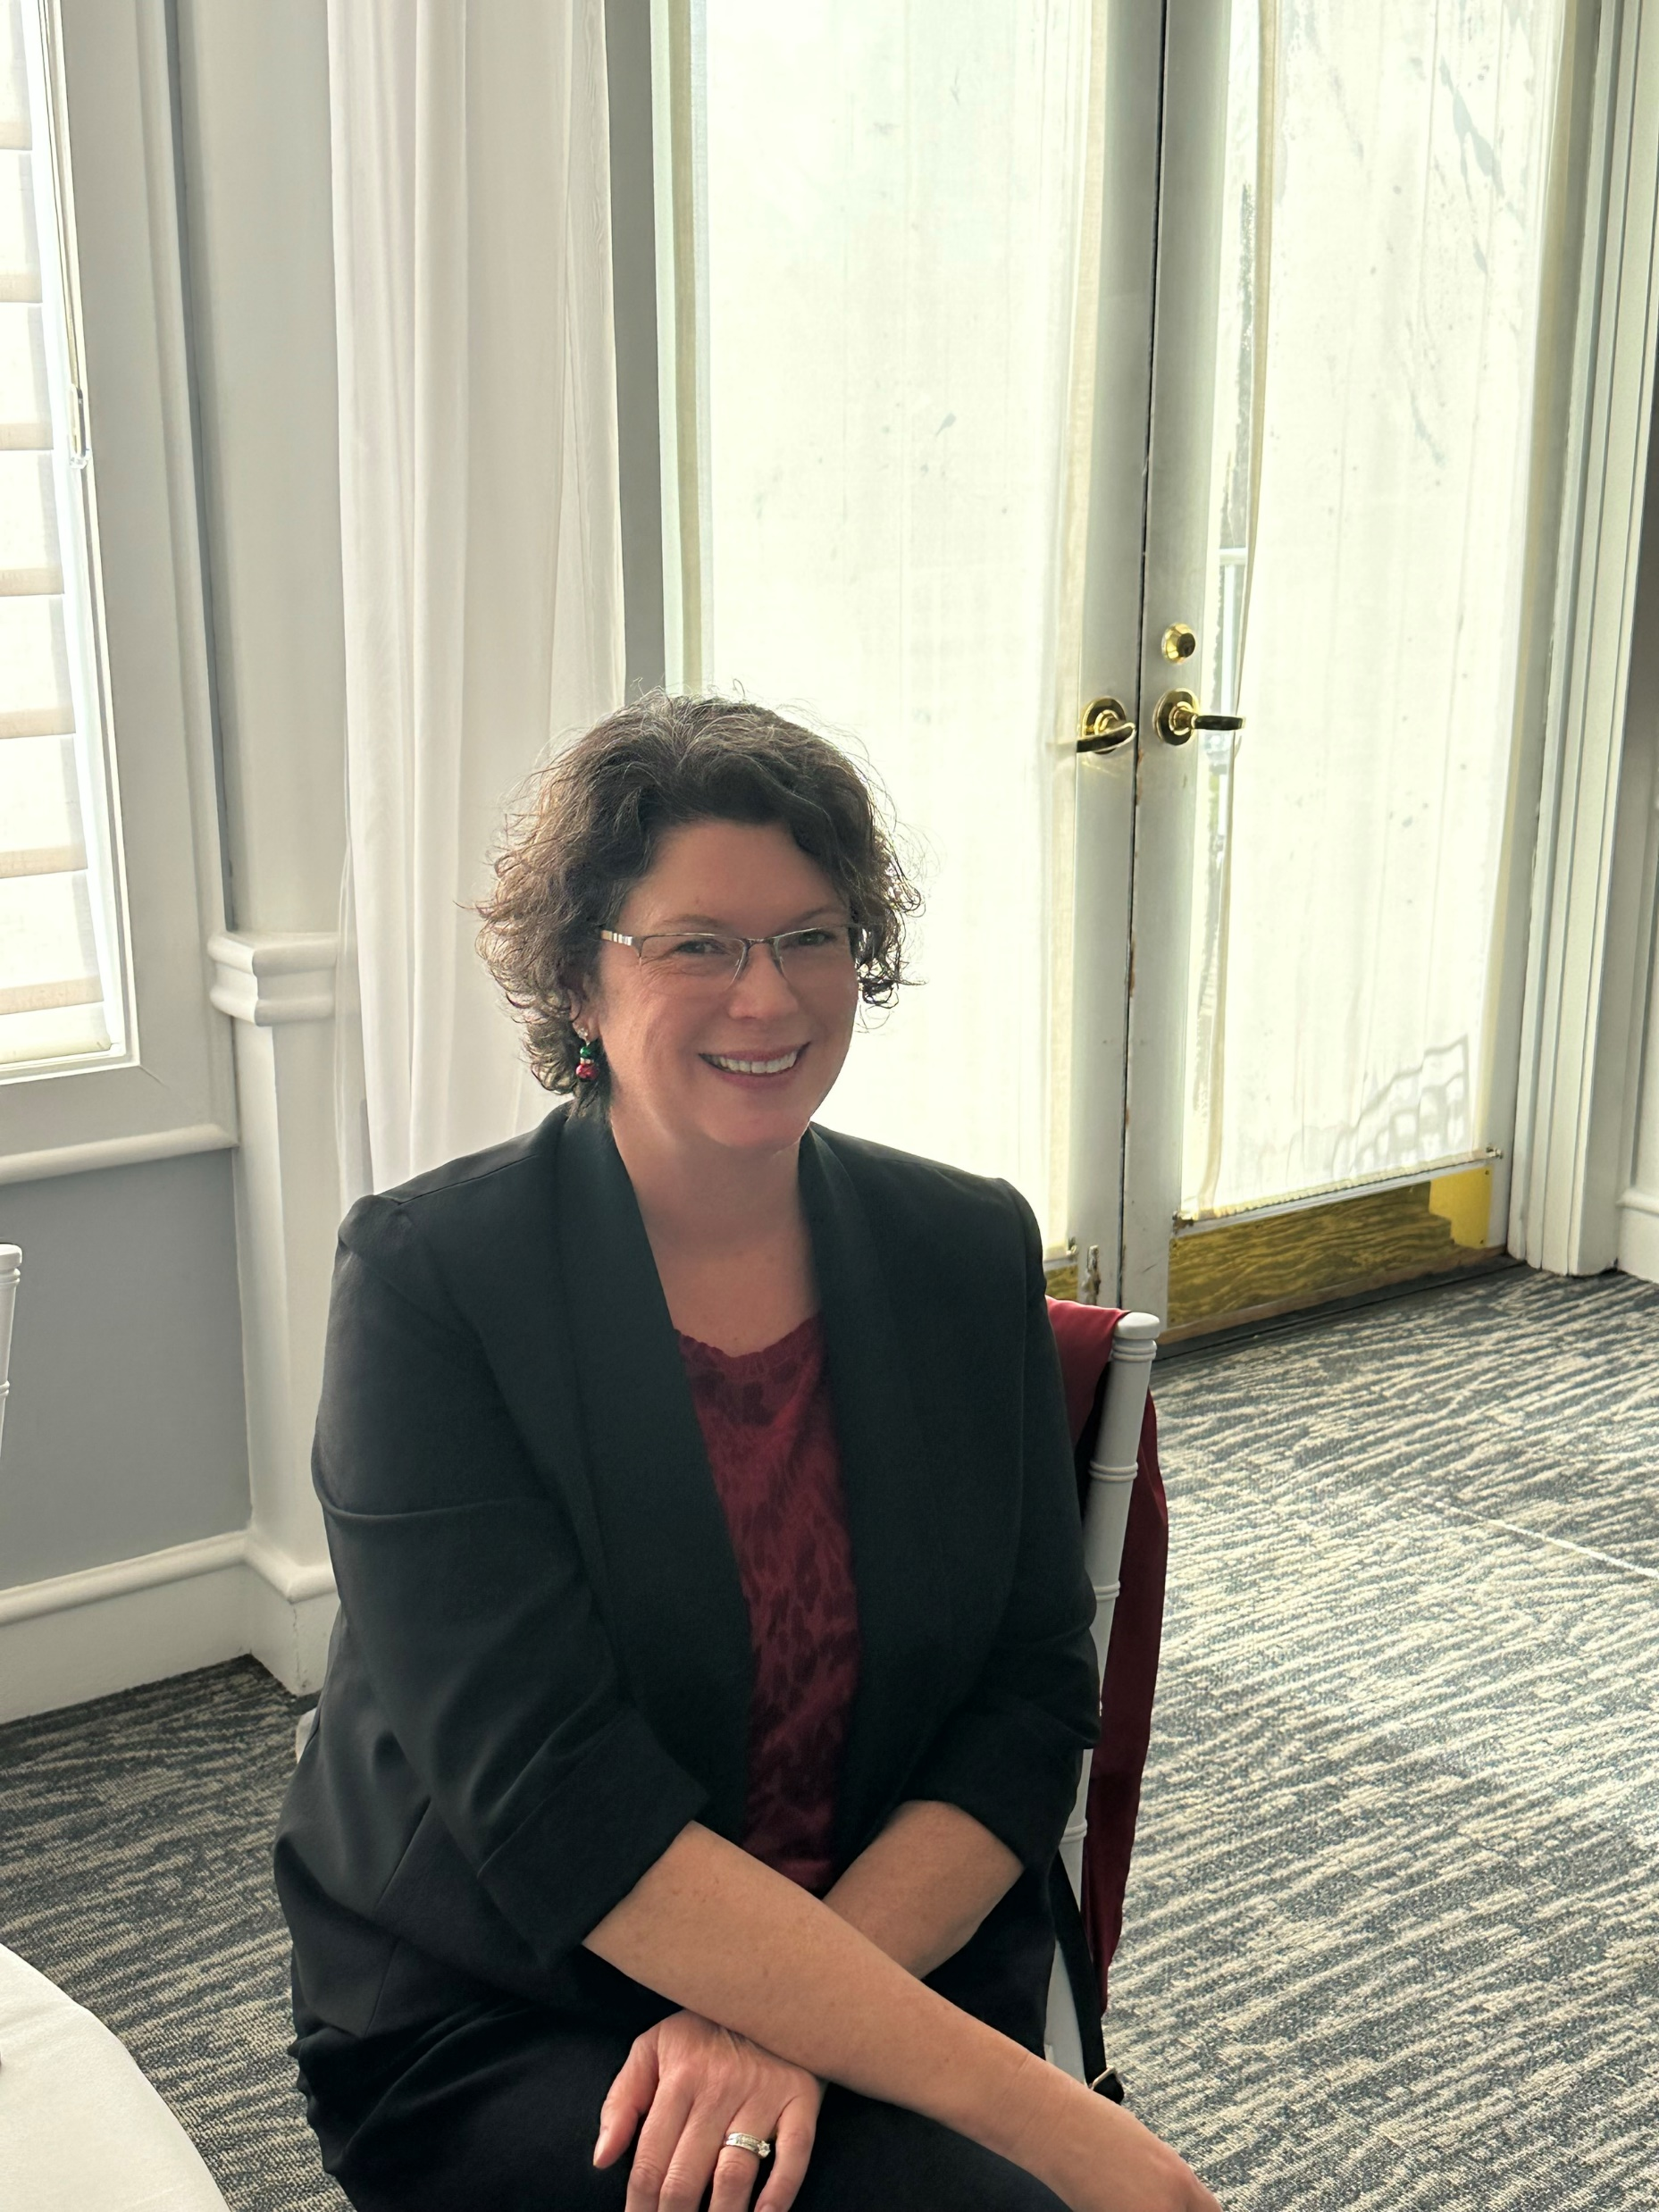
AGA Holiday’s Celebration
Ms. Katie Gambill
Notes:
Ms. Katie Gambill

Slide 3
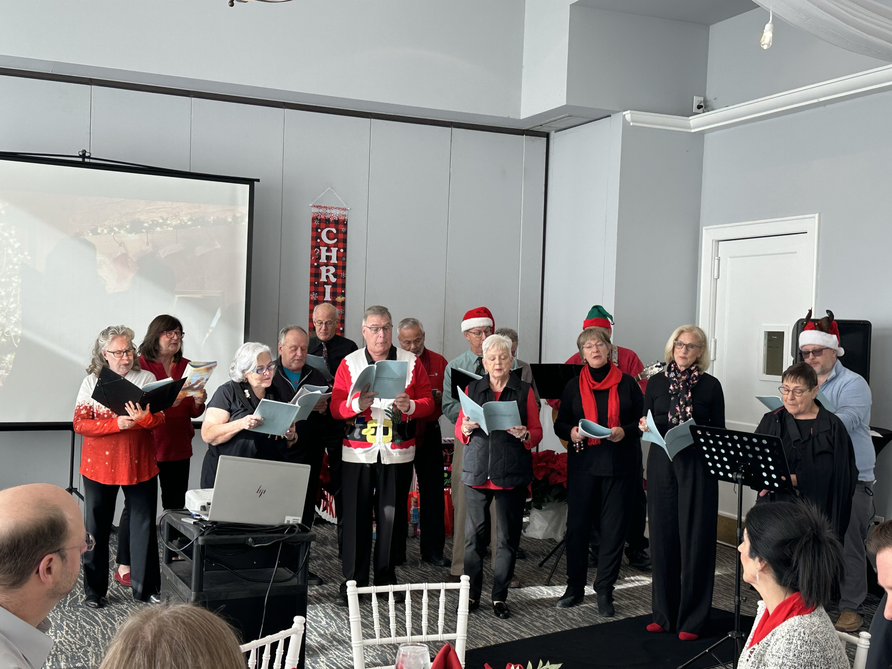
AGA Holiday’s Celebration

Slide 4
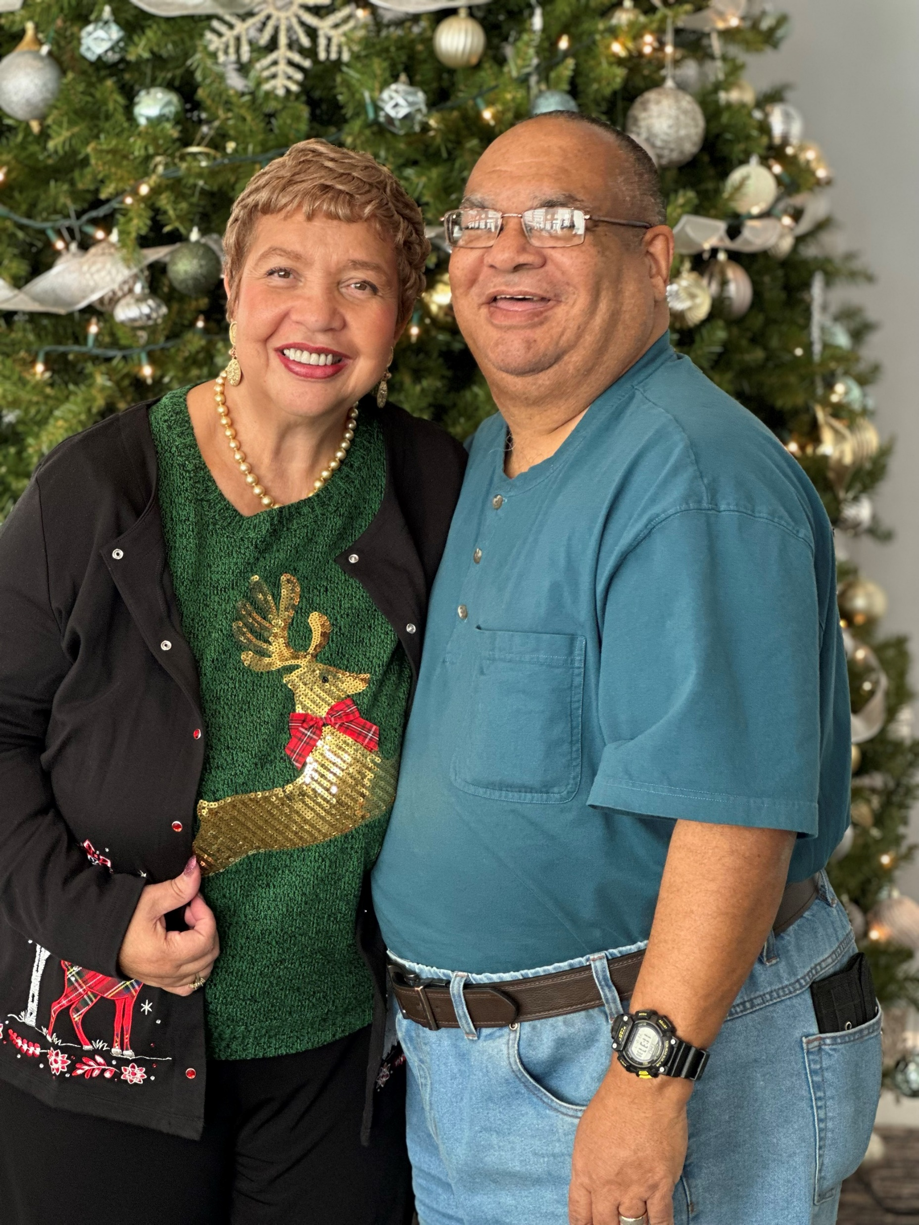
AGA Holiday’s Celebration

Slide 5
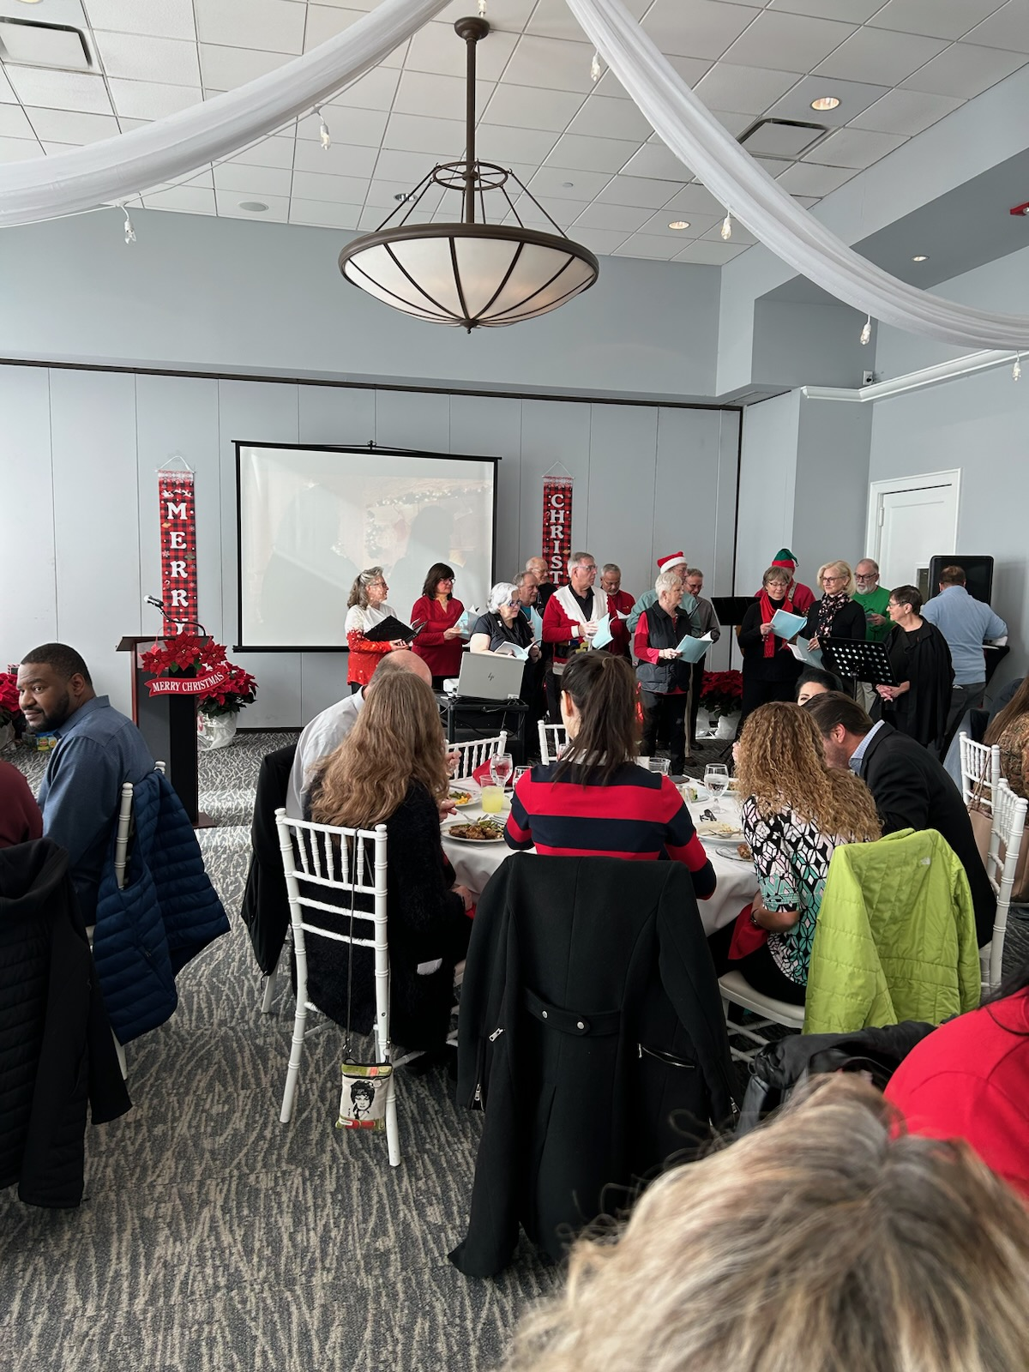
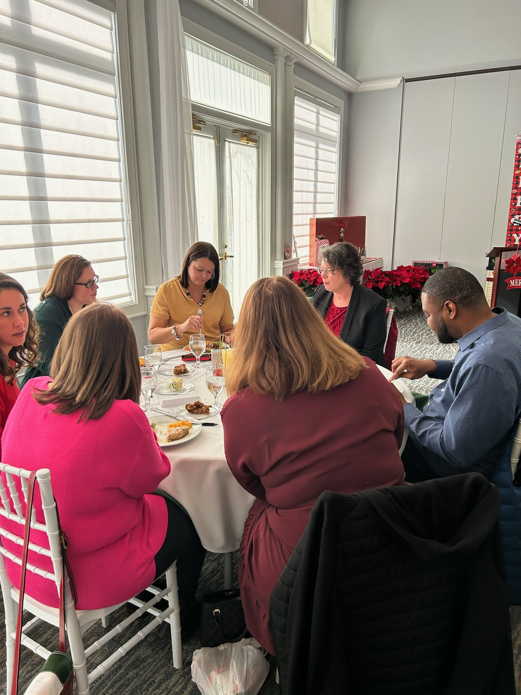
AGA Holiday’s Celebration

Slide 6
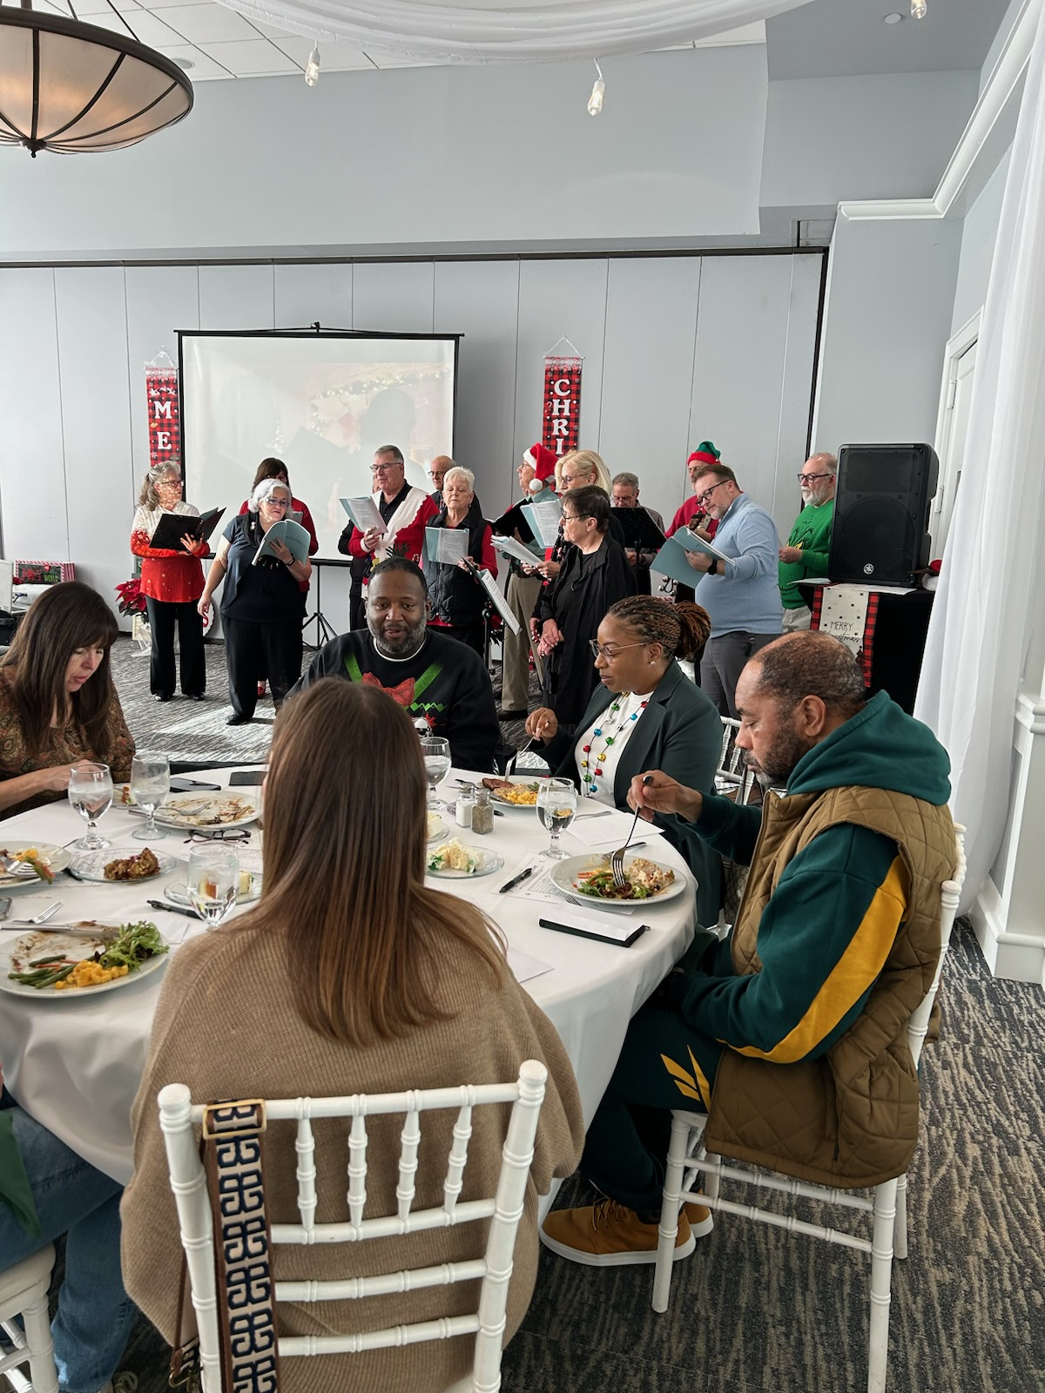
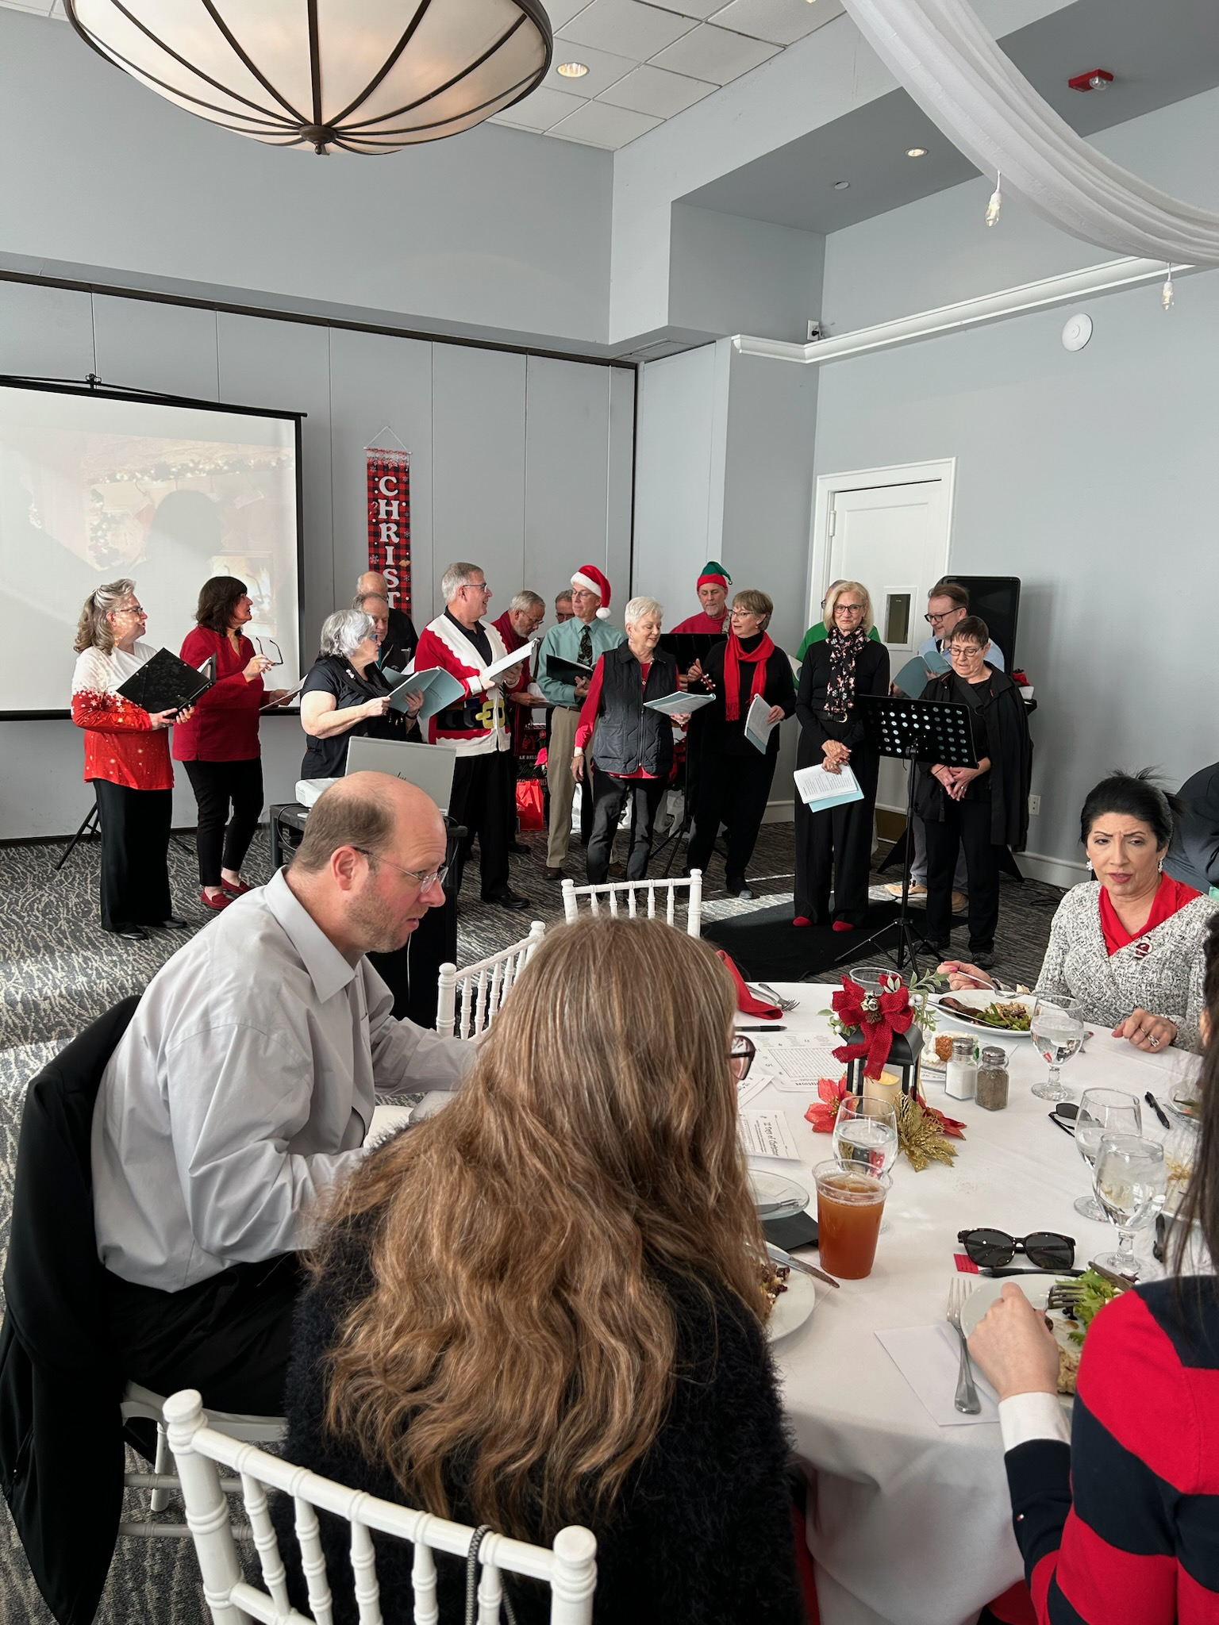
AGA Holiday’s Celebration

Slide 7
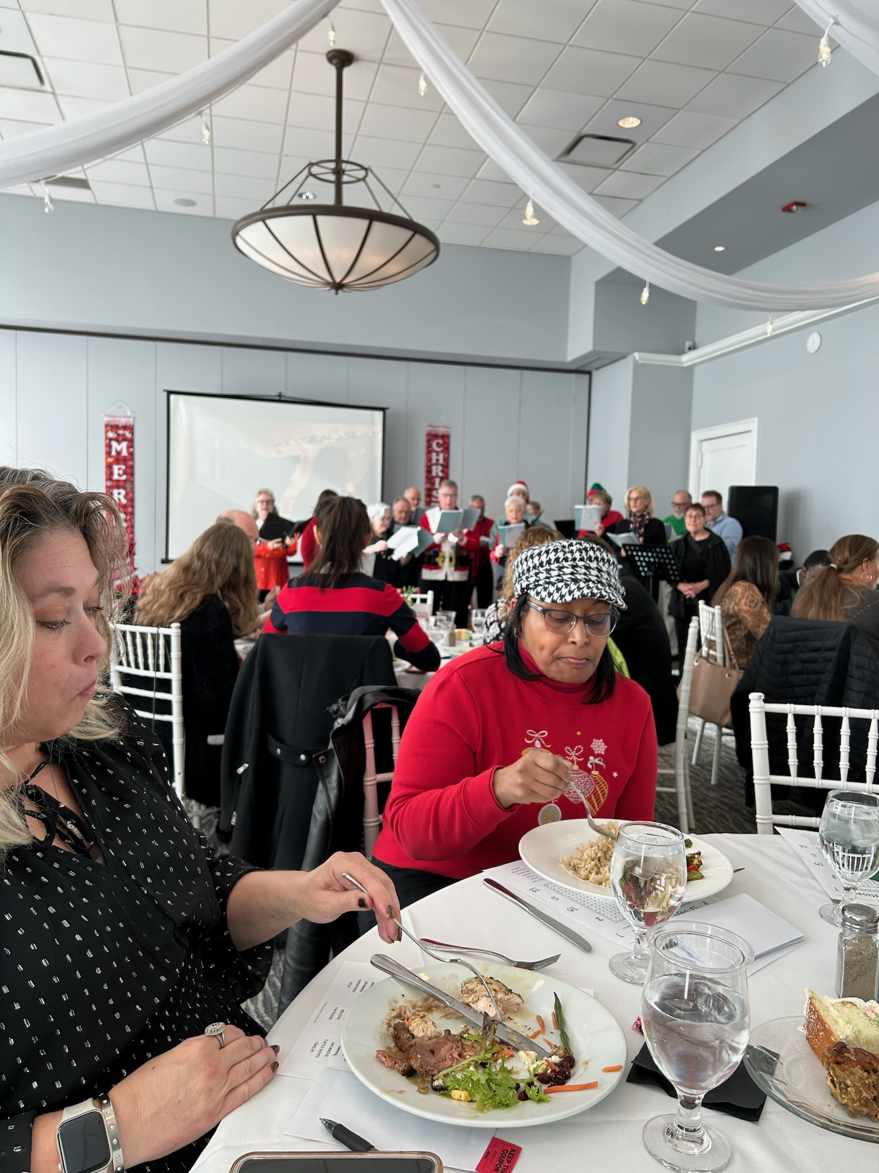
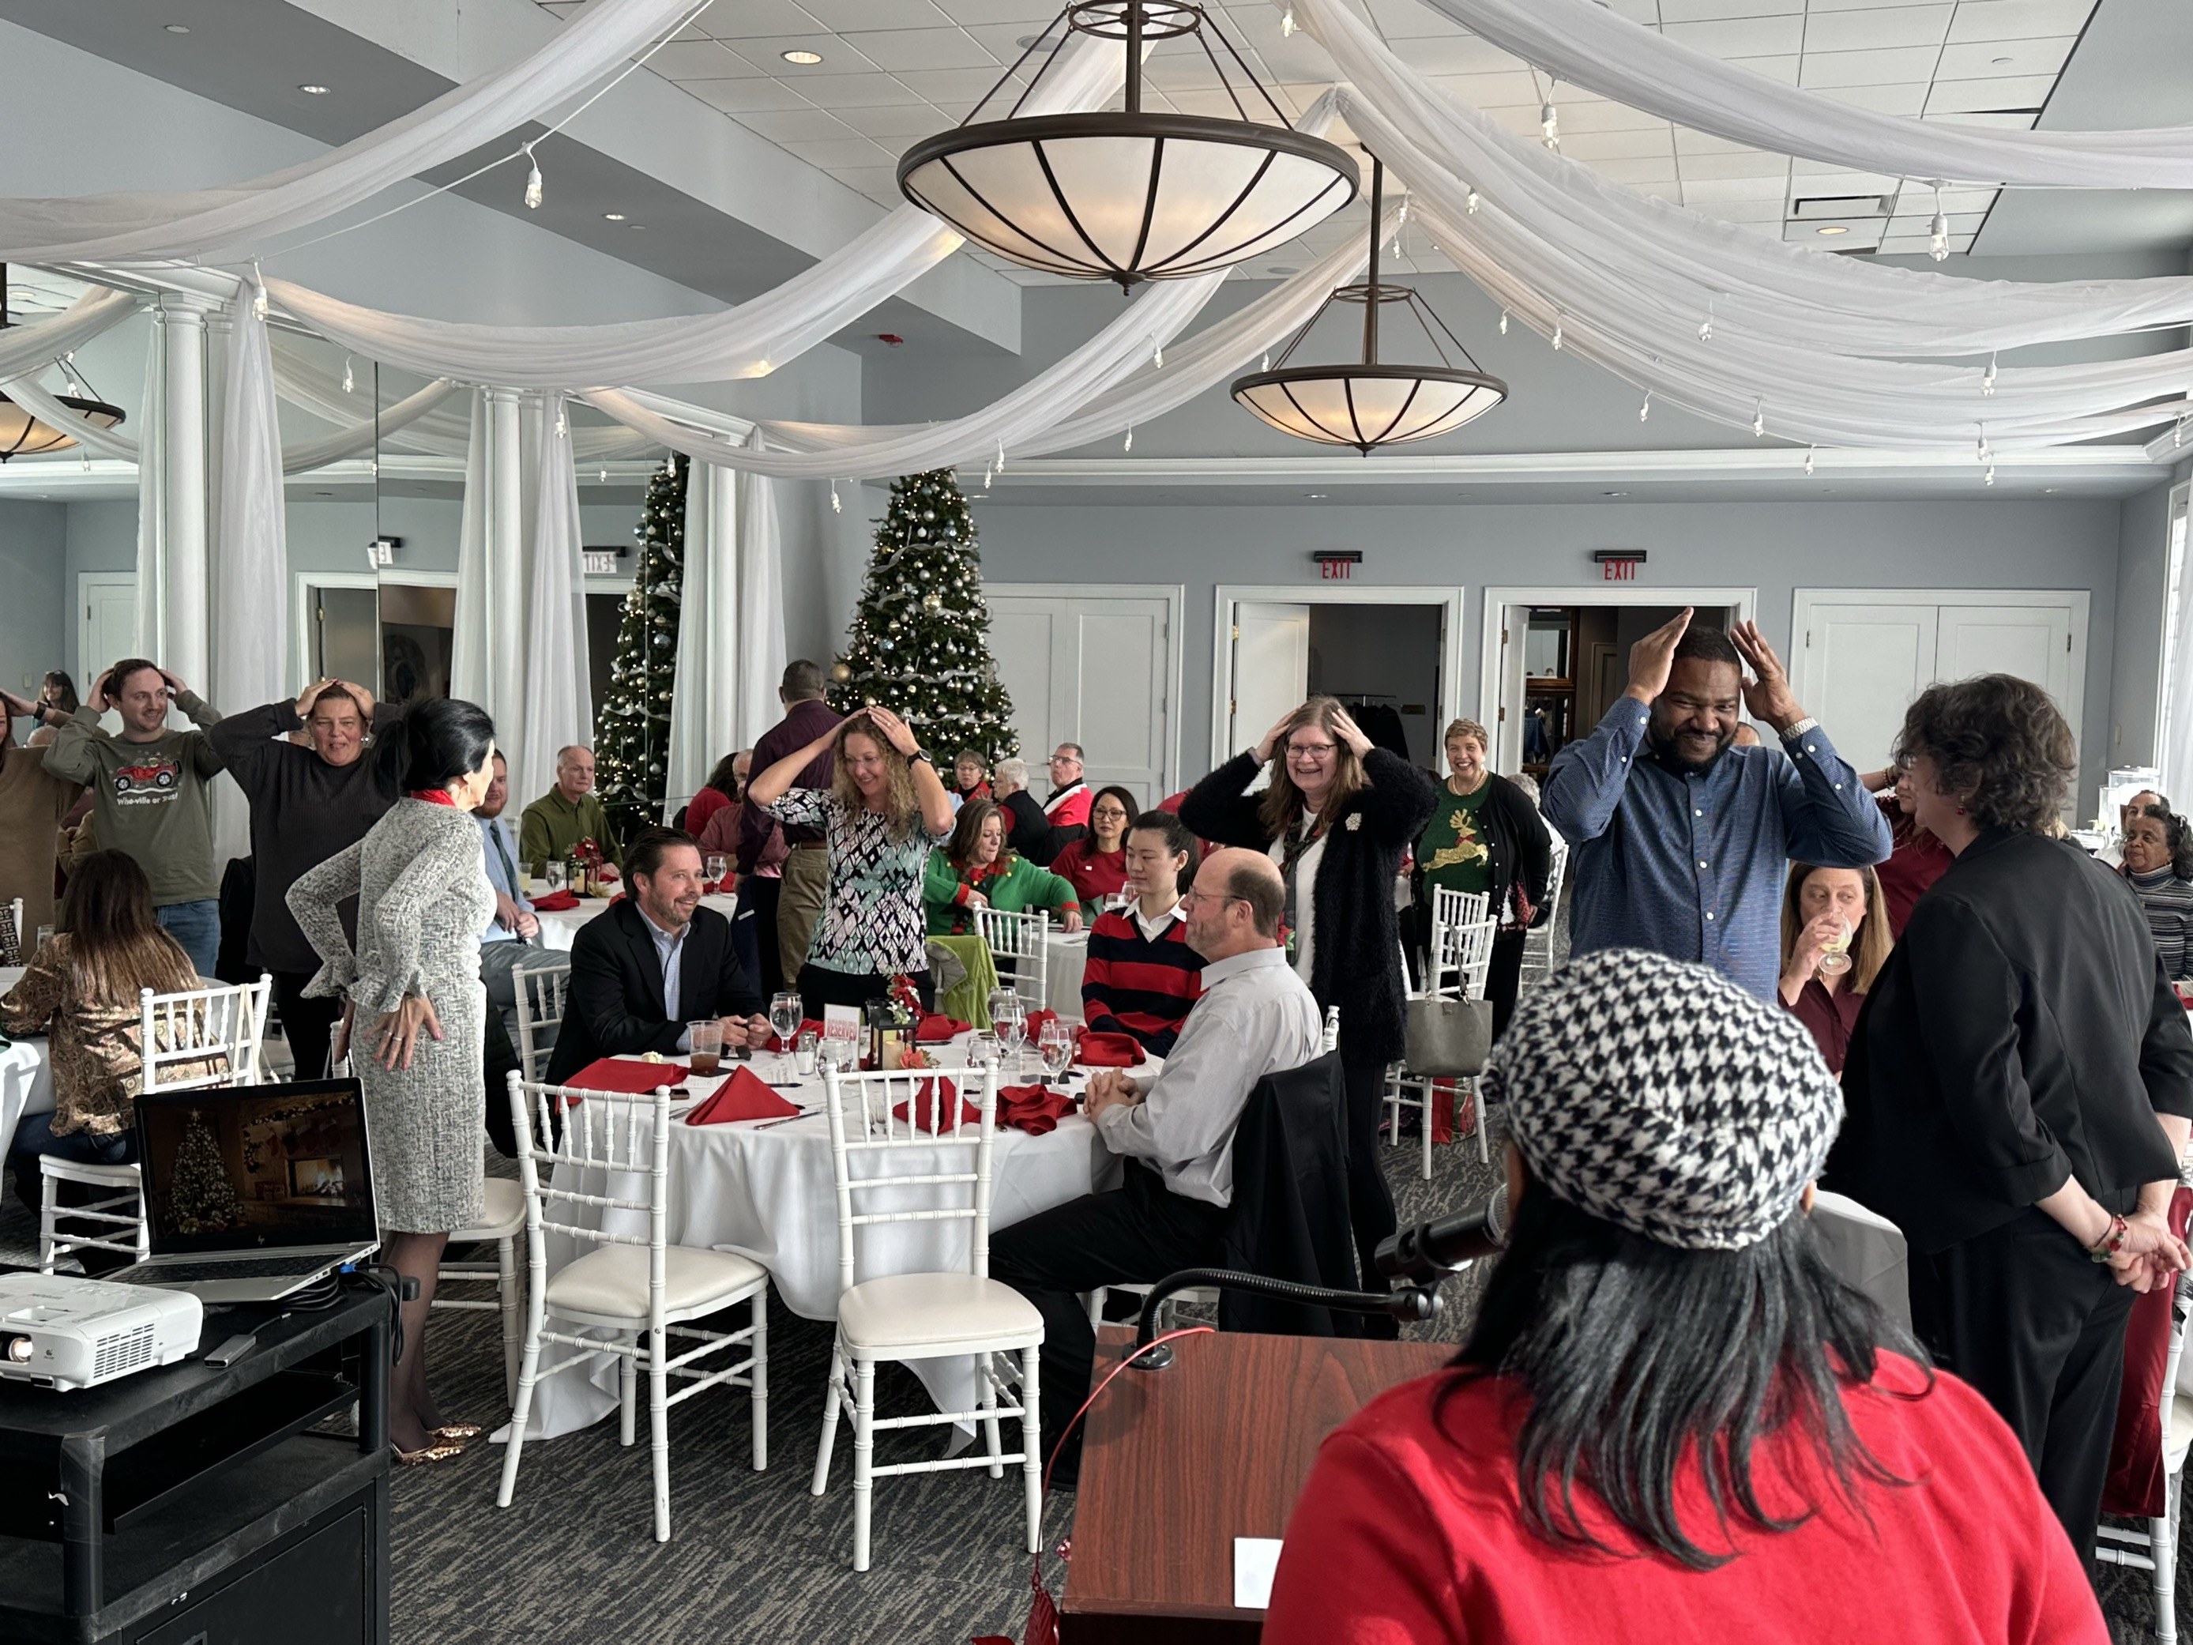
AGA Holiday’s Celebration

Slide 8
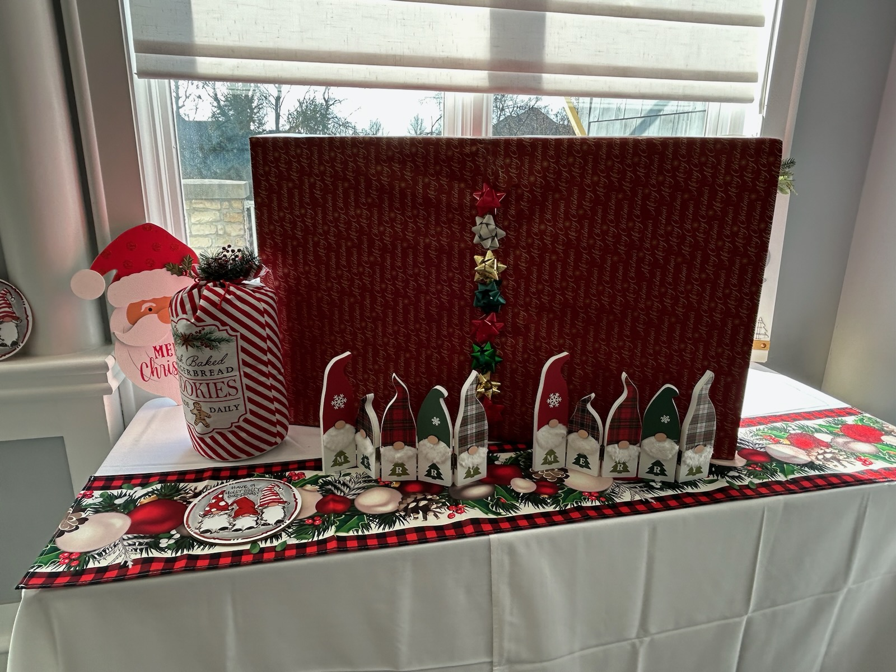
AGA Holiday’s Celebration

Slide 9
Have a very Merry Christmas 2023
Thank you all for your supports!

