Slide 1
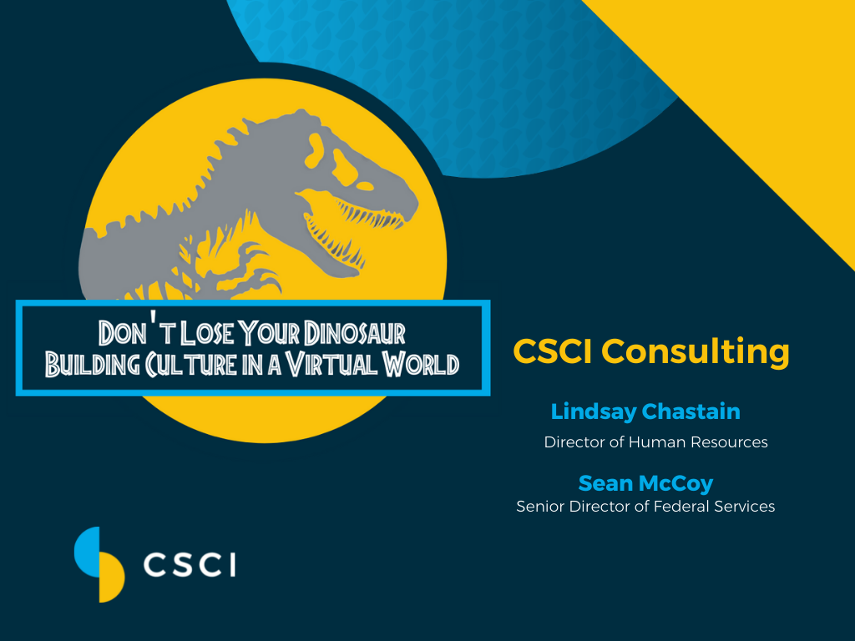
Notes:
Learning Objective: Attendees of this presentation will gain an understanding of the role that culture plays in the workplace, the importance of building and maintaining culture, and best practices for facilitating in a remote environment.

Slide 2
Introduction Video
Clip Credit: Step Brothers. Directed by Adam McKay, Columbia Pictures, 2008.

Slide 3

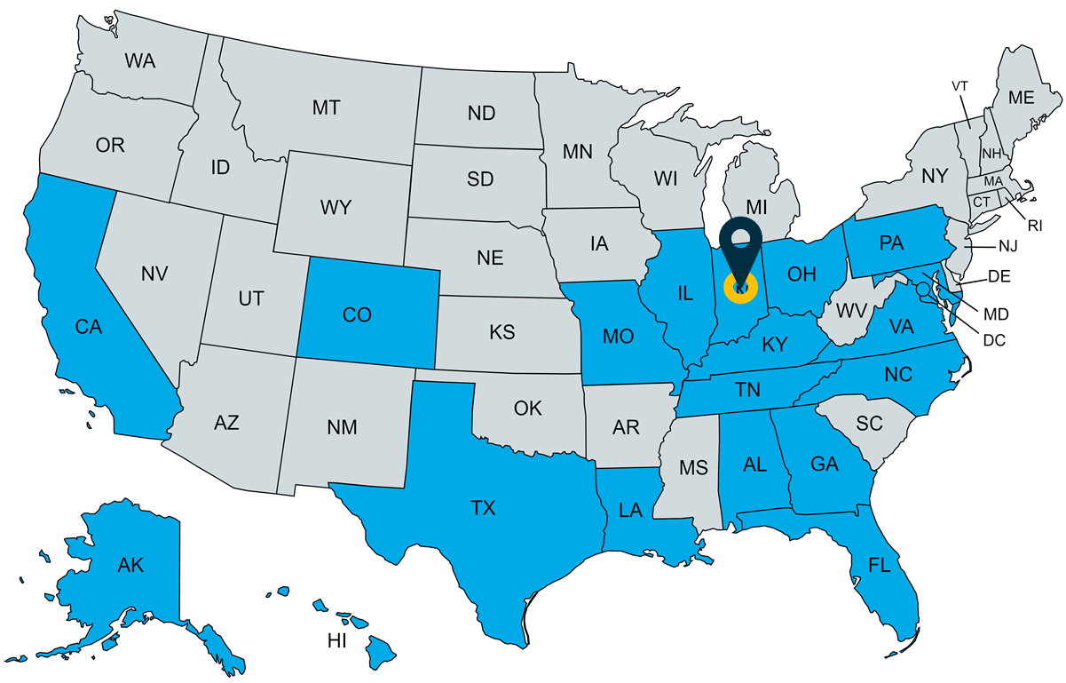




Who We Are
Founded in 2002
Woman-Owned Small Business
Headquarters in Indianapolis, IN
ENTERPRISE IT
Application Lifecycle Development
Cyber Security
Data Analytics and Business Intelligence (BI)
Data Warehousing, Integration, and Migration
Enterprise Architecture
ERP Management and Integration
Help Desk Management
IT Program, Project, and Portfolio Management
Web and Mobile Application Development
FINANCIAL MANAGEMENT
Audit Remediation and Sustainment
Enterprise Risk Management (ERM)
Financial Reconciliation, Data Mining, and Analysis
Governance, Risk, and Compliance
Planning, Programming, and Budgeting Execution (PPBE)
Risk Management and Internal Control Program (RMIC)
MANAGEMENT CONSULTING
Acquisition and Program Management
Business Process Reengineering and Standardization
Enterprise Integration
Executive and Administrative Support Services
Knowledge and Change Management
Strategic Planning
Training Support Services
3
Notes:
CSCI Consulting, Inc. (CSCI) is an award-winning, woman-owned small business (WOSB) that prioritizes teamwork, accountability, and loyalty.
Delivering consulting services to Federal, State, and commercial clients nationwide
Our company has a proven twenty (20)-year track record of hiring personnel with extensive technical and professional skills and knowledge for roles within Government entities.
Since our founding in 2002, we have built our business on mobilizing highly skilled resources to meet aggressive deadlines and ever-changing situations.
With a company motto to “Do what is right, always,” our diverse portfolio allows us to adapt and scale quickly and respond immediately to client needs.
Portfolio of services ranges from Financial Management and Internal Control, to System Integration and Sustainment, and Management Consulting.
Associates and clients spread across the country. Diverse portfolio of work means that we have a blend of skillsets and personalities. The geographic and professional spread means that a 1-size-fits-all approach is not always feasible.

Slide 4

Our Dinosaur
Culture is Our Dinosaur.
  Putting people first.
  Doing what is right, always.
  Go above and beyond.
  Work hard, play hard.
Culture is the reason people “want” to come to work
  People feel they are a part of something
  Engaged and contributing to a cause
  Their environment reflects them as individuals
Notes:
Culture is CSCI’s dinosaur. Our Culture is how we live our values. It is an important part of our strategy.
Regardless of your profession or field, we are all professionals in the people business. People support and depend on each others to achieve outcomes.
Why does culture matter? Culture is what gives us an identity. It may be the team you are on, the project you support, or the agency/company you work for.
What is unique about CSCI is that, because we perform services for clients, we also inherent our client’s environment. We typically work “extra-hard” to ensure that our associates feel like they are first and foremost a part of CSCI as a company.

Slide 5







Building a Strong Team
Hire the Right People
Maximize Strengths and Minimize Weaknesses
Provide Feedback on a Regular Basis
Conduct Performance Reviews
Keep your finger
on the Pulse
Facilitate Engagement
Notes:
Hire the right people for the job. Ensure the right people are in the right seats. Balancing team dynamics means looking for diversity to include a mix of skillsets, personas, and expertise. Great teams come in variety packs, with each member contributing their best with different strengths. Look to build teams that can relate to one another.
Maximize strengths and minimize weaknesses. Having the right people is step one, but true success comes from understanding their strengths and weaknesses (as we all have weaknesses). Recognizing these areas helps put people in the right areas to be successful and execute the mission.
Provide feedback on a regular basis. Giving consistent feedback, both positive and constructive, will help people know what they are doing well and inform them of areas they can improve upon. Providing feedback allows people to develop into the best version of themselves, adding to the overall strength of the mission.
Activate Performance Reviews. If you are a manager, performance reviews are important as they provide the opportunity for face time and for every employee to feel heard. It gives them a safe space to talk about themselves and reflect on their goals and achievements. Make the effort to ensure you have valid feedback and that you follow up on helping any actionable steps that are discussed. It is an opportunity to ensure people know they are appreciated, and you are setting aside the time to understand and help facilitate their goals. If you are not a manager, feedback on performance is still important. Thanking a colleague for helping you, going out of your way to make sure their supervisor is aware and even sharing peer-to-peer feedback are all things that can be beneficial in strengthening your work environment.
No matter your role, remember we are in the people business. People are our Product. Invest in each other.
The value of feeling valued
Keep your finger on the pulse. To maintain cohesive teams, you’ll need to continually monitor team dynamics. This can be done through work or team building activities that help people work together and ensure that everyone is pulling their weight. You can also use tools such as engagement surveys and solicitation of feedback from personnel.
Facilitate Engagement.
Go the extra mile to make people feel like they matter
Ensure people are appreciated
Ensure people are engaged
Ask questions and guide people to solutions. Make yourself available to the team and open to feedback and suggestions. Provide a space where team members feel they can connect with you and with each other. Encourage an open dialogue for new ideas and working together —it will build trust, propel your team forward, and strengthen your mission.

Slide 6


The Pre-Historic World
In-person Interviews
“First Day Experience”
Team Lunches
Quarterly Team Building Events
Visiting Associates at Client Site
Company Newsletters
Associate Recognition
Large Scale Corporate Events
Notes:
Prior to transitioning to a virtual environment, we implemented best practices for an in-person setting.
In-person interviews were mandatory for any new hire.
We established a “First Day Experience” protocol to make sure new hires felt welcomed and energized. We would introduce a person to the team, clients, folks that would be helpful to them. We typically always took an associate out to lunch for their first day.
Routinely had Team Lunches, at least monthly, to maintain morale and build comradery.
On a Quarterly basis, we held team Building Events. Whether going to a sporting event, escaping from a panic room, or going out to a karaoke bar – we wanted our teams to have fun together.
From a corporate perspective, we made sure to visit associates at Client Sites. This was critical to making sure they felt the “connection” to CSCI, not just their client.
We sent periodic Company Newsletters to highlight milestones, accomplishments, life events, and spotlights on current associates.
We recognized and track associate “kudos” from clients and recognized achievement through an awards program.
CSCI was known for some of our larger-scale Corporate Events, specifically the holiday parties. Associates and spouses would come to Indianapolis for “the party” and was our way of saying Thank You each year.

Slide 7

The Virtual World
Remote Engagement Plan
  Virtual Face to Face
  Enhanced Associate Recognition Program
  Virtual Team Building
  Virtual Company Celebrations
CSCI Management Training Program
  Virtual Monthly Management Meetings
  Virtual Annual Management Meeting
  Customer Service Training
  Client Interaction Training
Notes:
The virtual world changed things quickly. Fortunately, we had best practices in place and recognized the importance of culture in our brand. We also had remote teams in place that were already accustomed to working in a remote environment – so we leveraged their ideas and best practices.
Remote engagement plan:
We put a plan in place, to foster the same atmosphere we used to have in person.
Monthly Management meetings were conducted over Teams
Performance Reviews were conducted over Teams
We recognized that in a virtual environment it is more common for associates to feel “unseen” so we enhanced our Associate Recognition Program to “make it personal” including celebrating client kudos, personalized calls from Management on birthdays and special occasions, anniversary emails and phone calls, etc. (Again, the value of feeling valued)
We held our annual management meeting virtually in Teams
Sponsored Virtual booths at Conferences
Developed quarterly virtual events for associates – whether March Madness, Giveaways, Games, Competitions
We also improved our marketing and social media presence with a focus on developing more branded content
Management Training
We developed a training program for our Managers
Focused on the importance of Customer Service when virtual, with a theme of going the extra mile
Provided training on client interactions and associate interactions and how to navigate challenges in a virtual environment.

Slide 8

The Virtual World pt. 2
Virtual Interviews
  Phone Screen
  Virtual Face-to-Face
  Virtual Meet the Team
The First Day – An Enhanced On-boarding Program
  Employee Training
  New Associate Alerts
  The “Welcome Kit”
  Lunch a la Delivery
Notes:
We adapted our process of building teams:
We conducted phone interviews and then mandated virtual face-to-face meetings over Teams, Skype, Zoom, or Facetime as a required step prior to extending an offer.
The First Day for many newly hired employees was a problem. Anyone that has started a new job or changed jobs knows that the odds of having functioning IT equipment on the first day are incredibly low. We used to make that first day less painful with taking an associate out to lunch, going over the handbook, introducing them to people on the team, etc. and tried to replicate that in the virtual setting to the extent possible.
Our goal was to enhance the on-boarding experience in a virtual environment so that associates had a consistent and positive experience, whether in the office or from their couch.
We developed anew associate training program, which could be accessed from a personal device, to help ensure each associate got a consistent message on their first day.
We sent out new associate alerts to the entire company and included a picture of the person. They may not meet in person, but we help put a face with a name.
Our Welcome Kits are still a hit, we kept those around.
Lunches took a back seat for a while, but then re-emerged with DoorDash/Uber Eats. While the gesture of offering food is the same, we still miss the bonding that occurs with conversation over food. We realized quickly that watching people eat over a Teams call with cameras on is not ideal for anyone.

Slide 9

Best and Worst Practices
Best Practices
  Engagement Planning
  “Taste of Indiana” Holiday Box
  Handwritten Notes
  Recognition Programs
Worst Practices
  Doing nothing and assuming there is no impact.
  Do not send a “Gummy (Care)Bear” Package during the summer. The Gummy Bears will melt.
Notes:
We covered both ends of the spectrum. Not everything we tried was successful.
We tossed out our holiday parties and started sending gift boxes. We went with a “Taste of Indiana” theme and packaged each box with foods, snacks, and gourmet treats from Indiana companies. Each box included a handwritten card, hand signed by every member of our corporate team. The feedback was overwhelming.
Handwritten Notes: These can be thank-you cards, birthday cards, holiday cards – the reason for sending is not as important as the personal touch that it brings.

Slide 10

Don’t Lose Your Dinosaur
Identify the things that are most important to your culture
Develop a Remote Engagement Plan to ensure the important things are present
Continuously survey, evaluate, and improve
Prepare for the hybrid virtual + in person workplace
Notes:
Knowing what matters and having a plan are important, but adapting is critical to ensure you stay current with the times.
We went from in-person to virtual environments literally in a matter of days and remained virtual.
We solicit input from our associates; we want to know how we can improve. We are responsive to feedback, continuously evaluating how we can improve.
The next step on the horizon is a hybrid model?
Are you ready for that?
How should you prepare?
Have a plan. Adapt.

Slide 11
