Slide 1
Online Payment Options for Government
A Collections Perspective
Charmaine Cook, AAP
State Cash Manager
NM State Treasurer’s Office
505.955.1125
Charmaine.Cook@state.nm.us

Slide 2
Agenda
Available online payment options
Payment cost comparisons
E-Check payments
Fee options for card payments
Formula for creating a card payment
PCI DSS responsibilities
Questions

Slide 3
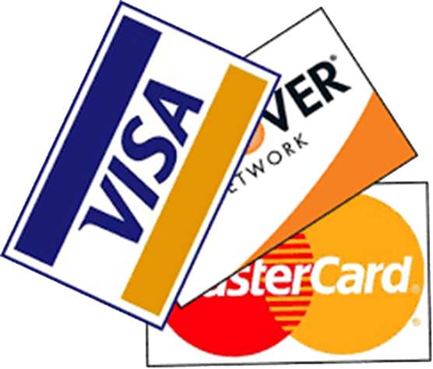
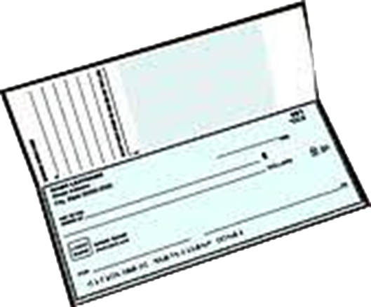
Online Payment Channels
1. Credit/Debit Cards
2. E-Checks (ACH Debits)
ACH
Debits

Slide 4
Average Processing Cost - $100 Payment
 | Check | E-Check | Credit/Debit Card
 | $1.10 | 30¢ - 90¢ | $2.00 @ 2% (card present) $2.50 @ 2.5% (card not present)
Who Pays | Check Issuer (government entity) | ACH Originator (government entity) | Merchant (government entity) OR cardholder

Slide 5
Average Processing Cost - $1000 Payment
 | Check | E-Check | Credit/Debit Card
 | $1.10 | 30¢ - 90¢ | $20.00 @ 2% (card present) $25.00 @ 2.5% (card not present)
Who Pays | Check Issuer (government entity) | ACH Originator (government entity) | Merchant (government entity) OR cardholder

Slide 6
E-Check Payments
Many online platforms provide Merchants the option to also offer E-Check payments
Cardholder enters bank account # and bank routing #;
their account is debited via ACH for payment
Entering account information and initiating payment serves as authorization allowing Merchant to debit the account one time
There are separate bank fees for E-Check payments;
no service fee option; Merchant pays fees
Good customer service payment option
Notes:
E=checks have been around a long, long time. An e-check is simply a way for an individual or a business to give you permission to debit my account one time, and one time only, on a specific date and for a specific amount.
Longer than e-checks have been around, we had direct debit arrangements. In that case, I’m giving you permission to debit my account on a periodic basis (weekly, monthly, quarterly or annually) for a specif amount and for range of dates.

Slide 7
Fee Options for Card Payments
“No Fee to Cardholder” processing
Convenience Fee processing
VISA Service Fee processing

Slide 8
Fee Options for Card Payments
“No Fee to Cardholder” Processing
  Cardholder initiates $100 payment $100.00 transaction created
Convenience Fee Added
  Cardholder initiates $100 payment $100.00 transaction created
  Convenience fee added (sample flat fee of $2.25) $2.25 transaction created
  Total charges to Cardholder $102.25 total
VISA Service Fee Added
  Cardholder initiates $100 payment $100.00 transaction created
  Service fee added (sample of 2.5% fee used) $2.50 transaction created
  Total charges to Cardholder $102.50 total

Slide 9
Convenience Fee Models
Vendors offer Convenience Fee services with many flavors
Allow merchants to designate a fee to cardholders to help offset the additional costs of accepting card payments
No limitation on transaction types (MCC Codes)
Convenience fee can be set as:
  A % of transaction, like 2% of payment amount, or
  A flat fee, such as $2.25 per transaction
Funding from Convenience Fees may be credited to:
  Merchant services vendor to pay for card processing fees, or
  Merchant, who then pays fees to the vendor separately
Notes:
Convenience Fee models are services designed by vendors, and

Slide 10

VISA Service Fee Program
For online payments only
Program designated for governments and higher education only
Limited set of transaction types (MCC Codes) are eligible
Merchants sign a separate addenda to Merchant Services Agreement to participate
Merchants are reviewed by VISA and accepted into program
Notes:
VISA
How does the VISA program affect other card issuers?

Slide 11
VISA Service Fee Program (continued)
Merchant accounts, called MIDs (Merchant ID)
  One MID created in Merchant name & tax ID for payments
  One MID in Financial Institution name & tax ID for service fees
Merchant is not charged any fees for card payments made under Service Fee Program
Service Fee is always a % of card transaction
Service Fee % is determined by Financial Institution based on Merchant history; strategy is have the service fee cover cost of card transaction

Slide 12
Formula for Creating a Card Payment
Merchant |  | Cardholder |  | Merchant Acquirer |  | Card Payment Processed
 |  |  |  |  |  | $$$
Government Entity |  | Owner of the Debit/Credit Card |  | Financial Institution with Settlement Relationships with VISA, MasterCard, Discover, American Express |  | Card Payment Processed
1 | X | 1 | X | 1 | = | 1

Slide 13
Formula for Creating a Card Payment
Merchant |  | Cardholder |  | Merchant Service Providers |  | Merchant Acquirer |  | Card Payment Processed
 |  |  |  | Vendor A Vendor B Vendor X, Y, Z |  |  |  | $$$
Government Entity |  | Owner of the Debit/Credit Card |  |  |  | Financial Institution with Settlement Relationships with VISA, MasterCard, Discover, American Express |  | Card Payment Processed
1 | X | 1 | X | Many variations and combinations of services are possible | X | 1 | = | 1

Slide 14
What is PCI DSS?
PCI - Payment Card Industry and DSS – Data Security Standards
  If you accept or process payment cards, the PCI Data Security Standards apply to you.
PCI Security Standards Council
  The Council was founded in 2006 by American Express, Discover, JCB International, MasterCard and Visa Inc. They share equally in governance and execution of the Council's work.
  The PCI Security Standards Council touches the lives of hundreds of millions of people worldwide. A global organization, it maintains, evolves and promotes Payment Card Industry standards for the safety of cardholder data across the globe.
  https://www.pcisecuritystandards.org/pci_security/maintaining_payment_security
Notes:
JCB International Credit Card CO, LTD - JCB is Japan's premier and only international payment brand, with wide acceptance in Japan and Asia. Currently on the Discover Network in the US.

Slide 15
Determining Factors for PCI DSS
In whose name are card transactions processed?
  Merchant name and Tax ID—Government Entity is responsible
Who touches cardholder data?
  Merchant, vendors, acquirer
Who stores cardholder data?
  Hopefully not the merchant
Does cardholder data pass through your system/network?

Slide 16
PCI DSS Prioritized Approach

Slide 17
PCI DSS is not just for IT

Slide 18
Questions

