Slide 1
Attributes of High Performing Organizations
Association of Government Accountants
New Mexico Chapter
April 6, 2018

Slide 2
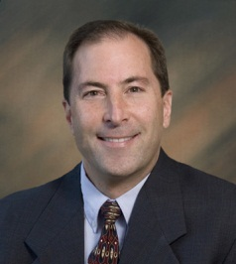
Presenter
Mark Steranka
Partner
Moss Adams

Slide 3
Agenda
    Market Factors
    A Different Perspective
    Employee Engagement
    Q & A

Slide 4
Market Factors

Slide 5
Employer Challenges
HIRING NEEDS
POPULATION
DEMOGRAPHICS
Human Capital strategies
EMPLOYEE ENGAGEMENT

Slide 6
Population Demographics
 | 2017 Age Range | 2020 Median | Total Count
Traditionalists | 72-89 | 84 | 31 M
Baby Boomers | 53-71 | 65 | 74 M
Generation X | 37-52 | 48 | 66 M
Generation Y | 17-36 | 30 | 86 M

Slide 7

Hiring Needs – Top 10 States in the U.S.
Utah Washington Idaho Nevada Florida | Oregon Arizona Georgia California South Carolina

Slide 8
Employee Engagement
    Annual Gallup Poll and Report
    Since 2000
    Survey approx. 100,000 workers; 18+ years of age
    Determine level of employee engagement
    Results consistently less than 32% engaged
      Approx. 50% not engaged
      Approx. 18% actively disengaged
    Associated productivity loss of approximately $500 billion per year

Slide 9
A Different Perspective

Slide 10
How Does the Market View You?
    What’s your organization’s DNA?
    How do you resonate with your customers?
    How do you differentiate from competitors?

Slide 11
How Do Your Employees View You?
    What’s your organization’s DNA?
    How do you engage your employees?
    How do you attract and retain the best talent?
    How do you achieve the highest and best use of your employees?

Slide 12
Golden Circle
What
How
Why

Slide 13
Employee Engagement

Slide 14
Four Attributes of High Performing Organizations
1 Plan
People 3
2 Perform
4 Communicate

Slide 15
Alignment = Engagement
    Plan: roadmap (goals, objectives, and action plan based on long-range vision, historical performance, SWOT analysis, and competitive assessment), broad-based input, all-inclusive distribution
    Perform: key metrics and performance targets to convey progress in achieving strategic goals and objectives
    People: human capital requirements to cultivate and compensate employees and execute strategic plan
    Communicate: ongoing communication on strategic plan, execution progress, and required adjustments

Slide 16
1 - Plan
Long Range View
Historical Financial Results
5-Year Strategic Goals
Annual Strategic Objectives
Community Stakeholder Input
5-Year Community Strategy
Annual Action Plan
Quarterly Action Plans
Metrics to Measure Results
Environmental Scan/Needs Assessment
5-Year Priority Initiatives
Annual Strategies & Tactics
Current SWOT Analysis
16

Slide 17
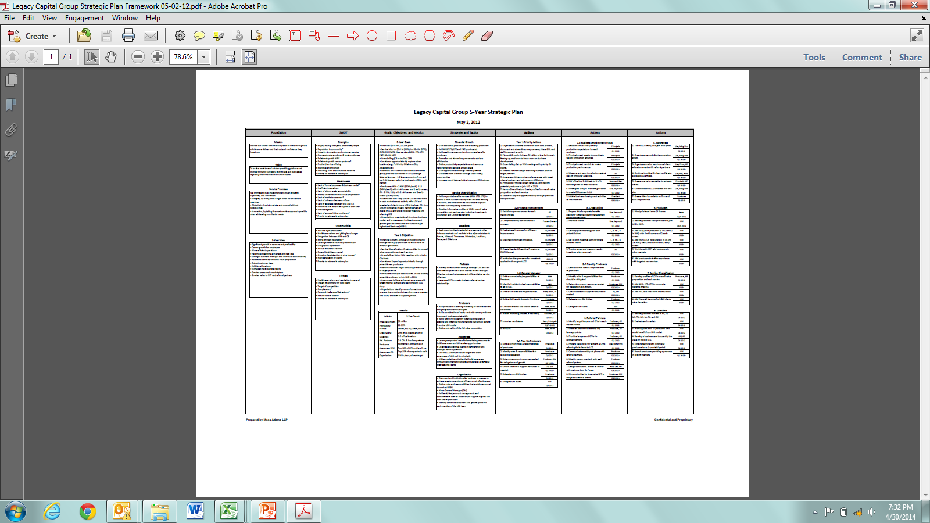
1 - Plan

Slide 18
2 - Perform
    Enterprise metrics
      Strategic goals
    Department metrics
      Key direct and support service objectives
    Individual metrics
      Organization values and/or management by objectives (MBO)

Slide 19
2 - Perform
Key Performance Metrics | Target
Enterprise Performance Strategic Initiatives | X
Department Performance Community & Economic Development Public Safety Public Works Utilities Parks & Recreation Finance Human Resources Information Technology Legal | X X X X X X X X X
Individual Performance Organizational Values and/or MBOs | X

Slide 20
3 - People
People
Manager
Program
Manager
Direct Service
Director
Staff
Department
Leaders
Executive
Office
Support
Service
Director
Technical
Manager
Functional
Manager

Slide 21

3 - People
Expert
Level of
Competency
Level in
Organization
Solid
Base
Service
Delivery
Communication
Team
Building
Technical Development
People Management
Competency

Slide 22
3 - People
Compensation |  | Performance |  |  | Annual
Component | Distribution | Company | Dept. | Individual | Max. Payout
Executives | X% | 50% | 25% | 25% | $
Management | Y% | 25% | 50% | 25% | $
Staff | Z% | 25% | 25% | 50% | $
Total |  |  |  |  | $

Slide 23
4 - Communicate
Key Performance Metrics | Target | Actual | Status
Enterprise Performance Strategic Initiatives | X | Y
Department Performance Community & Economic Development Public Safety Public Works Utilities Parks & Recreation Finance Human Resources Information Technology Legal | X X X X X X X X X | Y Y Y Y Y Y Y Y Y

Slide 24
4 - Communicate
    Communication Rhythm:
      Annually Strategic Planning
      Quarterly Enterprise Performance and Adjustments
      Monthly Department Performance and Adjustments
      Weekly Team Planning

Slide 25
Q&A

Slide 26
Presenter
Mark Steranka
Partner
Moss Adams
(206) 302-6409
mark.steranka@mossadams.com

