Slide 1

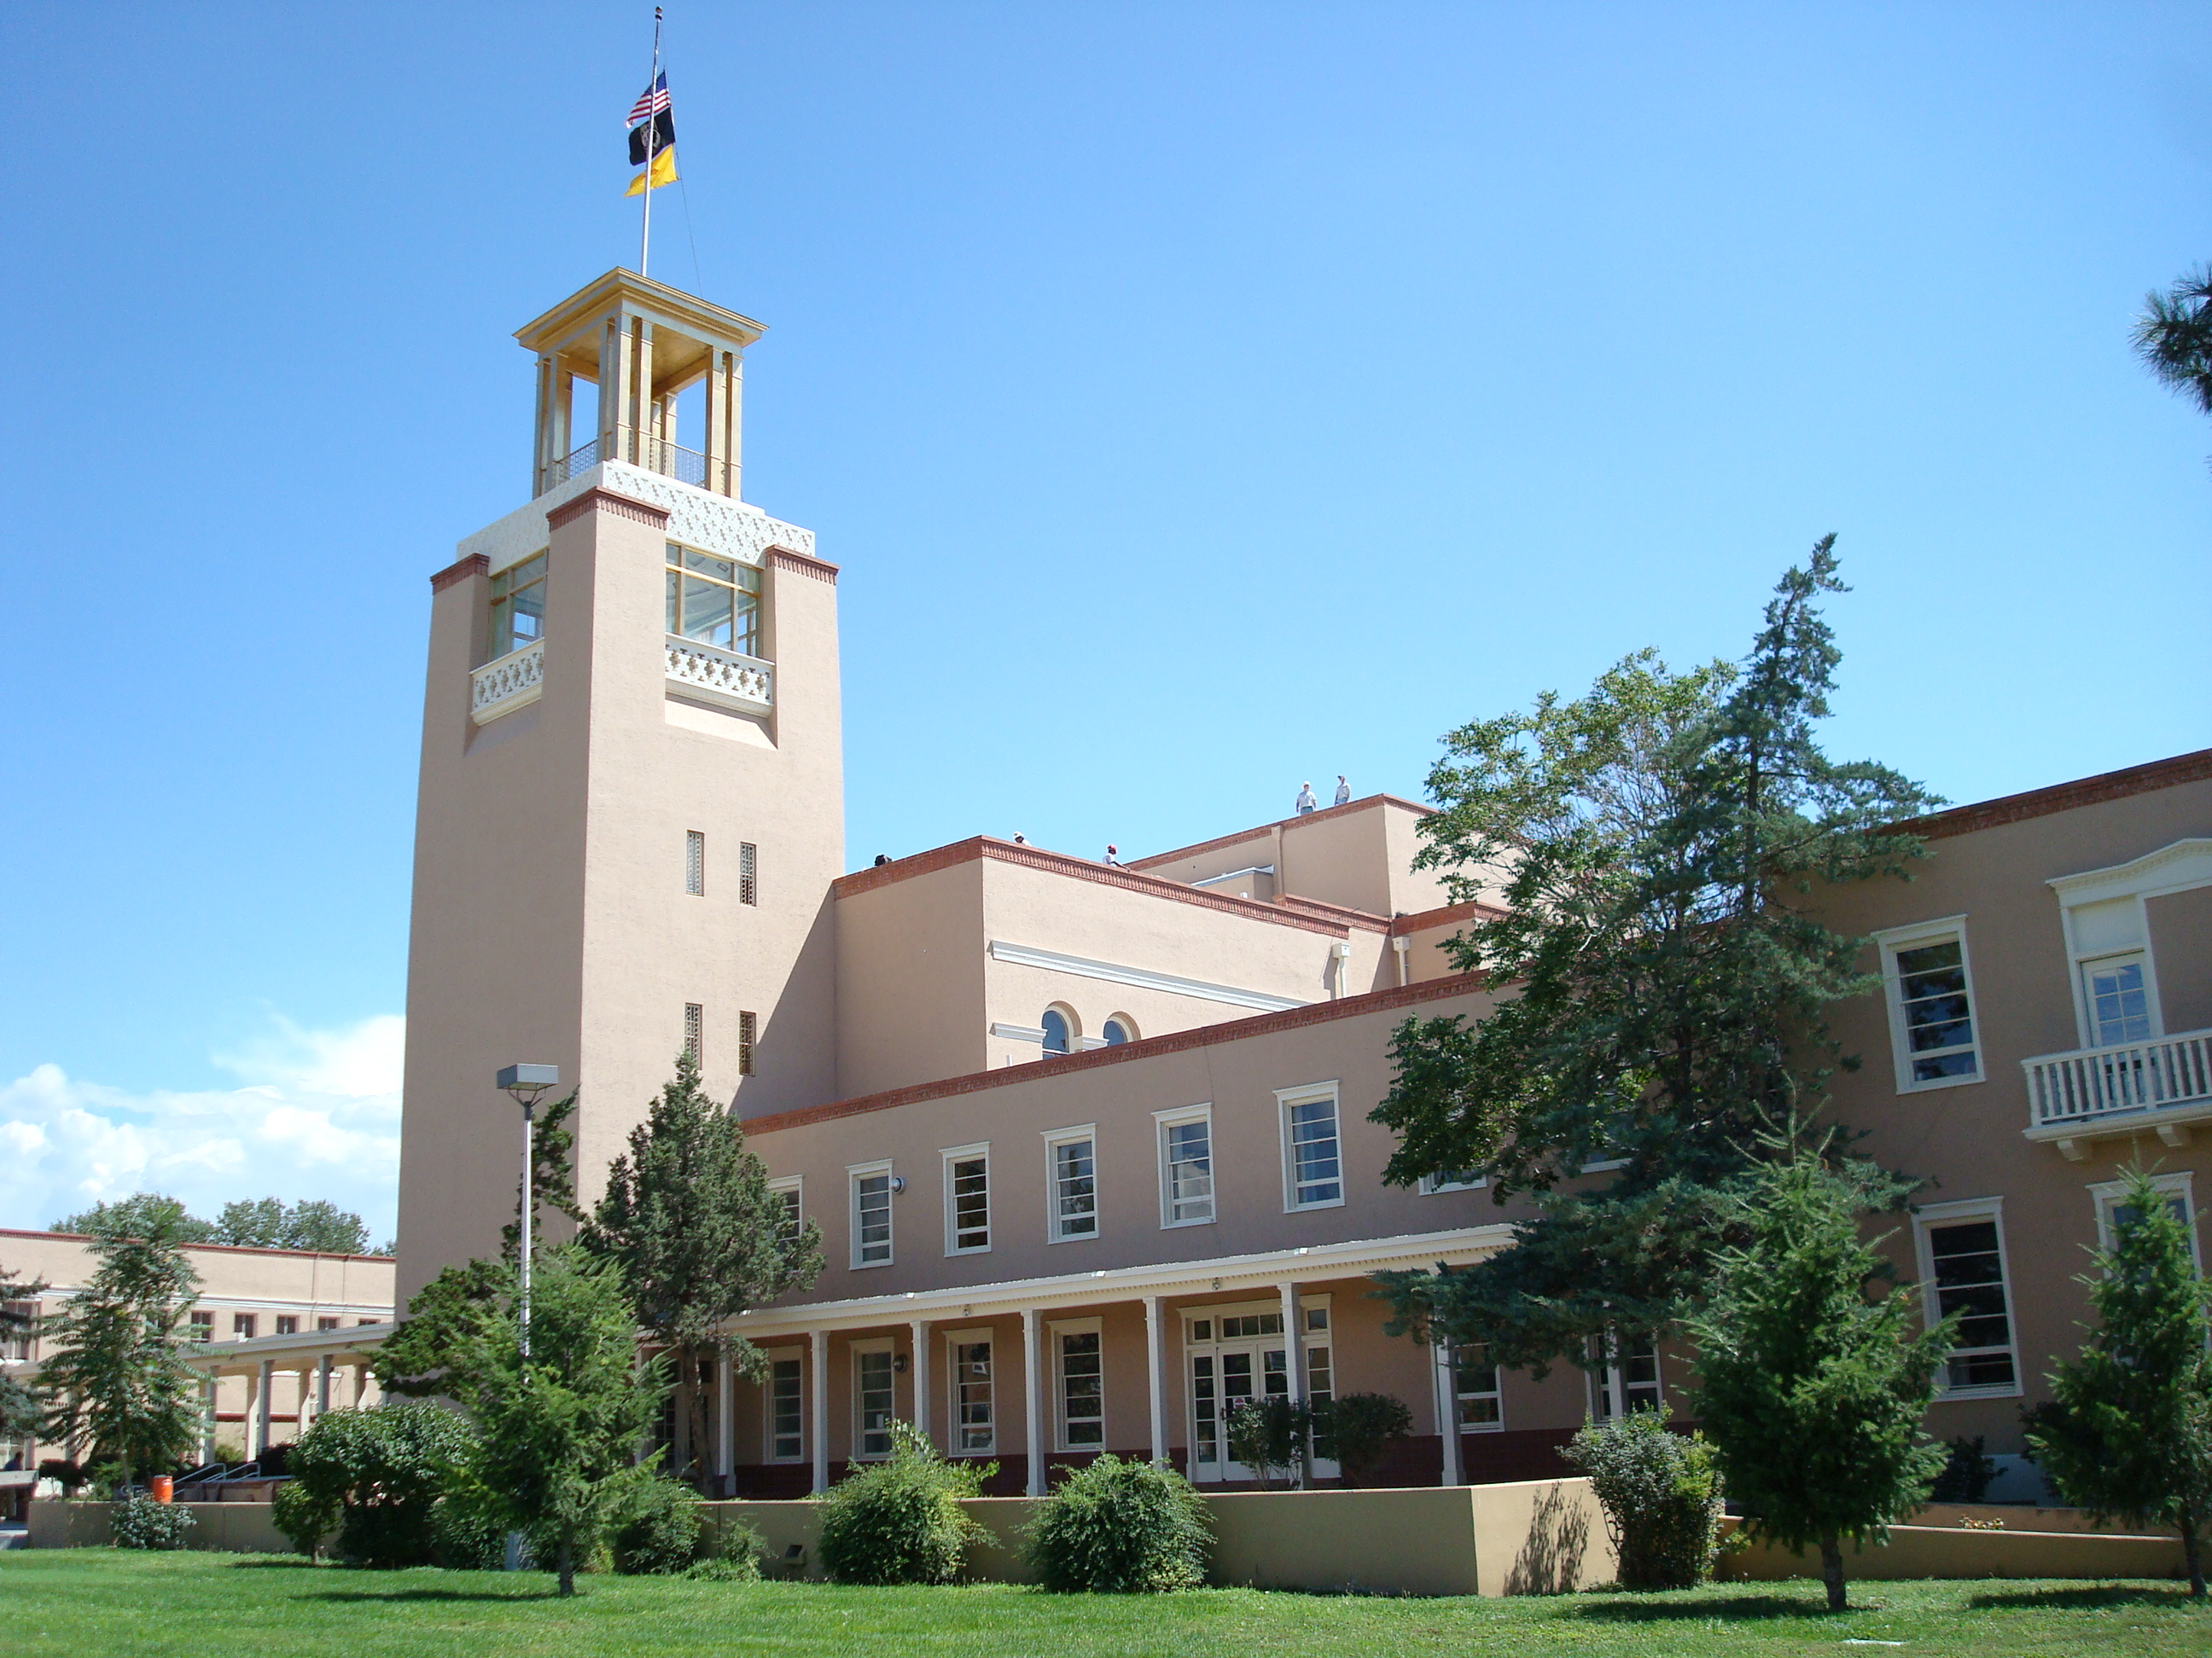

Local
Government
Division
Who we are ...What we do...

Slide 2
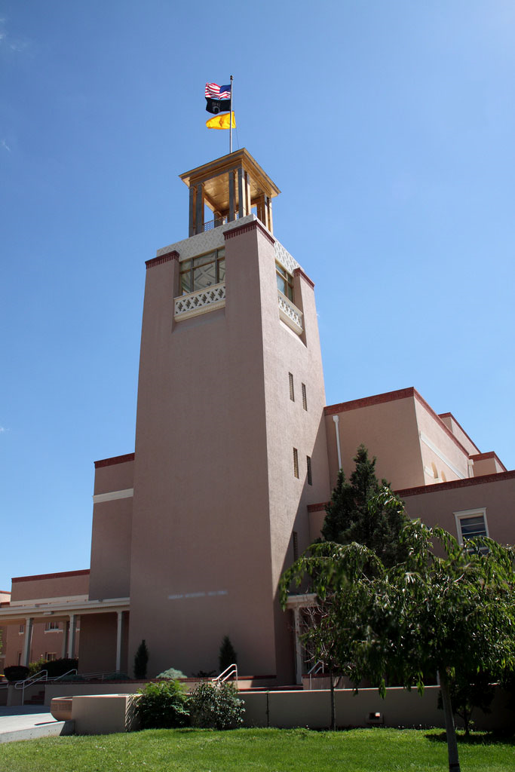
LGD Mission Statement
To assist local government entities, local representatives, citizens with appropriate use of public funds and to strengthen their ability to better serve New Mexico communities to improve their quality of life.

Slide 3
LGD Mission Statement
To accomplish this…
The Local Government Division (LGD) provides administrative and technical support to local entities throughout New Mexico to include counties, municipalities, special districts, and tribal governments.

Slide 4
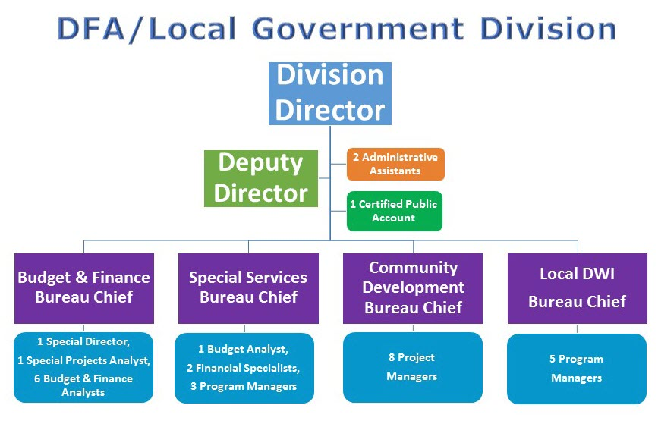
LGD Organizational Chart

Slide 5
Local DWI Bureau
Local DWI Program (LDWI)
Allocates Grant and Distribution funds, covered by a percentage of liquor excise tax
Serves to prevent or reduce the incidence of DWI, alcoholism, and alcohol abuse
A DWI Grant Council awards the funds to 33 counties
The LDWI Bureau distributes the funds
The goal is to make a difference at the local level
The Program covers 8 Primary Components:
Prevention Alternative Sentencing
Enforcement Coordination, Planning & Evaluation
Screening Compliance Monitoring
Domestic Violence Prevention Treatment
Six counties have social detoxification programs or alcohol related treatment services
Juvenile Adjudication Fund (JAF)
Provides an alternate adjudication process for juveniles charged with traffic offenses and other misdemeanors
A Grant application process with revenue generated from a $1.00 fee on misdemeanor traffic offenses

Slide 6
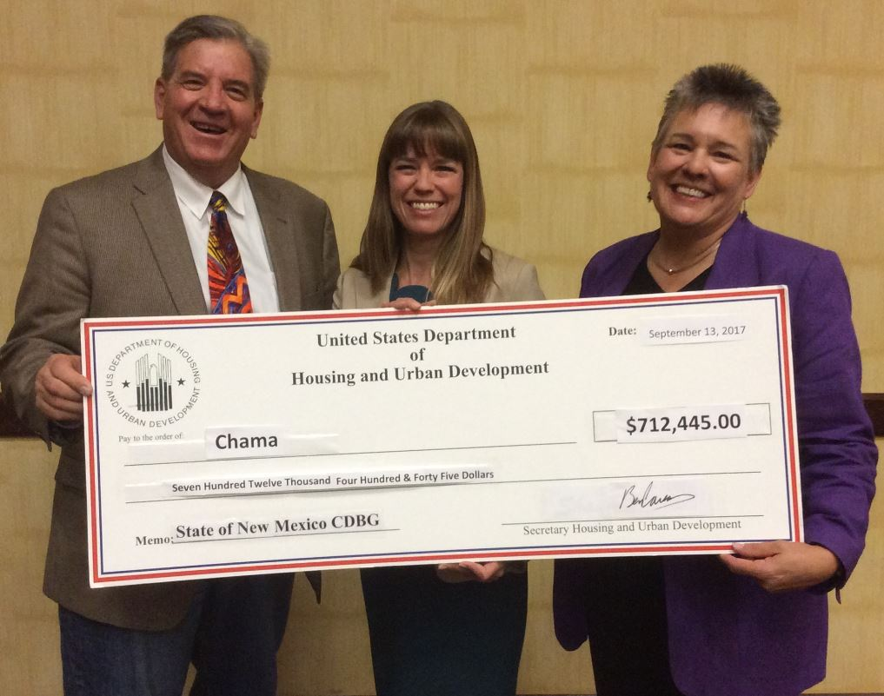
Community Development Bureau
Responsible for:
The HUD, Community Development Block Grant (CDBG) Program
The state’s legislative Capital Outlay grants
The CDBG program has a $10 million annual allocation and two national objectives:
Benefit low- and moderate-income persons
Address emergencies that pose a serious and immediate threat to a communities health or welfare
The CDBG is a Grant Program used in these areas:
Infrastructure
Planning
Economic Development
Housing
Emergency Grants

Slide 7
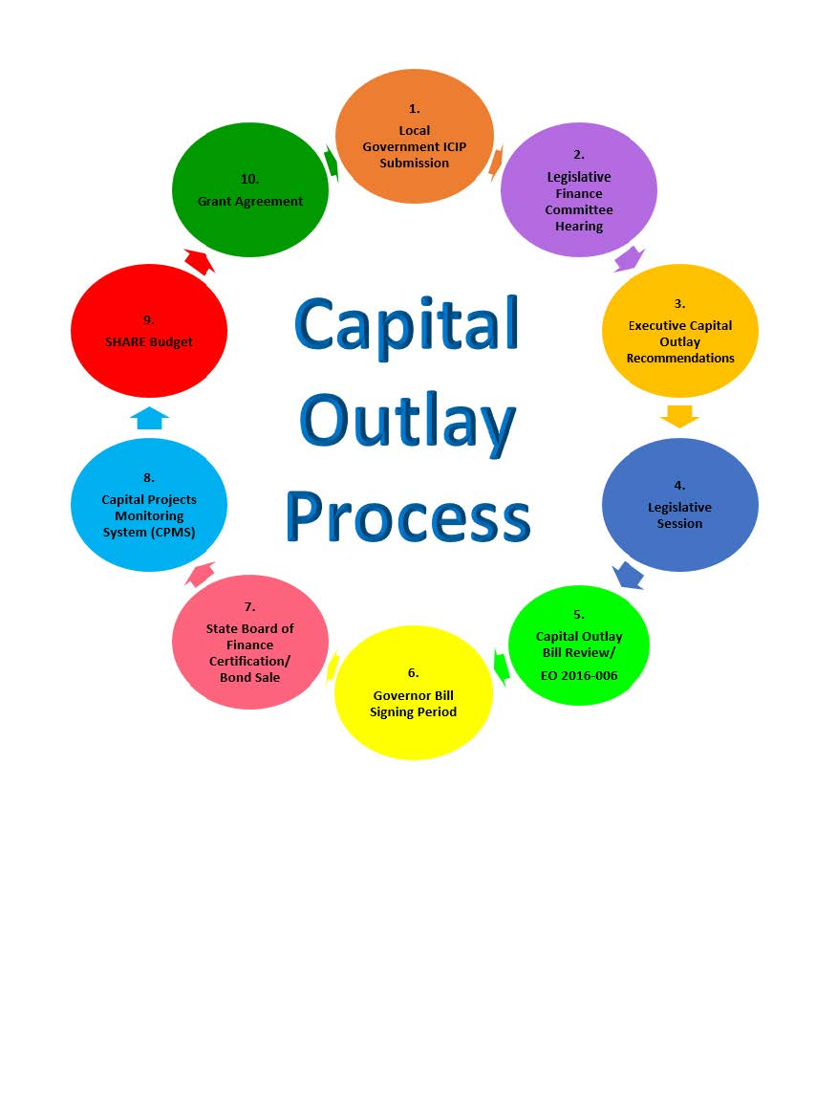
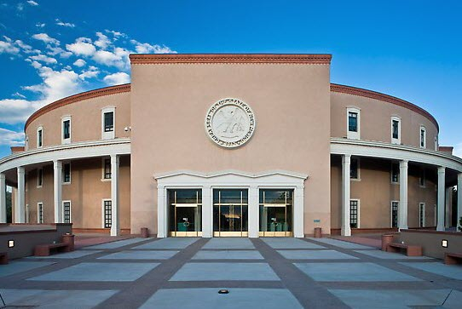
Community Development Bureau

Slide 8
Community Development Bureau
Responsible for:
EXECUTIVE ORDER 2013-006
Oversight Requirement State Capital Outlay Grants
Establish Uniform Funding Criteria
Review the Agency Latest Audit of Public Record
Allows for the Use of a Fiscal Agent

Slide 9

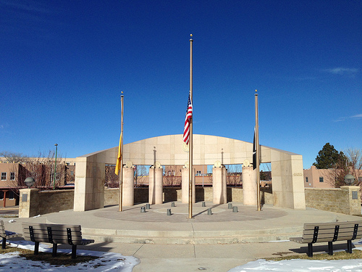
Special Services Bureau
Responsible for:
Purchasing and fiscal support for all LGD bureaus
Pay requests and distributions
Procurement and contract monitoring
Infrastructure Capital Improvement Plan (ICIP) for all local public bodies
Tribal Infrastructure Fund
Provide administrative support to the Civil Legal Services Commission, New Mexico Acequia Commission and Land Grant Council. Process annexation requests from local governments for submittal to the Municipal Boundary Commission

Slide 10
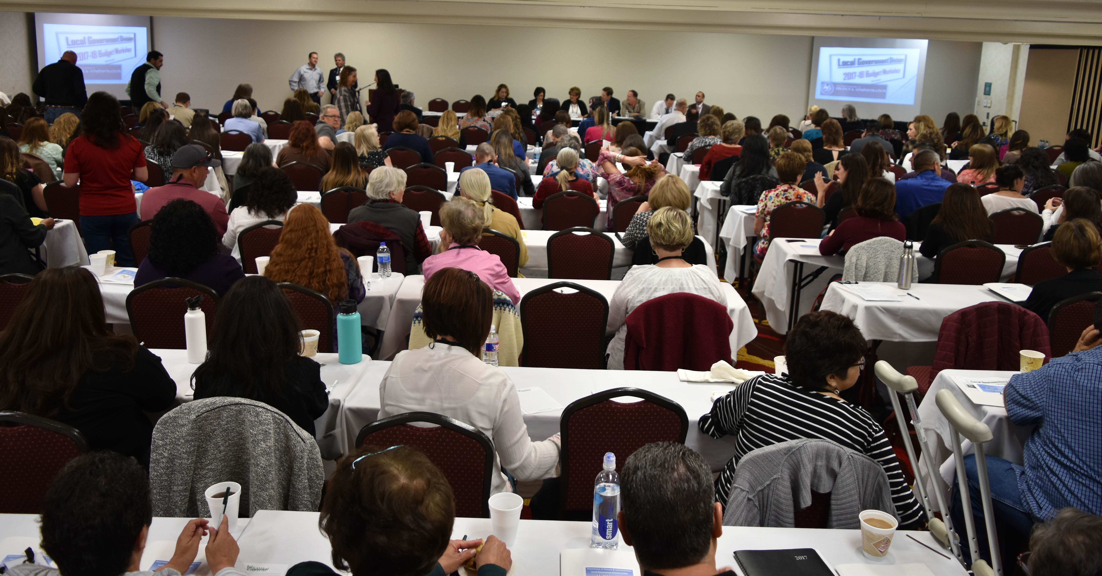
Budget & Finance Bureau
Review and approve operating budgets - to assure compliance with state statutes, properly account for revenues and expenditures, ensure local governments do not exceed available resources, and ensure sufficient funds are budgeted to cover required expenditures.
Review and approve budget adjustment resolutions (if applicable) - authorize budget adjustments for transfers between funds, fund increases, and fund decreases.
Review financial reports - to analyze current financial condition, detect financial difficulties early, and ensure that each entity maintains financial stability.
Provide assistance and training – regarding state statutes, BFB policies and procedures, governmental accounting, budgeting and analysis.
Prepare statistical analysis - for local revenues and expenditures comparisons, tax capacity, budget comparison, cash flow, and current budget conditions.
Understand operation and programmatic content of local government - to advise local governments about efficient and effective ways of dealing with organizational issues.
Develop budget and financial reports - to be followed by local governments.

Slide 11
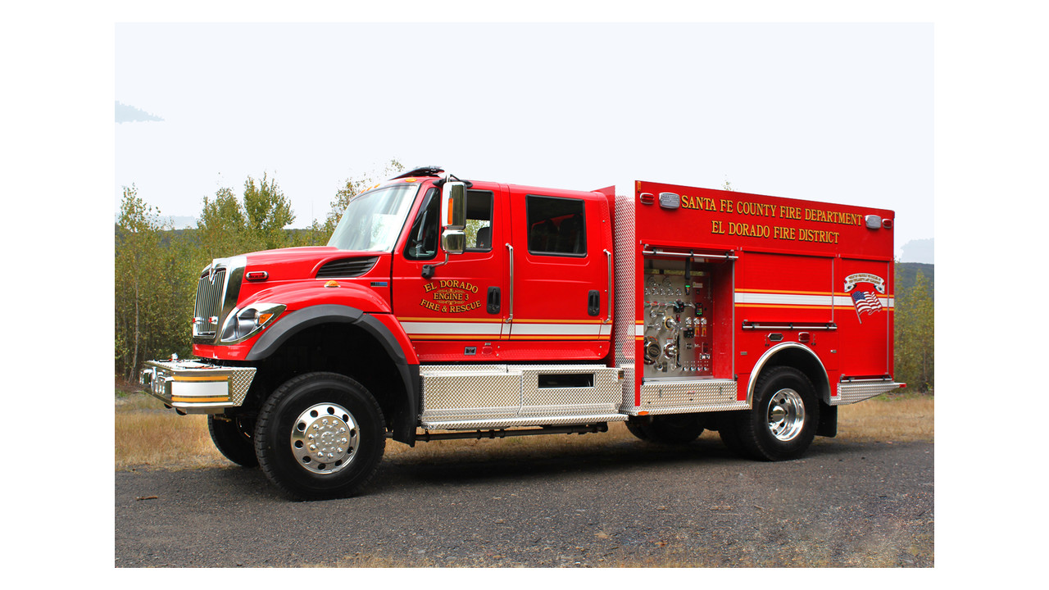
Budget & Finance Bureau
Other BFB responsibilities:
County Detention Facility Reimbursement
Law Enforcement Protection Fund (LEPF) Distributions
Forest Reserve (aka Secure Rural Schools) Distributions
Small Counties Assistance
Taylor Grazing Act Distributions
Lodgers’ Tax Act
Disposition of Property
Bond Refunding & GO Bonding Capacity Certificates
Property Tax Changes to Operational Mill Levy Rate by BFB

Slide 12
Budget & Finance Bureau
Local Government Budget Management System
Require electronically submitted budgets, quarterly reports, and budget adjustment requests (BARs)
Standardize data collection
Facilitate a systematic review process
Automate validation, queries, reports, and notifications
Provide effective data management, storage, and backup
Improve data analysis for all entities using a standardized chart of accounts and reporting system
Document communication with users via system
Be available 24 hours/day, 7 days/week
Improve user authentication by:
  Tracking dates and actions taken by authorized users
  Maintaining/updating user authorization information

Slide 13
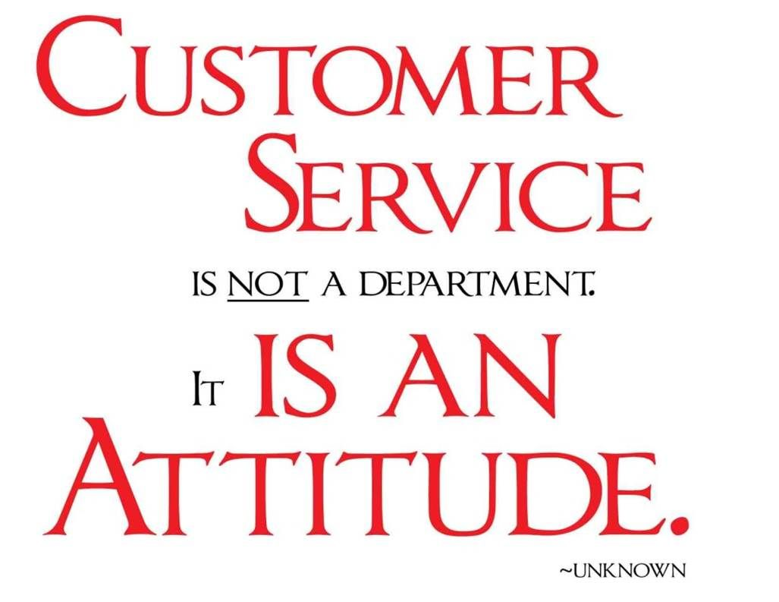
Local Government Division
Environment of Customer Service
Patience
Attentiveness
Clear Communication Skills
Tenacity
Willingness to Learn
Quality of Work
Honesty
Its Not Personal
No Assumptions
Do Your Best

Slide 14
Local Government Division
Environment of Customer Service
Be Honest- Especially to Yourself
Work Hard
Be Grateful
Pay It Forward
Have Fun! Enjoy Life!

