Slide 1


NEW MEXICO STATE AUDITOR
WAYNE A. JOHNSON
State Auditor
AUDIT RULE 2018

Slide 2
AUDIT FEE HISTORY
PERIOD | AUDITS | TOTAL CONTRACT AMOUNT | HOURS | AVERAGE PER AUDIT | AVERAGE PER HOUR | TOTAL IPA’s | REC'D CONT | PER CONT/ IPA
30-Jun-14 | 566 | $19,616,231.20 | 169,969 | $34,657.65 | $115.41 | 82 | 67 | 8.45
Fee Increase |  | $916,007.94
30-Jun-15 | 612 | $20,170,205.15 | 174,962 | $32,957.85 | $115.28 | 80 | 66 | 9.27
Fee Increase |  | $553,973.95
30-Jun-16 | 641 | $20,290,486.09 | 148,140 | $31,654.42 | $136.97 | 76 | 63 | 10.17
Fee Increase |  | $120,280.94
30-Jun-17 | 586 | $19,054,474.00 | 150,438 | $32,516.17 | $126.66 | 74 | 61 | 9.61
Fee Decrease |  | ($1,236,012.09)
Notes:
Reflection of our state’s rich history
We are both wide and deep and that is special

Slide 3
WHAT WE SEE IN THE FUTURE
Possible audits of public financing
The future of CAFR preparation
- Senate Bill 316
- Joint task force CPA society and state officials
- CAFR is the latest in the country
- Timely CAFR should increase our bond rating thus lower interest rate.
Performance Audits
- Internal control and compliance part of current audits
- Revenues should be same or more for all firms

Slide 4
CONTRACTING
AUDIT RULE 2018

Slide 5
BASIC OVERVIEW OF THE AUDIT PROCESS
Submission of firm profiles
Develop the list of approved audit firms
State Auditor’s Office will select which audits we will perform
Finalize Audit Rule, Audit Rule trainings & update financial compliance audit contracts
Send notification letters to Agencies/IPAs
Agencies must submit draft contract by due date listed in Audit Rule
IPAs conduct financial audits
Progress payments
Delivery and review of audit reports
Report release and final payments

Slide 6
CONTRACTING 101
Agency selects IPA
Agency submits draft contract to OSA through OSA-Connect
OSA reviews draft contract
OSA sends a letter of approval to Agency
  If OSA rejects contract, Agency can correct technical errors and resubmit, or request reconsideration
Agency obtains necessary signatures and third-party approvals (PED, HED, DFA)
Agency sends PDF version of final agreement with all signatures to OSA

Slide 7
SELECTING AN AUDITOR
Agency must receive written notification from the State Auditor before beginning the selection process (sent 2/27)
  You can request an exception BEFORE you start the RFP process
  You can perform interim work before this time
Available at www.osanm.org:
  2018 Audit Rule
  List of approved audit firms
  Past contract information

Slide 8
SELECTING AN AUDITOR FOR HIGHER ED
Use OSA-Connect to prepare draft contract
Submit Contract to HED for review and approval
HED issues each Institution an IPA Contract approval letter
Institutions submit draft IPA Contract to the OSA via the OSA-Connect website
OSA reviews and approves draft IPA Contract based upon review and communicates approval via letter
Institution obtains required contract signatures and submits final contract to OSA by email

Slide 9
CONTRACTING IS STILL ON OSA-CONNECT
WWW.OSA-APP.ORG
Don’t forget to update the contact persons for your agency.
Contact Frank Valdez (Frank.Valdez@osa.state.nm.us) for assistance.
Make sure to review ALL information for your agency, even if it is pre-filled in OSA-Connect.
Tier System- don’t forget to go to Agency Profile and confirm the tier for your agency for this fiscal year.

Slide 10
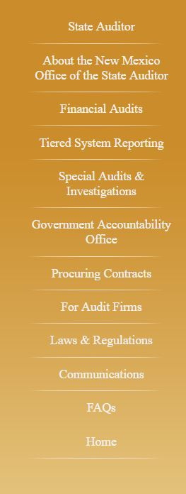
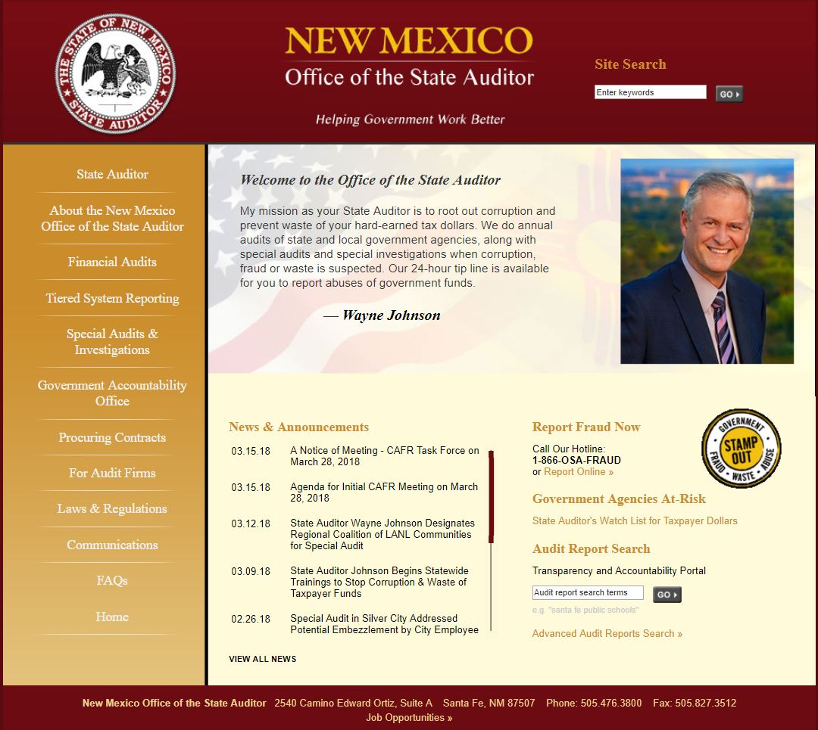
WHERE TO FIND CONTRACTING INSTRUCTIONS

Slide 11
AUDIT AND AUP CONTRACTS
  Fewer audit contract forms:
  State Agencies with DFA Approval
  Statewide CAFR
  PERA and ERB
  Higher Education
  All Others
Scope of work section refers to Audit Rule.
Deadline section refers to Audit Rule. If you want to have the exact deadline stated in your contract, use “Other”.

Slide 12
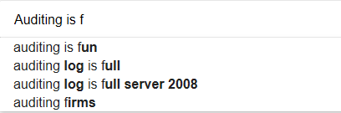
CONTRACTS and OSA-CONNECT
“Intellisense” will auto-fill the name of your audit firm after you start typing.
AUP contracts include the procedures as an exhibit (same as last year).
Notes:
The problem of doing a PO just for the amount of services and not putting anything in for taxes is not just a process one but can produce a potential statutory violation. For example, say the services are for $100,000 and the PO is set for that amount without including taxes. As the work goes on the vendor submits invoices. These invoices will invariably be for both the services and the amount of taxes for those services. The 100K PO is reduced. Eventually, the vendor comes to the end of the work and submits its final invoice (which will again be for services and applicable tax). Now, though, because the original PO just for services has been reduced for both services and taxes, the PO will not have enough funds left to pay the invoice without its being increased (in this example, it would be approximately $9,000 short). If this final invoice were just for taxes, it likely wouldn’t be a problem; but it would be for both services and taxes. And the amount of services being billed for which there is no PO in place would create a potential violation of Section 6-5-3 NMSA 1978 which requires an encumbrance in place prior to all services being delivered. So that’s really the issue for FCD.

Slide 13

PLEASE READ YOUR CONTRACT!
Late notification required as soon as IPA becomes aware that the audit may be late.
Subcontracting – requires State Auditor approval
Conflict of interest – Contractor and Agency both certify that you are complying with Governmental Conduct Act.
Pay Equity Reporting – are you (IPA) required to do it and are you?
  Applies to companies with 10 or more New Mexico employees OR 8 or more employees in the same job classification .
Notes:
The problem of doing a PO just for the amount of services and not putting anything in for taxes is not just a process one but can produce a potential statutory violation. For example, say the services are for $100,000 and the PO is set for that amount without including taxes. As the work goes on the vendor submits invoices. These invoices will invariably be for both the services and the amount of taxes for those services. The 100K PO is reduced. Eventually, the vendor comes to the end of the work and submits its final invoice (which will again be for services and applicable tax). Now, though, because the original PO just for services has been reduced for both services and taxes, the PO will not have enough funds left to pay the invoice without its being increased (in this example, it would be approximately $9,000 short). If this final invoice were just for taxes, it likely wouldn’t be a problem; but it would be for both services and taxes. And the amount of services being billed for which there is no PO in place would create a potential violation of Section 6-5-3 NMSA 1978 which requires an encumbrance in place prior to all services being delivered. So that’s really the issue for FCD.

Slide 14

OSA CONNECT COMMON QUESTIONS & ERRORS
Issues with the multi-year proposal – this information is very important to get right.

Slide 15
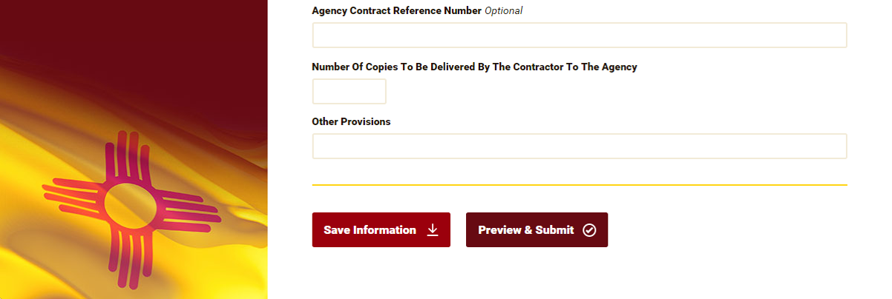
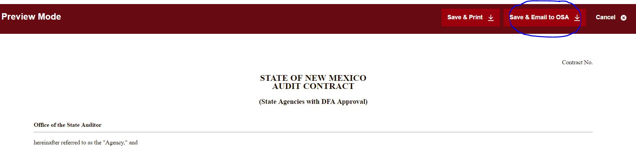
OSA-CONNECT COMMON ERRORS
Don’t forget to press “submit.” Saving and printing are not the same as submitting contracts to OSA.

Slide 16
AMENDMENTS TO CONTRACTS
Contracts expire one year after the latest signature (or DFA approval for state agencies requiring DFA approval). After that you need to submit a NEW CONTRACT, you can no longer amend.
Amendments are subject to review by the OSA. Increases in price must be justified by an increase in scope.
Amendments to change the tier (up or down) of an AUP need to include the procedures for the new tier.
Change from audit to AUP or vice versa requires new contract.
Consider price changes in all amendments.

Slide 17
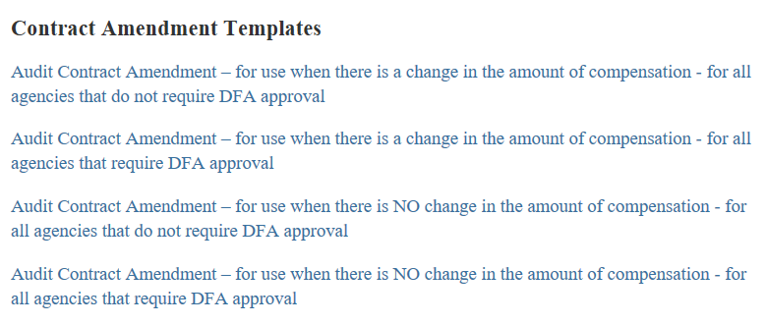
AMENDMENTS TO CONTRACTS
The OSA has several forms of amendment – pick the one most appropriate for your situation

Slide 18
KEY AUDIT RULE CHANGES
AUDIT RULE 2018

Slide 19
KEY AUDIT RULE CHANGES
2.2.2.10.L - Requirements of the summary of prior years findings only finding number, title, and status (resolved, repeated or repeated and modified).
2.2.2.10.L - Corrective plan of action for federal findings must be in a separate document from auditor's findings and must be on the audited agency's letterhead.

Slide 20
TOP TEN FINDINGS
Lack of policies, procedures and internal controls
State Law compliance (Anti-donation, open meetings)
Budgetary compliance
Financial reporting
Cash & investments (Stale checks, no reconciliation)
Payroll & related liabilities (W/H, pay rates, I-9)
Grant compliance
Capital assets (No inventory)
Improper Procurement
Revenue & receivables (Deposit 24 Hr., Cut-off)

Slide 21
KEY AUDIT RULE CHANGES
2.2.2.10.M - Exit conference- requirements for what must be available at exit conference scaled back from full report to draft including the following: independent auditor's report, basic financial statements, findings, schedule of prior year findings, internal control report, and single audit compliance report.
2.2.2.10.W - Capital asset inventory- eliminated the requirement to keep old assets capitalized under historical thresholds (under $5,000) on inventory listing.

Slide 22
KEY AUDIT RULE CHANGES
2.2.2.10.M.4 - Once the audit report is released to the agency by the State Auditor and five days have passed or unless waived, the audit report shall be presented by the IPA to a quorum of the governing authority at an open meeting.

Slide 23
PAST RULES CAUSING PROBLEMS
Cash vs Accrual
2.2.2.10.D.1 – The financial statements presented in audit report shall be prepared from the agency’s books of record.
2.2.2.10.D.2 – The financial statements are the responsibility of the agency.
2.2.2.8.L – IPA shall maintain independence in accordance with governmental auditing standards.

Slide 24
PAST RULES CAUSING PROBLEMS
Late Reports
2.2.2.9.A.5 – As soon as the auditor is aware that the audit will be late, a letter must notify the State Auditor with a copy to the oversight agency (DFA, PED, LGD). Letter shall contain specific explanation regarding why the report will be late. Must be signed by the IPA and a representative of the agency.

Slide 25

Government Finance Experts Conference
May 21, 22, 23, 2018
Sandia Resort & Casino
Albuquerque
Notes:
Reflection of our state’s rich history
We are both wide and deep and that is special

