Slide 1
Issues with State Agency Financial Reports that Impact the State CAFR
Ron Spilman, State Controller

Slide 2
NMSA 12-6-1 Audit Act
The financial affairs of every agency shall be thoroughly examined and audited each year
The audit shall be conducted in accordance with generally accepted auditing standards and rules issued by the state auditor

Slide 3
NMSA 6-5-2 Financial Control Division
A. Shall set standards for the accounting methods and procedures of all state agencies
B. The division shall issue a manual of model accounting practices containing the procedures and policies
  State agencies shall comply with the model accounting practices established by the division, and the administrative head of each state agency shall ensure that the model accounting practices are followed

Slide 4
GAAP FINANCIAL REPORTING FOCUS
At what entity level, are Financial Reporting Requirements Established?
State held discussions with GASB in Spring 2017
Amazed that every state “sub-entity” produced audited financial statements
Unaware of any other state doing this
Primary-Government / State Financial Statements are the only true GAAP statements
Sub-entities need to report information the same way the primary government does
Funds have no legal identity, can’t own assets or liabilities

Slide 5
The State is the Primary Government
Agencies are not separate financial entities for GAAP reporting
Issue - not recognizing how transactions between agencies affects the State as a whole
  Not understanding where the revenue is coming from and how to record
  Not understanding that the business relationship between one agency and another potentially could have no effect on the State’s financials.
  Not understanding Internal Service Funds and interfund services. ISFs are treated like a business and not like another agency when it comes to transactions

Slide 6
Entities that are part of the State
Unaware or not understanding the entities that are included in the State CAFR
  Universities and all their foundations
  State Charter Schools
  Component Units of the State of NM such as NM Lottery, NM Finance Authority, NM Mortgage Finance Authority, Cumbres and Toltec Railroad
  CONCERN - Recording two sides of the same transaction differently
State
Governmental
Agencies
125
Higher Educational Institutions
10
Component Units
6
State Charter Schools
60
Foundations
10

Slide 7
SHARE Matching Financial Statements
SHARE and Financial Statements MUST EQUAL
SHARE is the state’s official book of record, this includes balances in the
  ACTUALS (Fund Financial Statement) Ledger and
  FULLACCRUE (Government-wide Financial Statement) Ledger
OSA Rule 2.2.2.12 A.(5) requires agreement between SHARE and audit financial statements

Slide 8
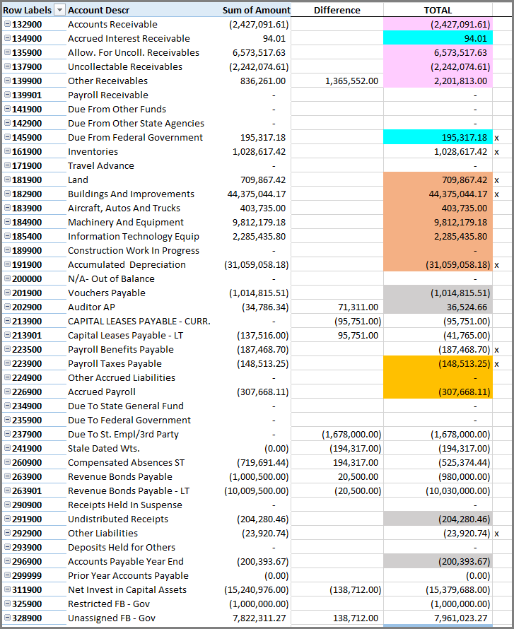
SHARE not matching audited financial statements
Page 10 of Agency Audited Statements Receivables shown as $4.1M, however SHARE had $2.7M
The difference column contains the balancing entries the CAFR unit had to work with the agency to get SHARE to reconcile.

Slide 9
SHARE FINANCIAL REPORTING BASIS
FUND FINANCIALS
GOV WIDE
ACTUALS
FULL ACCRUAL
LEDGER
ACCOUNTINGPERIOD
1-12 12 & ADJUSTMENT ADJUSTMENT
CASH
MODIFIED ACCRUAL
ACCRUAL
BASIS OF ACCOUNTING

Slide 10
Government-wide vs Fund Financials
Measurement Focus
  Governmental Fund – Current Financial Resources (Modified Accrual)
  Government-wide – Economic Resources (Resource Utilization)
Agencies not understanding the difference in measurement focus and what should be included in the financial statement
Examples:
  Capital expenditures reported in the government-wide financials instead of capitalizing the asset

Slide 11
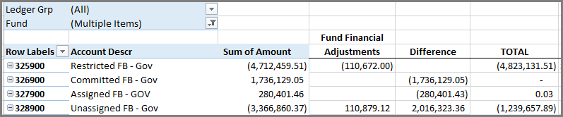
Government-wide vs Fund Financials Cont.
Examples:
  Not understanding the fund balance classifications are different for the government-wide versus the fund financials
  There should only be: Net Asset (311900), Restricted (325900) and Unassigned (328900)

Slide 12
Government-wide vs Fund Financials
Examples:
  Not understanding that transfers of assets should be on the Government-wide and not the fund financial statements
    This scenario happens with the courts and the DAs mostly. The Administrative Oversight Agency has the budget authority to purchase the funds, not the individual agencies. So the expenditure must be recorded on the Oversight financials and then a transfer of the asset occurs in the Government-wide.

Slide 13
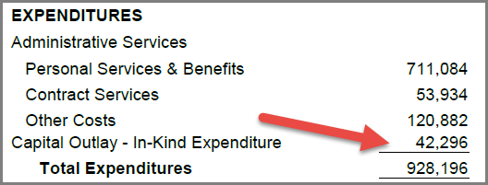
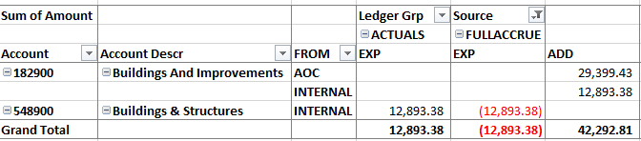

Government-wide vs Fund Financials
Examples:
  Not understanding that transfers of assets should be on the Government-wide and not the fund financial statements
PUBLISHED Fund Financials
Difference $29,399
This was the amount of the FULLACCRUE OPR that was done by the Oversight Agency to transfer the assets.
RECAST
SHARE AP Expenditures

Slide 14


SGFIP Overdrafts
Claims on State General Fund Investment Pool equivalent to a banking claim
  Entities are misclassifying overdrafts on the SGFIP as either a “DUE TO” State General Fund or from another agency fund
    The State General Fund is not due funds just because the SGFIP balance has a negative balance
    At the agency level, another fund is not necessarily due any funds just because one fund is in an overdraft position
  The SGFIP and General Fund two different concepts
  Negative SGFIP amounts represent overdrafts and should be shown as such under the Liabilities on the financial statements
    Overdrafts may occur on cost reimbursable activity where dollars are spent first and then reimbursed later

Slide 15
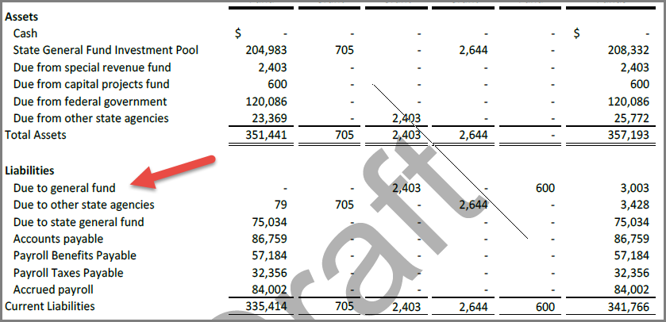
SGFIP Overdraft - Misclassification
This fund doesn’t owe the general fund – it’s an overdraft of the SGFIP balance. It is INCORRECT to account for an overdraft as a due to the general fund

Slide 16
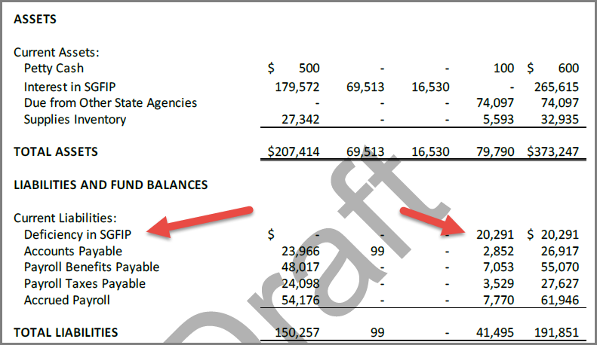
SGFIP Overdraft – Proper Classification

Slide 17

Reversions
NMSA 1978 Section 6-5-10 /MAPs Fin 1.2
Requirements
Unexpended balances in agency accounts as of June 30 shall revert to the General Fund by September 30
The agency may adjust the reversion within forty-five days of release of the audit report for that fiscal year

Slide 18

Over-Reversions
Agencies are erroneously reducing current year reversions by prior year over-reversions in which the agency did not request a correction within the 45 days
Agencies are processing the over-reversion as a current year expenditures
Over-reversions must be shown as a deficit fund balance. Agencies must request a deficiency appropriation for the over-reversion
The deficit fund balance remains in the general ledger and financials statements until deficiency is approved
Agency cannot book a Due from the General Fund for a prior year over-reversion as there is no statutory authority for the General Fund to send the money back to the agency after the 45 days have passed.

Slide 19
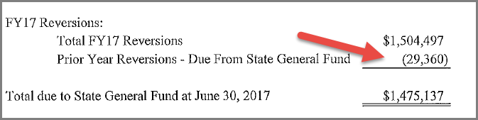
Over-reversions Cont.
Example: Netting prior period over-reversion with current reversion
Note 11. DUE TO STATE GENERAL FUND – AGENCY 20184

Slide 20

Stale Checks
A stale check is a check that has been outstanding for a given amount of time (typically one year)
The State issues 160,000 supplier-related checks annually
NMSA 6-10-57 Checks that are unpaid for one-year shall be cancelled
  Generic accounting re-establishes a liability
Balances must be reported properly
  Reverting Fund - amount sent to the State General Fund
  Non-reverting fund, amount recognized as Misc. Revenue
  In 2017, some agencies had processed an entry to revert the money back to the General Fund but the published financials still showed a Due To (see next slide)
Stay current, recognize monthly and prior to close of period 12

Slide 21
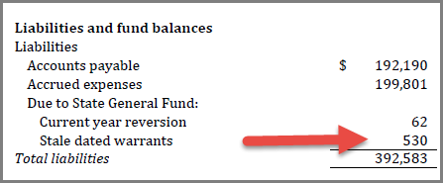
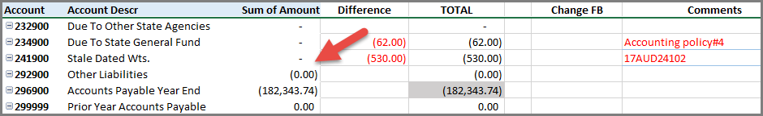
Stale Checks - Unpaid and over a Year Old
Stale-dated checks

Slide 22
Transfers In/Transfers Out
Agencies not understanding Interfund Transfers
Agencies not understanding that the revenue should only be accounted for once at the State level.
  Example: Agency M receives a grant from a third-party beneficiary. The grant language is written that the monies must first go to Agency O, as an oversight, and then Agency O sends the funds to Agency M.
  The issue – both Agency M and O claim the grant as revenue. So this accounts for it twice. The monies should only be accounted for once by Agency O and then Agency O will show the transfer to Agency M.

Slide 23
Netting
Netting amounts
  Net Transfers In with Transfers Out
  Net Expenditures with Revenue (next slide)
  Net Federal Receivable with Federal Payable (slide after next)
Netting abnormal amounts
  Debit balance in a liability account is netted against the asset accounts.
  Credit balance in an asset account is netted against the liability accounts.

Slide 24
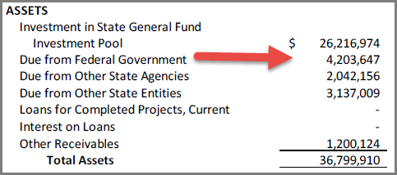
Netting Cont.
  Net Federal Receivable with Federal Payable

Slide 25
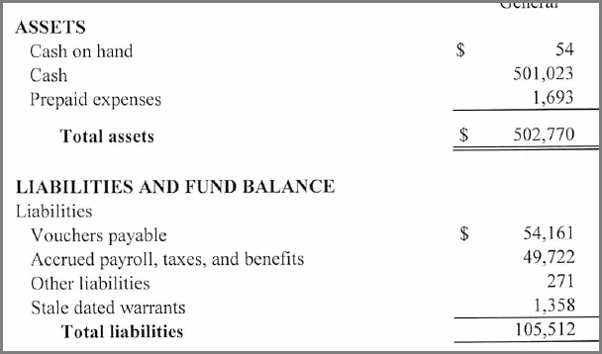
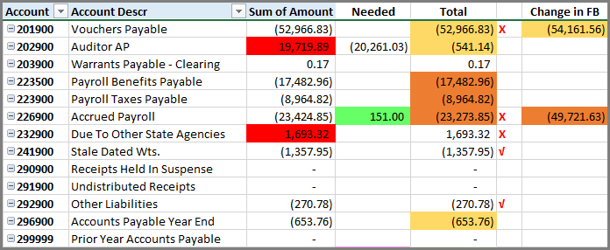
Netting Abnormal Balances
Large Debit in AP that netted with other AP accounts.
Debit in Liability 232900 – instead of correcting, listed as Prepaid on financials.
1
2

Slide 26
Budget Presentations
NMAC 2.2.2.12 A. (11) - Budgetary Basis for State Agencies
Modified Accrual
Since Agencies may request category transfers, budgetary control is at the program level (A/P/S/Z-Code)

Slide 27
Budget Issues
Absence of Budget to Actual comparison by P-Code – which is the statutory level the budget is to be audited at Per State Audit Rule: 2.2.2.10 Q(2)
  When an agency consists of a single fund and one P-code, reporting by fund is not an issue. The issue becomes when an agency has numerous funds in a Pcode. Doing a budget comparison by fund then is not an accurate representation of the appropriation.
  Budget Schedules do not tie to the amounts in the fund financial statements.
Agencies are over budget per category (200/300/400)

Slide 28
Note Disclosures
GASB has established about twenty notes deemed essential for fair presentation and lists an additional sixty if disclosures, if applicable
No note disclosure for Due To/Due From
No note disclosure for Transfers In/Out
Effects of prior period adjustment not highlighted in the financial statements or in note disclosure.
Note disclosure for compensated absences does not tie to the financial statements
Note disclosures are using last year’s numbers – i.e. not updated.
Issues with Footing/Crossfooting

Slide 29
What Can You Do To Help
Be inquisitive and understand your interfaces
Work with your CAFR Accountant
Read and understand YE guidelines, MAPs, Accounting Guidance and the Audit Rule
Attend Financial Statement Training the CAFR Unit Conducts

