Slide 1
Consumer Welfare
Considering the Role of Consumers in Marketing Research
Brian Gillespie, Ph.D.
Assistant Professor of Marketing
Daniels Fund Ethics Initiative Fellow
Anderson School of Management
University of New Mexico

Slide 2
MARKETERS ARE EVIL

Slide 3
Marketers are evil
They make people buy things they don’t need
They want to trick people
They manufacture demand
They are the reason that Americans are obsessed with commercialism
They are responsible (at least in part) for the large amount of credit card debt in America

Slide 4






Why does this perspective exist?
We, as consumers, cannot always communicate, recognize, or understand our own needs and wants
  To others but also to ourselves

Slide 5
Why does this perspective exist?
We make a purchase that, upon reflection, we cannot map onto our understood needs

Slide 6
Why does this perspective exist?
But we need to explain why we made the purchase
  look for an explanation for why we made the purchase

Slide 7
Why does this perspective exist?
We protect our ego because it certainly isn’t our fault we made a “mistake”
  We are perfect, rational beings that never make mistakes
  And when we do make a mistake, we recognize our error and immediately correct

Slide 8

Why does this perspective exist?
Marketers become the easy target, and as such…

Slide 9
“Marketers somehow tricked me into buying it!!!”

Slide 10
Distrust results
We become skeptical of marketers and marketing content
  Build resistances to messages
We begin to ignore messages
  Pass up on deals and offers that seem “too good to be true”
We go to war
  Buying an item on discount is deemed a victory
We view marketing communications as tricks and marketers as tricksters

Slide 11
Examples of marketing tricks are many
Quantity surcharges
  Charging more per unit for larger quantity offerings
Product placement advertising
  The integration of products and brands into media (e.g., television and film)
Subliminal priming
  Coca-Cola in the movie theater (Vicary 1957)
  Laws exist in the USA, UK and Australia that make subliminal priming illegal

Slide 12
But digging deeper…
Quantity surcharges
  Margins are smaller with standard sizes, saving consumers money (Sprott et al. 2003)
Product placement advertising
  When done correctly, product placement increases viewer enjoyment (Gillespie et al. 2018)
Subliminal priming
  This study simply never occurred. Seriously, it was completely made up.
Notes:
Target marketing is about efficiencies; margins are smaller with standard size containers; when done correctly product placement increases media enjoyment; the study never happened

Slide 13
As such, maybe not all marketers are evil?
A growing body of research is dedicated to the best interests of consumers and consumer welfare
  Transformative consumer research
  Public policy
  Marketing ethics

Slide 14
Transformative consumer research
Encourages, supports, and publicizes research that benefits consumer welfare and quality of life
  Addiction
  Healthy eating and dieting
  Materialism
  Youth, risk and consumption
  Poverty
  Sustainable products
  Charitable giving

Slide 15
The bottom dollar effect (Soster et al. 2014)
What happens when a personal budget is spent to complete depletion?
  Considers materialism, mental accounting and satisfaction
Pain of paying is associated with exhausting a budget
  Paying $19 from a $20 budget is more psychologically painful than paying $19 from a $200 budget

Slide 16
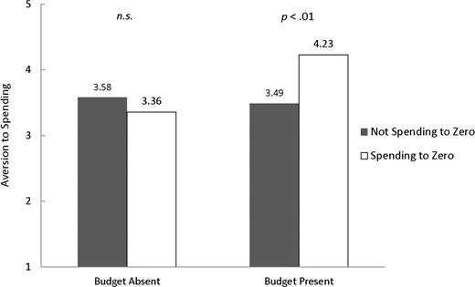
The bottom dollar effect
Individuals are adverse to spending a budget to $0

Slide 17
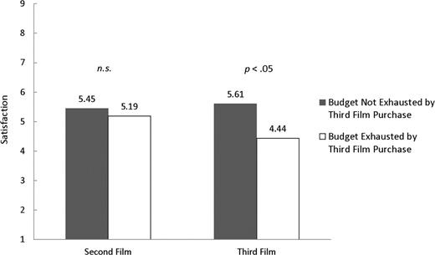
The bottom dollar effect
When a budget is spent to $0 satisfaction with the purchased item decreases
  But only when earning money is difficult
  When there is no windfall
  And when budget replenishment is unknown

Slide 18
Choice-removal effect (Gillespie, Carroll and Otto 2016)
Also called the “House Hunter” effect
Generated from an undergraduate class project at UNM
Choice sets are often either too large, or too difficult to make a confident decision
Removing choices from a choice set prior to making a decision
  Should result in a better and easier decision

Slide 19
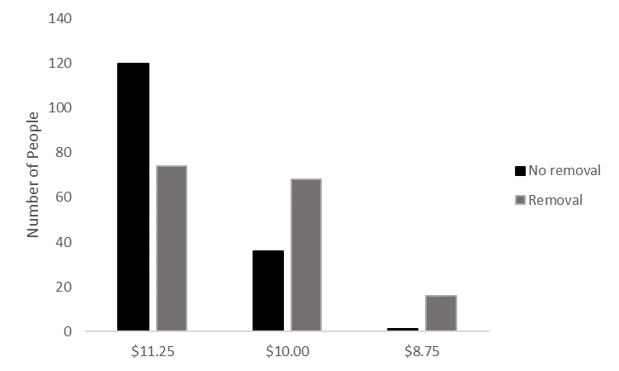
Choice removal in gambling
Individuals selected from one of three bets
Each bet had an expected payout
  75% chance of winning $15, $11.25 payout
  25% chance of winning $40, $10.00 payout
  25% chance of winning $35, $8.75 payout

Slide 20
Choice removal in house hunting
Individuals selected from a set of three homes
Two of the homes were similar while the third was unique
  Individuals in western cultures generally possess a need for uniqueness, and as such should be attracted to the unique option
An additional condition was added in which individuals were asked to only imagine which option they would remove

Slide 21
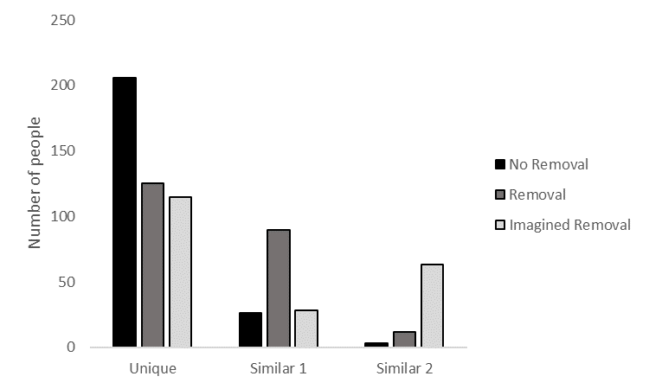
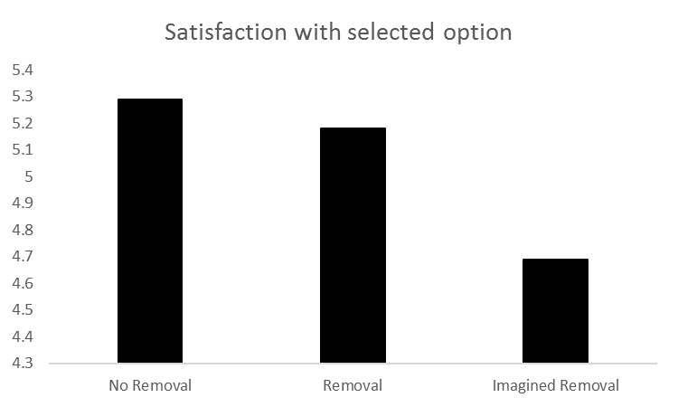
Choice removal in house hunting

Slide 22
Choice removal in house hunting

Slide 23
Public policy marketing research
Marketing research used to direct and guide public policy
Addresses the relationship between marketing and the public interest
  Economic development
  Globalization
  Ecology
  Safety and security
  Consumer vulnerability and protection
  Regulation and deregulation
  Antitrust, privacy, and intellectual property

Slide 24
Marketing ethics
Considerations of ethical decision making in marketing
  From both the manager and consumer perspective
A consideration of best practices
  Insights for industry and firm level codes of ethics

Slide 25
Price promotion keywords (Gillespie, Manning, Ferrell and Ferrell)
The price promotion keyword “sale” is regulated at federal, state and city levels
Other keywords (e.g., “clearance,” “blow-out,” “liquidation”) are not regulated
  Considered “puffery” terms that only signal a retailer’s desire to sell inventory

Slide 26
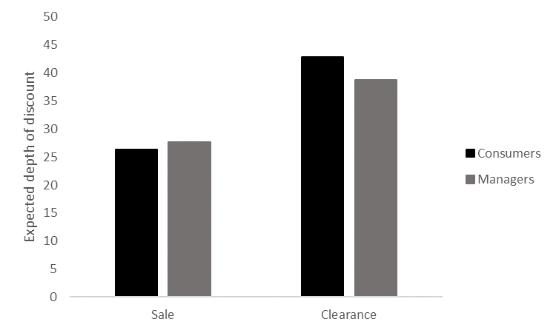
Price promotion keywords
Consumer and manager depth of discount expectations are consistent

Slide 27
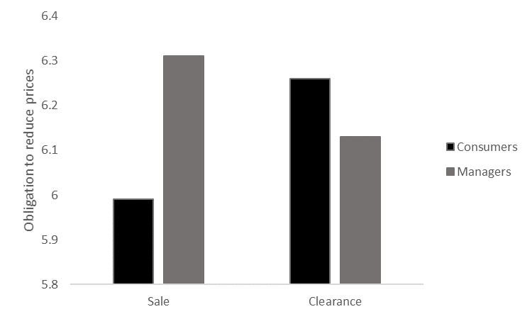
Price promotion keywords
Consumer and manager beliefs that retailers are obligated to reduce prices are considerably different

Slide 28
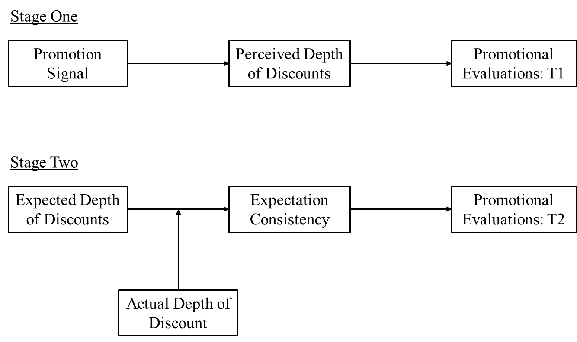
Price promotion keywords

Slide 29
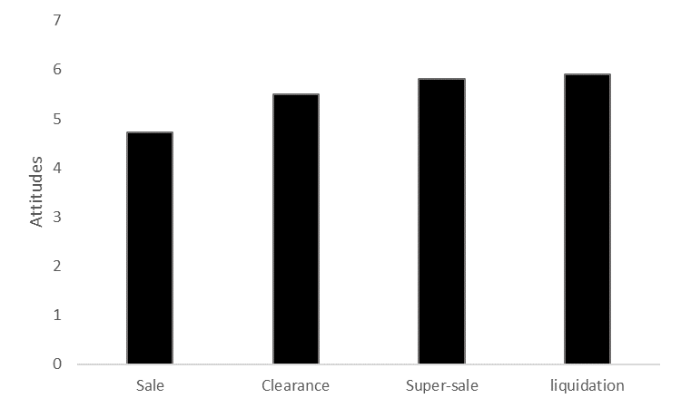
Price promotion keywords
Consumers’ initial attitudes vary by price promotion
This is due to expected depth of discounts

Slide 30
Price promotion keywords

Slide 31
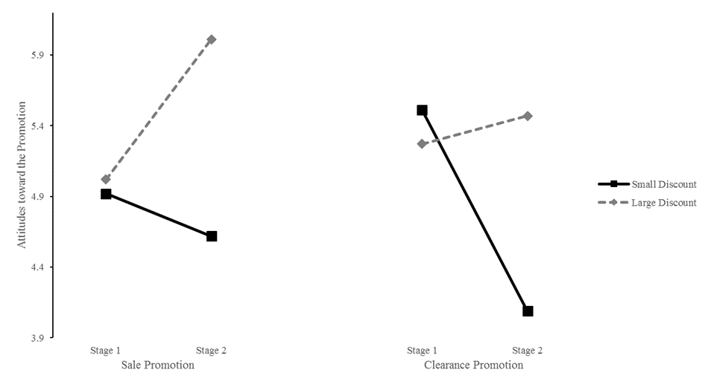
Price promotion keywords
Incongruences in actual vs. expected discounts resulted in attitude adjustments
Congruencies in discounts resulted in consistent attitudes

Slide 32
Price promotion keywords
Public policy implications
  Clearance and other similar terms are not “puffery” from a consumer perspective
  Legislation and regulations should be aligned with consumer expectations
Marketing ethics implications
  Price promotions are deceptive when the consumer is misled, causes potential or actual damage, or is harmful to the public welfare
  Clearance promotions that are not appropriately discounted could indeed mislead consumers, and are therefore unethical

Slide 33
In summation
Marketers are not inherently evil
  Not all marketing efforts are designed to separate consumers from their money
Marketing endeavors also focus on increasing consumer welfare and benefiting society
  Transformative consumer research
  Public policy
  Ethical decision making
Notes:
The take away here is not that all marketing and marketing research benefits the consumer, but that there is a large, and growing, stream of research that is designed to help, not hurt, the individual consumer.

Slide 34
Thank you and questions?

