Slide 1
Criminal Fraud Investigative Update
New Mexico Office of the Attorney General
Special Investigations Division
Director Benjamin Baker

Slide 2
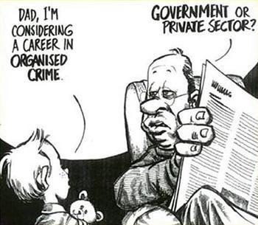

Slide 3
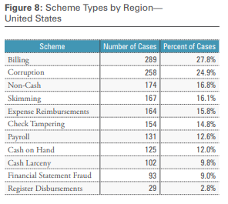
Fraud Stats
2016 ACFE Report to the Nations
Median Loss per entity - $120,000 – per fraud scheme
The longer a fraud scheme goes undetected, the greater the losses to the organization
The median duration of the frauds reviewed was 18 months
In every region studied, corruption was one of two of the most common fraud schemes

Slide 4
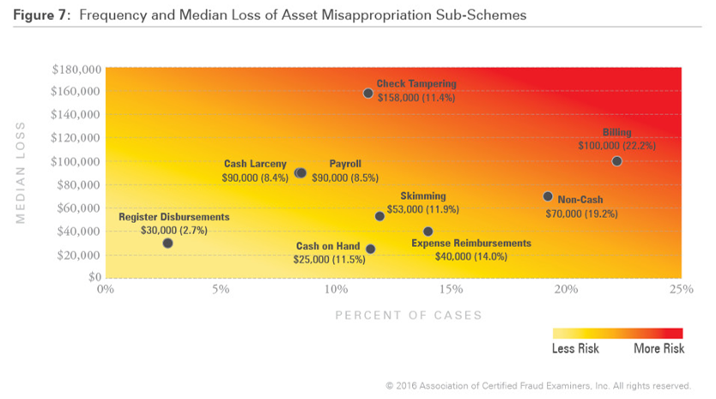

Slide 5
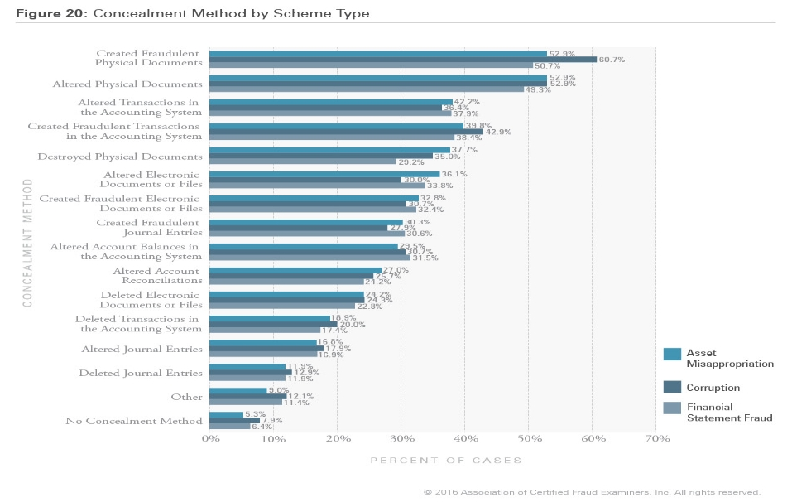
Concealment of Fraud Schemes

Slide 6
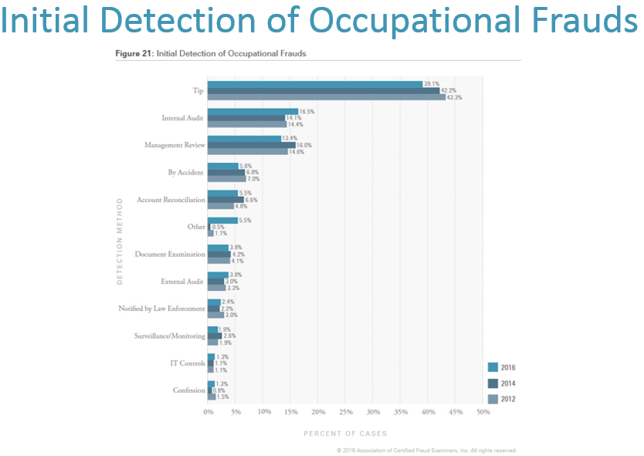

Slide 7

How do we get cases?
Law Enforcement referrals
State Agency referrals
Anonymous referral

Slide 8
Common Criminal Investigations
Embezzlement
Fraud
Money Laundering
Racketeering

Slide 9
Fraud and Corruption
Fraud consists of the intentional misappropriation or taking of anything of value that belongs to another by means of fraudulent conduct, practices or representations.

Slide 10
Corruption
Illegality; a vicious and fraudulent intention to evade the prohibitions of the law.
The act of an official or fiduciary person who unlawfully and wrongfully uses his station or character to procure some benefit for himself or for another person, contrary to duty and the rights of others
Black’s Law Dictionary

Slide 11
Who is a Public Official??
"public officer or employee" means any elected or appointed official or employee of a state agency or local government agency who receives compensation in the form of salary or is eligible for per diem or mileage but excludes legislators

Slide 12
Chapter 10, Section 16:
Governmental Conduct Act
10-16-3: Ethical Principles of public service: Legislators and public officers…
  Shall treat their office or position as a public trust and shall not use their office to obtain personal benefit or pursue personal interests
  Not use their office for personal benefit
  Conduct themselves in an ethical manner and maintain integrity
  Disclose all real or potential conflicts of interest
  Not exchange anything of value for promised performance or an official act
10-16-4: Official act for personal financial interest…prohibited!

Slide 13
Trends
Using position of public trust for personal benefit
Using knowledge of system and loopholes to exploit and profit
  Used for benefit of friends/family
  Procurement process
Position of Authority
  Using position of authority for personal benefit
  Using position of authority to intimidate
Collusion with external parties

Slide 14
New Mexico State Statutes
Campaign Practices Act, Chapter 1, Section 19
Governmental Conduct Act, Chapter 10, Section 16
Financial Disclosure Act, Chapter 10, Section 16A
NM Criminal Code, Chapter 30
NM Administrative Code

Slide 15
How we gather information…
Request
Open Source
IPRA
Subpoena
Search Warrant

Slide 16
Identify the Key Players
Identify individuals involved in the case
Who benefits from the bad act?
Who has access to the systems?
Don’t discount documentation as a key player in an investigation

Slide 17
You are a Key Player!

Slide 18
How you help us…
You know the inner workings of the organization
You know the parties involved
You have already gathered key information for the investigation
You have the ability to point us in the right direction

Slide 19
You are the internal regulatory authority

Slide 20
Considerations in Investigations…
Consider the materiality of actions and evidence:
How do we determine if something is material to the case?
  Not necessarily related to dollar amount
  Not always related to financial statements
If a material detail is known by one of the parties involved, could that have influenced their decision?
  If you know your co-worker is a bad actor, would you continue to process the request?

Slide 21
Scope Considerations
Identify actions of individuals involved
Not necessarily based on dollar amount but conduct surrounding incident
Cause and Effect of those actions
  Impact on the immediate community
  Impact on the SofNM finances
Identify how a crime could have been prevented
  This allows us to identify loop-holes in the system

Slide 22
The Reality of Investigations
  Constantly evolving
  Know how to separate the opinions from fact
  Know when to cut it off
  Keep within the scope of your investigation
  Be objective; let the evidence tell the story

Slide 23

What are some pitfalls in these types of investigations?

Slide 24
What are some pitfalls in these types of investigations?
Rabbit hole… stay on track!
Many cases are built on witnesses
  Consider the motivation of the witnesses and the reporting party
Losing potential damning evidence
  Who has access to the information
  How can it be manipulated
  Audit trails
Media Attention
Tipping your hand

Slide 25
Pulling it all together
Consider overall actions
  Criminal acts
  Violation of policy and procedure
  Pattern of conduct
Documentation of investigation
  Report of findings
  How did you draw that conclusion?
  Processes used

Slide 26
Special considerations for internal investigations…
Consider when and to whom you release information
Opportunities for damaged and destroyed evidence
  Administrative Leave or Termination of employment of target
  Restrict access of target employees
  Engage audit trails
  Employee confidentiality rules

Slide 27
Charging Criminally
Criminal Complaint
Arrest Warrant
Indictment (GJ)
Information

Slide 28
You’re not done yet!
Remember, once you refer a matter to a law enforcement agency, you will still need to be available for questions, interviews, follow-up investigation, and participation in prosecution, including testifying

Slide 29
Be part of the solution!
Your participation in a criminal investigation can result in significant changes in the system
  Policies and procedures
  Regulation
  Legislation
Identify situations where you fit into the solution

