Slide 1
Interactive Single Audit - A to Z
Sara Specht, CFE
Senior Audit Associate II

Slide 2
Agenda.
  Quiz
  What is a Single Audit?
  Auditee Responsibilities
  Importance of a SEFA
  Major Program Determination
  Questions

Slide 3
Quiz – Question 1.
Which of the following items are not required to be included in the Schedule of Expenditures of Federal Awards (SEFA)?
  List of individual federal programs by federal agency.
  The name of the pass-through entity and identifying number assigned by the pass-through entity for federal awards received as a subrecipient.
  Total federal awards expended for each individual federal program and the Catalog of Federal Domestic Assistance (CFDA) number or other identifying number when the CFDA information is not available.
  All of the information above is required to be included in the SEFA.

Slide 4
Quiz – Question 2.
If monies are provided to subrecipients, how does this get reported for the SEFA?
  In the notes to the SEFA
  On the face of the SEFA
  Not required to be disclosed

Slide 5
Quiz – Question 3.
Which of the following is not required to be disclosed in the notes to the SEFA?
  Significant accounting policies used in preparing the SEFA
  Whether the non-Federal entity elected to use the 10% de minimis indirect cost rate
  Balances of loan and loan guarantee programs outstanding at the end of the audit period for loans
  The total amount passed to subrecipients by entity name
  All of the above

Slide 6
Quiz – Question 4.
Under the Uniform Guidance, which of the following situations would prevent an auditee from being low-risk?
  A single audit was performed in each of the two preceding audit periods.
  There was a significant deficiency in internal control over financial reporting in one of the two preceding audit periods.
  A material weakness was reported in a Type B federal program in one of the two preceding audit periods.
  The data collection form and reporting package for one or both of the two preceding audit periods was submitted to the Federal Audit Clearinghouse late.

Slide 7
Quiz – Question 5.
Which of the following is not a threshold for determining Type A programs?
  At least $750,000, but is $20 million or less
  Greater than $25 million, but is $100 million or less
  Greater than $100 million, but is $1 billion or less
  Greater than $1 billion, but is $10 billion or less
  Greater than $10 billion, but is $20 billion or less
  Greater than $20 billion

Slide 8
What is a Single Audit?
The Single Audit Act of 1996:
  Promote sound financial management.
  Establish uniformed requirements for audits.
  Promote the efficient and effective use of audit resources.
  Reduce burden.
  Reliability of audit work performed.
Notes:
1. Promote sound financial management, including effective internal controls, with respect to federal awards administered by nonfederal entities.
2. Establish uniformed requirements for audits of federal awards administered by nonfederal entities.
3. Promote the efficient and effective use of audit resources.
4. Reduce burden on state and local government Indian tribes and nonprofit organizations.
5. Ensure that federal department and agencies, to the maximum extent practicable, rely upon and use audit work done under the single audit requirements.

Slide 9
What is a Federal Award?
The Uniform Guidance defines a federal award as:
  Federal financial assistance that a nonfederal entity receives directly from a federal awarding agency or indirectly from a pass-through entity.
  Cost-reimbursement contracts that a nonfederal entity receives directly from a federal awarding agency or indirectly from a pass-through entity.
  The instrument setting forth the terms and conditions of an award.

Slide 10
What is a Federal Program?
The Uniform Guidance defines a federal program as:
  All federal awards which are assigned a single number in the CFDA.
  Federal programs designated as a cluster must be considered as one program when determining major programs.

Slide 11
Key Responsibilities of Auditees.
The Auditee must:
  Prepare the financial statements.
  Evaluate and monitor noncompliance with federal statutes, regulations, and the terms and conditions of federal awards.
  Promptly follow up and take corrective action on audit findings.
Notes:
1. Prepare appropriate financial statements, including the schedule of expenditures of federal awards in accordance with the requirements of the Uniform Guidance.
2. Evaluate and monitor noncompliance with federal statutes, regulations, and the terms and conditions of federal awards.
3. Promptly follow up and take corrective action on audit findings, including preparation of a summary schedule of prior audit findings and a corrective action plan.
The corrective action plan is required to be on letterhead of the entity.

Slide 12
Key Responsibilities of Auditees – continued.
  Procure and ensure it is properly performed and submitted when due.
  Take reasonable measures to safeguard protected personally identifiable information (PPI).
  Provide the auditor with access to personnel, accounts, books, records, supporting documentation, and other information as needed for the auditor to perform the single audit.
Notes:
1. Procure or otherwise arrange for the single audit and ensure it is properly performed and submitted when due.
2. Take reasonable measures to safeguard protected personally identifiable information.
3. Provide the auditor with access to personnel, accounts, books, records, supporting documentation, and other information as needed for the auditor to perform the single audit.

Slide 13
Importance of a SEFA.
  The SEFA serves as the primary basis that auditors use to determine which programs will be audited.
  §200.510(b) of the Uniform Guidance requires the auditee to prepare a SEFA for the period covered by the auditee’s financial statements, which must include the total federal awards expended as determined in accordance with §200.502 of the Uniform Guidance, “Basis for Determining Federal Awards Expended.”
Notes:
Therefore, the auditee’s responsibility for preparing an accurate and complete SEFA is critical.
Remember, that year-end accruals must be captured in the SEFA.

Slide 14
Key SEFA Information.
  Federal agency prefix and Catalog of Federal Domestic Assistance (CFDA) three-digit extension (or other identifying federal numbers when the CFDA information is not available)
    https://cfda.gov/
  Federal agency name
  Name of individual federal program or cluster of programs (cluster) name
  Is this a cluster?
    If a cluster, list individual programs within the cluster.
Notes:
-Auditees should accumulate and document key information relating to each federal program to assist in preparing the SEFA.
-For clusters, refer to Part 5 of the Compliance Supplement, which is located in 2 CFR Part 200, Appendix XI.

Slide 15
Key SEFA Information – continued.
  Award number(s)
  Award period
  Was award (or incremental funding under this award) received on or after December 26, 2014?
  Award amount
  Was any portion of the award passed through to subrecipients?
    If so, total amount(s) passed through to subreceipients

Slide 16
Key SEFA Information – continued.
  Is the award a subaward?
    If so, what is the identifying number assigned by the pass-through entity?
    Pass-through entity name
    Subaward amount
    Subaward period
    If a subaward, was the original pass-through entity award (or incremental funding) received on or after December 26, 2014?

Slide 17
Key SEFA Information – continued.
  Do any of the awards (or subawards) include non-cash assistance?
  Does any aspect of the program include loans or loan guarantees?
  Has the federal agency or pass-through entity requested that this program be audited as major under the provisions 200.518(c)(2) of the Uniform Guidance?
  Name and contact information for Program Manager(s)
  Name and contact information for Fiscal Manager(s)

Slide 18
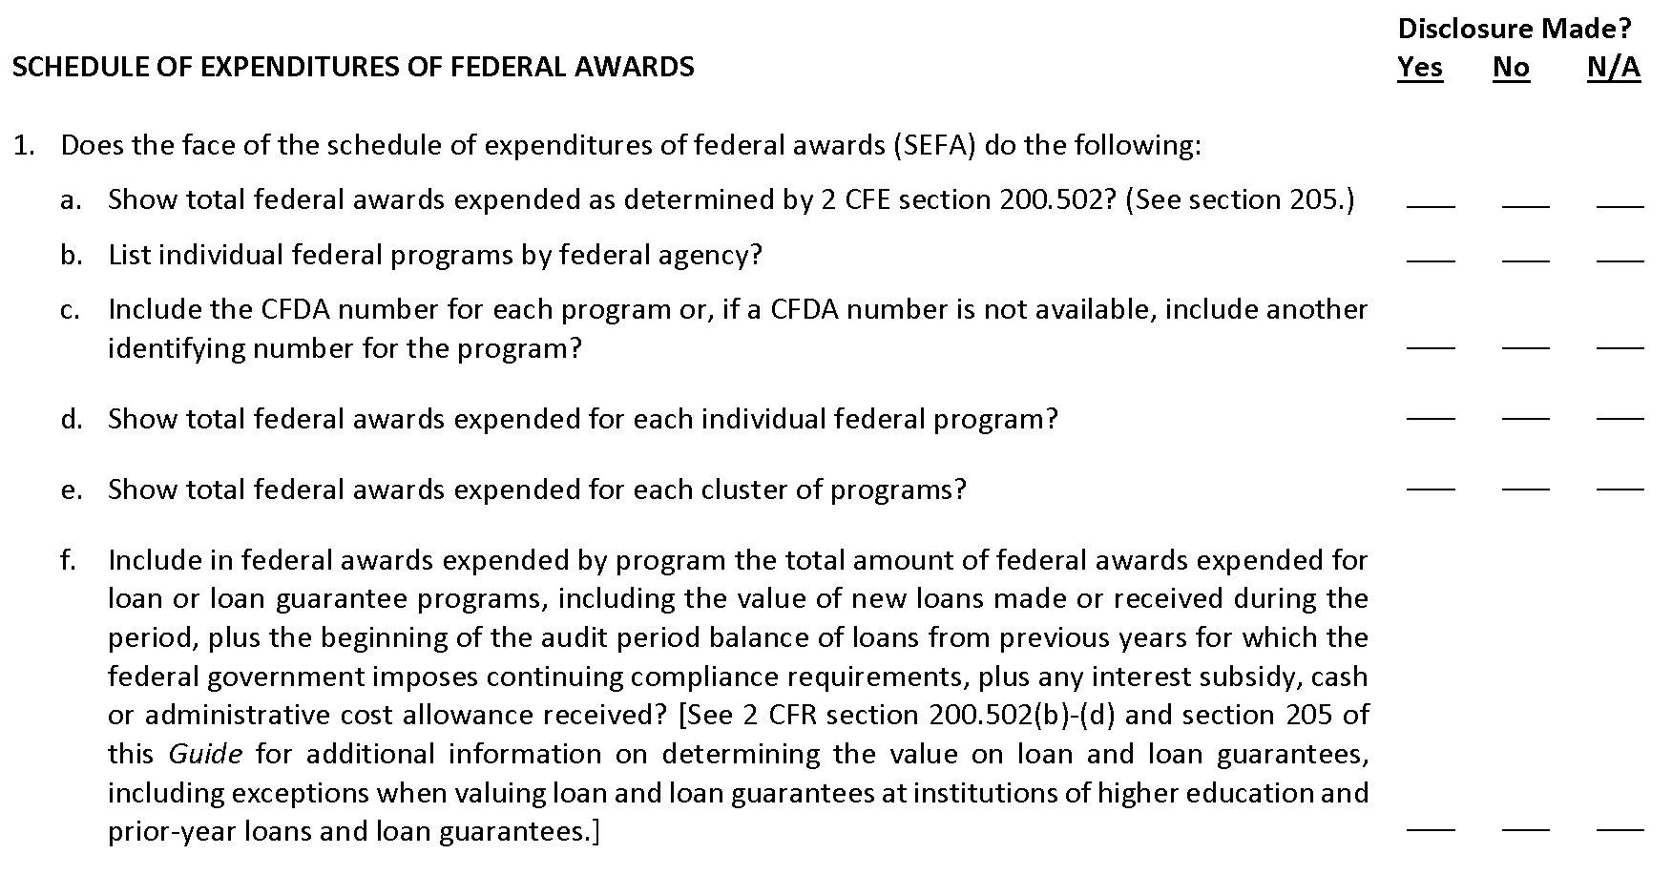
Disclosure Checklist.

Slide 19
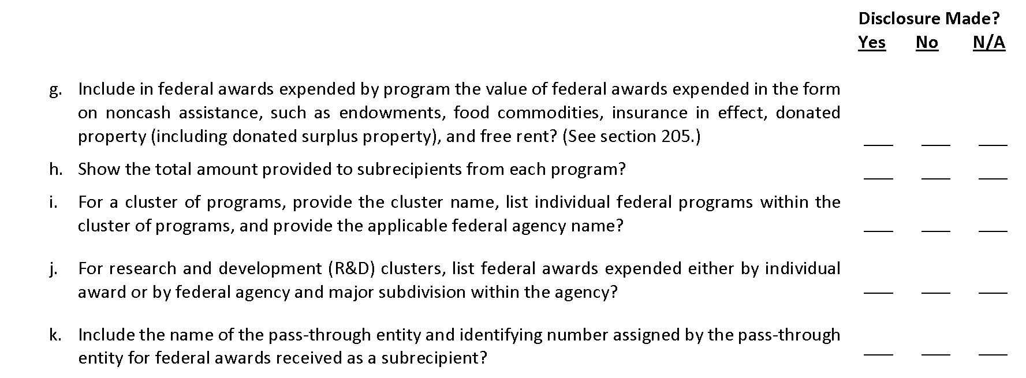
Disclosure Checklist – continued.

Slide 20
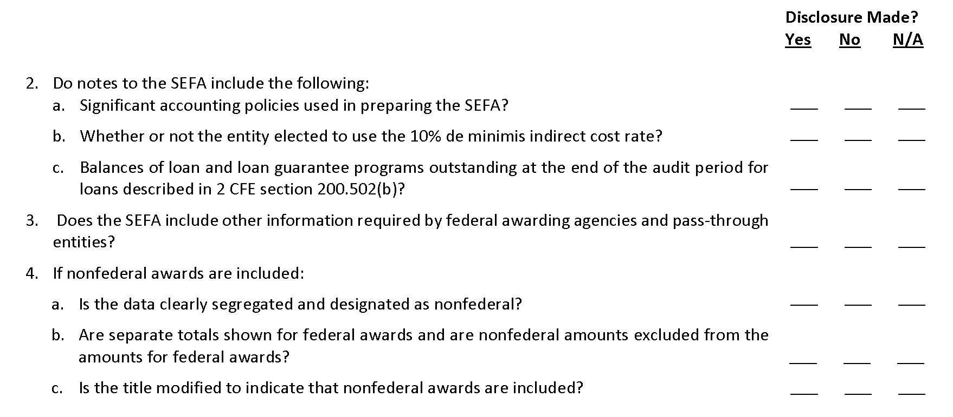
Disclosure Checklist – continued.

Slide 21
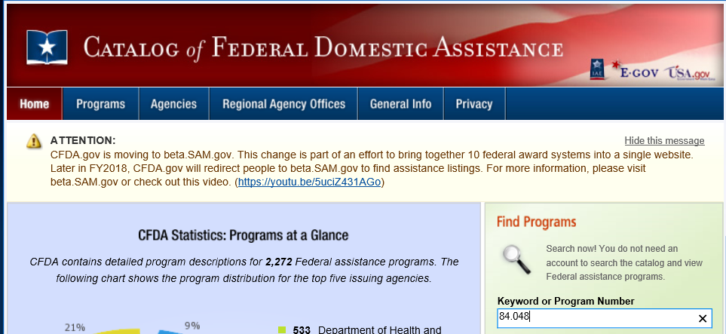

Slide 22
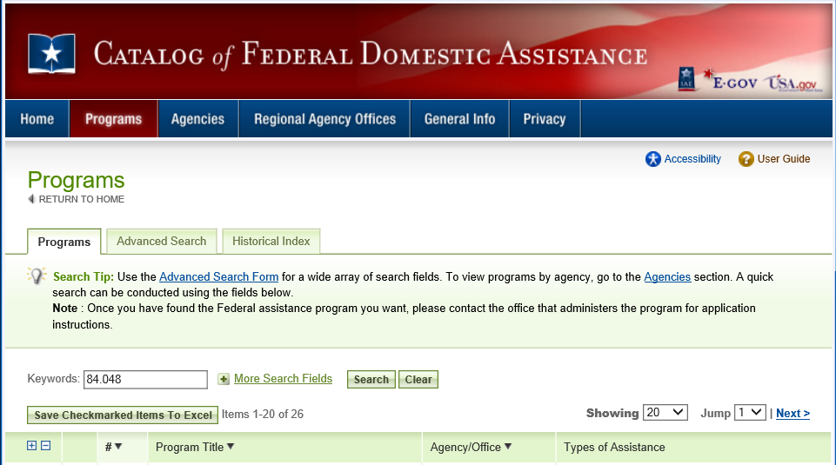
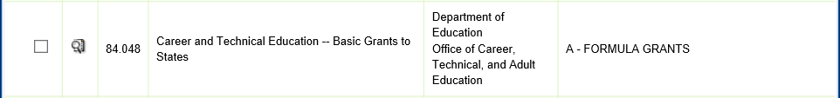

Slide 23
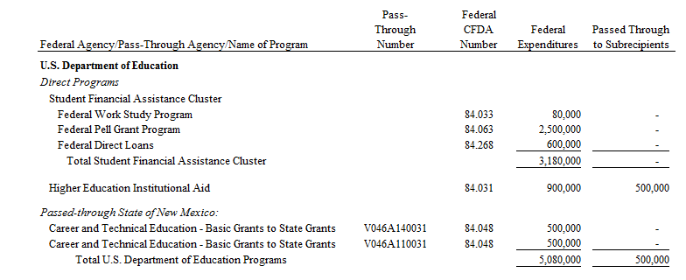
SEFA Answers.

Slide 24
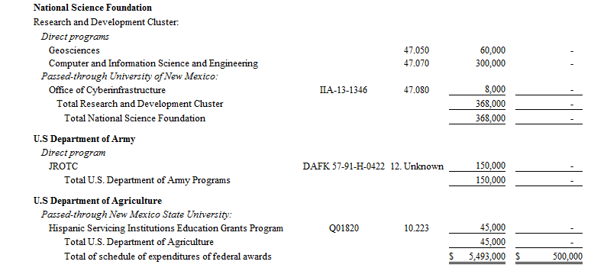
SEFA Answers – continued.

Slide 25
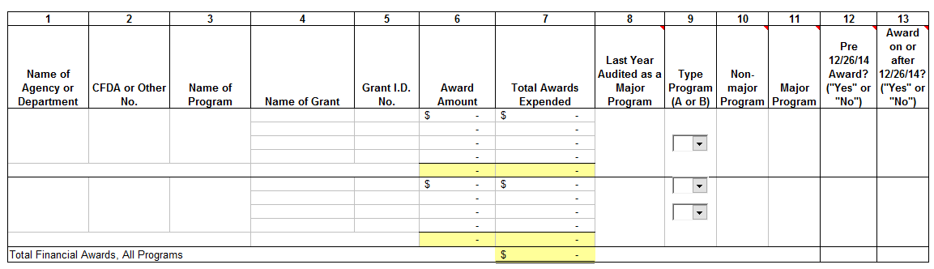
Major Program Determination.
Part I – Preliminary Step – Information Gathering
  Review the SEFA prepared by the auditee

Slide 26
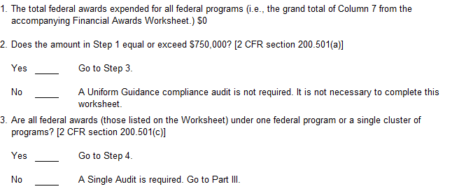
Major Program Determination – continued.
Part II – Determine the Need for a Single or Program-specific Audit

Slide 27
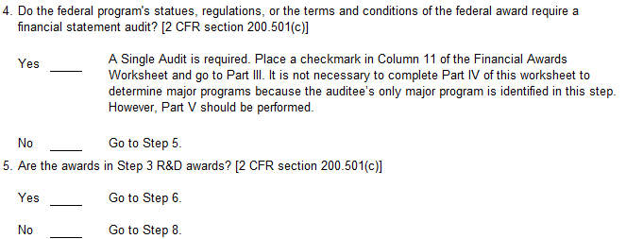
Major Program Determination – continued.
Part II – Determine the Need for a Single or Program-specific Audit – continued

Slide 28
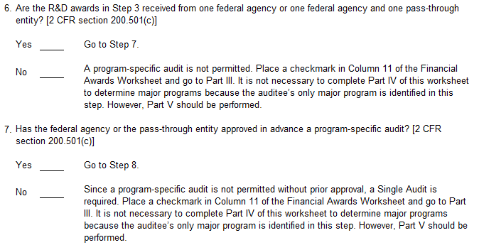
Major Program Determination – continued.
Part II – Determine the Need for a Single or Program-specific Audit – continued

Slide 29
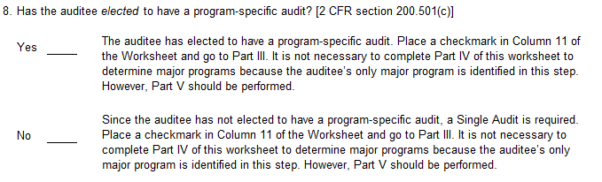
Major Program Determination – continued.
Part II – Determine the Need for a Single or Program-specific Audit – continued

Slide 30
Major Program Determination – continued.
Part III – Determining If the Auditee is a Low-risk Auditee
  An entity is considered a low-risk auditee if it meets All of the following criteria for each of the previous two audit periods.
    Single audits were performed on an annual basis in accordance with the provisions of
    2 CFR part 200, subpart F, including submitting the data collection form and the reporting package to the FAC by the due date.
    Auditor’s opinion on whether the financial statements were prepared in accordance with GAAP, or a basis of accounting required by state law, and the auditor’s in-relation-to opinion on the SEFA were unmodified.
    Auditor’s Yellow Book report on internal control did not identify any deficiencies in internal control over financial reporting as material weaknesses.
    Auditor did not report a substantial doubt about the entity’s ability to continue as a going concern.
Notes:
High-risk threshold is 40% of coverage rule.
Low-risk threshold is 20% of coverage rule.

Slide 31
Major Program Determination – continued.
Part III – Determining If the Auditee is a Low-risk Auditee – continued
  None of the federal programs had audit findings from any of the following in either of the preceding two audit periods in which they were classified as Type A programs.
    Internal control deficiencies that were identified as material weaknesses in the auditor’s report on internal control for major programs.
    A modified opinion on major program in the auditor’s report on major programs.
    Known or likely questioned costs that exceeded 5% of the total federal awards expended for a Type A program during the audit period.

Slide 32
Major Program Determination – continued.
Part IV – Determining Major Programs
Part V – Tests of Controls and Compliance Tests
Notes:
-During Part IV, the auditor performs a risk assessment process on the Type A and Type B programs, based on specific criteria.
-Part V is when the auditor has chosen the federal programs for audit and begins fieldwork inquiries and testing on the specific controls and compliance requirements.

Slide 33
Quiz – Question 1.
Which of the following items are not required to be included in the Schedule of Expenditures of Federal Awards (SEFA)?
  List of individual federal programs by federal agency.
  The name of the pass-through entity and identifying number assigned by the pass-through entity for federal awards received as a subrecipient.
  Total federal awards expended for each individual federal program and the Catalog of Federal Domestic Assistance (CFDA) number or other identifying number when the CFDA information is not available.
  All of the information above is required to be included in the SEFA.
Notes:
Answer: D
Correct! Section 200.510, “Financial Statements,” of the Uniform Guidance includes the complete list of information required for the SEFA.

Slide 34
Quiz – Question 2.
If monies are provided to subrecipients, how does this get reported for the SEFA?
  In the notes to the SEFA
  On the face of the SEFA
  Not required to be disclosed
Notes:
Answer: B
Correct! Section 200.510, “Financial Statements,” of the Uniform Guidance includes the complete list of information required for the SEFA, which indicates “include the total amount provided to subrecipients from each Federal program.”

Slide 35
Quiz – Question 3.
Which of the following is not required to be disclosed in the notes to the SEFA?
  Significant accounting policies used in preparing the SEFA
  Whether the non-Federal entity elected to use the 10% de minimis indirect cost rate
  Balances of loan and loan guarantee programs outstanding at the end of the audit period for loans
  The total amount passed to subrecipients by entity name
  All of the above
Notes:
Answer: D
Correct! Section 200.510, “Financial Statements,” of the Uniform Guidance includes the complete list of information required for the SEFA and the notes, you are not required to disclose the total amount passed to subrecipients by entity name. It does provide an extra level of transparency; however, it is not required.

Slide 36
Quiz – Question 4.
Under the Uniform Guidance, which of the following situations would prevent an auditee from being low-risk?
  A single audit was performed in each of the two preceding audit periods.
  There was a significant deficiency in internal control over financial reporting in one of the two preceding audit periods.
  A material weakness was reported in a Type B federal program in one of the two preceding audit periods.
  The data collection form and reporting package for one or both of the two preceding audit periods was submitted to the Federal Audit Clearinghouse late.
Notes:
Answer: D
Correct! Late submission of the data collection form and reporting package to the Federal Audit Clearinghouse in one or both of the two preceding years would prevent an auditee from being low-risk. Section 200.520, “Criteria for a Low-Risk Auditee,” of the Uniform Guidance lists the conditions that an auditee must meet for each of the preceding two audit periods to qualify as a low-risk auditee. One of those conditions is that single audits were performed on an annual basis and that the data collection form and the reporting package were submitted to the Federal Audit Clearinghouse within the time frame specified in Section 200.512, “Report Submission.” As a reminder, Section 200.512 indicates that the data collection form and reporting package must be submitted within the earlier of 30 calendar days after receipt of the auditor’s report(s) or nine months after the end of the audit period.

Slide 37
Quiz – Question 5.
Which of the following is not a threshold for determining Type A programs?
  At least $750,000, but is $20 million or less
  Greater than $25 million, but is $100 million or less
  Greater than $100 million, but is $1 billion or less
  Greater than $1 billion, but is $10 billion or less
  Greater than $10 billion, but is $20 billion or less
  Greater than $20 billion
Notes:
Answer: A
Correct! The amount should be $25 million or less, not $20 million or less.

Slide 38
Resources.
AICPA – GAQC: Auditee Practice Aids: The Schedule of Expenditures of Federal Awards
    https://www.aicpa.org/interestareas/governmentalauditquality/resources/auditeeresourcecenter/singleaudittoolspracticeaidsandotherresourcesforauditees.html
Catalog of Federal Domestic Assistance
  https://www.cfda.gov
Federal Register – 2 CFR Part 200
  https://www.federalregister.gov
  https://www.ecfr.gov
Compliance Supplement
  Appendix XI of 2 CFR Part 200

Slide 39

Questions?
Sara Specht, CFE
Senior Audit Associate II
sspecht@redw.com
505.998.3428

