Slide 1

Intro To Enterprise risk management (ERM)
Heather Prudhomme,
CPA, CGFM, CGMA
April 5, 2018

Slide 2
Agenda/Topics
What is Enterprise Risk Management?
  Federal Applications
Principles
ERM Framework
Components of COSO Framework with Steps in OMB Circular A-123
Roles and responsibilities within ERM
Developing the risk appetite and risk tolerance
Establishing a risk profile
Benefits
Pitfalls of implementation

Slide 3

What is it?
The ERM Buzzword
OMB A-123 Definition: "ERM is an effective Agency-wide approach to addressing the full spectrum of the organization’s external and internal risks by understanding the combined impact of risks as an interrelated portfolio, rather than addressing risks only within silos."
IIA Definition: “Enterprise risk management is a structured, consistent, and continuous process across the whole organization for identifying, assessing, deciding on responses to, and reporting on opportunities and threats that affect the achievement of its objectives.”
Notes:
I have heard in passing that ERM is the latest "Buzzword" or "OMB's flavor of the month". I can say that even a year after updating A-123, OMB is still promoting implementation of ERM across the Federal government.

Slide 4
What it IS
What it IS NOT
An ongoing, living capability and commitment to the evaluation of all risks, and their integration
A continuous way of thinking
A competitive advantage
A tool to enhance management decision-making, corporate governance, and accountability
A one-time consideration
A documentation exercise
A compliance checklist
A departmental/silo function

Slide 5

HOW DOES IT APPLY TO STATE/LOCAL GOV?
Where the Feds go……
State/Local entities are included in the concept of ‘Extended Enterprise’
  Grants, Fraud, Improper Payments, Disaster Relief
  Maturing ERM models will need increasing information
  A-123 Section “Managing Grant Risks in Federal
  Programs” (p. 47-48)
Notes:
These are three areas that tend to have more of a direct impact on the state and local governments, and are captured in the concept of the extended enterprise within the ERM model. Federal agencies may have less direct control over what happens in the extended enterprise, they do not lose responsibility for managing the risk.
Federal agencies are still in the earlier stages of implementing ERM, but as they build capacity and maturity, they will be asking their state and local government stakeholders as well as grant recipients for risk information.
A-123 has a section titled “managing Grant Risks in Federal Programs” on pages 47-48.

Slide 6

Approaching risk
General Known Factors:
All organizations exist to achieve their objectives
Internal and external factors affect those objectives
  Directly or indirectly, these factors cause uncertainly about achievement of objectives
  Overall effect of the uncertainty is “risk”

Slide 7
ERM vs. traditional risk Management (RM)
ERM takes an enterprise-wide approach
    Considers potential impact of all types of risks on all processes, activities, stakeholders, products and services
  ERM looks at both upside risk (opportunities) and downside risk (losses/damage)
  ERM assesses risk and opportunity in the context of strategic objectives
  ERM enhances existing strategic planning and budgeting processes
  ERM engages “risk owners” or subject matter experts to address and manage risks
RM risks are based on program or project executions – integration does not normally occur
Risk focus is more forward looking, but does not extend beyond program/project scope
Requires domain and technical expertise in specialized skillsets
Risk appetite and tolerance is not usually addressed
Notes:
RM part from ERM playbook
Most important takeaway from this slide is that all of the bullet items discussed on the RM side must be INCLUDED within the framework of ERM.
ERM constantly emphasizes the need to be integrated across the org, and to use the information for strategic planning
Highlighted point: Government tends to focus on the downside (losses/damages) vs. the upside (opportunities). This goes to the long term culture shift.

Slide 8
Current Risk Environment Facing Federal Government
The Federal government is facing greater change than at any other point in time
Current budget realities mean government agencies compete for limited resources as never before
Budgets will go to those who best show value
There is greater scrutiny and expectations from internal and external stakeholders for agencies to respond to risk faster and more effectively
The continual focus of risk management on financial areas has limited the broader considerations of risk within organizations
Major Management Challenges
Could they have been avoided?
Could the impact have been minimized and more manageable?

Slide 9
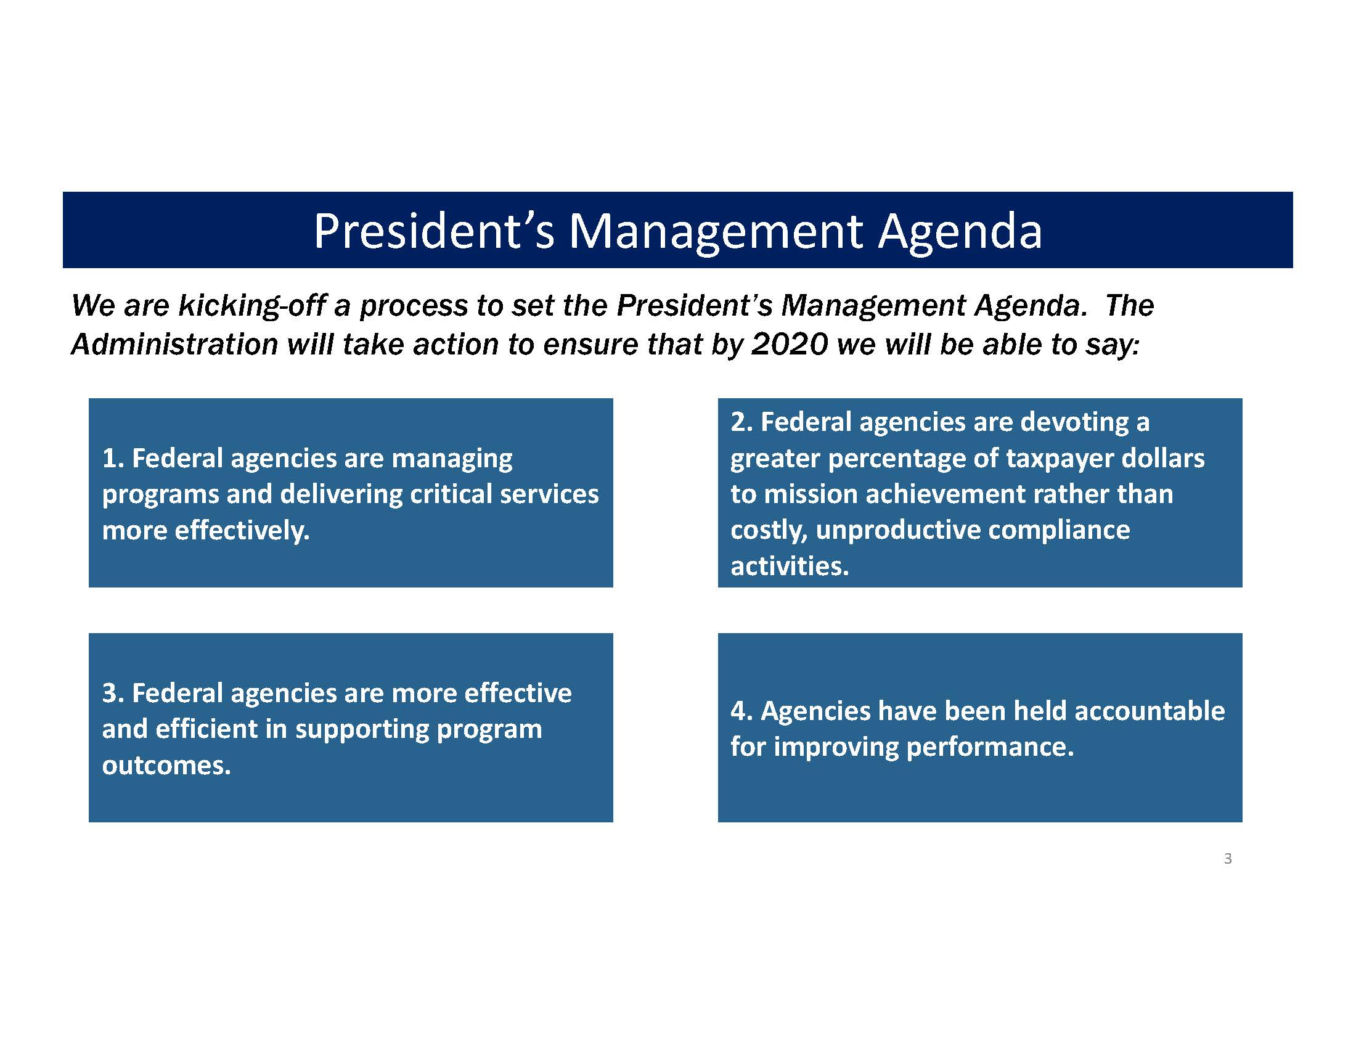
Going Forward

Slide 10
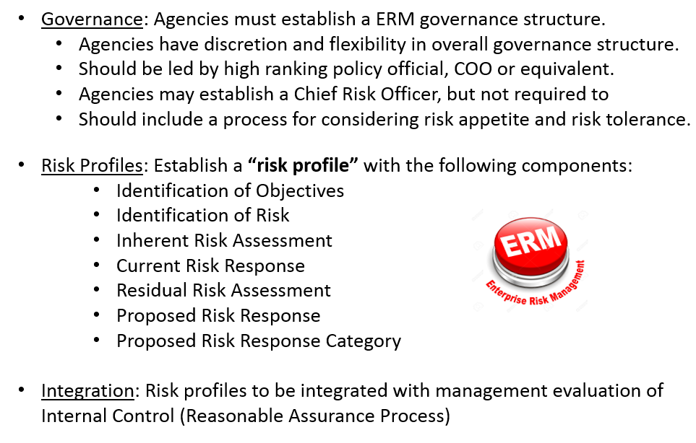
Required by A-123 for erm implementation

Slide 11
Updates – First year down
Rollout of requirements occurred in FY17– what is happening now?
Still a key initiative of the current administration
Key focus for OMB - encouraging integration of ERM within strategic reviews and internal controls
    These areas line up with two deliverables required by A-123
      Integrate with Annual Strategic Reviews – Identification of key notations from risk profiles are made available for discussion with OMB as part of Agency Strategic Reviews
              Risk profiles required to be in place, but was non-deliverable to OMB in FY17
      Integrate with Evaluation of Internal Control – Agencies providing assurances about internal controls under FMFIA
              In FY17, OMB noted several agencies that reported on ERM in several locations
              Going forward, further integration of areas is encouraged (Grants Management, Fraud Risk Management, Improper Payments, Data Integrity, etc.)
Notes:
This involves agencies to identify key findings from the risk profiles and make them available for discussion with OMB as part of the Agency Strategic Reviews, which occur in the Spring/Summer time period, as indicated by A-11, Part 6. For FY2017 we kept the June requirement for an initial risk profile in place, but made it a non-deliverable to OMB. This was in part due to the transition of the Administration, agency reform efforts under M-17-22, and the postponement of the strategic reviews for FY2017. We hope to have a more “normal” cycle starting in FY2018.
integrate ERM with the management evaluation of internal control. This involves agencies, as part of their annual assurance process under the FMFIA to provide reasonable assurances in their AFR/PAR for formal internal controls have been both identified and linked to the risk profiles. This usually occurs around the September/October time period. For FY2017 reporting, we noticed that agencies reported out on ERM not just in their assurance statements, but in other parts of the AFR/PARs. Going forward for FY2018, I hope to see further integration in areas not limited to financial controls, but expand to grants management, fraud risk management, improper payments, disaster relief assistance, and data integrity. As A-123 encourages a maturity model approach, agencies have the flexibility in how much and how quickly they integrate ERM in other areas.

Slide 12

Principles
Underlying points for developing a risk culture
Governance Framework is Important
Managing Risk is Everyone’s Responsibility
Managers Own the Risk
Transparency Supports Informed Decision Making
Forums for Discussing Risk are Important
Risk Management Should Be Integrated into Key Agency Processes
Establishing a Risk Appetite is Key
Planning Fosters a Culture of Resilience
Diversity of People and Thought Aids Risk Management
Notes:
1. ERM is built around a purposeful governance framework supported by the most senior levels of the organization and embedded into the day-to-day business operations and decision-making of the agency. Agencies may choose to adopt particular standards or frameworks (for example, COSO or ISO 31000), but it is important that whatever framework is selected, the agency customizes it to meet the mission, needs, structure, and culture of the organization.
2. enables understanding and appropriate management of the risks inherent in agency activities. It does not eliminate risk.
Risk management training should be available to all staff so they are equipped to manage risks associated with their work. Managers at each level should be equipped with appropriate skills and resources to manage risk appropriately. Everyone is a risk manager.
3. Responsibility for success at each level of the organization means responsibility for managing risk at that level. Key distinction. Even with a Chief Risk Officer (CRO) at an agency, managers still own the risk. The CRO is more of the facilitator of the ERM process, helping connect the dots and plan next steps. Doesn't Own the risk itself.
4. Informed decision making requires the flow of information regarding risks and clarity about uncertainties or ambiguities, up and down the hierarchy and across silos, to the relevant decision makers so they can make informed decisions.
5. establish forums or committees to facilitate an open discussion of risk. Members should include policymakers, program leaders and risk management professionals within the agency, not just risk executives speaking to each other. Discussions of risk should include those both within and across silos in agencies.
6. process should be integrated within organizational processes such as strategic planning, budgeting, and performance management. Agencies should consider risks from across the agency
7. Clearly expressed and well communicated risk appetite statements establishing thresholds for acceptable risk in the pursuit of objectives are important.
8. Risk management needs to be forward looking, learning from past mistakes as well as current best practices. Developing strategies to respond to alternate future scenarios facilitates a culture of resilience, where programs can continue to meet objectives in the face of changing realities.
9. importance of bringing together different views and perspectives to discuss issues across various departments

Slide 13
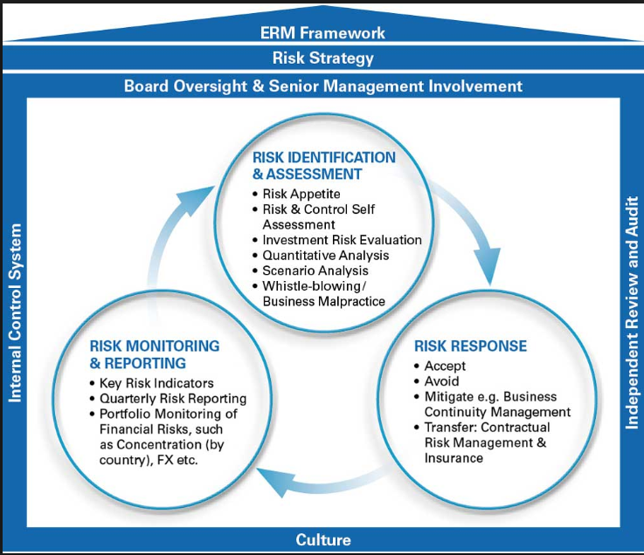
Relationships

Slide 14
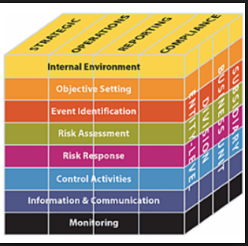
Components of ERM –
COSO 2013
Internal Environment
Objective Setting
Event Identification
Risk Assessment
Risk Response
Control Activities
Information and Communication
Monitoring

Slide 15
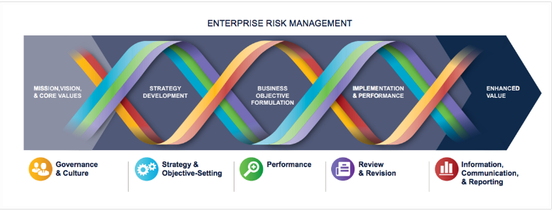
COSO ERM 2017
End Goal: Manage the Risks That Matter! NOT: Manage All the Risks that Exist
*Represents a shift from process based risk assessment to strategy/objective linked risk assessment and management*
Notes:
"DNA" model that incorporates 5 Components with strategy and performance management.

Slide 16
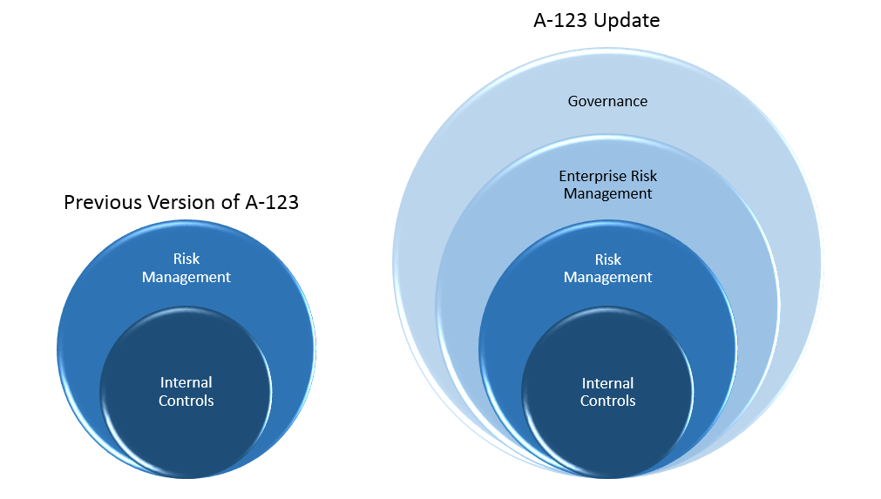

Slide 17
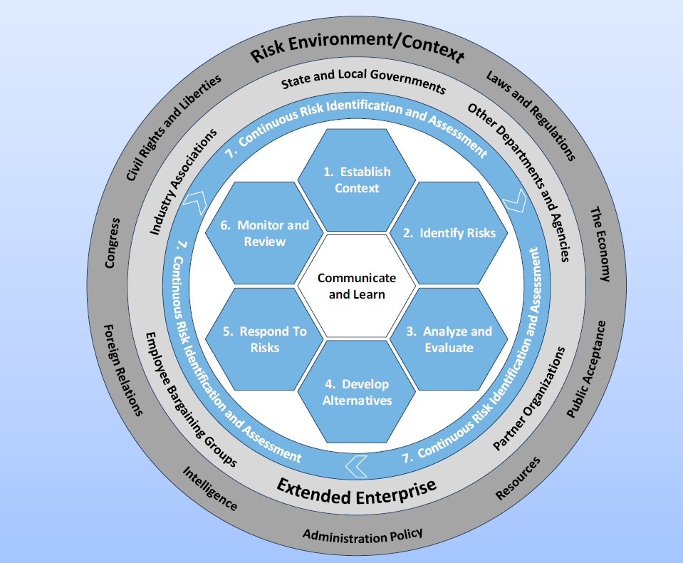
Enterprise Risk Management Model
Overview:
7 Cyclical Components
  Establish the Context
  Identify Risks
  Analyze and Evaluate
  Develop Alternatives
  Respond to Risks
  Monitor and Review
  Continuous Risk Identification and Awareness
3 Enterprise Components
  Communicate and Learn
  Extended Enterprise
  Risk Environment/Context
Notes:
Complexity Model
Full circle shows all context that encompasses the org externally
Next circle shows factors affecting the org internally
Moving in, the blue circle is showing what the black portion of the cube says – that every aspect of the ERM process needs continuous monitoring as the base of the design
Within the circle are the steps of the ERM formation and implementation
The center of the circle shows that each step relies on communication and learning from them to be able to be effective and progressive

Slide 18
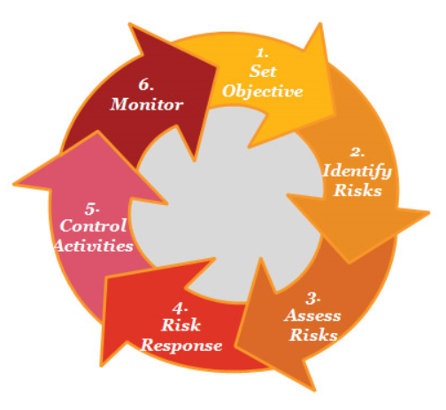
Internal environment/
OBJECTIVE SETTING
STEP 1: ESTABLISH CONTEXT
Determine the requirements and constraints that influence the decision making process
  Evaluation of policy, mission needs, stakeholder interests/priorities, culture and acceptable risk levels
  Consider how the existing control environment operates to ensure compliance with laws, regulations and policies

Slide 19
Event identification
STEP 2: IDENTIFY RISKS
Use a structured and systematic approach to recognize risks in meaningful categories
Address key risks significant to achievement of organizational objectives
In more formal process, having a risk register of all risks and their management is effective
Perform examination to determine highest risks for agency profile
Notes:
Categorize in ways that are relevant to agency mission
Recognize that any single risk could be associated with more than one area
Consider all risks without regard to which can be controlled by org or not
Gives segue to process for identifying the most significant to overall objectives

Slide 20
Risk assessment
STEP 3: ANALYZE AND EVALUATE
Consider root causes, sources, and probabilities
Evaluate potential positive and negative outcomes
Perform prioritization of identified risks
STEP 4: DEVELOP ALTERNATIVES
Identify and assess response options
  Accept, transfer, share, avoid, or mitigate
  Evaluate costs of addressing risks, and values of benefits
  Consider control options that respond to risk
Notes:
Look at all aspects and characteristics of the risk.
What is the source of the risk? External/Internal? Controllable?
What is the probability?
What is the impact?
What would a recovery require?
Root causes are also very critical because the root is not identified in many cases
Does this risk lead to a positive or negative outcome?
Provide a scale for the High to Low of what has been identified
Assessments of the likelihood and impact of risk events help agencies monitor whether risk remains within acceptable levels and support efficient allocation of resources to addressing the highest-priority risks. Agencies can be too risk-averse. It is important to assess risks of standing still and either missing opportunities or becoming vulnerable to a changing environment.

Slide 21
Risk response
STEP 5: RESPOND TO RISKS
Determine how to allocate resources to address
Document milestones for carrying out management process
Implement monitoring over the management process
Evaluate process for effectiveness and timeliness
Prepare and execute the selected response

Slide 22
Control activities Info & Communication
STEP 4: DEVELOP ALTERNATIVES (con’t.)
  Consider control options that respond to risk
      Controls are part of a full analysis of appropriate response to risks
  Design for control options: preventative, corrective, directive or detective
  OMB A-123 requires:
    Management responsibility for the development and maintenance of effective internal controls
    Management evaluation of internal control effectiveness
Processes in place should have provisions for alerting appropriate levels of management to:
  New or emerging risks
  Changes in identified risks
  Updates to risk environments or perceptions of threat/opportunity
  Responses to risks not in like with established risk appetite or tolerances
Notes:
Risk responses are not limited just to internal controls

Slide 23
monitoring
STEP 6: MONITOR AND REVIEW
Evaluate performance of selected risk responses
Determine if selected option is achieving desired result
Develop continuous routine for ongoing assessment
Must be a constant process to watch for leading indicators of future risks, as well as changing risks in those already identified

Slide 24

Risk appetite & Tolerance
Risk Appetite – Amount of risk that is willing to be accepted in pursuit of mission/vision
  Established at most senior levels of leadership
  Guidepost for setting strategy and selection of objectives
Risk Tolerance – Acceptable level of variance in performance relative to the achievement of objectives
  Established at the program, objective, or component level
  Consideration given to relative importance of objectives
  Portfolio View – Having insight into ALL areas of organizational risk exposure

Slide 25
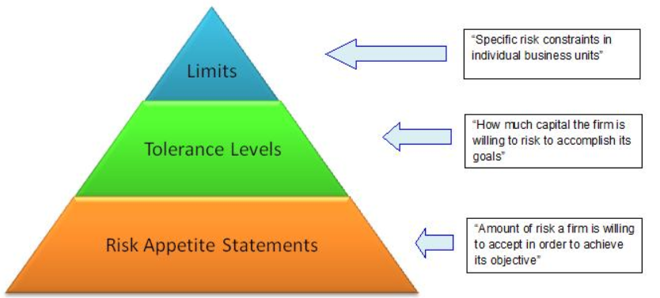
NOTE: A-123 recognizes the importance of the concepts of risk appetite and tolerance within an ERM framework, but does not actually require agencies to develop a risk appetite statement.

Slide 26
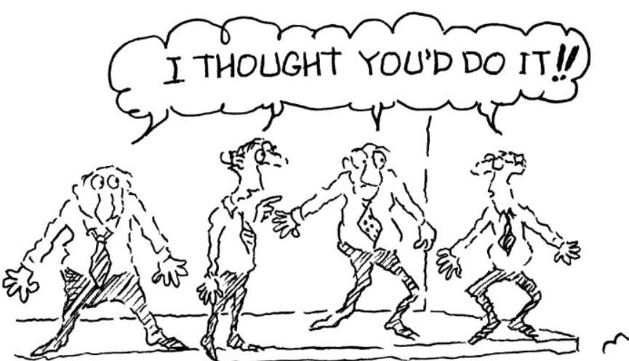
Roles and responsibilities within framework
Board of Directors & CEO/Director - Charged with ultimate accountability for all risks. Practices must be discussed periodically and related policies must be reviewed and approved.
Senior management - Should design, implement, and maintain effective framework. Develop policies and procedures, establish and monitor the risk appetite, and report regularly to the board of directors. Promote a risk-aware culture.
Middle management and Business units - Must identify, assess, measure, monitor, control, and report risks to senior management. Manage relevant risks within the framework established and ensure compliance with policies and procedures.
Support functions (i.e. Legal, HR, IT, etc) - Provide support to business units in developing and enforcing policies and procedures.
Internal Audit & Compliance - Monitor and provide independent assurance of the effectiveness of the framework.
Risk management - Coordinate the establishment of the framework and provide risk management expertise.
Notes:
It may seem straightforward and common sense, but agencies could benefit greatly from establishing clear roles and responsibilities for ERM.

Slide 27
Risk profiling
Part of new OMB A-123 requirements is for agencies to maintain a risk profile
An effective profile provides an analysis of the risks that an organization faces toward achieving its strategic objectives, operations, reporting and compliance objectives
Identifies options for addressing risks arising from mission and mission-support operations
Differs from a risk register in that it is a prioritized inventory of the most significant risks
MUST consider risks from the portfolio perspective AND be approved
MUST identify sources of uncertainly, and both positive opportunities and negative threats
1st Milestone of ERM implementation: Risk Profiles due to OMB in June 2017
Notes:
The development of an Agency risk profile:
􀁸 encourages open and candid conversations about risks facing an organization at all levels;
􀁸 facilitates the ranking of risk priorities (in particular to identify and escalate the most
significant risks of which senior management should be aware);
􀁸 captures the reasons for decisions made about risk tolerances;
􀁸 facilitates recording of the way in which it is decided to address risk;
􀁸 allows leadership at all levels to understand the overall risk profile and how their areas of
particular responsibility fit into it; and
􀁸 facilitates the review and regular monitoring of risks.

Slide 28
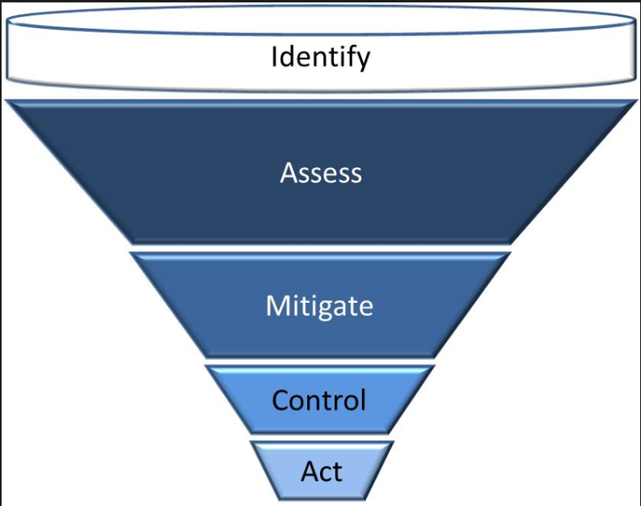
Components of a risk profile
Agencies have discretion in terms of form and content, but should include the following components:
1. Identification of Objectives
2. Identification of Risk
3. Inherent Risk Assessment
4. Current risk response
5. Residual Risk Assessment
6. Proposed Risk Response
7. Proposed Action Category

Slide 29

Benefits of erm
Supports achievement of strategic objectives, operations, reporting
and compliance objectives
Enhances institutional decision-making
Create a ‘risk-aware’ culture across the organization
Reduces operational surprises and losses
Prepares an organization to act on acceptable opportunities
Assures greater business continuity
Improves resource allocation by aligning risk and resources with strategic objects
Links strategies and business through relationships in a continuous causal analysis

Slide 30
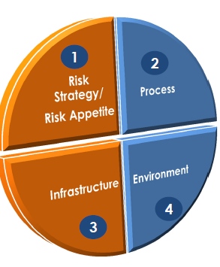
CRITICAL FACTORS for a mature framework
Strategy: ERM is built into, and applied, across the organization
  Aligned with strategic objectives and risk appetite
  Engages employees at every level
Environment: Culture supports success of framework
  Training and communication is provided to personnel and risk owners
  Roles and responsibilities are configured to promote efficient and effective risk-informed culture
  Assurance and communications are provided to management and the Board of Directors

Slide 31

CRITICAL FACTORS for a mature framework
Process Execution: Ongoing ERM process has elements necessary to flow throughout organization
    Risk identification – risks that may impact strategy through integrated or cross-disciplined approach
    Risk Assessment – impact and prioritization of identified risks
    Risk Response – categories of avoidance or acceptance of risk and procedures for response
    Risk Control – adherence to procedures, policies and regulations
Infrastructure: Systems, limits & methodologies provide a comprehensive view of risk
  Assists in identification of events that may affect the risk appetite
  Provides ongoing capability for analysis, monitoring and reporting

Slide 32

ERM PITFALLS – WHAT TO WATCH FOR
Design is not integrated
Focusing too much on Internal Controls
Narrow Focus on Financial View
Too Much, Too Quickly
Initiation of Overly Complicated Model
Absence of support from senior leaders
Lack of core team
Notes:
From ERM Playbook:
ERM should not be an isolated exercise – s/b integrated into the management of the org and eventually into its culture
ERM includes internal controls but also larger issues of the external environment – transparency, business practices, reporting and governance that help to the overall risk culture. The responsibility does not rest with financial side of house.
ERM is an iterative effort that develops over time. Management may consider an incremental approach, initially focusing on the top two or three risks or a type of risk. Trying to change the makeup of an agency too much/too quickly could result in defensive mechanisms within the agency that hamper overall ERM efforts.
Strong leadership is essential for achieving success – these are the people who dictate the tone for risk awareness and drive change in their positions. ERM also requires active involvement and commitment from leaders in each business and program areas to maintain a risk averse culture.
Having one person stand up an ERM program for mid/large agency is overwhelming. Agencies need the level of support to implement an effective ERM system – which requires a team with knowledge and experience. A CRO should analyze where a core team fits it to act more effectively
Care should be taken to ensure that what is elected makes the most sense for the agency (tailored) and provides value

Slide 33

Questions/feedback?

