Slide 1
Market insights
Fourth quarter 2022
Patrick D. Smith
Senior Vice President

Slide 2
Key points
1 | Inflation is the overriding issue for central banks around the globe. The war in Ukraine and China’s zero-COVID policies are elevating risks while the domestic labor market remains too hot.
2 | The Federal Reserve is aggressively raising rates and is beginning to reduce the size of its balance sheet at a faster pace than in the past.
3 | Global economies are slowing as central banks focus on fighting inflation. The risk of a recession, domestically and globally, continues to rise.
4 | Equity and bond prices have fallen significantly since the beginning of the year. The bond market may be closer to fair value. Equity prices may still be at risk as slower economic growth reduces earnings.
5 | We continue to recommend a defensive posture with an underweight to equities while the bond market is showing some areas of opportunity.

Slide 3
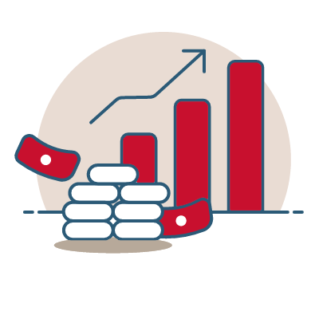


Base case outlook
Economy
Policy
Markets
Economic growth is slowing as consumers face higher prices and uneven supply of goods. Risk of a recession continues to escalate.
The Federal Reserve continues to raise rates to reduce demand. Fiscal policy is muted as the midterms approach.
Bond markets approaching fair value. Equities remain volatile as earnings declines become evident.
Risks: Russia-Ukraine war persists, and China maintains a zero-COVID policy.
Risk: More restrictive monetary policy may be required to tame inflation.
Risk: Potential for a global recession as well as inflation impacting earnings.

Slide 4

State of the economy
1 | Economic deceleration.
2 | Inflation stickiness.

Slide 5
Cool the economy to stop inflation
Real GDP growth in 2021 was reported up 5.7%. Growth in the first half of 2022 has been negative.
Growth has been impacted by an inflationary tax on consumers, resulting in lower real GDP.
A service recovery in 2022 has been a blessing and a curse, as demand recovers but supply remains labor-constrained.
Source: Bloomberg, Credit Suisse. Data shown as of June 30, 2022.

Slide 6
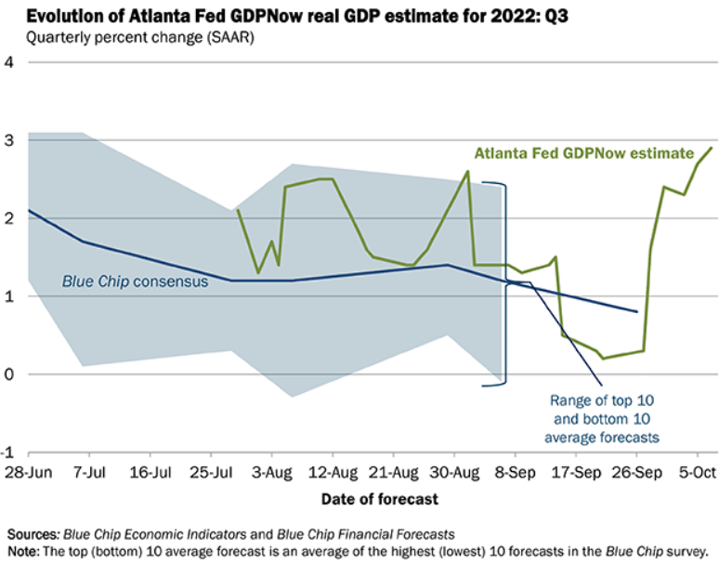
2022 Q3 Atlanta Fed GDPNow = 2.9%

Slide 7
Excess consumer savings being spent
The cushion of savings from the multiple rounds of fiscal stimulus during the pandemic is being depleted.
When broken down by income decile, the lower end of U.S. incomes have spent all stimulus.
Spending on essentials using credit cards has increased.
Consumer stress, as measured by food, shelter, and gasoline price increases, remains at 40-year highs.
Source: Federal Reserve Bank of St. Louis. Data shown as of April 30, 2022.

Slide 8
Americans cutting back in face of inflation
Rising prices force many to reconsider where money is being spent.
With roughly two-thirds of U.S. GDP driven by consumer spending, these decisions have material impacts on the economy.
Discretionary spending is the most impacted.
Slowing demand in some sectors will reduce inflationary pressures going forward.
Source: Statista Global Consumer Survey. Data shown as of July 31, 2022.

Slide 9
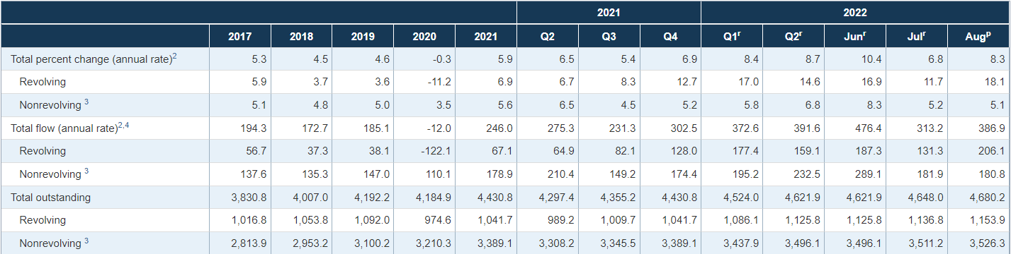
Credit card debt increasing at double digit annualized rate

Slide 10
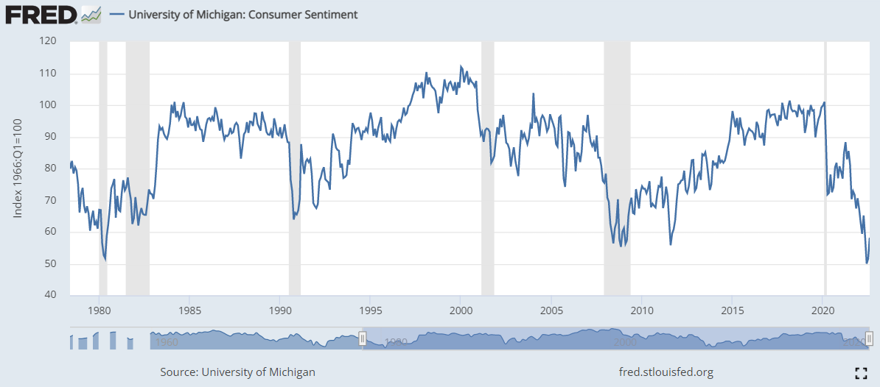
Consumer Confidence

Slide 11
Housing affordability near record lows
Housing is historically one of the most sensitive to changes in interest rates.
Affordability is a combination of interest rates and price.
The decline in affordability is driven by higher interest rates while prices have stayed elevated.
Price declines should be expected from here, but overall demand for housing remains robust.
Months’ supply of homes for sale rising significantly as consumers hold back on purchases.
Source: Bloomberg. Data shown as of June 30, 2022.

Slide 12
Manufacturing and services slowing
Consumer demand for goods is declining following the COVID binge.
Higher energy costs and a snarled supply chain are also slowing manufacturing.
Services, though slowing, remain elevated, and a tight labor force is driving service-led inflation.
Source: Bloomberg. Data shown as of August 31, 2022.

Slide 13
Oil prices declining with SPR releases
President Biden has ordered the release of oil from the Strategic Petroleum Reserve (SPR) to help reduce gasoline prices.
The release is still in place and has occurred at a faster pace and longer duration than previous SPR releases.
Gasoline prices have fallen since this action was taken.
SPR levels are at 35-year lows, leaving the US vulnerable to oil market disruptions.
Source: Bloomberg. Data shown as of September 3, 2022.

Slide 14
CPI still well above target
Parts of the Consumer Price Index (CPI) are always volatile.
Headline inflation is moderating as some cyclical prices retreat, including oil products.
Core inflation is continuing to accelerate, led by higher rents and wages.
The Federal Reserve is most focused on core inflation.
Source: Bureau Labor and Statistics. Data as of August 31, 2022.

Slide 15
Wages could be a source of sticky inflation
Competition for workers in the job market has led to significant wage increases.
Higher wages are a key metric for the Fed as they think about “core” inflation going forward.
The number of people quitting their jobs has been elevated as, according to private payroll company ADP, wage increases for job quitters have averaged 16% versus 7.6% for those staying in their current roles.
Source: Bloomberg. Data as of July 31, 2022.

Slide 16
Rental vacancy near historic lows
In addition to wages, rents are the other significant input to “core” inflation.
Higher home prices also play an indirect part in rent levels.
Broadly, vacancy rates are low and rents are increasing.
Rental tightness in an inflation-driven economy is significantly impacting lower-income households.
Source: Bloomberg. Data shown as of June 30, 2022

Slide 17
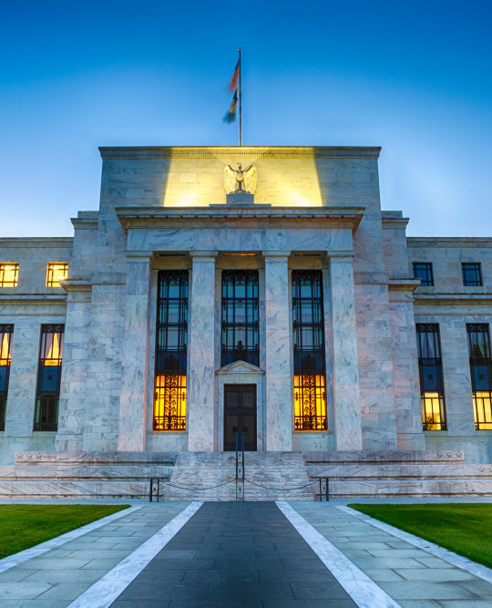
Policy response
1 | Federal Reserve actions.
2 | Tight monetary policy.
3 | Shrinking money supply growth.
4 | Fiscal policy.

Slide 18
The Fed is focused on inflation
The Fed hiked rates by 0.25% in March, another 0.50% in May, 0.75% in June, 0.75% in July, and 0.75% in September to 3.25 – 3.5%, with expectations for continued rate hikes at remaining meetings this year.
Current year-end rate expectations are 4.25 - 4.5%.
Terminal rate expectations are now 4.5 - 4.75%
2022-2023 FOMC Meeting Schedule
2022
2023
MAR
APR
MAY
JUN
JUL
AUG
SEP
OCT
NOV
DEC
JAN
FEB
MAR
APR
March hike
May hike
QT announced
June
hike
July
hike
Sept.
hike
Nov.
hike
Dec.
hike
Feb.
hike
QT: Balance sheet runoff
Source: Bloomberg.

Slide 19
Rates rising may stifle demand
Financial conditions are tightening faster than they have in 40 years.
The Fed has now raised rates to 3 - 3.25% through September.
Higher credit spreads are also playing a part in tightening financial conditions.
U.S. bank prime lending rate is up to 7%.
JUL
AUG
SEP
OCT
NOV
DEC
Source: Piper Sandler.

Slide 20
Inflation expectations are declining
As the Fed begins its tightening cycle, inflation expectations have stalled and turned lower.
We are monitoring data such as this to determine how effective the Fed policy is in lowering expectations.
JUL
AUG
SEP
OCT
NOV
DEC
Source: Bloomberg. Data shown as of September 22, 2022.

Slide 21
The Fed balance sheet has peaked
After years of balance sheet expansion dating back to the fiscal crisis in 2008, the Fed is shrinking its balance sheet.
Initially, the balance sheet will decline naturally as bonds mature and are not replaced.
If inflation remains hot, the Fed may choose to accelerate its balance sheet reduction via bond sales.
After the September meeting, the monthly balance sheet reduction has increased to $95 billion per month.
JUL
AUG
SEP
OCT
NOV
DEC
Source: Bloomberg. Data shown as of August 31, 2022.

Slide 22
M2 growth & core CPI
Money supply growth exploded during the pandemic as the Fed and Congress pumped trillions in stimulus into the economy.
As fiscal stimulus wanes, and the Fed raises rates and reduces the size of its balance sheet, money supply growth has slowed.
There is a significant lag in the impact on inflation, but slower money supply should help lessen inflation pressures.
JUL
SEP
OCT
NOV
DEC
Source: Federal Reserve Bank of St. Louis. Data shown as of August 31, 2022

Slide 23
Debt problem becoming a deficit problem
After years of deficit spending, the debt has grown to 100% of U.S. GDP. Now, interest rates are rising.
Though we are a long way from spending the same proportion of the Federal budget on interest costs compared to the mid-eighties to mid-nineties, interest as a percent of tax revenue is rising.
JUL
AUG
SEP
OCT
NOV
DEC
Source: OMB, Strategas, Forecast 2022 -2032.

Slide 24

Market Pulse
1 | Fixed income attractiveness.
2 | Equity market valuation.
3 | Mid-term Elections

Slide 25
Bond market yields improving
Government bond yields are approaching post-Great Financial Crisis highs.
Investment grade bond yields are also beginning to appear attractive as rates are approaching 12-year highs.
Source: Bloomberg. Data shown as of August 31, 2022

Slide 26
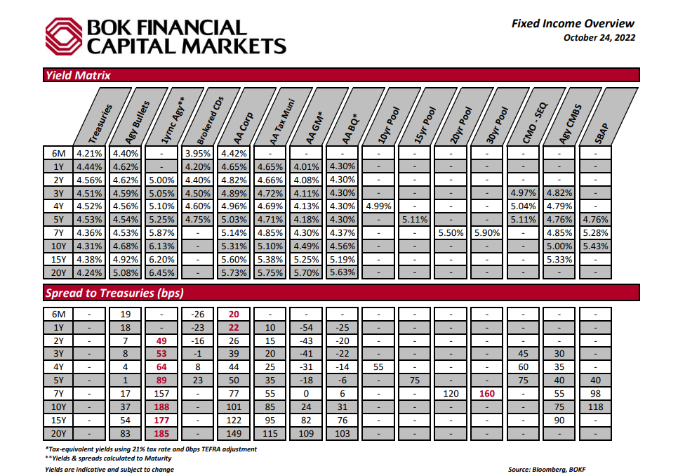

Slide 27
Credit spreads have widened
Rising credit spreads have historically been a good indicator of concerns about future growth prospects.
High-yield credit spreads have moved to levels of historical concern.
Higher spreads may result in fewer new borrowings, thus slowing economic growth.
If a recession is avoided, there may be opportunities developing in pockets of the bond market.
Source: Bloomberg. Data shown as of August 31, 2022

Slide 28
Stronger U.S. Dollar
Inflation is a global issue, and the U.S. began raising rates faster than most of the developed world, leading to a strengthening dollar.
The dollar’s strength has put pressure on foreign economies as they import inflation due to a weaker currency.
The weakening of foreign currencies relative to the dollar is forcing central banks to raise rates to stem imported inflation.
Source: Bloomberg. Data shown as of September 13, 2022.

Slide 29
S&P 500 valuation has declined
Valuations of equities have improved as prices have fallen.
Consensus expectations are that 2022 earnings will be higher than 2021. We are watching that assumption closely as we progress through 2022 and 2023.
Earnings are a bigger risk to stocks than are multiples.
Inflation and higher rates are headwinds to earnings and multiples.
Source: Bloomberg. Data shown as of August 31, 2022.

Slide 30
Earnings estimates are beginning to fall
We have only just begun to see estimates for the back half of 2022 and 2023 come down.
At present, 2023 earnings are still expected to be higher than 2022 as the market is not forecasting a recession.
Inflation, as well as restrictive monetary policy, is a headwind for the economy and earnings.
Source: Strategas

Slide 31
Operating margins likely to fall from peak
Corporate margins expanded as we worked our way through the pandemic.
Increased costs for raw materials, production, shipping, rents and wages will put margins under pressure.
Margins are unlikely to remain at peak levels, and as they return to more normal levels, earnings for companies are likely to decline.
Earnings, primarily due to lower margins, are the biggest risk to equity prices.
Source: Bloomberg. Data shown as of August 31, 2022.

Slide 32
U.S. market scenarios
It appears the market is pricing in earnings growth in 2023 vs. 2022. However, we think earnings estimates will trend lower.
A mild recession in 2023 is possible, and valuations are starting to reflect that possibility.
Though a recession is not our base case, a normal recession, where earnings drop 25%, would result in further losses in equity markets.
Upside is possible if inflation comes down more quickly than the market expects.
Market
Overvalued
Market
Undervalued
Source: Cavanal Hill. Data shown as of August 31, 2022.
Values assume consensus earnings per share (EPS) of $245 for 2023, $221 assuming mild recession in 2023, and $184 assuming “normal” recession in 2023.

Slide 33
Midterm elections reduce uncertainty
Markets tend to struggle when discounting uncertainty, and midterm elections provide substantial uncertainty.
Historically, midterm elections have been followed by higher-than-normal equity market returns.
The President’s current approval rating is at a level that has seen changes in the control of one or both houses of Congress in the past.
Source: Strategas

Slide 34
Midterm elections will impact markets
Past periods of mixed leadership between the White House, Senate and House of Representatives have seen higher equity market performance.
With the President’s approval rating below 45%, it’s highly likely that republicans will regain the House of Representatives.
Source: Strategas

Slide 35
Market pulse summary
1 | Bond rates are rising, though as spreads widen across the globe, we see pockets of opportunity emerging.
2 | International fixed income faces inflation and currency challenges and appears less attractive with yields below domestic yields.
3 | Domestic equities already reflect an economic slowdown. Areas of concern remain valuation and uncertainty surrounding margins and earnings.
4 | The midterm election is a source of uncertainty, and markets may see some relief following the election.

Slide 36
Missouri Amendment 1
Do you want to amend the Missouri Constitution to:
allow the General Assembly to override the current constitutional restrictions of state investments by the state treasurer; and
allow state investments in municipal securities possessing one of the top five highest long-term ratings or the highest short term rating?
State governmental entities estimate no costs and increased interest revenue of $2 million per year. Local governmental entities estimate no costs and increased interest revenue of at least $34,000 per year.

Slide 37
QUESTIONS????
PATRICK D SMITH
SENIOR VICE PRESIDENT
BOK FINANCIAL CAPITAL MARKETS
7101 COLLEGE BOULEVARD
OVERLAND PARK, KANSAS 66210
913-234-6623 | PHONE
816-668-1101 | MOBILE
PSMITH@BOKF.COM

Slide 38
Disclosures
The information provided herein was prepared by the Investment Management team of BOKF, NA. BOKF, NA is the bank subsidiary of BOK Financial Corporation (BOKF), a financial services holding company (NASDAQ:BOKF). BOKF offers trust and wealth management services through its subsidiaries including BOKF, NA (and its banking divisions Bank of Oklahoma, Bank of Texas, Bank of Albuquerque, and BOK Financial) and investment advisory services through its non-bank subsidiaries, Cavanal Hill Investment Management, Inc. and BOK Financial Private Wealth, Inc., each an SEC registered investment adviser, and BOK Financial Securities, Inc., also an SEC registered investment adviser and registered broker/dealer, member FINRA/SIPC (each an “Investment Affiliate”) (collectively, “BOKF”). Distribution of this document is intended for informational purposes. Information contained herein has been obtained from sources believed to be reliable, but not guaranteed. The opinions expressed herein reflect the judgment of the author(s) as of the date prepared and are subject to change without notice and are not a complete analysis of any sector, industry, or security regardless of the date on which the reader may receive or access the information. The information provided is intended to be educational in nature and not advice relative to any investment or portfolio offered through an Investment Affiliate, and does not constitute any form of regulated financial, legal, or tax advice, or other regulated financial service. The content provided herein is not a solicitation for the investment management services of any Investment Affiliate, nor is it intended to constitute a recommendation for, or advice to, any specific person on behalf of any Investment Affiliate, as it does not take into account the financial objectives, situation, or needs of any specific person. This information is provided on the understanding that the recipient has sufficient knowledge and experience to be able to understand and make their own evaluation of said content, any risks associated therewith, and any related legal, tax, accounting, or other material considerations. Recipients should not solely rely on this material in making any future investment decision. To the extent that the recipient has any questions regarding the applicability of any specific issue discussed above to their specific portfolio or situation, they are encouraged to consult with a qualified lawyer, accountant, or financial professional.
This document may contain forward‐looking statements that are based on management's beliefs, assumptions, current expectations, estimates, and projections, the securities and credit markets and the economy in general. Words such as "anticipates," "believes," "estimates," "expects," "forecasts," "plans," "projects," variations of such words and similar expressions are intended to identify such forward‐looking statements. Management judgments relating to and discussion of the value and potential future value or performance of any security, group of securities, type of security or market segment involve judgments as to expected events and are inherently forward‐looking statements. These statements are not guarantees of future performance. Likewise, past performance is not a guarantee of future results. This content is prepared for the use of the Investment Affiliates and their clients and prospective clients, and may not be reproduced, redistributed, retransmitted or disclosed, or referred to in any publication, in whole or in part, or in any form or manner, without the express written consent of BOKF or BOKF, NA. Any unauthorized use or disclosure is prohibited. Receipt and review of this document constitutes your agreement not to redistribute, retransmit, or disclose to others the contents, opinions, conclusion, or information contained herein. This report should not be distributed without the attached disclosures, and is considered incomplete if the disclosures are not attached.
Charts are for illustrative purposes only and not indicative of any actual investment.
Asset allocation, diversification, and rebalancing do not ensure a profit or protect against loss in declining markets. Investing involves risks, including possible loss of principal, and there is no guarantee that investment objectives will be achieved.
BOK Financial® is a trademark of BOKF, NA. Member FDIC. Equal Housing Lender . ©2022 BOKF, NA.
INVESTMENT AND INSURANCE PRODUCTS ARE: NOT FDIC INSURED | NOT GUARANTEED BY THE BANK OR ITS AFFILIATES | NOT DEPOSITS | NOT INSURED BY ANY FEDERAL GOVERNMENT AGENCY | MAY LOSE VALUE
Version 1 – Data as of 9/30/2022 unless otherwise stated
BOK Financial® is a trademark of BOKF, NA. Member FDIC. Equal Housing Lender.

