Slide 1

Selecting Talent
For Cultural & Motivational Fit

Slide 2
Good Interviewing Is Challenging
Best Practice | Reality
Make hiring decisions based on job-relevant criteria identified by studying the targeted job(s). | 56% make hiring decisions based on their instincts.
Train the interviewers to use a structured, behavior-based process & provide skill practice with feedback on how to do this. | Only 27% received such training.
Spend enough time with each candidate to make a good decision. | 47% spend < 30 minutes per candidate.
Thoroughly review each candidate’s competencies, personal characteristics, knowledge and experience. | 64% worry they are missing data on weaknesses that will show up later after hire.
Discuss data with other interviewers. | Only done 40% of the time.
Among interviewers never trained | Only 7% lack confidence in their ability.

Slide 3
Sources of Information
Knowledge Targets—Technical and/or professional information needed to perform job activities successfully. What people know.
Experience Targets—Educational and work achievements needed to perform job activities successfully. What people have done.
Competency Targets—A cluster of behaviors performed on a job. What people can do.
Personal Attribute/Motivation Targets—Dispositions that relate to satisfaction, success, or failure in a job. Who people are.

Slide 4





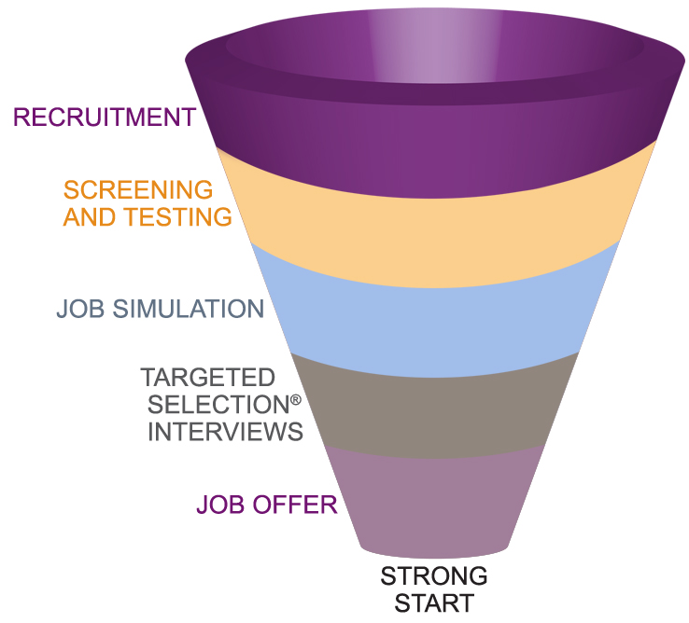

Selection Funnel

Slide 5
Sample Coverage Grid
 | Test | Interviewer A | Interviewer B | Interviewer C (Hiring Mgr.) | Simulation | Reference/ Background Check
Key Background Review |  |  |  | X
Decision Making |  | X | X |  |  | X
Planning and Organizing |  |  | X | X | X
Initiating Action |  | X | X
Applied Learning |  | X | X | X
Motivational Fit |  |  |  | X
Technical/Professional Knowledge and Skills |  |  |  | X

Slide 6

INTERVIEWER WORRY
I miss important information about strengths and weaknesses.

Slide 7
Past Behavior Predicts Future Behavior

Slide 8

Questionable Question #1
“If you were a tree (or animal), what kind would you be, and why?”

Slide 9


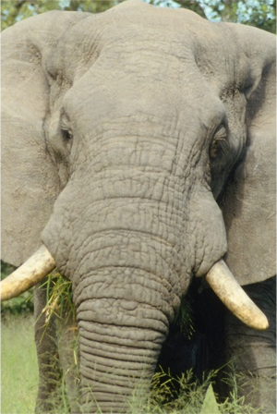
Questionable Question #2
“What would you do if I gave you an elephant?”
© Development Dimensions International, Inc., MMIX.
All rights reserved.

Slide 10

Questionable Question #3
“What do you think of the artwork hanging on the walls?”

Slide 11
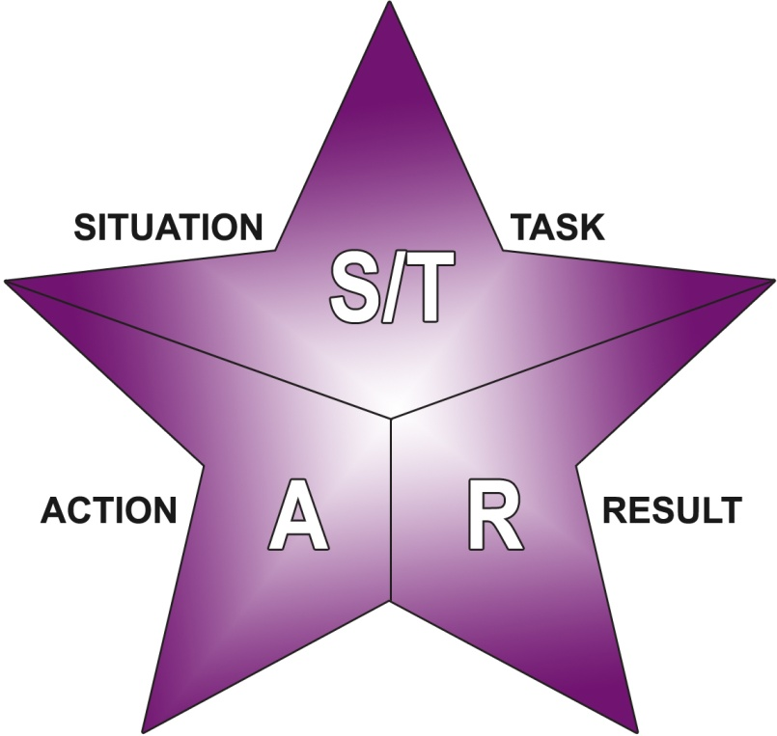
STAR
Situation/Task = Why?
Action = What done and how done?
Result = Effect of Action

Slide 12
Planned Behavioral Question
Target: Planning and Organizing
Example #1
Tell me about a time when you needed to complete several things at the same time. What did you do to get the work done?

Slide 13
STAR #1
Every morning before the store opens, there’s
a lot to do to get it ready—restocking, cleanup, taking markdowns, things like that. Last week two people called off sick on the same day, so we had even more prep work than usual. So I prioritized the work based on what would have the greatest impact on customers—restocking, cleanup, things like that. Then we did the lower priority things during the day as we had time. The store was fully stocked and looking good when we opened.

Slide 14
STAR #1—Situation/Task
Every morning before the store opens, there’s
a lot to do to get it ready—restocking, cleanup, taking markdowns, things like that. Last week two people called off sick on the same day, so we had even more prep work than usual. So I prioritized the work based on what would have the greatest impact on customers—restocking, cleanup, things like that. Then we did the lower priority things during the day as we had time. The store was fully stocked and looking good when we opened.

Slide 15
STAR #1—Action
Every morning before the store opens, there’s
a lot to do to get it ready—restocking, cleanup, taking markdowns, things like that. Last week two people called off sick on the same day, so we had even more prep work than usual. So I prioritized the work based on what would have the greatest impact on customers—restocking, cleanup, things like that. Then we did the lower priority things during the day as we had time. The store was fully stocked and looking good when we opened.

Slide 16
STAR #1—Result
Every morning before the store opens, there’s
a lot to do to get ready—re-stocking, clean-up, taking mark-downs, things like that. Last week two people called off sick the same day, so we had even more prep work than usual. So I prioritized the work based on what would have the greatest impact on customers—re-stocking, clean-up, things like that. Then we did the lower priority things during the day as we had time. The store was fully stocked and looking good when we opened.

Slide 17
Planned Behavioral Question
Target: Planning and Organizing
Example #2
What have you done to make your team more efficient and organized?

Slide 18
STAR #2
I cross-trained the team in all the responsibilities of running the store, including opening and closing and balancing the register. The person I replaced had only trained the most experienced people in these things, so when one of them didn’t make it to work, we had more tasks than people trained to do them. That made life miserable for me and the team. That hasn’t happened since people have been cross-trained, and every team member has said that their jobs are more interesting now.

Slide 19
STAR #2—Situation/Task
I cross-trained the team in all the responsibilities of running the store, including opening and closing and balancing the register. The person I replaced had only trained the most experienced people in these things, so when one of them didn’t make it to work, we had more tasks than people trained to do them. That made life miserable for me and the team. That hasn’t happened since people have been cross-trained, and every team member has said that their jobs are more interesting now.

Slide 20
STAR #2—Action
I cross-trained the team in all the responsibilities of running the store, including opening and closing and balancing the register. The person I replaced had only trained the most experienced people in these things, so when one of them didn’t make it to work, we had more tasks than people trained to do them. That made life miserable for me and the team. That hasn’t happened since people have been cross-trained, and every team member has said that their jobs are more interesting now.

Slide 21
STAR #2—Result
I cross-trained the team in all the responsibilities of running the store, including opening and closing and balancing the register. The person I replaced had only trained the most experienced people in these things, so when one of them didn’t make it to work, we had more tasks than people trained to do them. That made life miserable for me and the team. That hasn’t happened since people have been cross-trained, and every team member has said that their jobs are more interesting now.

Slide 22
False STARs—Part 1
I usually had no problems with the doctors. Some of the staff did, but I generally got along well with them.
We really struggled when it came time to implement the new system. But, after a few days, we had all the problems worked out and everything was running smoothly.

Slide 23
False STARs—Part 1—Vague
I usually had no problems with the doctors. Some of the staff did, but I generally got along well with them.
We really struggled when it came time to implement the new system. But, after a few days, we had all the problems worked out and everything was running smoothly.

Slide 24
False STARs—Part 2
I believe that people have an obligation to suggest new approaches, even if their ideas are controversial.
I think if you asked anybody they would tell you that my goals are very difficult and that meeting them is one of my greatest sources of satisfaction in my job.

Slide 25
False STARs—Part 2—Opinions
I believe that people have an obligation to suggest new approaches, even if their ideas are controversial.
I think if you asked anybody they would tell you that my goals are very difficult and that meeting them is one of my greatest sources of satisfaction in my job.

Slide 26
False STARs—Part 3
If it had been my decision, I wouldn’t have started the work until I had the design specifications.
The next time I get that kind of resistance, I’ll know how to handle it.

Slide 27
False STARs—Part 3—Theoretical
If it had been my decision, I wouldn’t have started the work until I had the design specifications.
The next time I get that kind of resistance, I’ll know how to handle it.

Slide 28
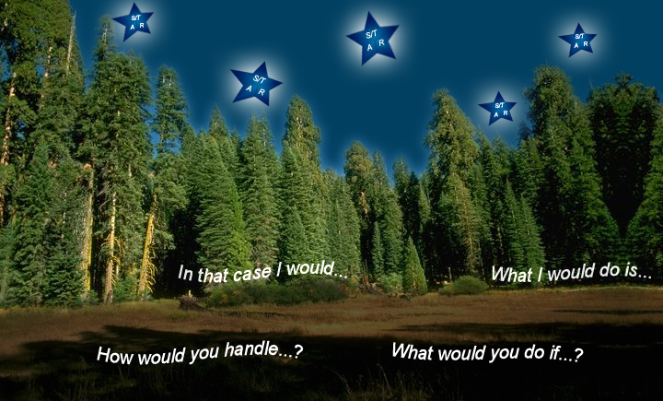
Stay Out of the “Woulds”

Slide 29
Candidate Provides/
Interviewer Asks
Candidate Provides
Interviewer Asks
Partial STAR →
One or more follow-up questions.
False STAR →
Follow up to get a true STAR.
Complete STAR →
Ask for another STAR under the same planned question or ask another planned behavioral question for this target.

Slide 30
Follow-up Quick Quiz—Part 1
Behavioral? Theoretical? Leading?
You say you like working with others. Does that mean you like working in a team?
Leading—Signals the candidate that teamwork is important.

Slide 31
Follow-up Quick Quiz—Part 2
Behavioral? Theoretical? Leading?
What happened as a result?
Behavioral—Seeks a result.

Slide 32
Follow-up Quick Quiz—Part 3
Behavioral? Theoretical? Leading?
You say their processes are inefficient. How would you change them?
Theoretical—Asks how you would change; this is hypothetical.

Slide 33
Follow-up Quick Quiz—Part 4
Behavioral? Theoretical? Leading?
Why did you decide to do that?
Behavioral—Seeks Situation/Task, factors that led to the candidate’s decision.

Slide 34

INTERVIEWER
WORRY
I’m not sure what questions to ask.

Slide 35
INTERVIEWER WORRY
It takes a psychologist
to interpret the candidate’s answers.

Slide 36
INTERVIEWER WORRY
I don’t know if I
have enough data
to make a decision.

Slide 37
Motivational Fit
Job Fit
Organization Fit
Location Fit
“Can Do” and “Will Do”

Slide 38
Motivational Fit Facets - Organization
Achievement Recognition | Bias for Action
Challenging the Status Quo | Civic Responsibility
Continuous Improvement | Customer Focus
Environment Sensitivity | Fun & Friendly Environment
Growth at Any Cost | High-Tech Orientation
Intellectual Focus | Lean and Mean
Minimum Mgmt. Structure | Openness to Change
Participative Management | Personal Freedom
Personal Growth | Planning for LT Success
Prestige | Quality Focus
Quick Reaction to Opp. | Resource Consciousness
Thriving on Risk | Valuing Diversity

Slide 39
Motivational Fit Facets - Job
Achievement | Center of Attention
Challenging Work | Coaching Others
Commission | Continuous Learning
Detail Orientation | Entrepreneurialism
Formal Recognition | High Responsibility/Accountability
Influencing Others | International Exposure
Interpersonal Support | Physical Environment
Position/Status | Practical Results
Promotion Opportunities | Recognition for Expertise
Relationship Building | Standardized Work
Task Variety | Travel

Slide 40
Motivational Fit
Takeaway Exercise:
YOUR Organizational Fit
Job Fit
Location Fit

Slide 41

INTERVIEWER WORRY
New hires quit within 90 days.

Slide 42

INTERVIEWER WORRY
Candidates don’t accept the job offer.

Slide 43
Legal Considerations
Selection System with Legal Credibility:
Job-Related Competencies & Components
Consistency in Handling Applicants

Slide 44

INTERVIEWER WORRY
I might be asking illegal questions.

Slide 45

INTERVIEWER WORRY
Interviewing is no better than flipping a coin.

Slide 46
Key Concepts
Competencies for Success
Gathering In-Depth Behavioral Data
  STARs
  Follow Up Questions
Motivational Fit
Legal credibility

Slide 47
Business Integration
Competencies for Success
Job Descriptions
Talent Selection
Organizational Development – Leaders & Individual Contributors
Performance Management
Compensation Strategies
Succession Planning

Slide 48

Ollis/Akers/Arney Business Consulting Division
Questions?

Slide 49

Thank You
Karen Shannon
Vice President Business Consulting/CHRO
(417) 881-8333
(417) 848-3133 (m)
Karen.Shannon@ollisaa.com
Business Consulting Division

