Slide 1
Gilbert C. Barrera, Jr., J.D., CPA, MPA
Clinical Associate Professor
Department of Accounting & Finance
College of Business
Texas A&M University-San Antonio
One University Way
San Antonio, TX 78224 gbarrera@tamusa.edu
© Gilbert C, Barrera, Jr.

Slide 2
Gilbert C. Barrera, Jr., J.D., CPA, MPA
Disclaimer
The information herein is provided for educational and informational purposes only, and should not be construed as legal advice or as an offer to perform accounting or legal services on any subject matter.
The opinions I express are my own and should not be construed as representative of Texas A&M-San Antonio, or of the San Antonio Police Department.

Slide 3
OVERVIEW OF
STAGES IN TEXAS CRIMINAL JUSTICE SYSTEM
TRIAL
PRE-TRIAL
GRAND JURY PRESENTATION
DA INTAKE
INVESTIGATION BY LAW ENFORCEMENT
© Gilbert C. Barrera, Jr.

Slide 4
AICPA STATEMENT ON STANDARDS FOR FORENSIC SERVICES NO. 1
EFFECTIVE JANUARY 1, 2020§§
On July 10, 2019 the AICPA released Statement On Standards for Forensic Services No. 1 (SSFS 1) .
Effective for engagements accepted on or after January 1, 2020.
SSFS 1 is the first effort by the AICPA to establish best practices for litigation and investigating services.
“Forensic accounting is a diverse practice, and this standard is unique because it is applied based on why a service is provided—litigation or investigation—rather than what skill set is employed.” Annette Stalker, CPA, CFF, and chair of the AICPA’s Forensic and Valuation Services (FVS) Executive Committee.
© Gilbert C. Barrera, Jr.

Slide 5
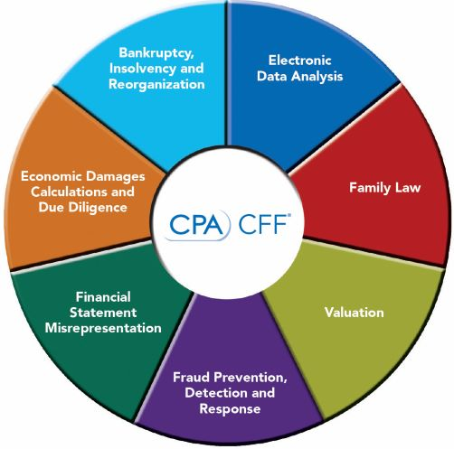
Forensic accounting services generally involve the application of specialized knowledge and investigative skills by a member to collect, analyze, and evaluate certain evidential matter and to interpret and communicate findings (forensic services).
SSFS No. 1: DEFINITION OF FORENSIC ACCOUNTING
© Gilbert C. Barrera, Jr.

Slide 6
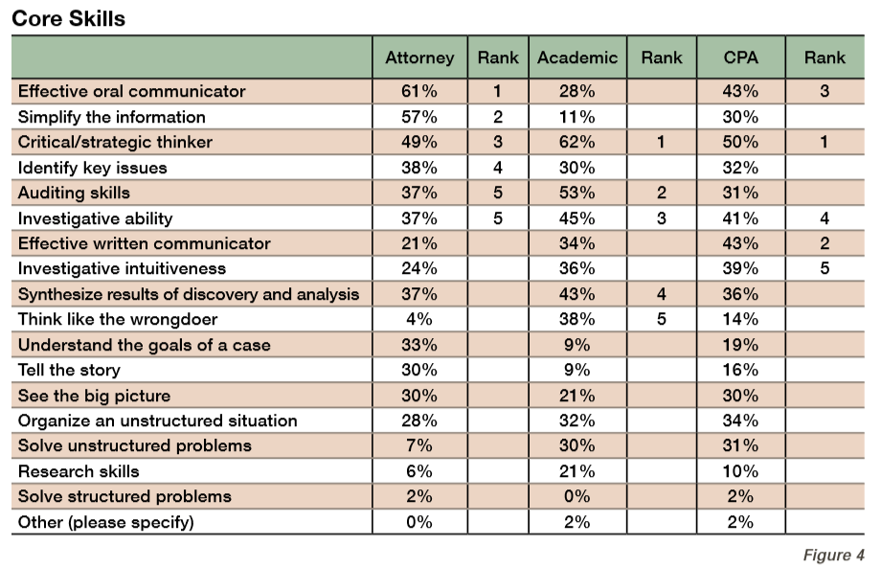
FORENSIC ACCOUNTING DEFINITION
“SPECIALIZED KNOWLEDGE AND INVESTIGATIVE SKILLS”;
“INTERPRET AND COMMUNICATE FINDINGS”
Characteristics and Skills of the Forensic Accountant https://linomartins.files.wordpress.com/2010/04/10307378_forensicaccresearchwhitepaper.pdf

Slide 7
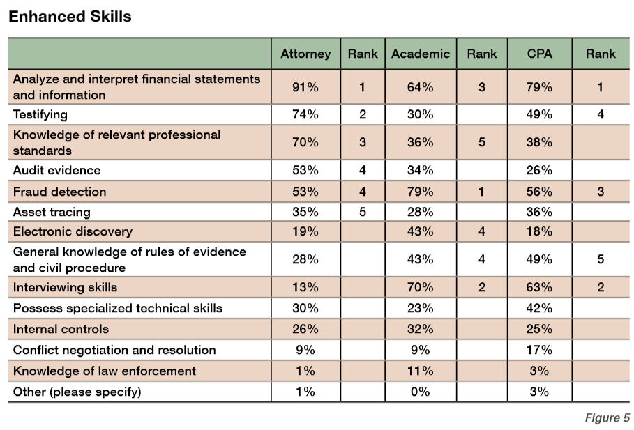
FORENSIC ACCOUNTING DEFINITION
“SPECIALIZED KNOWLEDGE AND INVESTIGATIVE SKILLS”;
“INTERPRET AND COMMUNICATE FINDINGS”
https://linomartins.files.wordpress.com/2010/04/10307378_forensicaccresearchwhitepaper.pdf

Slide 8
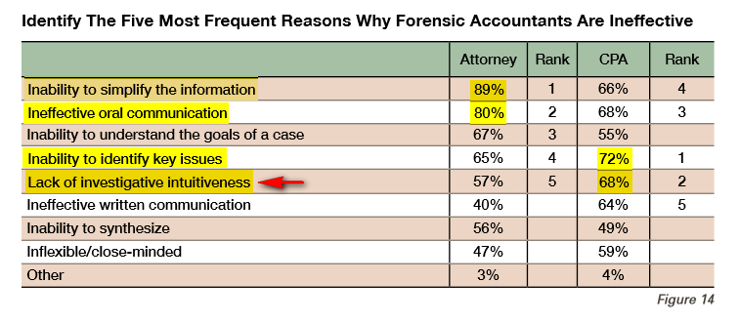
FORENSIC ACCOUNTING DEFINITION
“SPECIALIZED KNOWLEDGE AND INVESTIGATIVE SKILLS”;
“INTERPRET AND COMMUNICATE FINDINGS”
Speaker’s Note:
What is“investigative intuitiveness” supposed to mean? It is not defined.d
However, mention the sales tax case / Inventory vs. Property, Plant, & Equipment
However, mention the elder fraud case / savings bonds /
https://linomartins.files.wordpress.com/2010/04/10307378_forensicaccresearchwhitepaper.pdf
© Gilbert C. Barrera, Jr.

Slide 9
STATEMENT ON STANDARDS FOR FORENSIC SERVICES NO. 1
1 OF 4 POINTS OF EMPHASIS §§
“Authoritative standards and nonauthoritative guidance are not a substitute for the use of professional judgment¹.” SSFS 1, P.1
¹ Speaker’s note:
Extent of classifications in Rule 1006 (divorce case, C/P VS. S/P);§§
Subject to attorney’s professional judgment; never forget whose case it is; pawn shop case – decide selection of transactions to test.
Subject to what law requires: cash basis or accrual basis; criminal or civil;
Decide what is irrelevant and exclude it – confer w/ atty.;
© Gilbert C. Barrera, Jr.

Slide 10
STATEMENT ON STANDARDS FOR FORENSIC SERVICES NO. 1
2 OF 4 POINTS OF EMPHASIS §§
“The term litigation as used herein is not limited to formal litigation but is inclusive of disputes and all forms of alternative dispute resolution.” SSFS 1, ¶ 1
Speaker’s note:
“Litigation” includes civil, criminal, depositions, all forms of discovery, affidavits, etc.
© Gilbert C. Barrera, Jr.

Slide 11
STATEMENT ON STANDARDS FOR FORENSIC SERVICES NO. 1
3 OF 4 POINTS OF EMPHASIS §§
“Investigation. A matter conducted in response to specific concerns of wrongdoing in which the member is engaged to perform procedures to collect, analyze, evaluate, or interpret certain evidential matter to assist the stakeholders (for example, client, board of directors, independent auditor, or regulator) in reaching a conclusion on the merits of the concerns.” SSFS 1, ¶ 1
Speaker’s note:
Attorney work product privilege (legal v. business advice); no CPA privilege;
Get affidavits (Tranum v. Broadway, 283 S.W.3d 403 (Tex. App. Waco 2008);
Upjohn warnings (corporate Miranda); 449 U.S. 383 (1981); §§
Confidentiality of investigation; slander, defamation of character;
Coerced confession (Blake, 379 S.W.2d 899)§§(Fisher, 379 S.W.2d 900)§§
  Video in interview room
© Gilbert C. Barrera, Jr.

Slide 12
STATEMENT ON STANDARDS FOR FORENSIC SERVICES NO. 1
4 OF 4 POINTS OF EMPHASIS §§
“The ultimate decision regarding the occurrence of fraud is determined by a trier of fact; therefore, a member performing forensic services is prohibited from opining regarding the ultimate conclusion of fraud. This does not apply when the member is the trier of fact. A member may provide expert opinions relating to whether evidence is consistent with certain elements of fraud or other laws based on objective evaluation.”¹
¹Speaker’s Comment: I disagree:
on direct no; on cross yes;
forensic accounting expert ≠ legal expert;
Knowledge of the law does not allow for expert testimony under oath.
© Gilbert C. Barrera, Jr.

Slide 13
EXAMPLES:
HYDROCODONE ADDICTED PAYROLL EMPLOYEE (R) NEGOTIATED HEALTH I NSURANCE PLAN (A);
SALES REP (A) WHO EMBEZZLED $ (C) FROM SMALL CUSTOMER (SEE SPREADSHEET);§§
BOOKKEEPER (A) HAS SIGNATURE AUTHORITY ON CHECKING ACCOUNT (C)§§
© Gilbert C. Barrera, Jr.

Slide 14
LESSONS TO LEARN FROM PREVIOUS CASES:§§
WATCH EVERYTHING! §§
Defendant incorporates ABC Corp. with bank X account # 123456.
Then Defendant attracts investor , Mr. Majority Shareholder, who imposes the following terms:
  Defendant must close ABC Corp. and bank X account # 123456
  Defendant must open bank account for ABC Corp. at bank Y account #78910.
  Mr. Majority Shareholder will put up $100k cash in a separate bank account as collateral for a loan for ABC Corp.
Defendant does not close ABC Corp. or bank X account # 123456 and deposits into it checks made payable to ABC Corp.
Defendant also forged Mr. Majority Shareholder’s signature on lines of credit with business vendors.
© Gilbert C. Barrera, Jr.

Slide 15
LESSONS TO LEARN FROM PREVIOUS CASES:
FAILURE TO MAINTAIN G/L ACCOUNTS AND AUTHORIZED VENDORS LIST
Powers v. Caremark Inc. (In re Powers), 261 Fed. Appx. 719§§
Robert Powers owned Powers Construction, Inc. ("PCI"), that did construction work for Caremark prior to April 2001.
However, this resulted in a lawsuit which ended April 2001.
On April 18, 2001, Caremark mistakenly issued a check for $ 633,369.00, payable to "Powers Construction, Inc." The check should have been made payable to another contractor who completed PCI’s work.
Caremark did not owe PCI this money.
There was no existing contractual relationship between Caremark and PCI.
The check was deposited by PCI in its corporate bank account on April 23, 2001
© Gilbert C. Barrera, Jr.

Slide 16
LESSONS TO LEARN FROM PREVIOUS CASES:§§
BOOKKEEPER WROTE CHECKS TO HERSELF / FALSE EXPENSE
POINTS OF EMPHASIS:
PC 31.03 Theft - “continuing offense” (S of L 5 yrs.)
PC 32.45 Misapp. of Fiduciary Property -“continuing offense” (S of L 7 yrs.)
PC 32.21 Forgery is complete each time it is committed. (S of L 10 yrs)
Example of Statute of Limitations:
Each of the 3 offenses (Theft, M of FP, Forgery) is committed every year for 10 years ending Dec. 31, 2000
Theft – indict by 123105 for offenses 1991-2000
M of FP – indict by 123107 for offenses 1991-2000
Forgery – indict by 123110 for offense Dec. 31, 2000 only
2000 | 2001 | 2002 | 2003 | 2004 | 2005 | 2006 | 2007 | 2008 | 2009 | 2010
© Gilbert C. Barrera, Jr.

Slide 17
TEXAS LAW MOST OFTEN APPLIED IN FINANCIAL CRIMES:
Tex. Penal Code Ann. § 32.45 Misapplication of Fiduciary Property
(a) For purposes of this section:
(1) “Fiduciary” includes:
(A) a trustee, guardian, administrator, executor, conservator, and receiver;
(B) an attorney in fact or agent appointed under a durable power of attorney as provided by Subtitle P, Title 2, Estates Code;
(C) any other person acting in a fiduciary capacity, but not a commercial bailee unless the commercial bailee is a party in a motor fuel sales agreement with a distributor or supplier, as those terms are defined by Section 162.001, Tax Code; and
(D) an officer, manager, employee, or agent carrying on fiduciary functions on behalf of a fiduciary.
(2) “Misapply” means deal with property contrary to:
(A) an agreement under which the fiduciary holds the property; or
(B) a law prescribing the custody or disposition of the property.
PRACTICE POINTERS:
With regard to partnership assets, a partner is a fiduciary, but is not a trustee because a partner does not have ownership rights in partnership assets.
Note: agreement’s terms become an element of the offense (E.G. partnership agreement).
© Gilbert C. Barrera, Jr.

Slide 18
TEXAS LAW MOST OFTEN APPLIED IN FINANCIAL CRIMES:
Tex. Penal Code Ann. § 32.45 Misapplication of Fiduciary Property (cont.)
(b) A person commits an offense if he intentionally, knowingly, or recklessly misapplies property he holds as a fiduciary . . . in a manner that involves substantial risk of loss to the owner of the property or to a person for whose benefit the property is held.
c) An offense under this section is:
(1) a Class C misdemeanor if the value of the property misapplied is less than $100;
(2) a Class B misdemeanor if the value of the property misapplied is $100 or more but less than $750;
(3) a Class A misdemeanor if the value of the property misapplied is $750 or more but less than $2,500;
(4) a state jail felony if the value of the property misapplied is $2,500 or more but less than $30,000;
(5) a felony of the third degree if the value of the property misapplied is $30,000 or more but less than $150,000;
(6) a felony of the second degree if the value of the property misapplied is $150,000 or more but less than $300,000; or
(7) a felony of the first degree if the value of the property misapplied is $300,000 or more.
© Gilbert C. Barrera, Jr.

Slide 19
TEXAS LAW MOST OFTEN APPLIED IN FINANCIAL CRIMES:
Tex. Penal Code Ann. § 31.03 Theft
Sec. 31.03. Theft.
(a) A person commits an offense if he unlawfully appropriates property with intent to deprive the owner of property.
(b) Appropriation of property is unlawful if:
(1) it is without the owner’s effective consent;
(2) the property is stolen and the actor appropriates the property knowing it was stolen by another; or
(3) property in the custody of any law enforcement agency was explicitly represented by any law enforcement agent to the actor as being stolen and the actor appropriates the property believing it was stolen by another.
Note: the range of punishment for theft is based on the same amounts as § 32.45.
© Gilbert C. Barrera, Jr.

Slide 20
TEXAS LAW MOST OFTEN APPLIED IN FINANCIAL CRIMES:
RE: RESTITUTION
Tex. Code Crim. Proc. Ann. art. 42.037(a) (Supp. 2008):
(a) In addition to any fine authorized by law, victims of crime fund established under Subchapter B, Chapter 56, to the the court that sentences a defendant convicted of an offense may order the defendant to make restitution to any victim of the offense or to the compensation to extent that fund has paid compensation to or on behalf of the victim.
Underwood v. State, 2008 Tex. App. LEXIS 5936, Court of Appeals of Texas, Fifth District, Dallas, August 7, 2008, Opinion Issued No. 05-06-01589-CR:
In addition to any fine authorized by law, the court that sentences a defendant convicted of an offense may order the defendant to make restitution to any victim of the offense. Tex. Code Crim. Proc. Ann. art. 42.037(a) (Supp. 2008). Among the limits of a trial court's discretion in ordering restitution are that the amount of restitution must be just, and it must have a factual basis within the loss of the victim.
© Gilbert C. Barrera, Jr.

Slide 21
OTHER MATTERS TO CONSIDER
THEFT VS. MISAPPLICATION OF FIDUCIARY PROPERTY
Theft vs. Misapplication of Fiduciary Property:
  Hughes v. State, 2013 Tex. App. LEXIS 4917§§
  Hypothetical – Video of employee takes box labeled for TV; still must prove what is in the box; both offenses apply
In cases involving theft of inventory, must identify the suspect as the only one who could have done it.
  Proof beyond all doubt, not just reasonable doubt;
  gross profits decline in cafeteria is insufficient evidence of suspect stealing food inventory.
© Gilbert C. Barrera, Jr.

Slide 22
Gilbert C. Barrera, Jr., J.D., CPA, MPA
Additional areas of assistance:
Correct accounting terminology in drafting subpoena duces tecum
  Cash basis v. accrual basis;
  General ledger, cash disb. journal, depreciation schedule, etc.
Choose correct victim to allege in indictment.
Analyze financial data to determine if there was a profit motive in committing a murder.
Meet with attorney before trial; anticipate cross-examination questions; introduce during voir dire.
© Gilbert C. Barrera, Jr.

Slide 23
Gilbert C. Barrera, Jr., J.D., CPA, MPA
Thank you!

