Slide 1
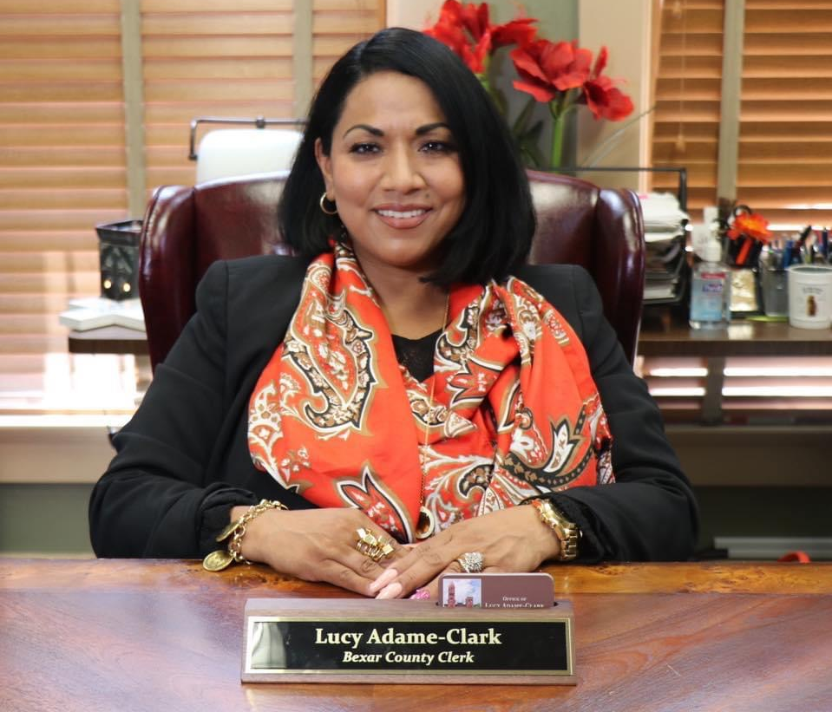


Lucy Adame-Clark
Bexar County Clerk

Slide 2
About the Bexar County Clerk
The first Latina and first woman elected in history as a Bexar County Clerk.
Born and raised in San Antonio, I am a mother of two beautiful Children and wife to a Sheriff’s Deputy.
Child to a mother who is an activist in the community and a father who is a former marine.
Obtained education through Southern Careers Institute where I studied Paralegal Studies before.
Started Career with the Sheriffs Office in 1997.
Promoted to the Criminal Investigation Division section as a Latent Print Examiner/AFIS and worked high profile cases through the county and across the state.
I am a member to several governmental entities such as the Bexar County Bail Bond Board, Chairwoman of the Records Management Committee, and I maintain many records:
  Commissioner’s Court, 3 Probate Courts, Mental health Court, Auxiliary Jail Court, 15 County Courts at Law and several other departments

Slide 3

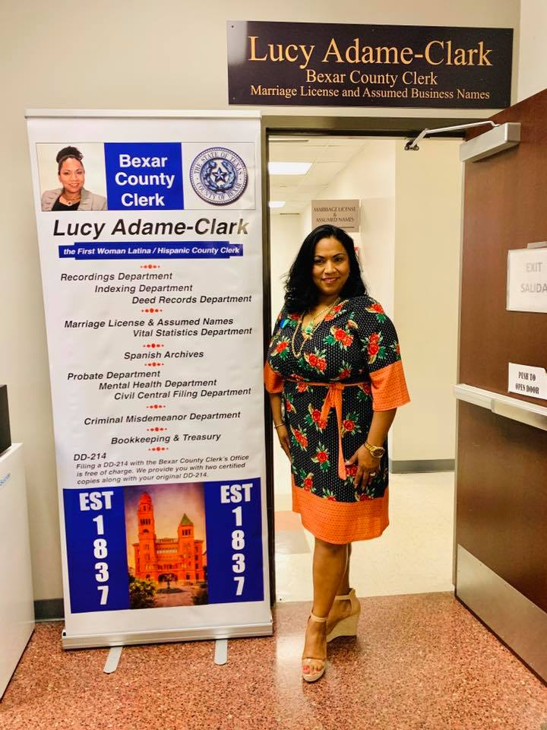
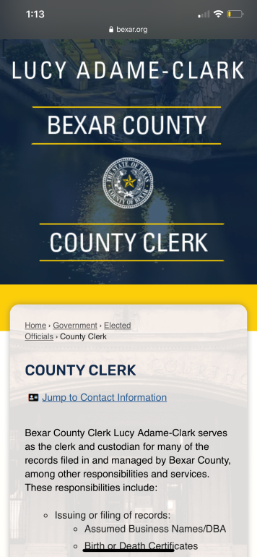

Changes in the Bexar County Clerk’s Office
Assumed Business Names Department
Improved and redesigned mobile Friendly website that offers 51 Multi-languages.
Integrated Credit Card machine usage.
Added a Projects Coordinator for better outreach within Small Businesses, Veterans, and the community.
Translated documents to better serve Spanish-Speaking individuals.
Influenced & Improved customer service experience
Placed informative banners to better direct constituents to designated Departments.
Implemented a Live Chat service online to allow constituents to communicate with live deputy clerk’s for any questions.

Slide 4

The “Thank A Veteran” program is a way of giving back to the Veterans who have served our country through the armed forces. This program extends to all branches of the military and offers our service men and women an opportunity to receive our thanks through discounts at participating merchants.
The benefits of participation are rewarding for both merchants and veterans:
Veterans are shown gratitude for their sacrifices and loyalty to our country through a discount at participating merchants for recording their DD-214’s with the County Clerk.
Veterans will be issued a Thank A Veteran program discount card and can be presented at all participating merchants.
Merchants are given an opportunity to give back by participating and registering their businesses for the Thank A Veteran program. These businesses will receive a Thank A Veteran decal to place in a visible area showing they are merchants for this program.
Participating merchants will be listed on the County Clerk's website for advertisement.

Slide 5

To sign up your business or learn more about this program, go to www.bexar.org/countyclerk

Slide 6

Hunting & Fishing License discounts for disabled Veterans and Texas residents on active duty.

Slide 7

Vanguard Property Alert
Get notified against potential fraudulent claims or transactions regarding real property.
Receive email alerts any time your personal property or business entity name is used in Real Property filing within the Bexar County Clerk’s Office.
FREE SERVICE! FREE SERVICE!
Sign up at: www.bexar.org/countyclerk

Slide 8
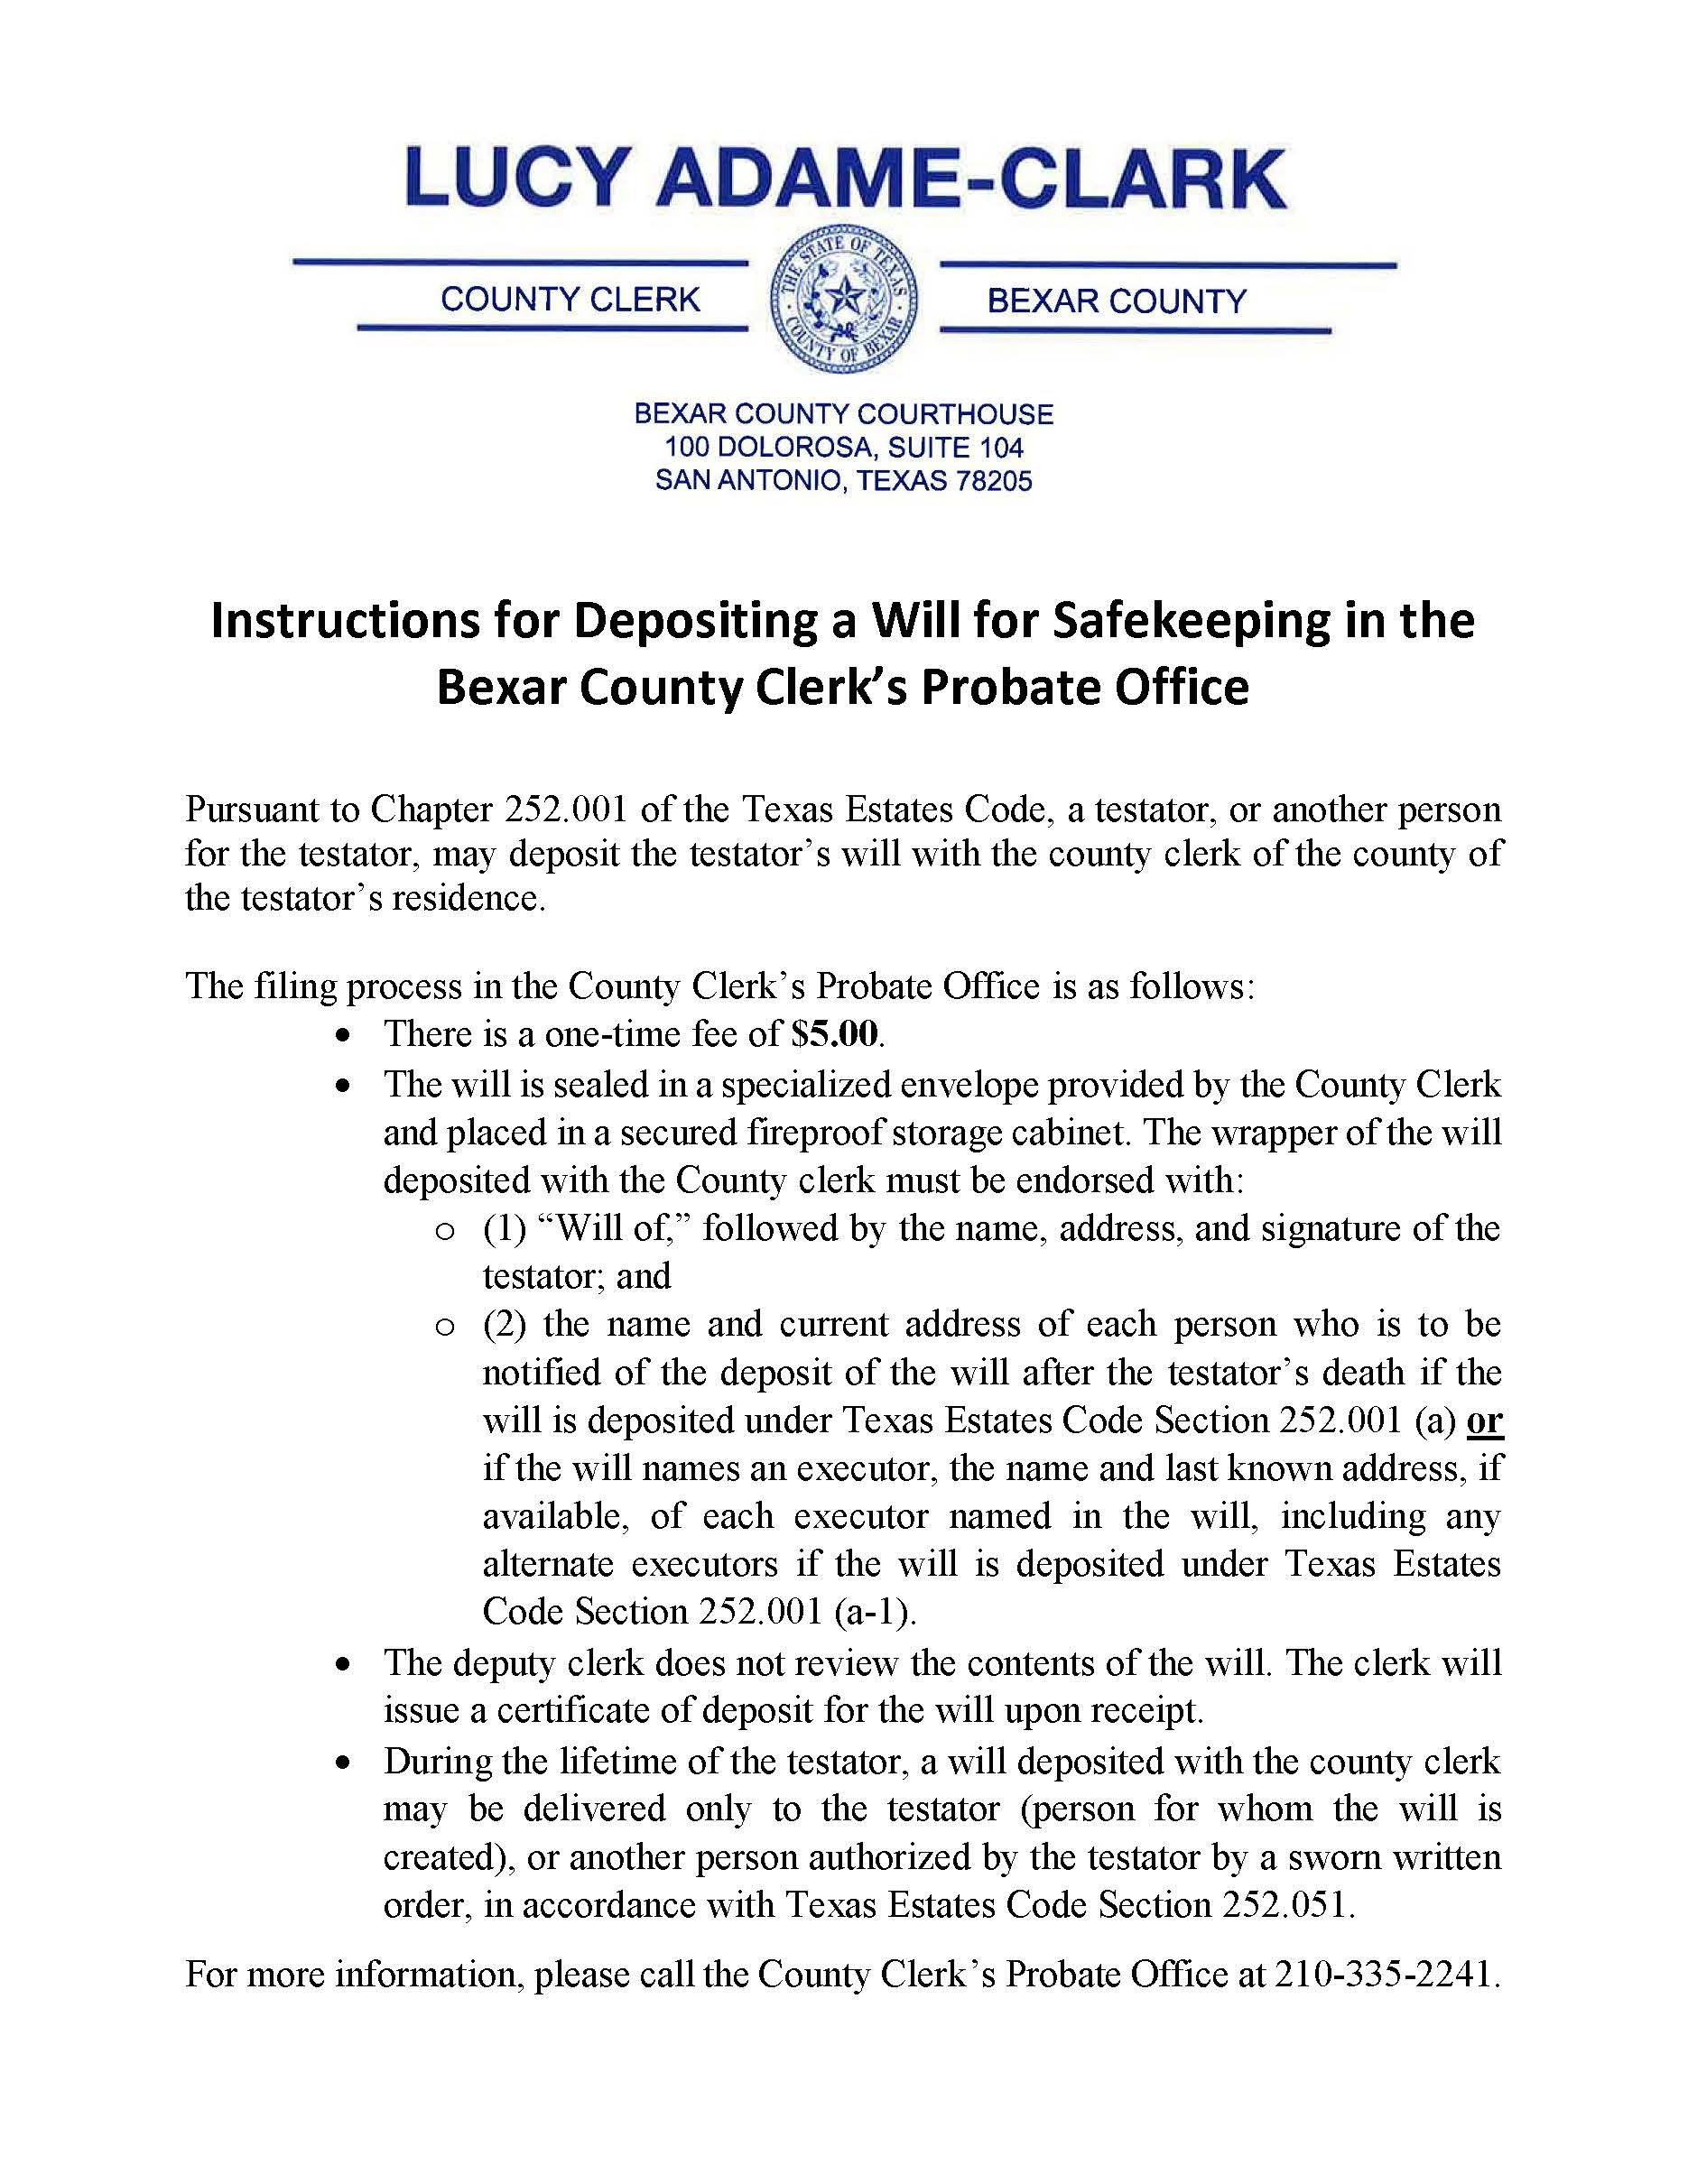
Safekeeping of Wills
Safeguard your will with the County Clerk
One time fee of $5.00
Sealed in a specialized envelope provided by the County Clerk
Placed in a secured fireproof storage cabinet
Issued certificate of deposit for the will upon receipt
Only the testator or person authorized by the testator can withdraw the will with a sworn written order.

Slide 9

What is an Assumed Business Name/DBA-Doing Business As
When you file for an Assumed Business Name/DBA in Bexar County you are notifying the public that you intend to conduct business under a name other than a legal name. See details below for section description:
Texas Business & Commerce Code,
Section 71.002(2)
Assumed Name :
For an individual – a business name that does not include the surname of the individual;
For a partnership - a business name that does not include the surname or other legal name of each joint venturer or general partner;
For an individual or a partnership – a name, including a surname, that suggests the existence of additional owners by including words such as "Company," "& Company," "& Son," "& Sons," "& Associates," "Brothers;"

Slide 10

Why Do I Have To File My Assumed Business Name/DBA?
Texas Business & Commerce Code,
Section 71.051
CERTIFICATE FOR CERTAIN UNINCORPORATED PERSONS
A person must file a certificate under this subchapter if the person regularly conducts business or renders a professional service in this state under an assumed business name other than as a corporation, limited partnership, limited liability partnership, limited liability company, or foreign filing entity.
Section 71.052 (3)
The period not to exceed 10 years, during which the registrant will use the Assumed Name.
Section 71.151
A certificate is void at the end of the certificate‘s stated term, unless within 6 months preceding the certificate‘s expiration date the registrant files in the office of the county clerk…

Slide 11
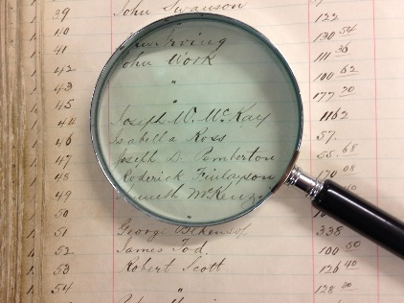
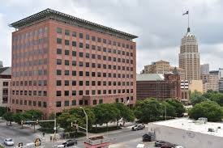
How To File Your Assumed Business Name/DBA with the County Clerk’s Office
Research Your Business Name
Research the business name on the Bexar County Clerk’s Assumed Business Name database to determine if the name is available for use in Bexar County.
You may research your business name at: http://bexar.tx.publicsearch.us
Or visit the County Clerk’s Assumed Business Name Department or the Mobile Command Unit Services: https://www.bexar.org/DocumentCenter/View/29324/
Paul Elizondo Tower, 1st Floor
101 W. Nueva, Suite 120
San Antonio, TX 78205
(210) 335-2223

Slide 12
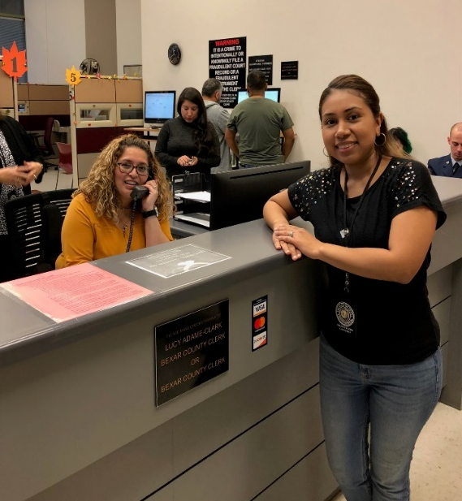
How To File Your Assumed Business Name/DBA with the County Clerk’s Office
File Your Assumed Business Name Certificate
Once you have decided on a business name and it is available for use you may visit the County Clerk’s Office at 101 W. Nueva, Suite 120 to file your Assumed Business Name Certificate.
The County Clerk’s Office will assist you with the filing process and acknowledge your signature on the certificate.
The following items will be needed to process your certificate:
  Valid form of ID
  Assumed Business Name
  Business Address
  Filling Fee (approximately $21.00)
DBA packets with instructions on how to file by mail are available in our office.
Certified Copies will be available for purchase after filing. If you lose your certificate, you can visit our Vitals' Statistics Office to purchase certified copies.

Slide 13
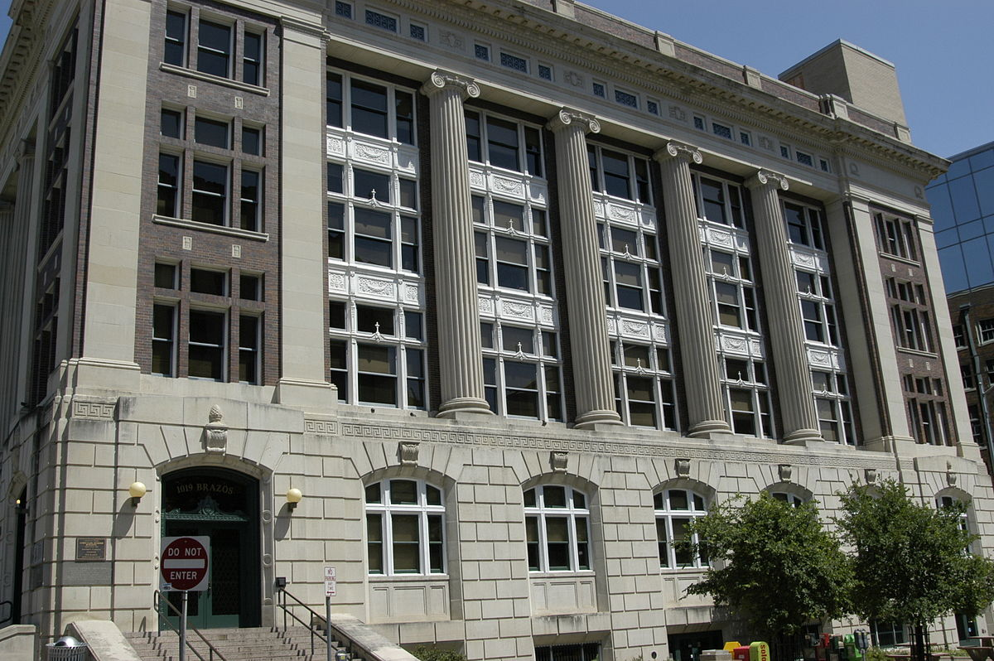
Incorporated Businesses
(Legislative Change Effective September 1, 2019)
HB.3609. Sec 71.103
A corporation, limited partnership, limited liability partnership, limited liability company, or foreign filing entity required to file a certificate under Section 71.103 shall file the certificate in the office of the secretary of state.
WWW.SOS.STATE.TX.US
Texas Secretary of State
1019 Brazos St.
Austin, TX 78701
(512)463-5555
Office of the Secretary of State Austin, TX
James E. Rudder Building

Slide 14
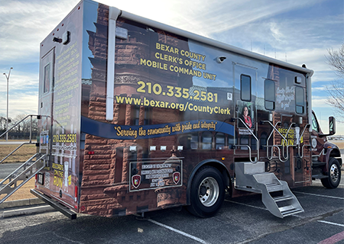
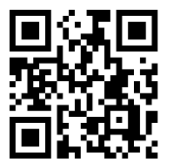
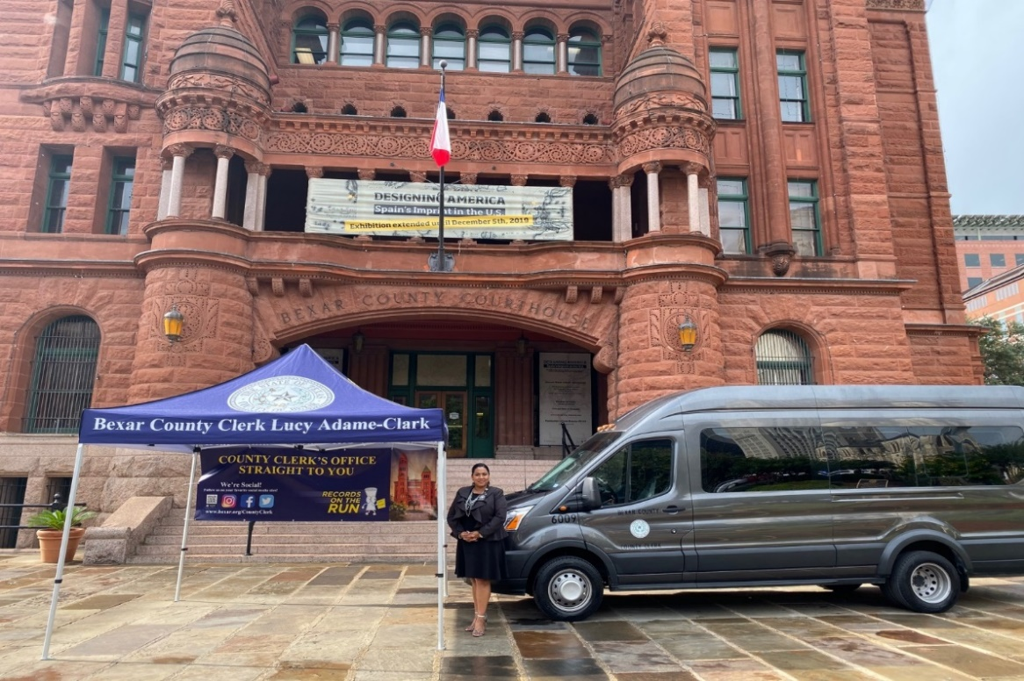
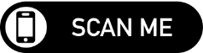
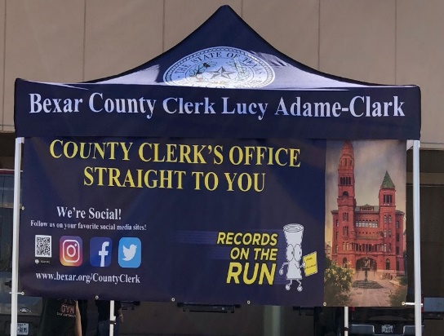
The County Clerk’s Office Straight to You
The Bexar County Clerk’s Office now offers its International Innovative Award-winning Mobile Satellite Van for services in the community.
The Mobile Satellite Units are scheduled to set up at locations throughout Bexar County monthly to assist with Assumed Business Names and other services.
Visit our Website for our scheduled Mobile Unit Satellite Locations and special events.
QR Code (Quick Response Code)

Slide 15
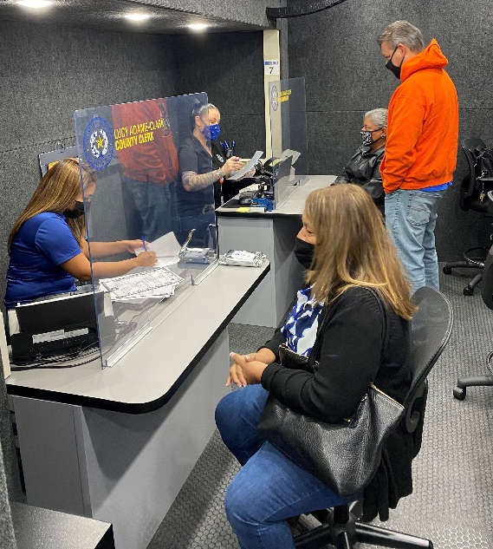
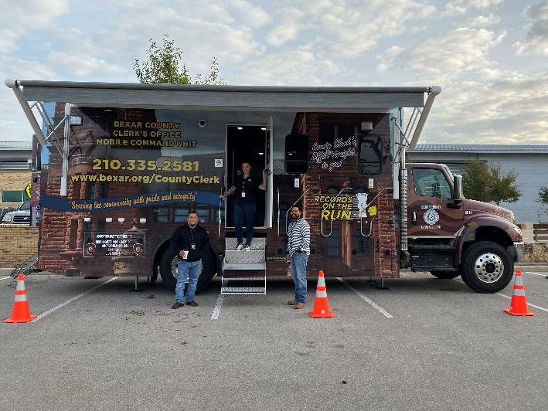
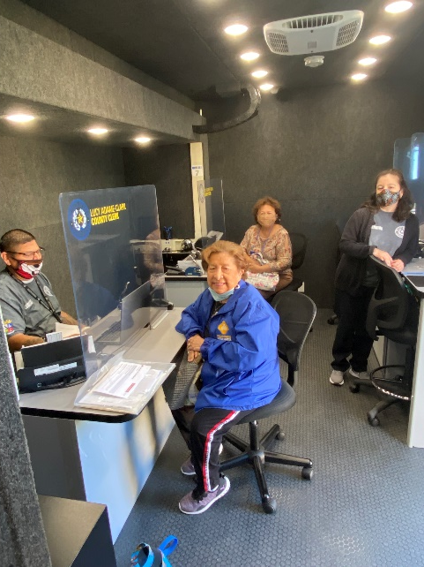
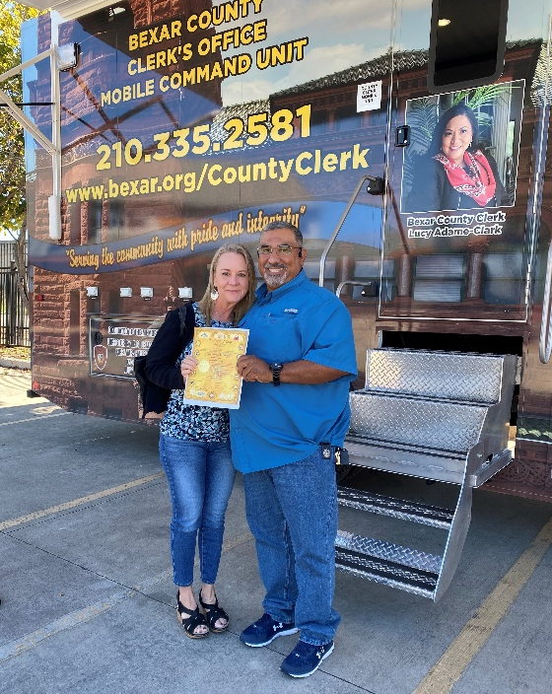
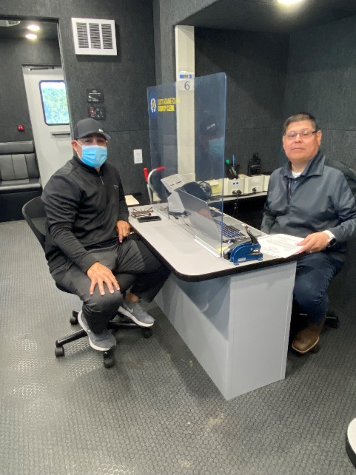

The County Clerk’s Office Out in the Community

Slide 16




Bexar County Clerk’s Office Projects & Innovations Since 2019
In 2019 Launched social media platforms that have increased community involvement and helped bring awareness of our services to Bexar County.
In 2020 The Count Clerk’s Office received
  The Alamo Area Council of Government – Government Project of the Year
  Texas Association of Counties Best Practices Award
In 2021-Current
  National Association of Counties (NACo) Achievement Award
  International Association of Government Officials (iGO) Innovator Award
  Thank A Veteran Program
  Free Public Search Training Webinars
  Deed Help Desk collaboration with San Antonio Legal Services Association (SALSA)
  Vanguard Property Alert System and more..
  Southside Annex at Bexar County Precinct 1

Slide 17
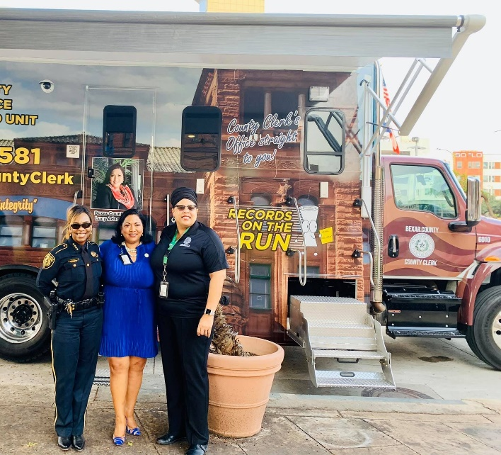
Helpful Information & Numbers
If you are needing permits you would need to reach out to your local municipality for any guidance.
For example:
  Unincorporated would reach out to Bexar County Public Works 210-335-6700.
  City of San Antonio would reach out to City One Stop 210-207-0260.
If you are a veteran you may reach out to Office of Small & Disadvantaged Business Utilization (OSDBU) through the VA Office 1-800-698-2411.
If you need help with launching your own business you can contact The Launch SA Business Center at the Central Library 210-207-3903.
Internal Revenue Service for E.I.N. # or Tax # is 210-840-2090.
Small Business and Entrepreneurship Department (SMWBE) 210-335-2478 assists with starting your business and working with Bear County.

Slide 18





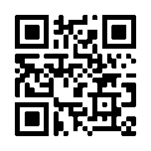

“We can be productive, successful, and conquer our goals if we work together!”
- Hon. Lucy Adame-Clark
Bexar County Website:
https://www.bexar.org/2946/County-Clerk
Hon. Lucy Adame-Clark
Bexar County Clerk
100 Dolorosa, Suite 104
San Antonio, TX 78205
210-335-2106
Small Business and Entrepreneurship Department
210-335-2478
Bexar County Purchasing
210-335-2211
Find us on Social Media
https://www.instagram.com/countyclerkbc/
Schedule for our Records On the Run!
https://www.facebook.com/countyclerkbc/
https://twitter.com/countyclerkbc
About The County Clerk

Slide 19
There is more to come from your
Bexar County Clerk’s office in 2025-2026!

