Slide 1
Fraud: From good to guilty
South Dakota AGA
April 2025

Slide 2
Agenda
Key takeaways
Recipe for fraud
How not to blow the case
Case studies
Fraud prevention checkup
Fraud risk assessment

Slide 3
Key takeaways

Slide 4
Key takeaways
Fraudsters aren’t always bad people
The combination of several key elements may drive the act of fraud
You can’t control someone’s rationalization and internal pressures
Focus on the control environment and opportunities, not a person
Trust and tenure are not internal controls

Slide 5
Key takeaways
Fraud is detected typically from tips and being proactive
The steps you take in the first few days of suspecting fraud
can make or break the case
Make everyone think they are being watched and monitored
even if they aren’t
Internal controls protect good employees from doing bad things

Slide 6
Recipe for fraud

Slide 7
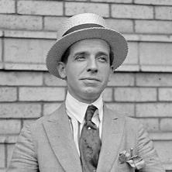

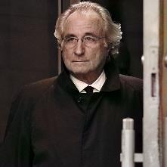
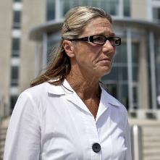
“Don’t judge a book by it’s cover.”
Recipe for fraud
Charles
Ponzi
Elizabeth
Holmes
Bernie
Madoff
Rita Crundwell

Slide 8





Common fraudsters
Recipe for fraud
Employee
Family member
Friend
Business partner
Vendor

Slide 9
Donald Cressey’s
“fraud triangle”
Recipe for fraud
Types of pressure:
  Gambling
  Lack of bonus or
  annual merit increase
  Alcohol/drugs
  Medical bills
  Not meeting work budget
Financial pressure
Rationalization
Opportunity

Slide 10





High frequency frauds
Recipe for fraud
Inventory
Overtime
Accounts payable
Credit cards/
P-cards
Gift cards

Slide 11
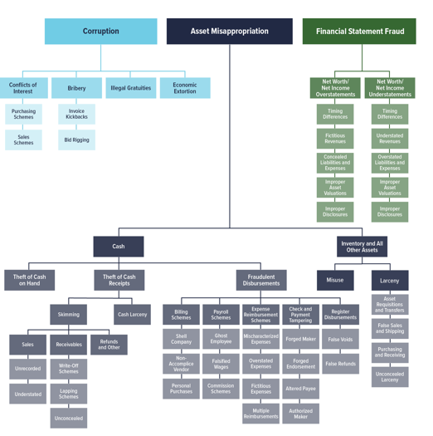
Recipe for fraud
ACFE Fraud Tree
Source: Association of Certified Fraud Examiners (ACFE)

Slide 12
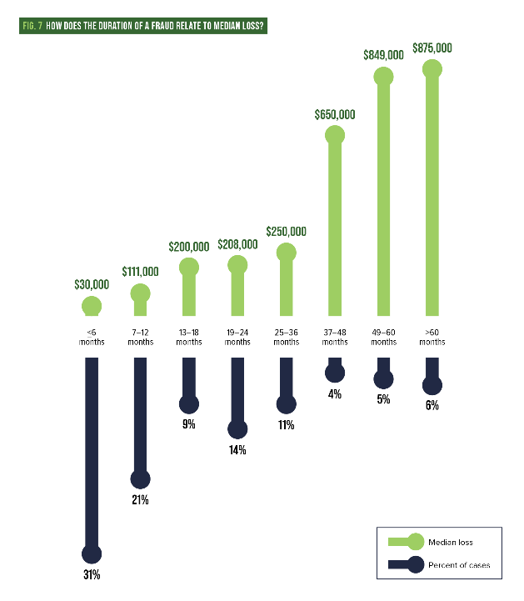
Recipe for fraud
Source: Association of Certified Fraud Examiners (ACFE)

Slide 13
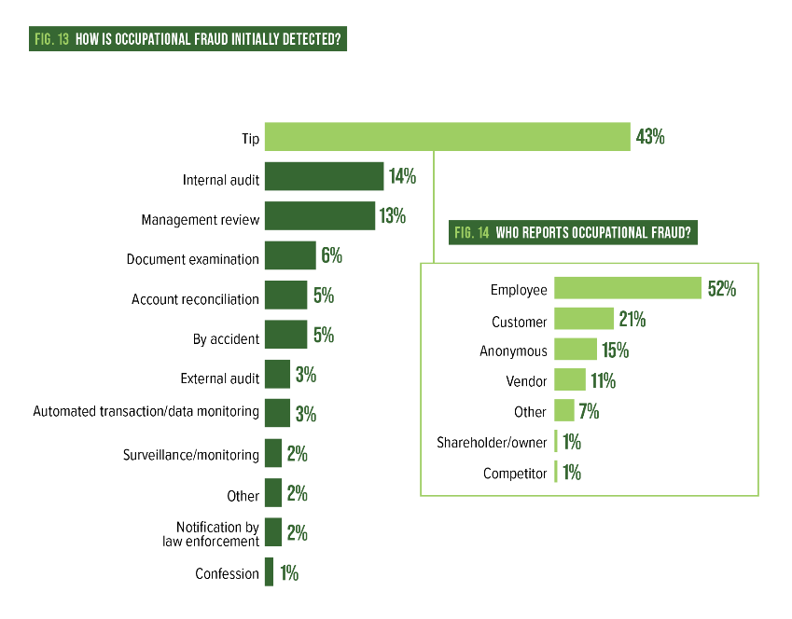
Recipe for fraud
Source: Association of Certified Fraud Examiners (ACFE)

Slide 14
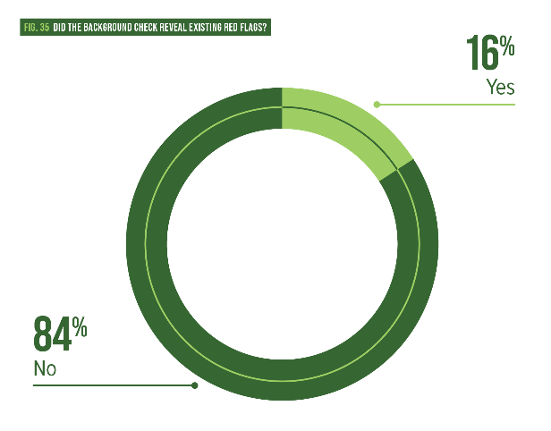
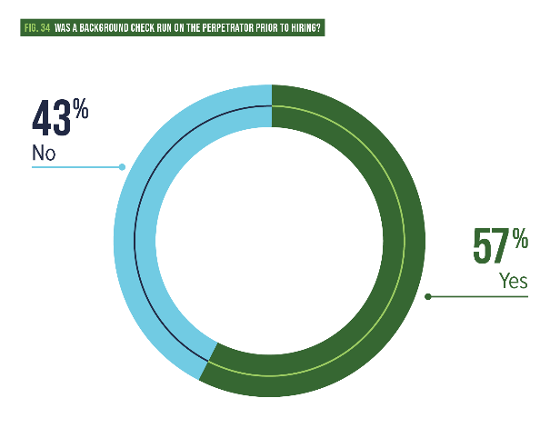
Recipe for fraud
Source: Association of Certified Fraud Examiners (ACFE)

Slide 15
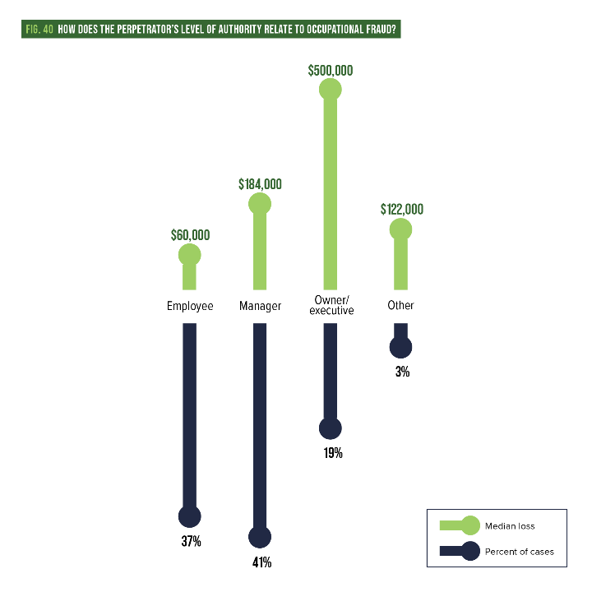
Recipe for fraud
Source: Association of Certified Fraud Examiners (ACFE)

Slide 16
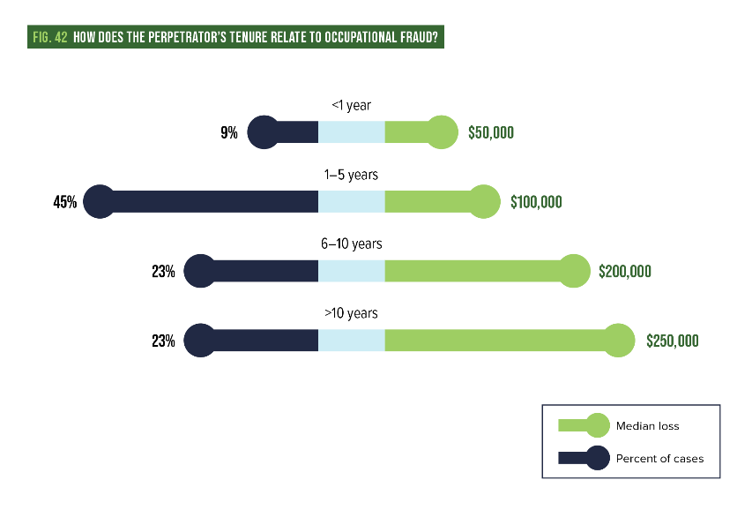
Recipe for fraud
Source: Association of Certified Fraud Examiners (ACFE)

Slide 17
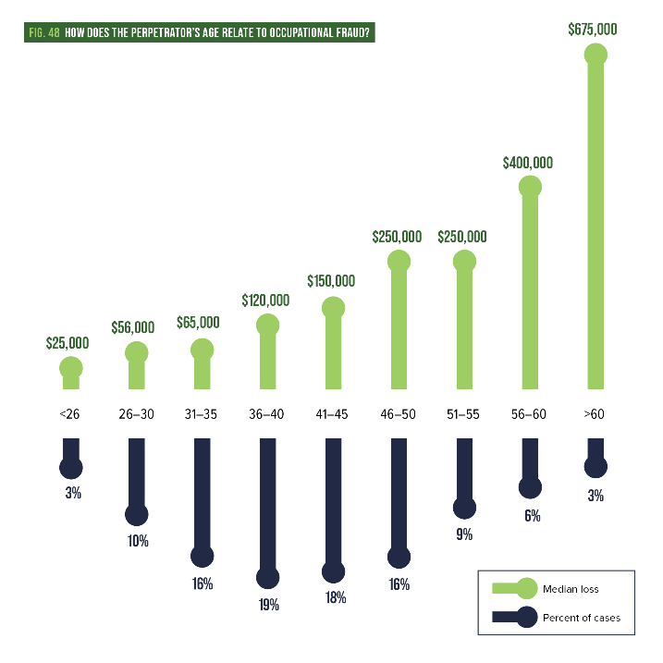
Recipe for fraud
Source: Association of Certified Fraud Examiners (ACFE)

Slide 18
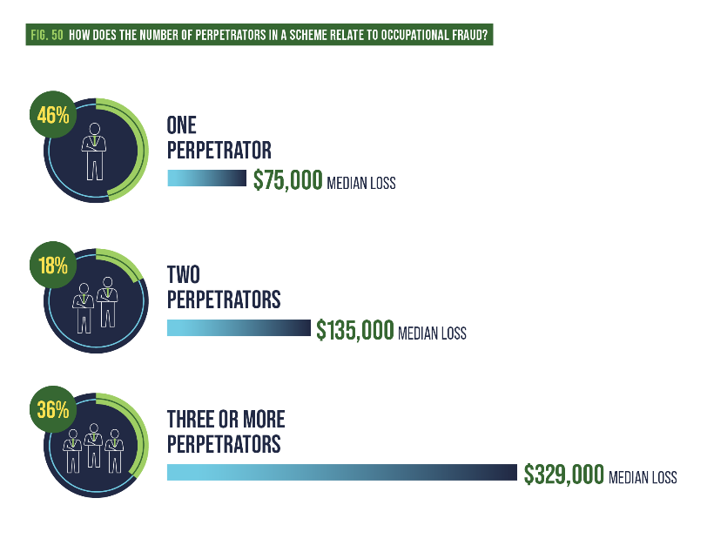
Recipe for fraud
Source: Association of Certified Fraud Examiners (ACFE)

Slide 19
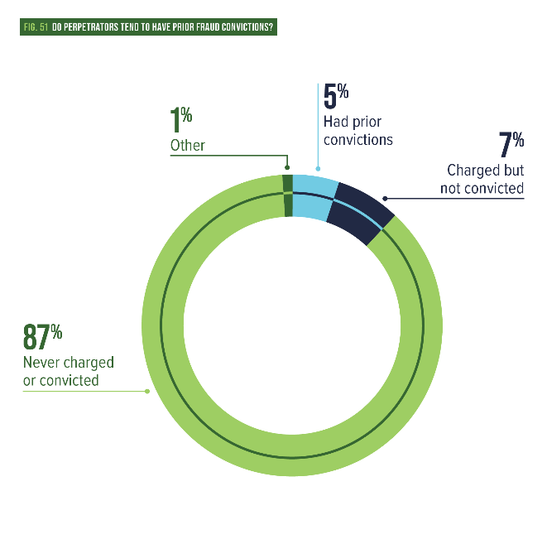
Recipe for fraud
Source: Association of Certified Fraud Examiners (ACFE)

Slide 20
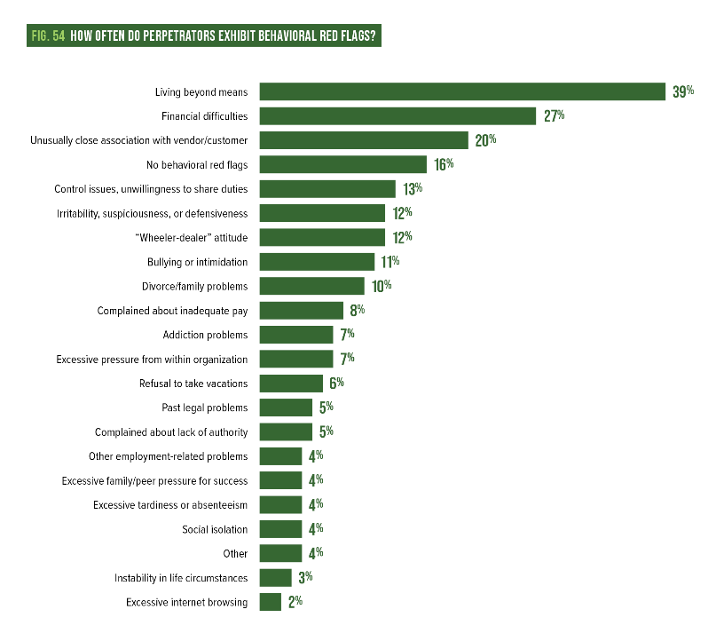
Recipe for fraud
Source: Association of Certified Fraud Examiners (ACFE)

Slide 21
How not to blow the case

Slide 22




Ensure the proper setup
How not to not to blow the case
Insurance
Legal
counsel
Internal
controls
Response
plan

Slide 23
Eight key initial actions
How not to not to blow the case
1
5
Protect evidence
Collect additional evidence
2
6
Make decisions
Preserve chain of custody
3
7
Minimize distractions
to operations
Use the plan
4
Keep it private
8
Don't play the hero! Get help

Slide 24




Key evidence
How Not To Blow The Case
Internal financial records
Human Resources
(HR) policies
Bank records
Digital records
  Email, files, pictures, GPS, etc.

Slide 25
Case study 1

Slide 26
$37,000 desk
Community center reception desk was built by city employees
Significant overtime (OT) by two city employees
Hotline complaint about city vehicle usage

Slide 27
Extreme and needless costs
Facility manager requested minor modifications to existing desk
Trades supervisor decided to use granite
Incorrectly built five feet tall with 135 OT hours
Should have been 40-hour project
OT approved by senior management
Primary carpenters not asked to perform the job
$12,000 labor and materials, $25,000 in medical bills

Slide 28
Other concerns
No design specs
Lacked cost estimate from vendor
Apparent conflict of interest with granite
Spent OT to build when had downtime on normal work schedule
Two workers had 550 hours of OT in a year
Injured employee had 116 hours of OT when mandated “light duty”

Slide 29
Lack of supervision
No documented authorization for supervisor use of the vehicle
Taken outside city limits 18 times over 20 workdays sampled
Visited potential customers for a side business during work hours
Injured employee found asleep at work by investigators and later claimed self-diagnosed sleep apnea
Defended by the supervisor

Slide 30
Case study 2

Slide 31
$200,000+ credit card spend
Warehouse club purchases exceeded $200,000 over four years
900+ purchases, one every 1.5 days
31 cardholders
No pre-approvals and rubber stamp payment process
No listing kept of purchased goods and no physical inventory
Most purchases were grocery items, but also included $45,000 in electronics and 99 gift cards
Retirement luncheon – 55 lbs. steak, 120 burgers/hot dogs
for 20 people

Slide 32
Missing items & other issues
Sampled 492 inventory items and 157 were missing—including TVs, DVDs, video game systems or games, etc.
Unnecessary purchases, could have used existing items for events
84 gift cards and 38 electronics were labeled as “gifts” to employees or citizens over two years
Gifts were not authorized, no listing of who received them
Purchased 30 canopies and 338 folding chairs and no tracking of these items and many could not be located
Apparent personal purchase of $19 for sandals

Slide 33
New internal controls
All cardholders forfeit their card
P&P to govern usage of credit cards
Pre-purchase approval and employee check out a card
Credit card statement analysis
No more “gifts” without documented approval from leadership
Physical inventory to be maintained for high dollar items or those with high risk of fraud
Transfer existing inventory between locations for events

Slide 34
Case study 3

Slide 35
Largest U.S. municipal fraud
Dixon, IL, with only 16,000 residents
2012—Comptroller Rita Crundwell accused of $53M embezzlement
Worked there almost 30 years
Last salary was about $80,000 but she owned...

Slide 36
Life of luxury
$2.1M home
400+ horses in modern facility
$259,000 horse trailer
Vacation home in Florida
Jewelry
Fur coats

Slide 37
How she did it
$53M fraud over 22 years
Typical cycle: small-to-large over time with confidence and greed
Keys to the kingdom and no separation of duties
Created fake bank account in the city’s name and transferred funds
Fake invoices for capital projects that didn’t exist
Auditors didn’t seem to question anything
Told her commission budget shortfalls were due
to timing issues for state disbursements
On vacation when caught by city clerk, sentenced to 20 years

Slide 38
Fraud prevention checkup and fraud risk assessment

Slide 39
Fraud prevention checkup
Oversight
  What governance exists like a board or audit committee?
Ownership
  Is it clear who owns fraud risks? And are business units aware?
  If a third-party assessor interviews employees, what will they say?
Assessment
  Does a process exist to identify fraud risks in business units?
Source: Association of Certified Fraud Examiners (ACFE)

Slide 40
Fraud prevention checkup
Tolerance and risk management
  What fraud risk is acceptable and who approved it?
  How does the organization handle fraud risks?
    Avoidance = change how it operates (not accept checks)
    Acceptance = do nothing (employee takes money bag to bank)
    Sharing = purchase insurance
    Reduction = implement internal controls
Process level controls
  Do basic controls exist around authorization, custody and recording?
  Controls cost money, but should you implement new ones?
Source: Association of Certified Fraud Examiners (ACFE)

Slide 41
Fraud prevention checkup
Environmental level controls
  How is the tone at the top?
  Does a code of conduct exist and do employees sign it?
  Does fraud training occur?
  Does a mechanism exist to report fraud concerns?
  Is there a formal investigative process that includes HR, legal
  and internal audit (IA)?
Proactive fraud detection methods
  Does the organization use data analytics, exception reports and other system generated tools to flag suspicious transactions and red flags?
Source: Association of Certified Fraud Examiners (ACFE)

Slide 42
Overview and importance
Fraud Risk Assessment
15 modules that mostly mirror the ACFE fraud tree on fraud types
Determine potential fraud risks inherent to your organization
Assess significance and likelihood
Analyze what areas are most susceptible to fraud
Fraud risks are mapped to internal controls
Determine if controls are designed effectively and operating properly
Identify gaps in controls to provide opportunity for fraud
Enable the organization to respond to residual fraud risks
Source: Association of Certified Fraud Examiners (ACFE)

Slide 43
Module 1 employee assessment
Fraud Risk Assessment
(34 questions)
Does the company have written P&P for accounting and purchasing?
Does senior management exhibit and encourage ethical behavior?
Does the organization provide an anonymous way to report suspected violations of fraud, waste or abuse?
Are pre-employment background checks performed?
Do proper segregation of duties exist?
Do employees feel they are treated and compensated fairly?
Source: Association of Certified Fraud Examiners (ACFE)

Slide 44
Module 1 employee assessment
Fraud Risk Assessment
(34 questions)
Do any employees appear to be spending far more than they are earning?
Do any employees resent their superiors?
Do any employees have outside business interests that might conflict with their duties at the organization?
Is the organization experiencing high turnover?
Are employees required to take annual vacations?
Do unrealistic productivity or financial measurements exist?
Are employees educated on the importance of ethics?
Source: Association of Certified Fraud Examiners (ACFE)

Slide 45
Module 2 management assessment
Fraud Risk Assessment
(41 questions)
Is the board of directors or other governance group comprised of mainly officers of the organization or related individuals?
Is the organization under pressure to report favorable earnings or results?
Do any employees have friends or relatives reporting directly to them?
Do any employees have outside business interests that might conflict with their job duties?
Has the organization recently experienced large operating
or investment losses?
Source: Association of Certified Fraud Examiners (ACFE)

Slide 46
Module 2 Management Assessment
Fraud Risk Assessment
(41 questions)
Does the organization change auditors often?
Does the organization delay or avoid supplying auditors with the information necessary to complete the audits?
Does the organization have poor accounting records?
Does the accounting department appear to be inadequately staffed?
Does the organization lack an internal control system, or does it fail to enforce existing internal controls?
Source: Association of Certified Fraud Examiners (ACFE)

Slide 47
Questions?
Baker Tilly Advisory Group, LP and Baker Tilly US, LLP, trading as Baker Tilly, operate under an alternative practice structure and are members of the global network of Baker Tilly International Ltd., the members of which are separate and independent legal entities. Baker Tilly US, LLP is a licensed CPA firm that provides assurance services to its clients. Baker Tilly Advisory Group, LP and its subsidiary entities provide tax and consulting services to their clients and are not licensed CPA firms. The name Baker Tilly and its associated logo is used under license from Baker Tilly International limited. The information provided here is of a general nature and is not intended to address the specific circumstances of any individual or entity. In specific circumstances, the services of a professional should be sought. © 2024 Baker Tilly Advisory Group, LP

Slide 48
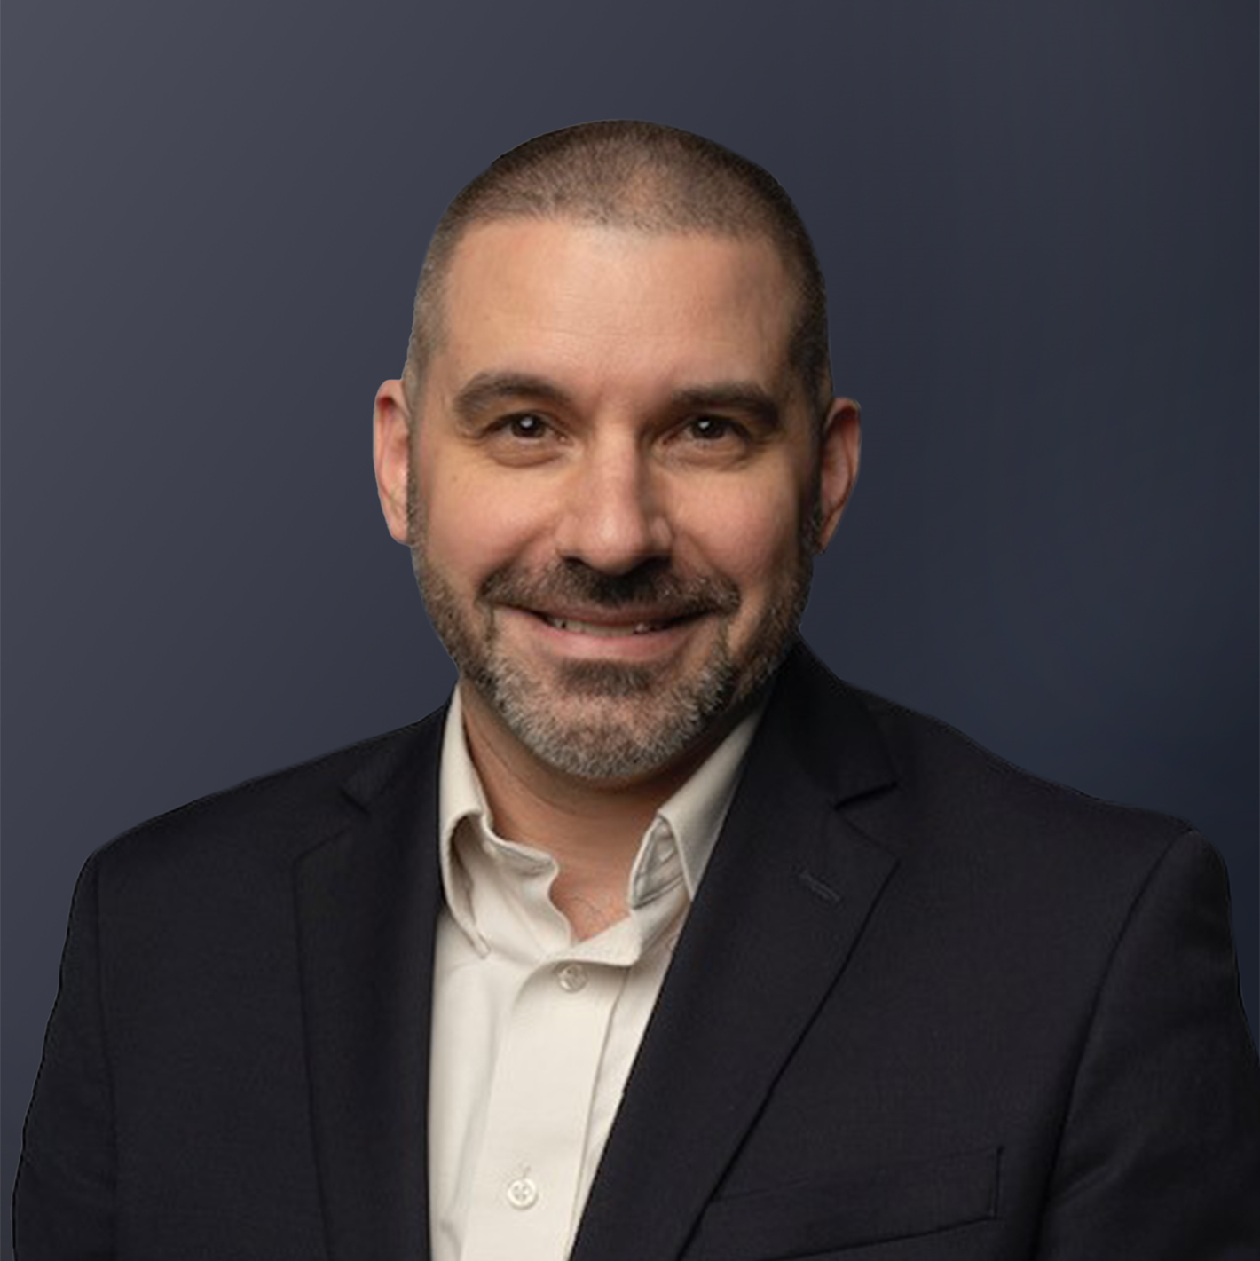
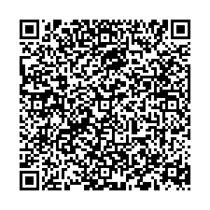
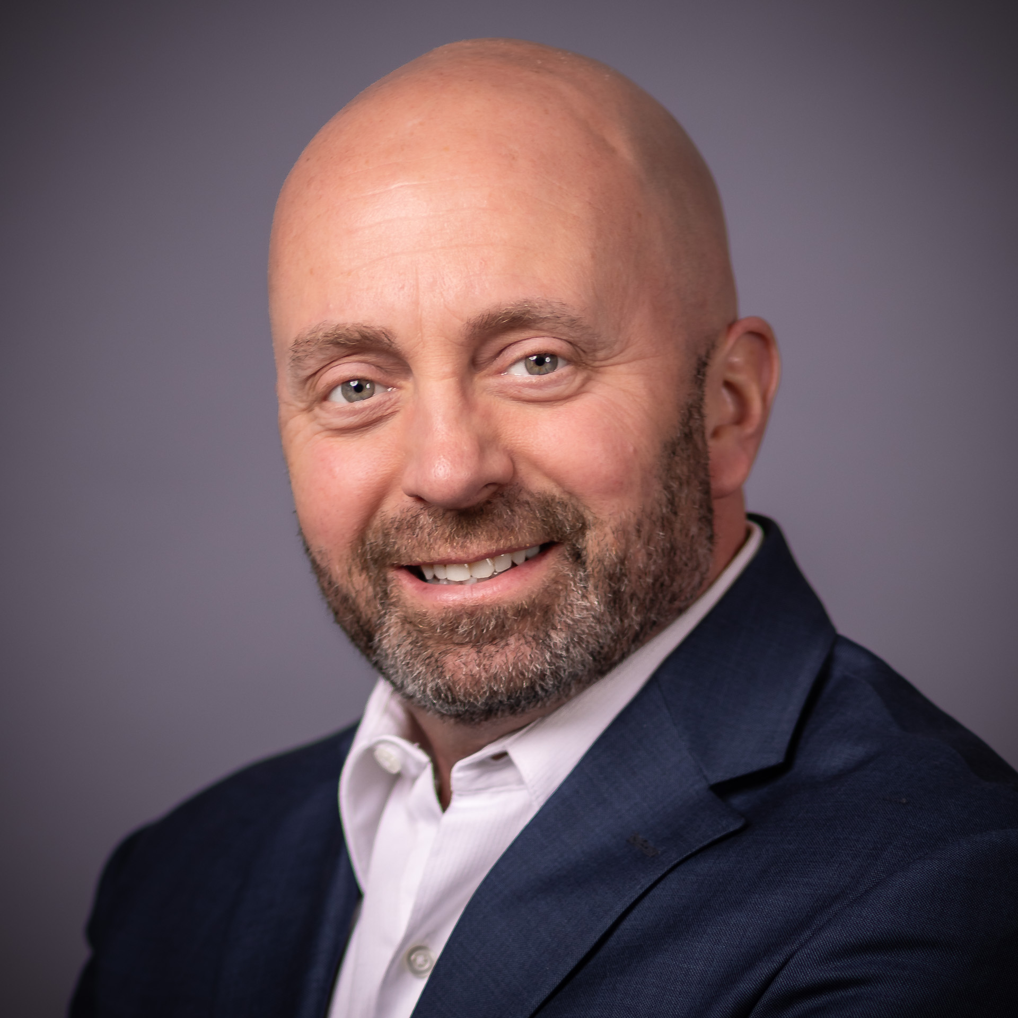
Let’s stay in touch!
Chris Kalafatis, CPA, CIA, CFE
Managing Director, Risk Advisory
Public Sector Leader
M: +1 (804) 307-2610
E: chris.kalafatis@bakertilly.com
Randy Sherrod, CPA, MBA
Senior Manager, Risk Advisory
M: +1 (804) 728-8339
E: randy.sherrod@bakertilly.com
Baker Tilly Advisory Group, LP and Baker Tilly US, LLP, trading as Baker Tilly, operate under an alternative practice structure and are members of the global network of Baker Tilly International Ltd., the members of which are separate and independent legal entities. Baker Tilly US, LLP is a licensed CPA firm that provides assurance services to its clients. Baker Tilly Advisory Group, LP and its subsidiary entities provide tax and consulting services to their clients and are not licensed CPA firms. The name Baker Tilly and its associated logo is used under license from Baker Tilly International limited. The information provided here is of a general nature and is not intended to address the specific circumstances of any individual or entity. In specific circumstances, the services of a professional should be sought. © 2024 Baker Tilly Advisory Group, LP

