Slide 1
Subrecipient monitoring
April 1, 2025

Slide 2


^{DISCLAIMER}
This presentation is presented with the understanding that the information contained does not constitute legal, accounting or other professional advice. It is not intended to be responsive to
any individual situation or concerns, as the contents of this presentation are intended for general information purposes only. Viewers are urged not to act upon the information contained in this presentation without first consulting competent legal, accounting or other professional advice regarding implications of a particular factual situation. Questions and additional information
can be submitted to your Eide Bailly representative, or to the presenter of this session.

Slide 3



Presenter
Kurt Schlicker, CPA
Partner
Reno, NV

Slide 4
Agenda
Uniform Guidance Changes – Subrecipient Related
Subrecipient Monitoring Overview
Common Findings and OIG Report Review
Example Subrecipient Determinations

Slide 5

Uniform guidance amendment – round 2
Established at 2 CFR 200.109.
OMB will review UG at least every 5 years after December 26, 2013.
First amendment was back in 2019.
Notice of Request for Information was published in February 2023.
Notification of Proposed Guidance in October 2023.

Slide 6

Purpose?
Incorporate statutory requirements and administration priorities.
Reduce agency and recipient burden.
Clarify sections that recipients/agencies have interpreted in different ways.
Rewrite applicable sections in plain language.
Intended to improve management, transparency, and oversight.
Effective date is for awards issued after 10/1/24, unless earlier adopted by federal agency.

Slide 7

Subpart b – general provisions
200.112 Conflict of interest – minor wording changes.
200.113 Mandatory disclosures – aligned this with the requirements under FAR:
  Now requires timely disclosure based on credible evidence (versus a violation).
  Added clarity that must be reported to federal agency, the related OIG office, pass-through entity in writing.
  Now also includes subaward activity:
    For example, if a State has credible evidence of fraud, conflict of interest, bribery, or gratuity violations at one of its subrecipients, the State must disclose.

Slide 8
Subpart d – post federal award requirements
200.303 Internal Controls:
  Clarified an expectation that internal controls are documented.
  Added cybersecurity to safeguard information, including protected personally identifiable information.
200.303 Federal Payment:
  Clarified that subrecipients must be paid in advance provided they maintain a willingness to maintain written procedures and minimize the time elapsing between the transfer of funds and disbursement. In addition, financial management systems must meet the standards for fund control and accountability:
    Big picture – advance payments to subrecipients should be the default for immediate cash needs (administratively feasible).
  No change to when reimbursement is preferred - if the above cannot be met,
  when a specific condition per 200.208 is set, when requested by the
  subrecipient, or when the award is for construction.

Slide 9
Subpart d – post federal award requirements
200.332 Requirements for pass-through entities:
  Risk assessment should also include fraud risk (not just risk of noncompliance).
  Added that pass-through entities must verify a subrecipient is not excluded (this was already a requirement but in section 180.300, added here as well for clarity).
  Added the requirement to notify the federal agency of specific conditions added to subawards.
  Clarified that monitoring corrective action is required on all significant developments that negatively affect the subaward:
    Audit findings, site visits, other adverse conditions or impacts.
  Clarified that they must follow-up on their awards but not responsible for cross-cutting findings.

Slide 10
Subrecipient monitoring

Slide 11
Subrecipient vs contractor
Different requirements for contractors vs subrecipients
Different best practices
Different stewardship is implied
Different procurement process

Slide 12
Determinations
Subrecipient | Contractor
Creates the assistance relationship | Obtains goods / provides services for the entity and creates a procurement relationship
Determines who is eligible (i.e. program participants) to receive what grant assistance | Provides goods / services within normal business operations
Has performance measured in relation to whether objectives of the grant program were met | Provides similar goods / services to many purchasers
Has responsibility for programmatic decision-making | Normally operates in a competitive environment
Must comply with program requirements specified in the grant awards | Provides goods / services ancillary to federal program
Uses funds to carry out program for public purpose specific in award / statute etc. | Not subject to compliance requirements as a result of the agreement, but may have other requirements related to local law

Slide 13
subrecipient / Contractor Determination
All characteristics need not be present
Judgment should be used in the determination process
Substance of the agreement is more important than the form
Documentation should be retained to support the determination
Should be re-evaluated on a regular basis as relationship may
change (or at least when new agreements are entered into)
Important for communication requirements
(contract provisions vs. subaward elements)

Slide 14

Monitoring Principles (Overview)
Subrecipient Monitoring Principles:
  Stewardship
  Monitoring Activities:
    Risk Assessment (Risk Based Review)
    Review (invoice, reports, on-site visits, desk reviews)
      Cost Principles
      Other Compliance (Procurement, Eligibility, Reporting, etc.)
  Common goals:
    Performance objectives
    Carrying out the grant (Teamwork – it requires everyone)

Slide 15
§ 200.332 – Requirements for PTE’s
Requirements can generally be broken into 3 areas
Pre-award requirements
Subaward communication
During the award requirements
Monitoring
Findings
Management decisions
Corrective action
Post-award
(or after the fiscal year) requirements
Single audits
Findings
Management decisions
Corrective action

Slide 16

During the award monitoring requirements
Each subrecipient should be evaluated from the risk of them not being compliant and fraud
Risk factors may include:
  Prior experience.
  Results of previous audits.
  New personnel or new systems.
  Extent and results of Federal monitoring.
  Others?

Slide 17
During the award monitoring requirements
Monitoring of the subrecipient must include:
  Review reimbursement requests and performance reports.
  Follow-up with subrecipient for corrective action.
  Issuing management decisions.
May include on-site reviews, desk reviews and independent audits (rotated as necessary to achieve desired monitoring outcomes).
The extent of the above is based on a risk based subrecipient monitoring policy.

Slide 18
Post-award monitoring
Single Audits
  Required at $750K, change to $1M effective fiscal year ends 9/30/25 and later
    Should be monitoring to see that they were obtained or
    Receiving a certification if they fall below the threshold
What to look for?
  Findings related to the grant program
  Financial reporting findings are not required unless have a significant impact on your grant
Management Decisions
  State whether the finding is sustained or not
  Reasons for decision
  Expected auditee action to repay disallowed costs, make financial adjustments, or take other action
  Timetable for correction (if not already occurred)
  Must be issued within 6 months of receipt into the FAC

Slide 19

§200.425 – AUP Engagements
Pass-through entity may arrange for a limited scope engagement for an outside CPA to review compliance at a subrecipient.
Limited in scope to key compliance areas (i.e. allowable costs, eligibility, reporting, etc.).
This is an allowable cost (provided a few key factors met – see 200.425 if interested).
Why is this beneficial?
  Time and Effort
  Cost/Benefit

Slide 20
Can for-profit entities be subject to audit?
The pass-through entity is allowed to set the terms and conditions for other entities, including for-profit entities.
Subrecipient vs. Contractor. An auditee may simultaneously be a recipient, a subrecipient, and a contractor. Federal awards expended as a recipient or subrecipient are subject to audit. Payments received for goods/services as a contractor are not a federal award.
For-profit subrecipient. Uniform Guidance does not apply to for-profit subrecipients. However, the agreement with the for-profit subrecipient must describe applicable compliance requirements and the for-profit subrecipient’s compliance responsibility. Methods to ensure compliance for federal awards made to for-profit subrecipients may include pre-award audits,
monitoring during the agreement, and post-award audits.

Slide 21
What about beneficiaries?
By definition - Subaward means an award provided by a pass-through entity to a subrecipient for the subrecipient to contribute to the goals and objectives of the project by carrying out part of a Federal award received by the pass-through entity. It does not include payments to a contractor, beneficiary, or participant. A subaward may be provided through any form of legal agreement consistent with criteria in with § 200.331, including an agreement the pass-through entity considers a contract.
By definition - Recipient means an entity that receives a Federal award directly from a Federal agency to carry out an activity under a Federal program. The term recipient does not include subrecipients or individuals that are participants or beneficiaries of the award.
Big picture
  Subrecipients – subject to single audit
  Contractors – subject to Appendix II contract provisions
  Beneficiaries – subject to the terms of the grant award for eligibility requirements, if applicable

Slide 22
Example determinations

Slide 23
EXAMPLES
Facts and circumstances:
  County A is running a business interruption program for all nonprofits to apply.
  If a nonprofit can evidence fundraising loss, County will reimburse the nonprofit for the fundraising loss, not to exceed $50,000.
  County A provides CSLFRF funding to Nonprofit B which qualified by showing decreased fundraising dollars.
  There are no other terms and conditions imposed on Nonprofit B other than spending the money on organizational costs.
Conclusion – Beneficiary. Nonprofit B is receiving funding in response to the negative economic impact as a subsidy.

Slide 24
EXAMPLES
Facts and circumstances:
  County A is running a business interruption program for all small businesses to apply.
  If a business can evidence loss of net income via comparative financial statements or tax returns, County will reimburse the business.
  To facilitate this process, County A provides $5,000,000 to a local non-profit to run the program. The local non-profit will make the payments to the businesses.
Conclusion – Nonprofit is a subrecipient (carrying out a federal program). Businesses are beneficiaries (receiving a subsidy).

Slide 25
EXAMPLES
Facts and circumstances:
  County A is running a business interruption program for all small businesses to apply.
  If a business can evidence loss of net income via comparative financial statements or tax returns, County will reimburse the business.
  To facilitate this process, County A pays a local nonprofit to collect and process applications and send the results/data to the County. The County then pays the businesses who qualify.
Conclusion – Nonprofit is a contractor (providing a service). Businesses are beneficiaries (receiving a subsidy).

Slide 26
Common findings and some oig examples

Slide 27
Common findings – Subrecipient monitoring
Subrecipient Monitoring:
Subawards not updated for U.G.
No risk assessment policies or procedures
Risk assessment policies/procedures but lack of performance
Lack of review of subrecipient audit reports
Lack of management decisions
Lack of suspension and debarment verification on subrecipients (or not documented)

Slide 28
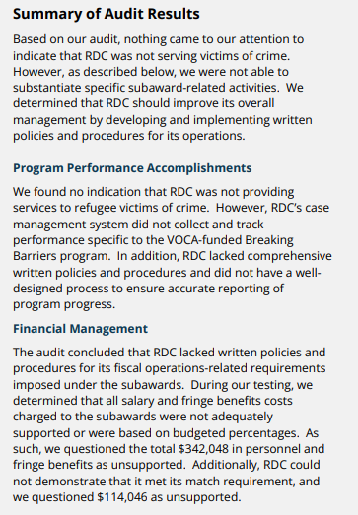
Recent oig reports
Rhode Island
August 2023
Questioned Costs $456,094
Lack of payroll documentation
Lack of demonstrating match

Slide 29
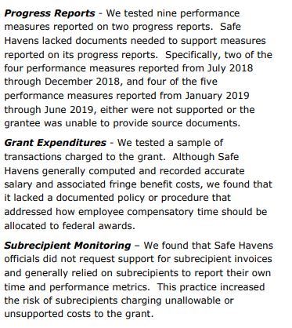
Recent oig reports
Virginia
April 2020
Questioned Costs: We are feeling luck today!
Lack of reliable reporting
Lack of monitoring
Poor policies

Slide 30
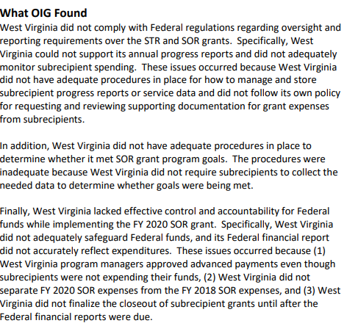
Recent oig reports
West Virginia
April 2024
General lack of monitoring subrecipients
Poor policies

Slide 31
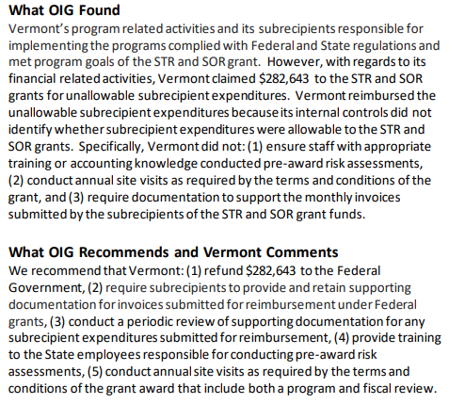
Recent oig reports
Vermont
May 2023
Questioned Costs $282,643
Unallowable subrecipient expenditures

Slide 32
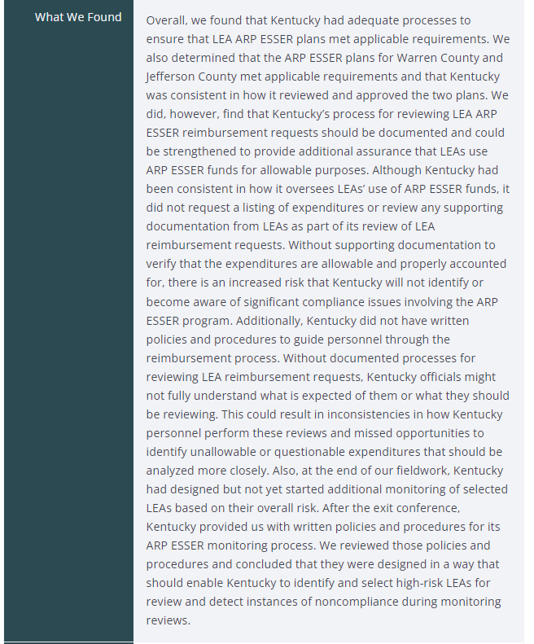
Recent oig reports
Kentucky
October 2023
Review of subrecipient reimbursements
Poor policies

Slide 33
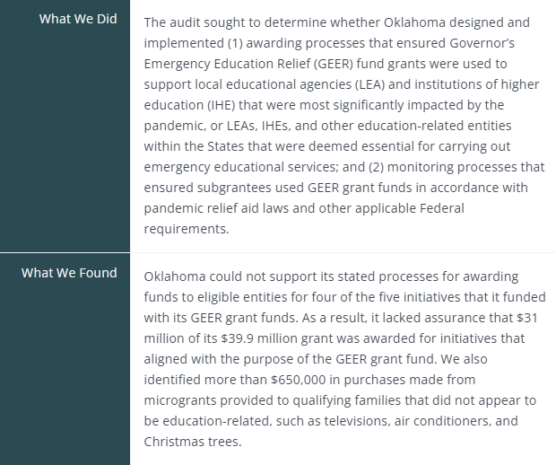
Recent oig reports
Oklahoma
July 2022
Awarding process

Slide 34
Common findings – subrecipient monitoring
Subrecipient Monitoring Prevention:
Training, training, training
Documented policies
Document retention
Calendar of monitoring
Assignment of responsibilities
Design and implement internal controls to monitor compliance
Subawards
Risk Assessment
Risk Based Monitoring
Audit Review and Management Decisions

Slide 35

QUESTIONS?

Slide 36
Thank You!
Kurt Schlicker
Partner
kschlicker@eidebailly.com
775.689.9234

