Slide 1
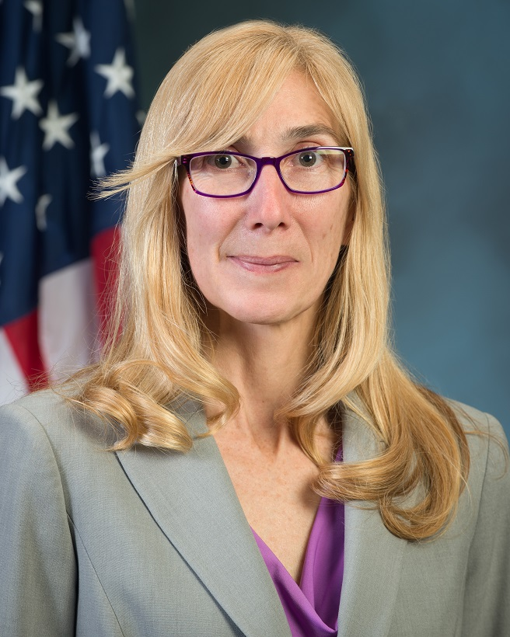
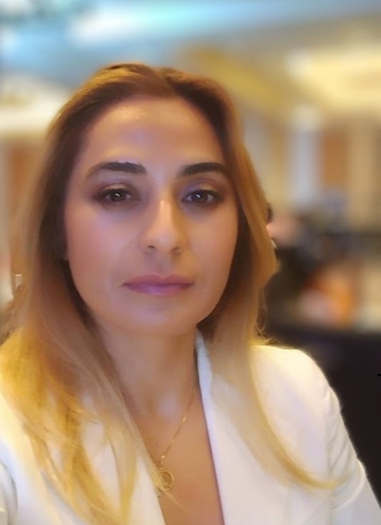
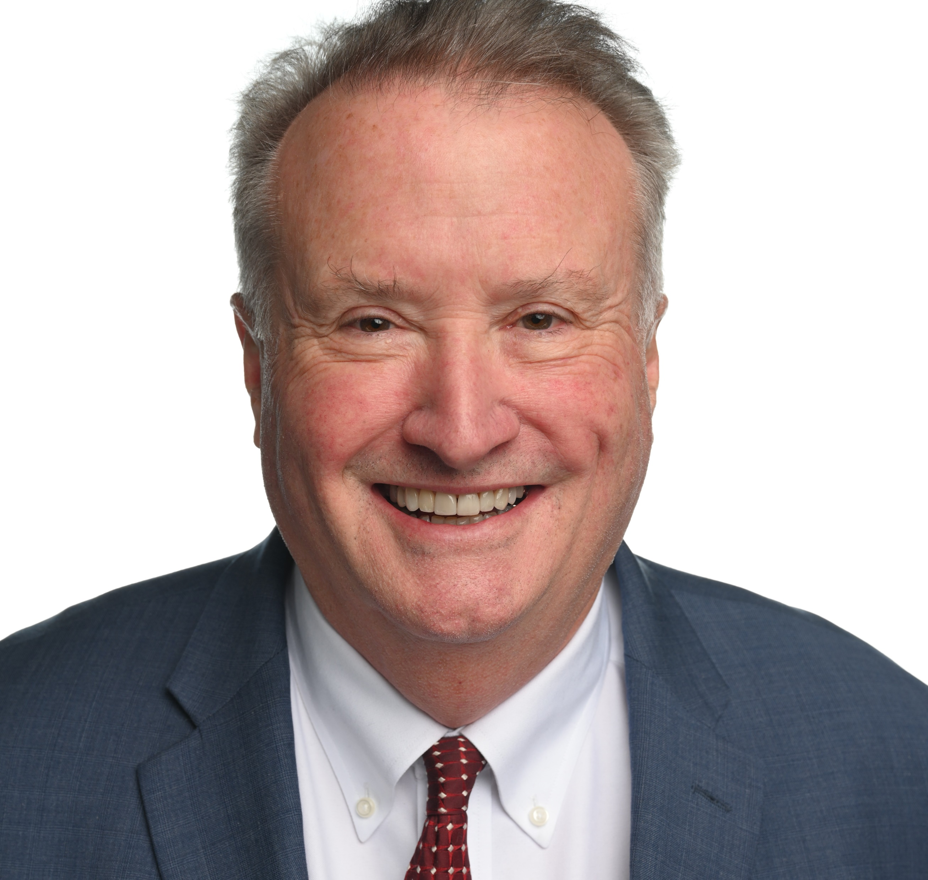
Speakers & Moderator
MelaJo Kubacki, ACFO - HUD Ms. MelaJo Kubacki‘s passion is forging a better path to results. During her three-decade, five-agency career with the federal government, MelaJo has enhanced mission delivery, improved financial results, enriched skills, driven risk and control engagement, and cultivated technology empowerment. During her days at NASA, MelaJo envisioned and delivered financial statements from the system of record (SAP) – a government first. While the Deputy CFO for U.S. Agency for Global Media, MelaJo, moved the agency from a failing government service provider to a commercial service provider, and successfully implemented a major financial management system upgrade (Momentum) in 6 months. Her efforts earned the agency an unmodified audit opinion. At HUD, as Assistant Chief Financial Officer for Financial Management, MelaJo advanced the Department’s capabilities across several fronts. She spearheaded Robotic Processing Automation (RPA) – successfully delivering over a dozen automations; she reimaged training and delivery – increasing reach by 1,000%; she reshaped HUD’s internal control and risk program to be forward-looking, harnessing the power of data analytics to reduce mission burden and drive unbiased evidence-based decision-making. In addition, MelaJo has experience in payment integrity, budget formulation and execution, travel, payroll, contracts, passport management, financial reporting, and system development and implementations. MelaJo has managed 8 contracts at 4 federal agencies. Before joining the federal sector, MelaJo was an auditor with Big 8 CPA firm and worked in banking. MelaJo has a bachelor’s degree in accounting and a master’s degree in tax law.
Rahaf Kaylani, M.A., M.B.A. - HUD Rahaf Kaylani serves as the senior advisor to the Chief Financial Officer at the Department of Housing and Urban Development. Ms. Kaylani has served HUD in roles spanning from overseeing the financial operations and management of HUD funds, establishing and implementing enterprise risk management and fraud risk management in grant programs, establishing internal audit standards, implementing AI in financial operations, to helping lead the first financial transformation at HUD. Rahaf has been instrumental in improving financial governance of program funding by introducing methodologies that streamline government operations, for the first time in HUD’s history of grant operations. Ms. Kaylani is involved in collaborative initiatives across Federal agencies to improve payment integrity and fiscal responsibility within government financial operations.
Joseph Hungate, Director - RMA Associates LLC Joseph Hungate is an RMA Director who has over 35 years of experience, with 28 years in the US Government (Centers for Disease Control, Housing & Urban Development, Treasury, and Commerce) in oversight of IT, Tax Administration, and Executive Leadership. He is responsible for Performance Audits and A-123 engagements, including enterprise risk management, to help government agencies improve processes and procedures. Passionate about financial transformation, he is a Certified Government Financial Manager (CGFM) from AGA and has achieved the Presidential Rank Award of Meritorious Executive. Joe enjoys traveling, single malt whisky, and spending time with his family outside of work.

Slide 2
Controls and Risks
April 2025

Slide 3

Risk
Buckets
Risk Descriptions
Controls to Monitor
Opportunities
People Dependencies
People based controls, manual processes, limited capacity, resource turn-over, immature policies and procedures, and gaps in knowledge transfer
Staffing Departures
Statutorily Required
America’s Bank Accounts
Modernizing Payments DNP
Benefits to US Citizens
MOUs between Federal Agencies
Systems & Data
Data that is disconnected, inconsistent, inaccessible, incomplete, owned by others, and ineffectively used
Gaining Access
Ineffective and limited monitoring of funds at all levels internal and external to HUD in achieving HUD mission
Monitoring
Collecting Evidence
External Landscape
Changing landscape, third-party execution of programs, market conditions, heavy dependence on sub-servicer support, and economic factors impacting models & assumptions
Understanding Our Landscape
Interplay of Risks and Controls

