Slide 1
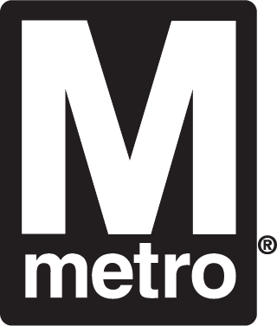
All Aboard! Lessons from WMATA on Resilience and Strategy
April 28, 2025
AGA DC Chapter Hybrid Training

Slide 2
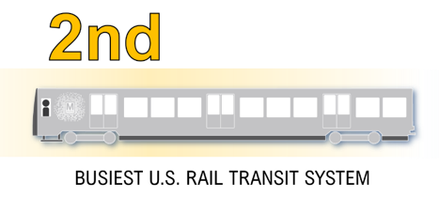
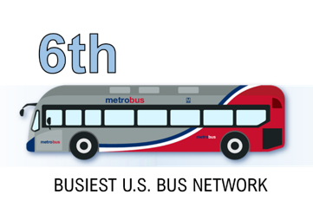



WMATA At A Glance: FY2026 Budget
All aboard! Lessons from WMATA on Resilience and Strategy
$2.6B
Operating*
$5.0B
*
total budget
$2.4B
Capital
Rankings based on American Public Transportation Association
3%
of land
Metro station areas =
30%
Metro repays the region’s investment many times over.
$3.2B
Transit customers
per year
of property value
save
$2,800
65%
on average, by not having to pay for rideshares, taxis, parking, and tolls
Tax revenue
of new office developments
*Includes reimbursables and debt service

Slide 3
WMATA Challenges
All aboard! Lessons from WMATA on Resilience and Strategy

Slide 4





Factors Impacting Public Transit
All aboard! Lessons from WMATA on Resilience and Strategy
All aboard! Lessons from WMATA on Resilience and Strategy
Social
Technology
Economic
Environmental
Political
Pandemic
Customer Experience
Crime/Fare Evasion
Automatic Train Operations
Mobile Payment Options
Digital Modernization
Enterprise Resource Planning
Employment
Regional Economic Growth
Inflation
Interest Rates
Workplace Policies
Public Priorities
New Policies
Local Funding
Federal Funding
Social, Technology, Economic, Environmental, Political (S.T.E.E.P.)
S.T.E.E.P. provides a framework for assessing external factors affecting a business.

Slide 5



WMATA has faced significant challenges over the past 5 years due to external factors
All aboard! Lessons from WMATA on Resilience and Strategy
Ridership
Inflation
Pandemic and Recovery
Changing Federal Employee travel patterns
Customer Experience Focus (e.g., crime, reliability)
Historically high inflation from recent years has increased baseline expenses
Inflation outlook of 3.0% in FY2026 and 2.3% in FY2027 for non-personnel expenses
Funding
Policies
Federal Relief Funding Runs Out
Jurisdictional Subsidies in Flux
Remote working
Return to office mandates
Federal workforce changes
Executive Order changes
5

Slide 6
Global Pandemic Reduced Ridership by Over 70% -- But Ridership is Rebounding
All aboard! Lessons from WMATA on Resilience and Strategy
Impacts to Ridership
Covid-19 Pandemic reduced ridership by over 70%
WMATA recovered with strong year-over-year ridership growth
Changes in commuting and travel patterns continue to impact recovery
Future Considerations
Return to Office policies
Changes to federal workforce
6

Slide 7








All aboard! Lessons from WMATA on Resilience and Strategy
WMATA and the Region Remain More Vulnerable Than Peers Due to Lack of Dedicated Operating Funding
Public Investment in Operating Budget
Federal Relief | 4% | 0% | 29% | 27% | 0% | 7% | 25% | 0%
State/Local Subsidies¹ | 75% | 3% | 10% | 1% | 15% | 13% | 5% | 12%
Dedicated Sources² | 0% | 43% | 34% | 52% | 79% | 61% | 15% | 63%
1. Sales Tax |  |  | ✓ | ✓ | ✓ | ✓ |  | ✓
2. Property Tax (includes real estate, mortgage recording, transfer, etc) |  | ✓ | ✓ | ✓
3. Payroll Tax |  | ✓
4. Tolls/Congestion Charge³ |  | ✓ |  |  | ✓ |  | ✓
5. Other (local assessments, for-hire vehicle surcharge) |  |  |  |  |  | ✓
WMATA
NY MTA
BART
CTA
LA Metro
MBTA
NJ Transit
SEPTA
Based on publicly available FY2025 budget information for comparison purposes
7
Funding subject to annual appropriations
Specific revenue source—such as a sales or gas tax—that is designated to be used for transit and is not subject to appropriations
Starting June 30, 2024, vehicles will be tolled to enter the Congestion Relief Zone in New York City

Slide 8
Facing the Operating Fiscal Cliff
All aboard! Lessons from WMATA on Resilience and Strategy
More than 75% of deficit remains with fully recovered ridership
Impacts to Funding
Federal relief funding exhausted in FY2025
Ridership remains below pre-pandemic norms
Dependent on state and local subsidies
No dedicated funding source
Future Considerations
Macroeconomic conditions (e.g., jobs, inflation, growth)
Changes to federal workforce
Historic Inflation
$1.2B
Funding Deficit
Pandemic
$0.75B
Federal Relief
Fares and Other Revenues
State and Local Subsidies
* Projection as of June 2023

Slide 9
Solving the Fiscal Cliff -- FY2025 Budget
All aboard! Lessons from WMATA on Resilience and Strategy
Targeted Service Adjustments
Modest Fare Increases
Additional Subsidy Investment
Schedule peak service periods to align with ridership levels through targeted adjustments
Operate more six-car trains where shorter trains provide sufficient capacity
Reduce service levels on holidays with low ridership
Redesigned Bus Network to reallocate existing resources to deliver more value to the region, adapting to how customers travel now
Increase fares by 12.5% to keep pace with inflation
Reduce fare evasion with system-wide high-barrier faregate installation and increased fare enforcement
Make it easier to pay with increased use of Metro Lift and Senior reduced fare programs
Jurisdictions increase operating subsidy by $463 million above the traditional 3% subsidy cap

Slide 10
Facing the Capital Fiscal Cliff
All aboard! Lessons from WMATA on Resilience and Strategy
WMATA will soon reach its debt capacity resulting in a significant decrease in capital funding in the latter years of its six-year Capital Improvement Program
Funding constraints will revert WMATA to a primarily reactive capital plan which addresses infrastructure issues as they arise, rather than proactively when the costs are usually lower
Indexing all capital funding sources would maintain future purchasing power and maximize the value and utilization of the region’s investment in transit
Excludes debt service and revenue loss from capital projects

Slide 11
WMATA Implemented Efficiencies Exceeding Half a Billion Dollars in Operating and Capital Savings Since FY2023
All aboard! Lessons from WMATA on Resilience and Strategy
Operating Savings
$257M
Capital Savings
$275M
Capital Program Administrative Savings - $175M
$25M in recurring annual savings from FY2025-31
Capital Project Savings - $100M
Structural recurring savings by simplifying standards, requirements and practices, and reducing customization
Examples of Cost Savings – No Impact to Investment Outcome
Bus Shelters: Reducing per shelter cost by ~50%
Drainage Pumping Stations: Reducing project cost by ~$5M
Digital Modernization: Reducing system support cost by ~$17M
Capital program cost reductions preserve funding capacity for future state of good repair program investments
FY2025 Savings - $119M
$38M: Salary and wage freeze for Metro’s largest union and
non-represented employees
$30M: Call center consolidation, optimize use of alternative and lower cost paratransit services (Uber & Lyft)
$20M: Reduced consulting services and related contracts, improved asset management, savings from digital transformation initiative
$20M: Targeted service cuts (e.g., use of six-car trains, decrease peak hours, modest increase in headways)
$11M: Optimize materials and supplies expense management
FY2024 Savings - $133M
$123M: One-time savings through management actions to increase ridership and revenue, optimize procurement/inventory management and manage vacancies
$10M: Reduced expenses for consulting services
FY2023 Savings - $5M
$5M: Improved labor utilization and process and program modernization
11

Slide 12








WMATA’s Financial Risks
All aboard! Lessons from WMATA on Resilience and Strategy
Major state and federal sources not indexed to inflation
Operating funding that relies on jurisdictional sources not dedicated to Metro
Lack of clarity on long-term operating subsidy commitment
Over reliance on using capital funding to balance the operating budget
Fare evasion on Metrobus reduces revenue
No rainy-day fund for emergencies
Loss of federal pandemic relief funding eliminates backstop
No federal operating funding provided to large transit systems

Slide 13
Regional Interdependence
All aboard! Lessons from WMATA on Resilience and Strategy

Slide 14
WMATA Operates in a Multi-jurisdictional Environment
All aboard! Lessons from WMATA on Resilience and Strategy
WMATA relies on its 3 jurisdictional partners for funding, each with individual financial, economic and public service priorities
District of Columbia
State of Maryland
Commonwealth of Virginia
Budgets
Leadership
Populations
Businesses
Priorities
WMATA
Economic Growth
Federal Government
Local and Regional Transit Providers

Slide 15
An Example of Regional Interdependence
All aboard! Lessons from WMATA on Resilience and Strategy
WMATA depends on its jurisdictional partners for funding – what impacts the region, impacts WMATA
D.C. Labor Market
DC CFO Forecast – Feb 2025
Over half of the District's civilian jobs are in Government (Federal and D.C.) and the Professional and Management Services sectors
Federal employees make up nearly 25 percent of total civilian employment in the District
D.C. significantly reduced its revenue estimates for FY2025 – FY2029 by $1 billion
Lower revenue could impact the District’s ability to meet its WMATA funding commitments
Lower employment in DC will negatively impact Metro ridership & revenue
Market uncertainty presents challenges in determining future service plans and investment
Revised forecast from DC CFO anticipates lower revenue from Federal workforce changes
Forecast based on memo from the District’s Office of the Chief Financial Officer, February 28, 2025

Slide 16
Economic Resilience through Collaboration, Planning, and Communication
All aboard! Lessons from WMATA on Resilience and Strategy

Slide 17
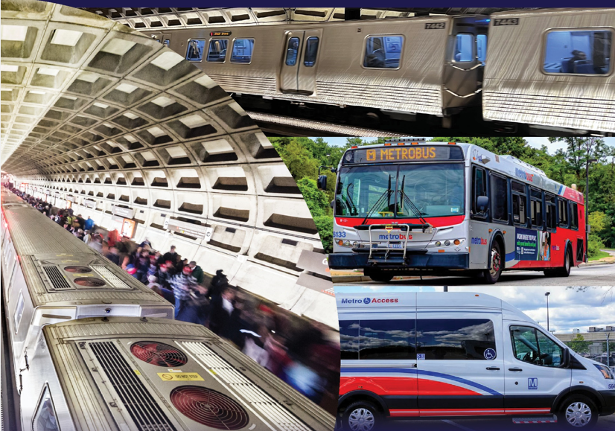
Promoting Economic Resilience through Budgeting Enhancements and Regional Collaboration
All aboard! Lessons from WMATA on Resilience and Strategy
Restructured Operating Subsidy Formula to increase transparency and align service benefits and costs
Incorporated future year forecasting into annual budget process for planning
Communicated Proposed Budget, Revised Budget and Final Budget with stakeholders to ensure transparency and build trust
Lead regional collaboration on a future transit vision through DMVMoves
Enhancements implemented to WMATA’s Budget Process and Regional Collaboration
17

Slide 18
Regional Collaboration: DMVMoves
All aboard! Lessons from WMATA on Resilience and Strategy
WMATA supports the region in achieving its regional goals through collaboration
Comprehensive, regional transit initiative led by WMATA and the Washington Council of Governments (COG)
Connects businesses, community leaders and government to create a unified vision and long-term funding model
Numerous operators collectively provide the region’s public transportation services
Inaugural meeting in May 2024 to approve a resolution supporting COG—WMATA transit team to develop a regional transit vision

Slide 19
DMVMoves Opportunities and Priorities
All aboard! Lessons from WMATA on Resilience and Strategy
Meet the regional goals for high-quality transit
Provide Best Customer / Constituent Experience
Improve Return on Investment
Ensure Long-Term Viability of Transit

Slide 20

Potential Transit System and Funding Scenarios
All aboard! Lessons from WMATA on Resilience and Strategy
Expansion
Existing Service + Baseline State of Good Repair
Maximized Service + Modernized Assets
Enhanced Service + Baseline State of Good Repair
Scenarios build on each other.
For example, Scenario 3 incorporates the changes and costs of Scenario 2,
Scenario 3 must be completed before
system expansion, etc.
Scenario 4
Scenario 3
Scenario 2
Scenario 1

Slide 21
Key Lessons Learned
All aboard! Lessons from WMATA on Resilience and Strategy
Public transit landscape is constantly evolving and responding to structural changes, whether a pandemic, funding crisis, or changing public policies
Identify and use good data to make decisions. Adopt leading indicators rather than only lagging indicators to help identify changes or risks early
Demonstrate and communicate both the benefits to the region and the consequences of inaction
Long-term solutions likely require regional collaboration – promote transparency, maintain trust & build momentum for change
Continue to focus on operations – safe and reliable service is key to generating ridership

Slide 22
Thank you!
AGA DC Hybrid Training

