Slide 1

2025 AGA DC Chapter Spring Training
M105
DEMONSTRATING VALUE OF FINANCIAL MODERNIZATION AND INNOVATION

Slide 2


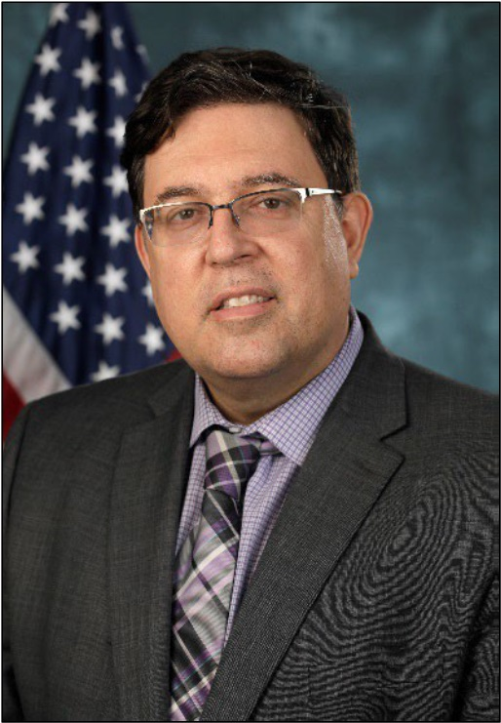


Speakers
Moderator:
Jeff Ledford CGFM
Senior Associate
The MIL Corporation
Saesha Carlile
Deputy Assistant Secretary for Budget and Programs, DOT
Jose Fabre
MPA, CGFM
Deputy Chief Financial Officer, DHS ICE

Slide 3

What is It?
What is financial modernization and innovation to you and what makes it a priority?
Image source: Artificial Intelligence - Definition, Examples, Types (corporatefinanceinstitute.com)

Slide 4

Getting Support
How do you convince decision-makers to support the innovation efforts?
Image source: Gain-Support-Image - Powermatic Intelligent Power Management

Slide 5

Where is the Need?
What are the most critical areas in need of modernization and innovation?
Image source: Americans’ Future Technology Needs and Wants

Slide 6

Tools at Your Agency
What specific examples can you provide to illustrate how modernization tools improve productivity and create efficiency?
Image source: What Is Data Analysis: A Comprehensive Guide (simplilearn.com)

Slide 7

Budgets
How do you balance the need for modernization within your budget?
Image source:The Top 5 Budgeting Techniques Every Young Adult Should Know | by Illumtori | Medium

Slide 8

Workforce
Once the technology has created the intended efficiencies, how will that shape your workforce?
Image source: 5 ways to engage, train and develop a global workforce -

Slide 9

Image source: Thank You Any Question Images HD

