Slide 1
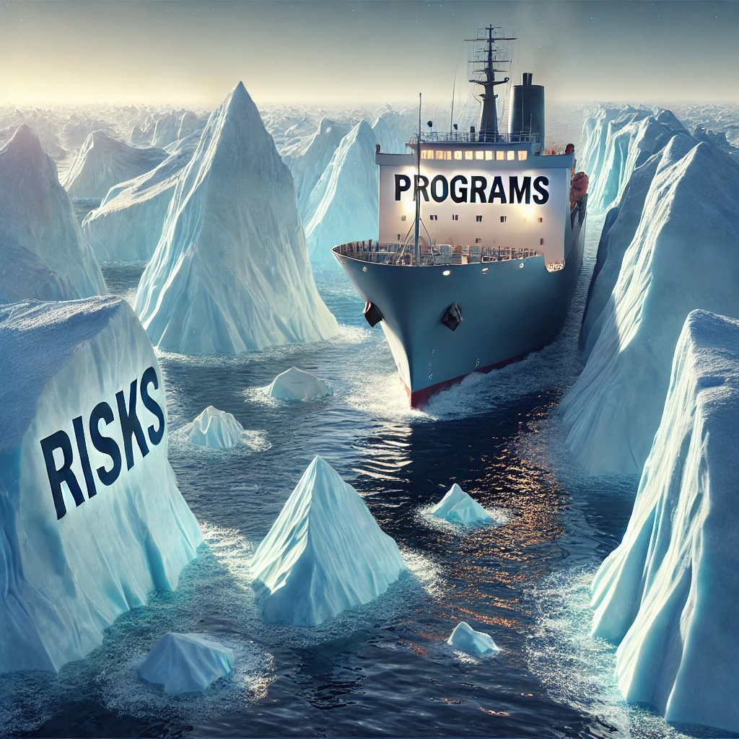

From Icebergs to Clear Sailing:
Strategies for Navigating Change and Risk

Slide 2
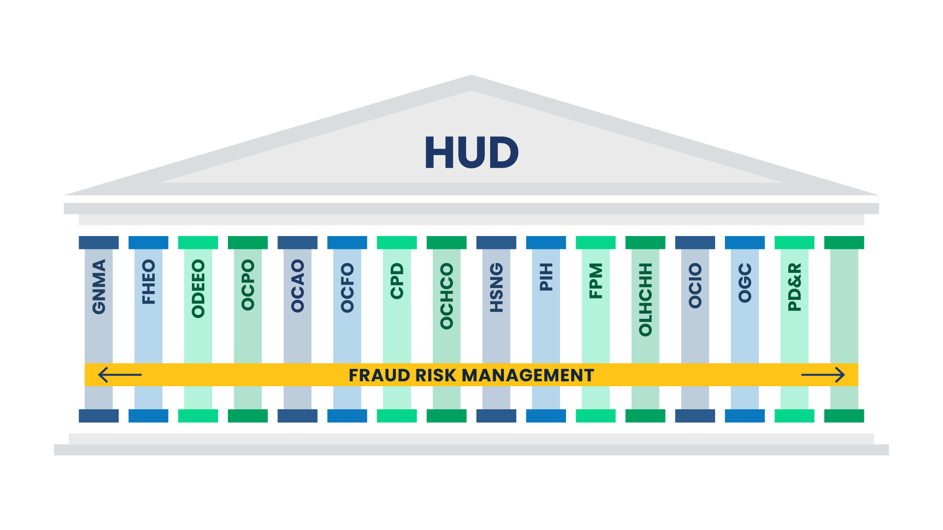
Safeguarding the Mission - A Portfolio Approach
HUD Mission
Create strong, sustainable, inclusive communities and
quality affordable housing for all.
PDR
ENTERPRISE & FRAUD RISK MANAGEMENT
Enterprise Risk Management
Provides a Department-wide portfolio view of HUD opportunities and vulnerabilities.
Strengthens HUD’s ability to prioritize resources toward accomplishing its mission and priorities.
Fraud Risk Management
Enterprise-wide management of emerging trends and themes.
Proactive measures to prevent, detect, and appropriately respond to fraud risks.

Slide 3



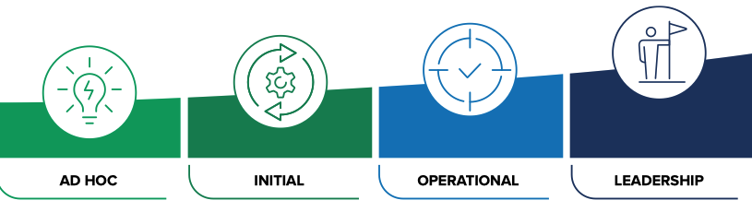
Enterprise & Fraud Risk Management Programs
Annual Risk Profile Refresh*
Fraud Risk Management Approach **
Phase 1 - Jan
Phase 2 - Feb
Phase 3 - Mar
Phase 4 - Apr
Phase 5 – May+
DEPARTMENT
OCRO provides strategic direction, guidance, and methods to mature HUD’s Fraud Risk Program and documents the Fraud Risk Profile at the HUD level.
HUD-wide Risk Identification and Assessment
HUD Enterprise Risk Profile/
Portfolio Draft
Risk Management Council approve/ publish
Enterprise-Wide Mitigation Plans
Enterprise-Wide Mitigation Plans Executed
OFFICES
The Oﬃces lead Office level activity to support fraud risk assessments, set risk appetite and tolerances, contribute to risk proﬁles, and monitor risk mitigation across their Office Programs.
Commit
Assess
*As required by OMB A-123 and A-11
PROGRAMS
The Programs perform Program fraud risk assessments, identify fraud risks, and manage implementation of risk mitigation plans.
Front-End Risk Assessment (FERA)
Evaluate &
Adapt
Design &
Implement
Identify and evaluate the impact and likelihood of program risks and vulnerabilities.
SUB-PROGRAMS
Grantees and Sub-recipients report information in support of fraud risk management and provide data to the Programs and HUD that can be used to achieve effective risk management.
New program with appropriations in excess of the materiality threshold (preparing guidance, e.g. $83M).
An existing program in excess of the materiality threshold and has a 5% increase or decrease in funding.
Discretionary new or existing program that exhibits enterprise-wise impact or poses a significant risk for fraud, waste, abuse or mismanagement.
Review Memorandum offered where FERA was performed within the prior 3 years and mitigation plan is current.
**Aligns with the GAO Framework for Managing Fraud Risks in Federal Programs
Maturing HUD’s Fraud Risk Management Program
*

Slide 4
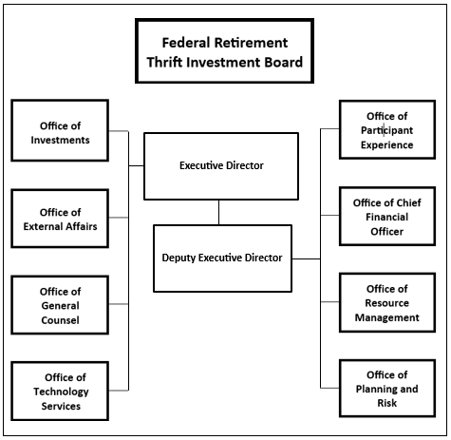
Federal Retirement Thrift Investment Board
The Federal Employees’ Retirement System Act of 1986 (FERSA) authorized the Federal Retirement Thrift Investment Board (FRTIB), an independent agency of the U.S. Executive Branch, to administer the Thrift Savings Plan (TSP).
The TSP is a defined contribution plan for U.S. Federal civilian employees and members of the uniformed services.
The mission of FRTIB is to administer the TSP solely in the interest of its participants and beneficiaries.
The TSP has more than 7 million participants, with assets over $900 billion.

Slide 5
Annual ERM Program Cycle
OPR uses a cyclical, five-step process to manage enterprise level risks across their full lifecycles. This process provides a comprehensive, enterprise-wide view of organizational challenges to improve insight on how to address the highest priority risks to mission delivery.
ERM CYCLE
Overview of the ERM Program cycle conducted throughout the year
1. Risk Identification
2. Risk Assessment & Prioritization
RISK IDENTIFICATION Identify adverse conditions or events that could prevent the Agency from delivering its mission and achieving its strategic goals and objectives
RISK ASSESSMENT & PRIORITIZATION Apply standardized qualitative/quantitative criteria to evaluate the likelihood, impact, and velocity of identified risks to arrive at an Enterprise Risk Profile
RISK TREATMENT Develop Risk Treatment Plans with specific strategies and actions to manage identified risks to an acceptable level in line with expectations and risk appetite
RISK MONITORING Continuously monitor the progress and performance of Risk Treatment Plans to determine whether chosen strategies and actions are managing risks as intended
RISK REPORTING Regularly report risk information, including risk treatment progress and performance and other risk trends and insights, to inform decision-making
1
2
Communication
5. Risk Reporting
3
3. Risk Treatment
4
4. Risk Monitoring
5

Slide 6
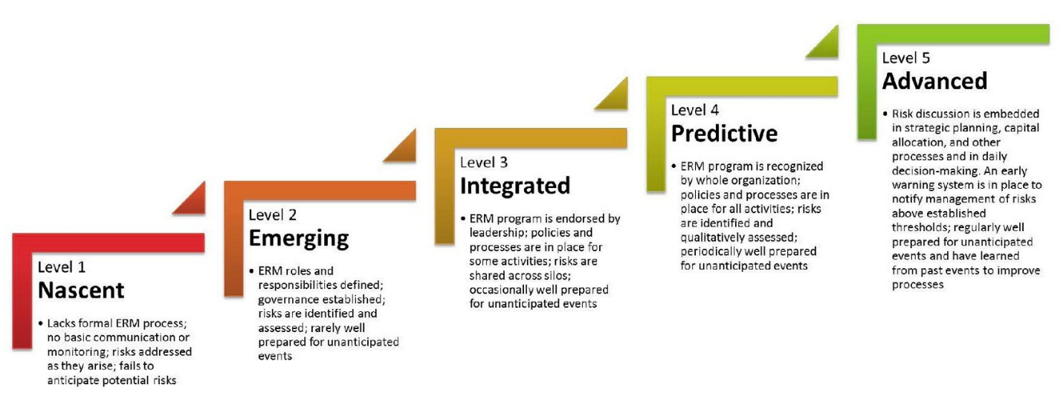
ERM Maturity Model
Source: US Federal Government Enterprise Risk Management Playbook, Fall 2022 edition

