Slide 1
FASAB Update
AGA DC Chapter - Spring Training Event
April 29, 2025

Slide 2
Disclaimer
Views expressed are those of the speaker
The Board expresses its views in official publications

Slide 3
Agenda
FASAB Background
Research Topic
Active Projects
Looking Ahead
How to Get Involved

Slide 4
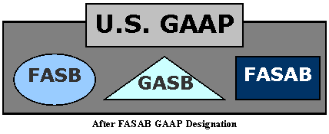
FASAB Background
Established in 1990
  a FACA Committee
Achieved GAAP status in 1999
  One of three in the U.S.
9 Board members
  6 non-federal members and 3 federal sponsors
4

Slide 5
Research Topic

Slide 6
Revenue
The Board recently added this topic to the research agenda to potentially address narrow-scope issues based on priority
  Issues identified for review include private debt collections and non-exchange revenue recognition for unpaid assessments
  Further research and identification of issues to continue in 2025

Slide 7
Active Projects

Slide 8
Intangible Assets
The Board agreed on a framework to develop intangible asset standards
  Capitalize the cost incurred to acquire an identifiable intangible asset from another entity
  Reissue the internal use software guidance, including updates from the Board software technology project, as a component of the intangible asset Statement

Slide 9
Software Technology
Project scope
  Cloud-service arrangements
  Shared services
  Internal use software
  Other software technology
Consider updates to software license and IUS development guidance
Digital assets, blockchain, AI, cybersecurity, etc.

Slide 10
Public-Private Partnerships (P3s)
Phase I – In 2016 the Board issued SFFAS 49, Public-Private Partnerships: Disclosure Requirements, effective FY 2019
Phase II – Measurement and Recognition
What do we measure?
How do we recognize profits/losses?
How do we treat liabilities?
Current Status – ASIC developing implementation guidance for Phase 1

Slide 11
Commitments
FASAB has issued pronouncements on specific types of commitments; however, there is no Statement on general commitments.
The Board will consider developing an accounting Statement that defines commitments and develops guidance on reporting general commitments.
  The Board deliberated a project plan during the February 2025 meeting

Slide 12
Direct Loans and Loan Guarantee Disclosures
Federal reporting entities’ direct loan and loan guarantee note disclosures have become lengthy with numerous schedules and narratives
The Board will consider ways to improve, clarify, and streamline required note disclosures and reduce preparer burden regarding loan note disclosures.
  The Board deliberated a project plan during the February 2025 meeting

Slide 13
Federal GAAP Hierarchy
Level A GAAP
FASAB Statements of Federal Financial Accounting Standards (SFFASs)
FASAB Interpretations
Level B GAAP
FASAB Technical Bulletins
Level C GAAP
FASAB AAPC Technical Releases
Level D GAAP
FASAB Staff Implementation Guides
Widely recognized and prevalent federal practices

Slide 14
Federal GAAP Hierarchy
SFFAS 34 provides the sources of accounting principles and the framework for selecting the principles used in the preparation of general-purpose financial reports of federal entities that conform with GAAP.
The Board will consider ways to improve, simplify, clarify, and streamline the federal GAAP hierarchy to ensure it is effective.

Slide 15
MD&A
On September 27, 2024, the Board issued SFFAS 64, Management’s Discussion and Analysis: Rescinding and Replacing SFFAS 15
The FASAB Board and staff are making efforts to help stakeholders transition to SFFAS 64
  Staff is offering training sessions for agency CFO staff and program managers
  The Board discussed developing staff implementation guidance to provide best practices for MD&A reporting

Slide 16
Land
SFFAS 59 effective dates:
  FY22-FY25 - Required supplementary information
  FY26 - Notes disclosure
The Board is considering actions necessary to address identified challenges in preparation for the transition of RSI requirements to note disclosure requirements in fiscal year 2026.
  The Board considered SFFAS 59 audit issues during the February 2025 meeting

Slide 17
Leases Implementation
SFFAS 54 implementation results for FY 2024
  Agency financial reports provided information that appropriately summarized lease balances, activities, and the nature and terms of the agreements.
  The form, content, disclosure, and presentation of lease information was consistent, comparable, understandable, and navigable across the reporting entities
  None of the 32 audit opinions in FY 24 were adversely modified or affected by implementation of SFFAS 54
  Reporting entities with significant leases almost universally applied the transitional accommodation
Success!

Slide 18
Looking Ahead

Slide 19
What’s New Out There?
Recent initiatives may impact our FM community. Potential issues specific to financial reporting include:
  Divested assets and liabilities
      Asset impairments, discontinued operations, fair value assessments, reporting gains/losses, allocation of proceeds from divestitures
  Direct loans halted or delayed
      Revenue and interest income impacts, loss allowance/loan modification adjustments
      Grants halted – obligated but not disbursed

Slide 20
What’s New Out There? (continued)
Entity reorganizations
  Reporting entity changes, prior period restatements, defining “control” or “ownership”, form & content of F/S for discontinued operations
  Remaining goods/services moved to another entity (asset transfers)
Accounting and reporting for a potential sovereign wealth fund
  Reporting entity characteristics, invested assets, liabilities, revenue sources, etc.

Slide 21
What’s New Out There? (continued)
Potential evolution of characteristics of digital assets and their use in the federal government
Impact on CFR consolidations:
  Financial impact on savings transparency
  Discontinued operations

Slide 22
FASAB Actions
FASAB has begun coordinating with OMB and GAO
FASAB’s GAAP Hierarchy (SFFAS 34) along with OMB A-136 are up to the task
Consider doing your own research before submitting a TI. We’ll all save time and achieve better outcomes working together!

Slide 23
How to Get Involved in the
Standard-setting Process
Collaboration, Education & Outreach

Slide 24

Outreach Activities
Workshops
& Trainings
Board Educational Sessions
Other
Standard-Setters
Technical Inquiries
GAAP
Implementation
&
Year-Round
Education
Round Tables
RE
Developing
GAAP
* Due Process*
Staff Liaison to Gov Working Group
Surveys
Collaboration w/ Other
Standard-Setters
Published
Articles
FASAB Members & Staff
DE
Professional Org Presentations
Task Forces &
Working Groups
Educational Briefings
FI
Clarification
Discussions
Annual Update
Implementation Group
Meetings
Public Hearings
Key
RE – Research Phase
DE – Development Phase
FI – Finalization Phase
Key:
RE – Research phase
DE – Development Phase
FI – Finalization Phase
Promulgated GAAP

Slide 25
New Training & Outreach Web Page
FASAB is pleased to announce our new web page dedicated to training and outreach that can be found at: https://fasab.gov/training/courses/
We are currently offering the following courses:
  Accounting Concepts and Standards
  Understanding Government Debt Reporting
  Accounting for Internal Use Software
  Understanding the Statement of Budgetary Resources
  Public-Private Partnerships: Disclosure Requirements
  Federal Accounting for Climate-related Activities
  Transitioning MD&A reporting from SFFAS 15 to SFFAS 64
  Accounting for Leases
  The FY 2024 Leases Implementation Experience: Looking Forward to FY 2025

Slide 26
Technical Inquiries
If you need help applying GAAP for implementation or existing accounting issues then visit our technical inquiry page to learn
  How we can help
  Who we help
  What you can expect from the TI process once you submit the new form at https://fasab.gov/technical-inquiries-2/

Slide 27
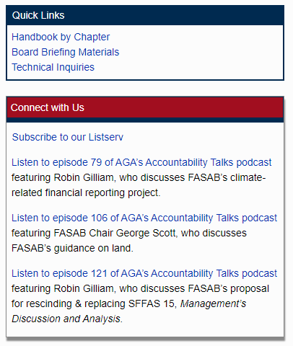
How to Stay Connected
Sign up for our listserv
Check out our website

Slide 28
Questions?

Slide 29

Contact Information
www.fasab.gov
fasab@fasab.gov
(202) 512-7350

